Slide 1
Partnerships, approaches, infrastructure and covid: a reflection from EUMETSAT
Mark Higgins, EUMETSAT

Slide 2
A reflection on our distance learning approach for operations and research before and during the COVID period and our future plans – including our collaboration with RTCs

Slide 3
Reflection on our approach in 1 slide
Objectives: data and systems used in applications that support other goals (National, SDGs, Paris, Sendai, Protection of Life and Property), made concrete through skills frameworks
Partnerships and networks – no "EUMETSAT" course, everything is with partners – those partnerships are negotiated (have a mandate) and sustained.
Educational approach: adult skills development (Merril and others) and designing for the audience
Technologies that support learning and are accessible

Slide 4
Reponses to COVID builds on existing activities
Existing
Partnerships
Methodology
Skills frameworks
Online Infrastructure
Online Resources
Provided a significant basis to respond to the COVID restrictions.
4 and 5 are about what is online. 1-3 are about relationships, approaches and standards

Slide 5
Example: ASMET Project
Partnership with 4 training centres
Producing resources for trainers and forecasters
Targeting operational meteorology
Supported by EUMETSAT and COMET
Ongoing during COVID

Slide 6
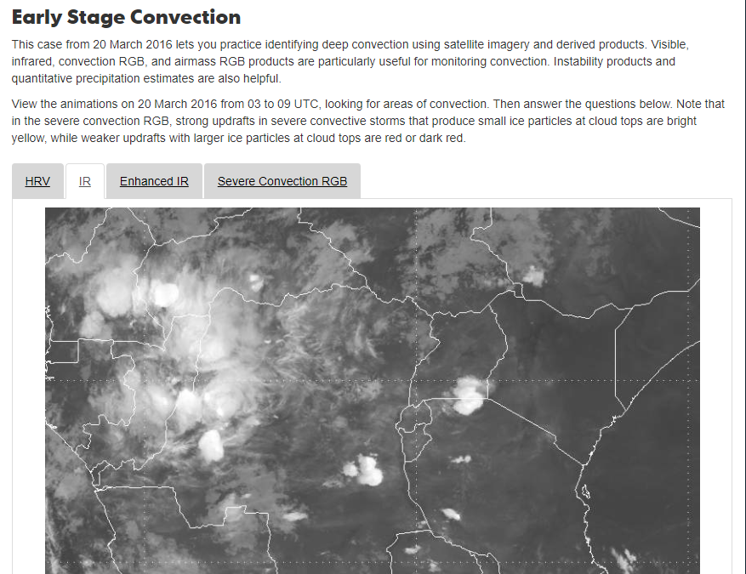
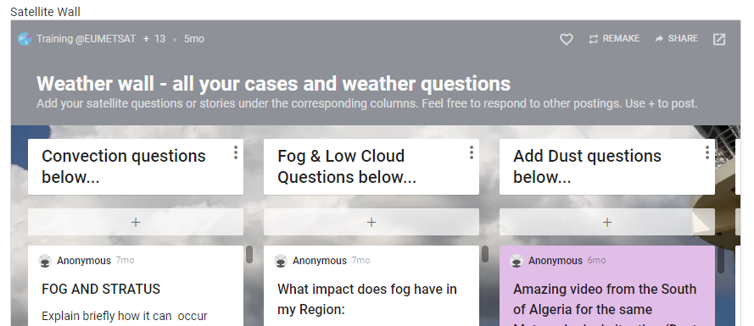
Example: Online courses
Partnership with 4 training centres
En & Fr streams
50 – 80 participants
Teaching skills and knowledge
Mostly asynchronous (forums and tasks ) with some synchronous sessions (zoom)
Ongoing during COVID

Slide 7
Skills frameworks:
Competencies
Satellite skills
Challenge: Framework is missing Atmosphere, Climate & Agriculture
These keep us focuses on the skills we need to teach and stop a drift to theory only

Slide 8
Partnerships
WMO Global Campus
RTC Network
VLab centres of excellence
Operational services
Universities
Where we had relationships we wee able to work and in many cases deepen our work together.
Building relationships we did not have was a challenge

Slide 9
Theoretical basis for EUMETSAT training
Merrill's 5 principles - good things happen (learning) when :
You teach with real-world problems.
What the students already know is activated as a foundation for skills and knowledge.
You demonstrate the new skills and knowledge.
The students apply the new skills and knowledge.
The students integrate their new skills into their day to day work

Slide 10
Innovations:
Working with software notebooks
Increasing accessibility of courses

Slide 11
Innovation Software Notebooks
OPEN!
Code
Output
Instruction

Slide 12
Accessibility:
People who would have otherwise had a travel constraint were able to participate in the courses
Streaming and observer modes of participation made the courses a little more open

Slide 13
Future – how do we know we are doing a good job?
Improving the connection of the needs assessment to all the needs information available, formal and informal, targeted at training and secondary
Impact assessment of interventions as a whole over a 3-5 year period looking to stories of significant change

Slide 14
Future - cloud computing for training
We plan to grow the use of cloud computing within our own training
As well as teaching cloud computing
This will extend to AI applications in meteorology

Slide 15
Integration
For me there is (almost) no such thing as a satellite course
Operations requires the use of satellite data in the context of doing a job and with other data.
Hence the need for integrated courses – for example the EUMeTrain marine course deals with so much more that satellite data.

