Slide 1
Roles and responsibilities in WDQMS
Recalling the RWCs concept and principles
Terms of Reference of various NFPs
Luís Nunes
WIGOS Branch, WMO Secretariat

Slide 2
WIGOS Operational Phase (2020 – 2023) Main priority areas according to Res.37/Cg-18
National WIGOS implementation;
Implementation of the Global Basic Observing Network and the Regional Basic Observing Networks;
Operational deployment of the WIGOS Data Quality Monitoring System;
Operational deployment of Regional WIGOS Centres;
Further development of the Observing Systems Capability Analysis and Review (OSCAR) databases and integration with other system elements;
Fostering a culture of compliance with the WIGOS technical regulations.

Slide 3
Recalling the RWCs principles
Regional WIGOS Centres (RWCs) will play a critical role in advancing operation of WIGOS.
The overall purpose of the RWCs is to provide support and assistance to WMO Members and Regions for their national and regional WIGOS implementation efforts.
The RWCs will work closely with:
WMO Regional Offices
RICs, RRCs, RMICs
RTCs, RCC
Regional TTs/WGs on WIGOS/Inf
Members
INF Department

Slide 4
Mandatory functions
Regional WIGOS metadata management
work with data providers to facilitate collecting, updating and providing quality control of WIGOS metadata in OSCAR/Surface;
Regional WIGOS performance monitoring, evaluation and incident management (WIGOS Data Quality Monitoring System - WDQMS)
These functions are operational functions
Unlike many other WMO Regional Centres, the RWCs have to perform daily operations such as:
Checking the outputs and statistics from the monitoring function,
Identify, analyse and decide on issues that should be raised as incidents
Register and follow up on the issues and incidents with the NFPs, using an incident management procedure

Slide 5
Optional Functions (mostly non daily-operation)
Assistance with the coordination of regional/sub-regional and national WIGOS projects;
Assistance with regional and national observing network management; and
Support for regional capacity development activities.
…

Slide 6
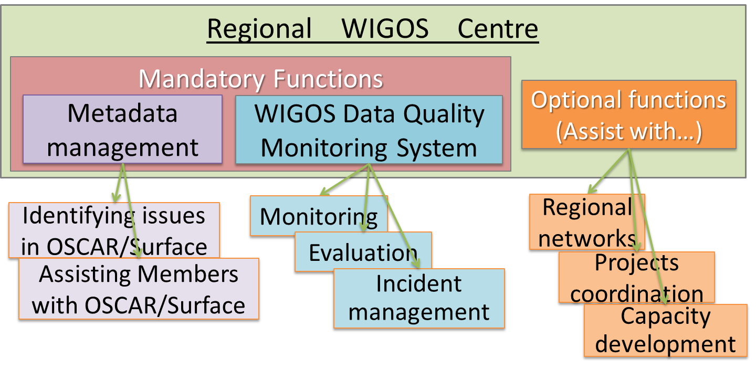
A diagram of the RWCs Functions

Slide 7
Support to RWCs related activities
Tools and material available to support the RWCs:
Guide to WIGOS (WMO-No.1165)
Technical Guidelines for RWCs on WDQMS (WMO-No.1124)
OSCAR/Surface User’s Manual
WIGOS Learning portal - WMO Moodle platform – contains videos, presentations, documents, links, etc
OSCAR/Surface, hosted by MeteoSwiss, operational since May.2016
WDQMS Webtool, hosted by ECMWF, operational since Mar.2020
A prototype of an Incident Management System as an online tool available to all RWCs, to register and follow-up on incident tickets

Slide 8
RWC staff = identify performance issues with observations provided by Members and use an incident management system to raise tickets, and to follow-up on them, using the RWC account credits to manage the tickets; Can also provide support and assistance to Members and Regions for their WIGOS implementation efforts.
Regional level
Member A
National level
RWC
WIGOS NFP
WDQMS NFP
OSCAR/Surface NFP
. . . .
Member C
National level
Member B
National level
WIGOS NFP
WIGOS NFP
WDQMS NFP
OSCAR/Surface NFP
WDQMS NFP
OSCAR/Surface NFP
. . . .
. . . .

Slide 9
WIGOS NFP = leads Member’s communications on WIGOS, with WMO; Monitors and reports on national status of WIGOS implementation and issues in the country; Identify and follow-up on WIGOS-related training and capacity development needs;
Member A
National level
OSCAR/Surface NFP = Coordinates national activities related to WIGOS metadata towards their availability in OSCAR/Surf; Coordinates its user accounts at national level; Promulgates WMO relevant regulatory, guidance and training materials; Ensures that all accredited users are trained to edit metadata in OSCAR/Surf, including the use of automatic insertion/updates to OSCAR/Surf; Works closely with the relevant RWC; Reports on the status of national WIGOS metadata in OSCAR/Surf; Takes actions to correct erroneous and/or missing metadata in OSCAR/Surface.
WIGOS NFP
WDQMS NFP
OSCAR/Surface NFP
. . . .
WDQMS NFP = Provides timely answers to all queries and tickets sent by the RWC related to issues with observations from the country; Initiates and coordinates actions to solve those issues as quickly as possible; Liaises with OSCAR/Surface NFP in relation to stations that exchange data internationally; Promulgates nationally the WDQMS related practices and procedures; Liaises with other relevant WMO Regional Centres, e.g. RICs, RTCs, to find sustainable solutions for issues identified by the WDQMS.

Slide 10
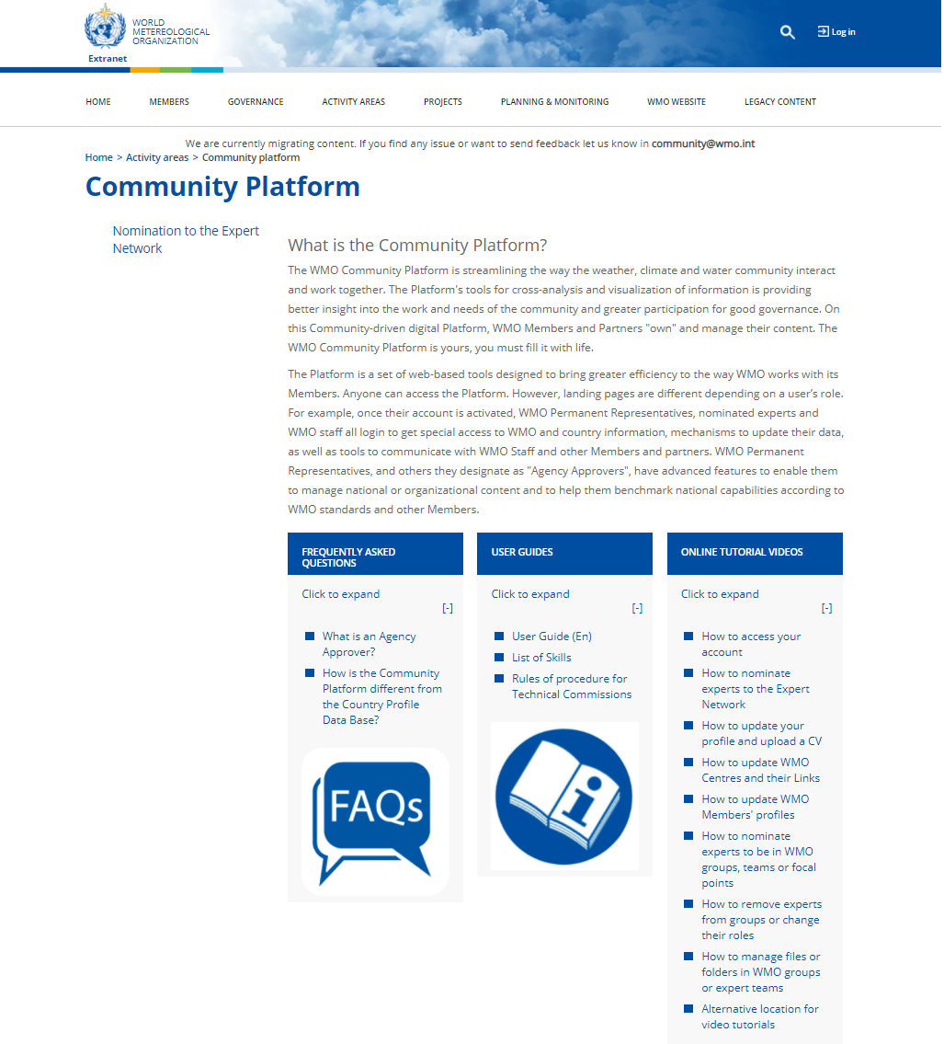
Guidance on nominations
https://community.wmo.int/activity-areas/community-platform

Slide 11
Thank you
Luís Nunes lfnunes@wmo.int
For further information:
https://community.wmo.int/activity-areas/wigos

