Slide 1
Workshop for Regional WIGOS Centres in RA I (SADC)
Introduction to
WIGOS Data Quality Monitoring System
(WDQMS)

Slide 2
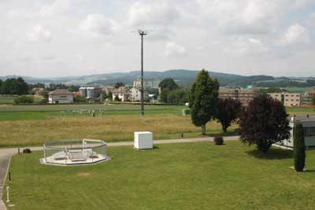
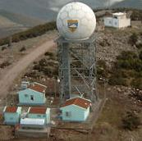
Weather observations and their quality
The overall purpose of taking weather observations is to provide weather and climate information in sufficient detail to meet the needs of many different users, including the safety and well being of the public.
To ensure that the data meets all needs, efforts are made to acquire, transmit, and archive observations with the greatest precision and consistency possible.
Data must be as accurate as possible. However, observed data can be subject to errors (e.g. human error, sensor error or failure, issues in the data processing, coding, or transmission).
Various means are used to "quality assure" the data.

Slide 3
Near real-time monitoring - WDQMS
WMO monitoring of conventional observations was based on monthly reports produced by Lead Centres in the past following the recommendations of WMO Manual on Global Data-processing and Forecasting System (GDPFS).
WMO has launched an initiative to modernise the monitoring of the surface-based component of WMO Integrated Global Observing System (WIGOS).
The goal is to move towards a near-real-time (e.g. daily) monitoring of the status of the Global Observing System (GOS) which would help WMO to take actions, namely reporting back to data providers to have the problem fixed in a timely manner.
➔ WIGOS Data Quality Monitoring System (WDQMS)
Notes:
Attachment II.9 of WMO Manual GDPFS (WMO, Manual on the GDPFS 2010)

Slide 4
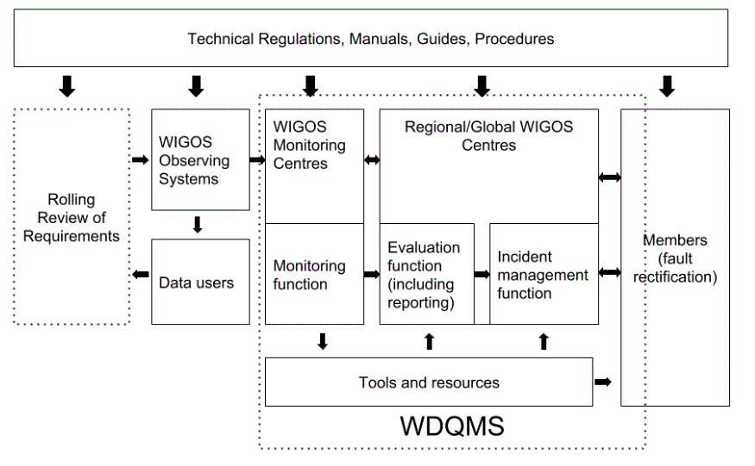
Interoperability of WDQMS
'Technical Guidelines for Regional WIGOS Centres on the WIGOS Data Quality Monitoring System’
WMO-No. 1224

Slide 5
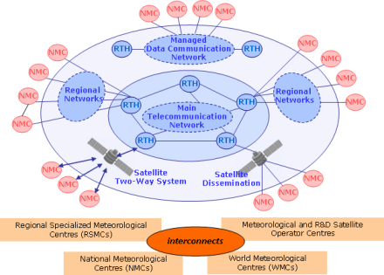
International data exchange essential for WDQMS
National observing stations
!
Data transmission from site to NMHS Data Centre or Headquarter (HQ) Office
WDQMS starts here
International users
e.g. global NWP centres
NMHS HQ
GTS
International exchange
to be indicated in

Slide 6
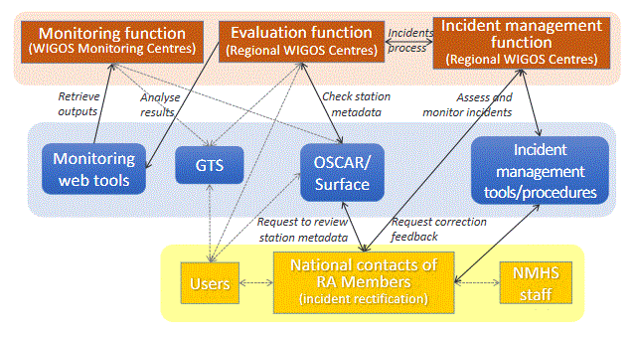
The WDQMS process
WDQMS will describe how well WIGOS is functioning
Notes:
WIGOS monitoring function: WIGOS monitoring centres provide quality monitoring information on a 6-hourly basis
Quality monitoring reports as basis of the WIGOS monitoring function
Categories data availability, timeliness and data quality
Provide input to the WIGOS evaluation function.
WIGOS evaluation function: generates routine performance reports measured against reference sources
From the quality monitoring reports
From metadata about the observing stations, from the Observing Systems Capability Analysis and Review (OSCAR)/Surface tool,
From the WMO Information System (WIS).
WIGOS incident management function: takes up the issues that the evaluation function raised as incidents, and follows up actions with the data supplier to resolve the incident.

Slide 7
The WIGOS monitoring function
WIGOS Monitoring Centre (WMC): a WMO Centre in charge of running the WIGOS monitoring function with a global or regional scope for one or more observing systems/components
Four Global NWP centers (ECMWF, NCEP, JMA, DWD) are providing quality monitoring outputs in near-real time (every six hours) at the moment;
Simple ASCII files in commonly agreed format contain the following information for each individual observing station:
Observation received within operational data cut-off (yes/no)
Observation used in assimilation (yes/no)
If not used, why not (flag)
Observation minus background residual (value)
Quality monitoring outputs for different variables (mainly surface pressure, 2m temperature, wind and 2m relative humidity)

Slide 8
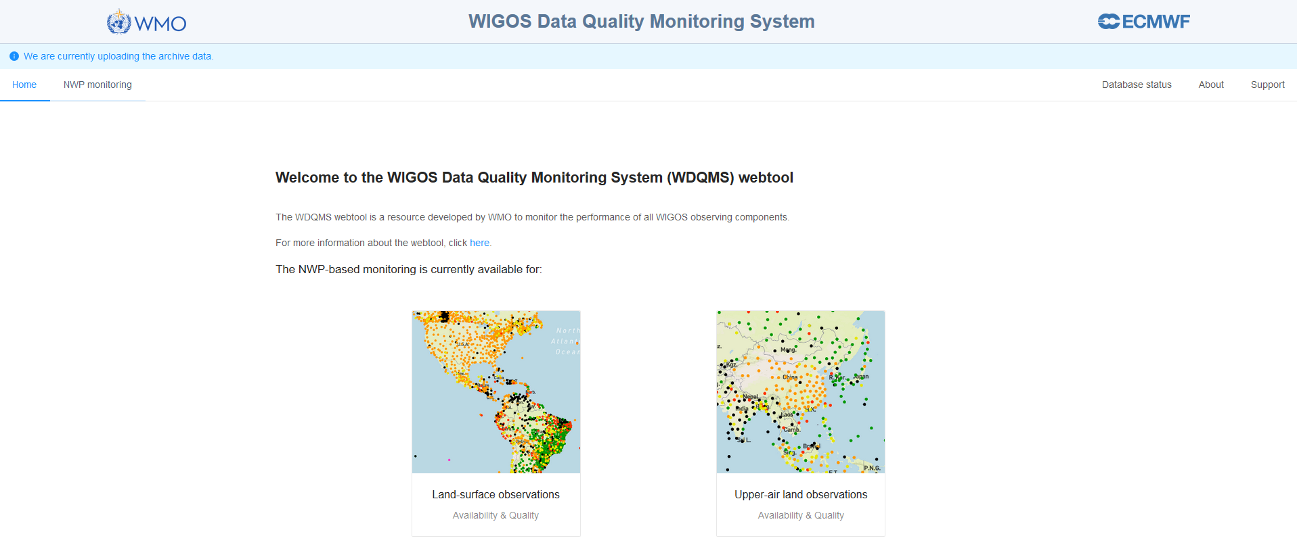
The link between the WIGOS monitoring function and WIGOS evaluation function
The use of the WDQMS web tool (https://wdqms.wmo.int/) for displaying the quality monitoring outputs from the WIGOS Monitoring Centres is beneficial to evaluate the performances within a RWC´s responsibility
The web tool is serving as part of the WIGOS monitoring function by displaying the quality monitoring outputs and
Serving as part of the WIGOS evaluation function by aggregating the performances on a daily basis or in time series
https://wdqms.wmo.int/

Slide 9
The WIGOS evaluation function
Regional WIGOS Centres (RWC) evaluate the performance of stations of countries under their responsibility on a daily basis by reviewing the automated quality monitoring outputs received from the WIGOS Monitoring Centres (global NWP centres) which are displayed in the available web tool outputs.
Check the performance concerning the three main quality monitoring categories data availability, timeliness and accuracy regarding the WDQMS performance targets (e.g. referring to GBON requirements for designated GBON stations).
Identifies stations showing non-compliance and monitoring the performance in the next days.
Initiates the incident management process if the issue turns into an incident (non-compliance over several days).

Slide 10
The WIGOS incident management function
In the case of any non-compliance of a particular station RWC raises an incident ticket by describing the issue.
If an issue continued for 5 (or more) days an incident management process (IMP) be initiated by turning the issue into an incident and the data provider be contacted asking for incident rectification.
RWC monitors the status of raised incident tickets and ensure that the country to which an incident has been reported confirmed the reception (WDQMS national focal point, NFP) and provided an appropriate action proposal to resolve the incident.
Close an incident ticket after the WDQMS NFP has reported incident rectification, check the improvement in performance and inform issue reporters about successful incident rectification.

Slide 11
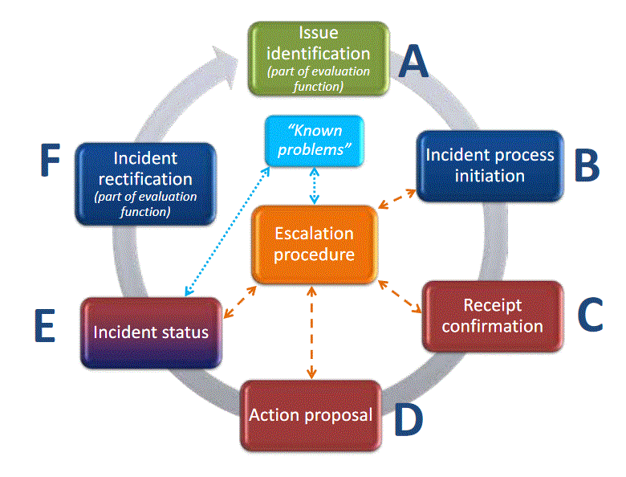
WIGOS incident management function – interaction with countries
The issue might be closed again before initiating an incident managment process if the performance improved.
Responsbility
RWC or data user
Responsbility RWC
Responsbility RWC
Responsbility RWC
Responsbility
country
Responsbility Contact country → RWC
Responsbility country
Potential need to close IMP and open new IMP due to incident cause by different activator

Slide 12
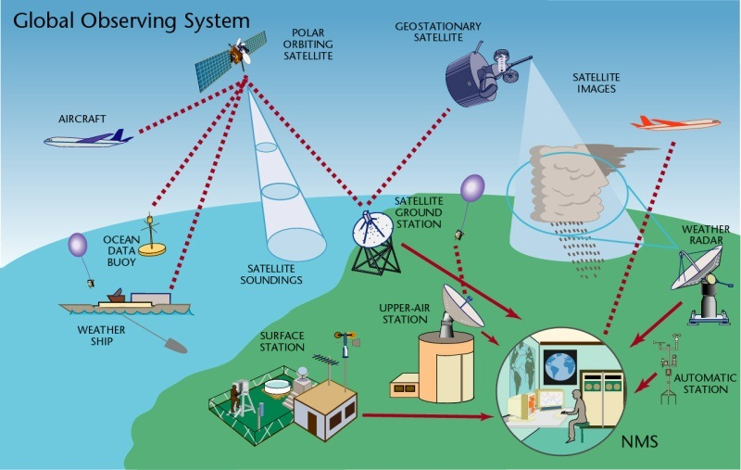
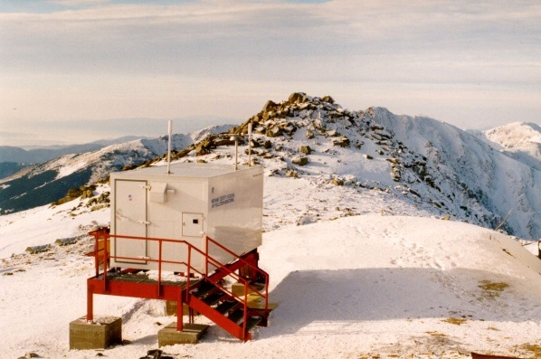
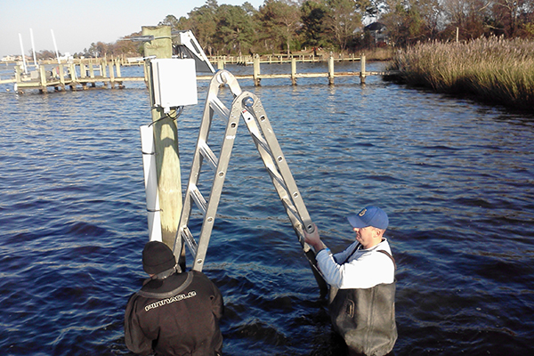
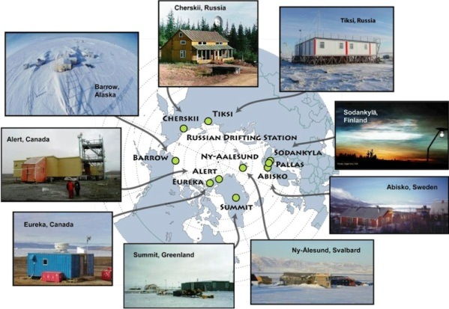
The scope of the WDQMS
To initiate the operationalisation of Regional WIGOS Centres the main focus will be on the GOS networks.
In the future all WIGOS components should be considered in the WDQMS.
Other networks, such as GAW (Global Atmosphere Watch) or the GCW (Global Cryosphere Watch) or others might be added at a later stage.
12

Slide 13
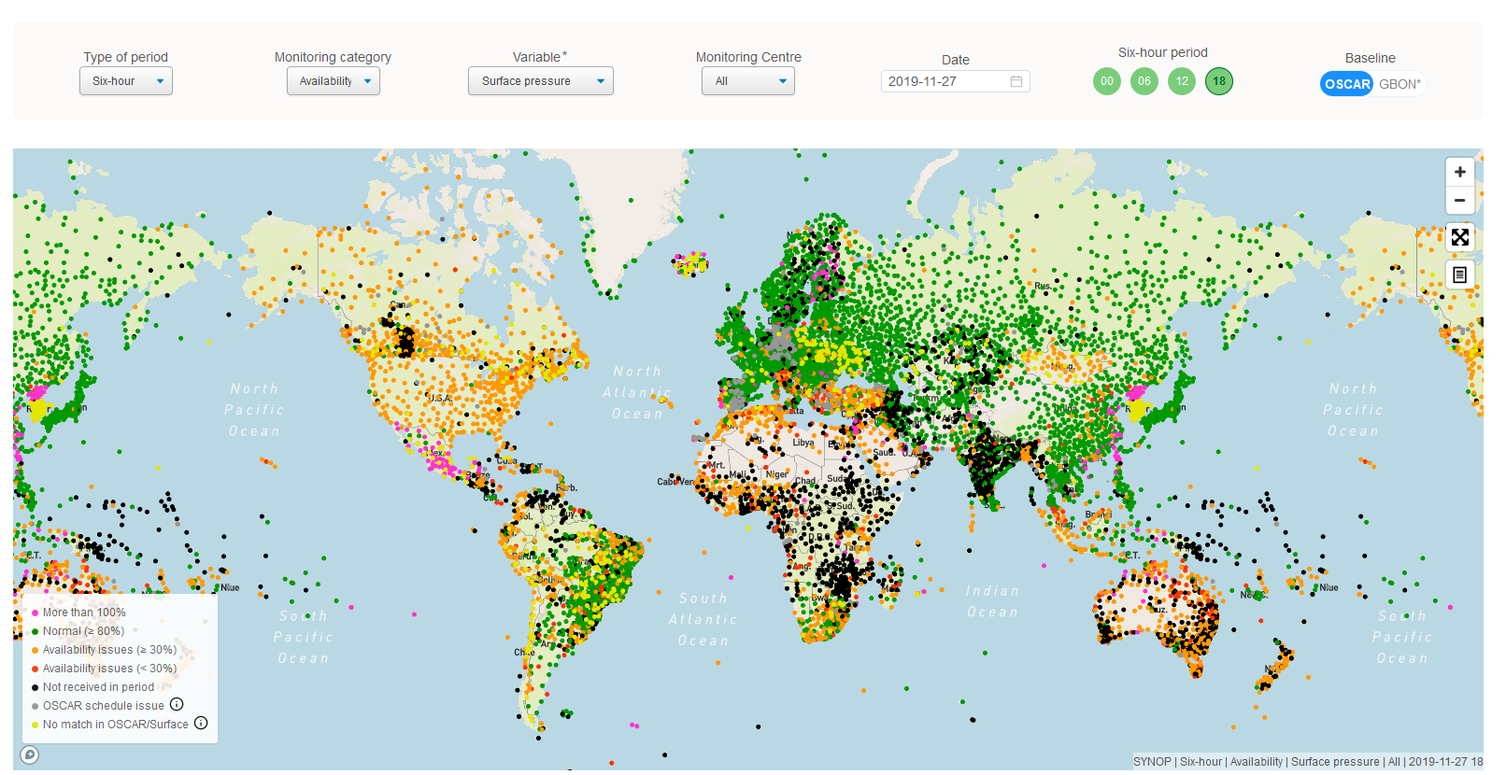
Result…
The WDQMS will describe how well WIGOS is functioning
And will improve the overall global performance of WIGOS
In an ideal world all stations would turn into green color…
OSCAR-WDQMS webinars: see Moodle sites WIGOS Learning Portal https://etrp.wmo.int/course/view.php?id=146
https://wdqms.wmo.int/

Slide 14
Thank you
Tanja.Kleinert@dwd.de
https://community.wmo.int/activity-areas/wigos

