Slide 1

Workshop for Regional WIGOS Centres
in RA I (SADC)
Examples on
practical of monitoring, evaluation and
incident management

Slide 2
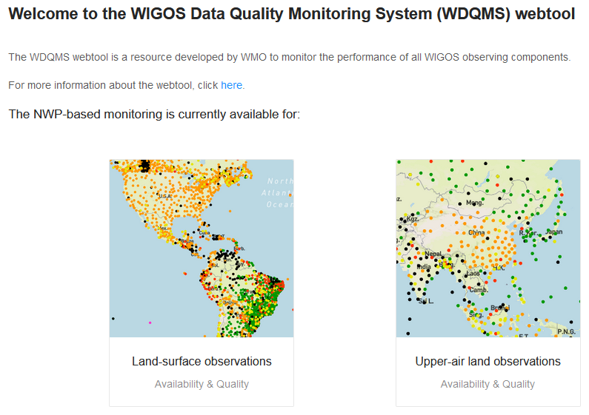
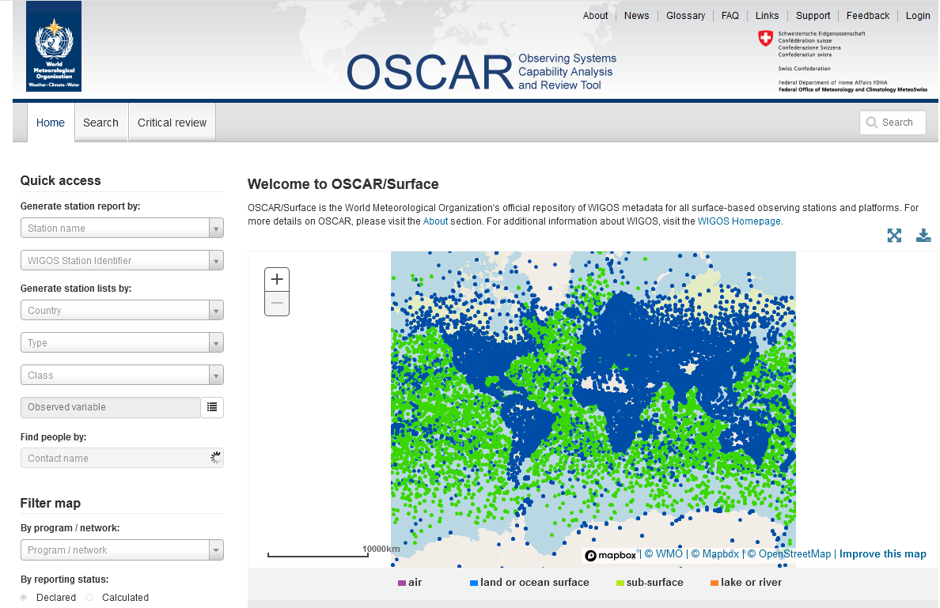
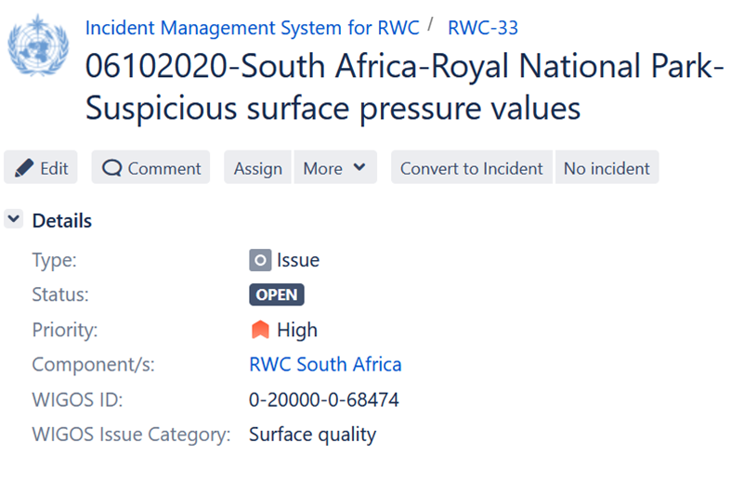
Global tools available for RWCs/Members
OSCAR/Surface
WDQMS
Incident Management System

Slide 3
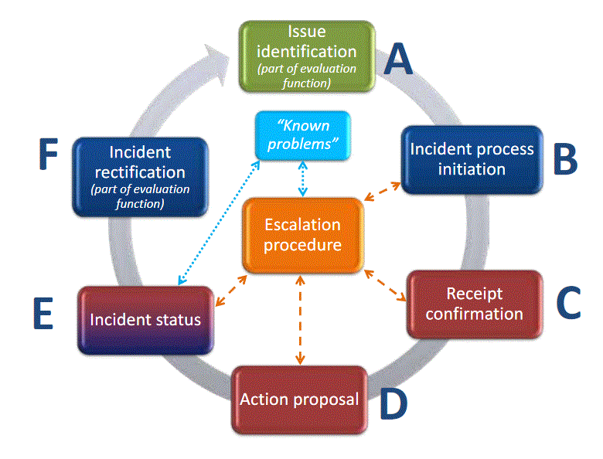
Incident Management System Procedure
Used to formally record issues, report incidents, follow up on actions and correct problems.
What are the frequent issues and their potential sources?
Responsbility
RWC or data user
Responsbility RWC
Responsbility RWC
Responsbility RWC
Responsbility Contact country → RWC
Responsbility
country
Responsbility country

Slide 4
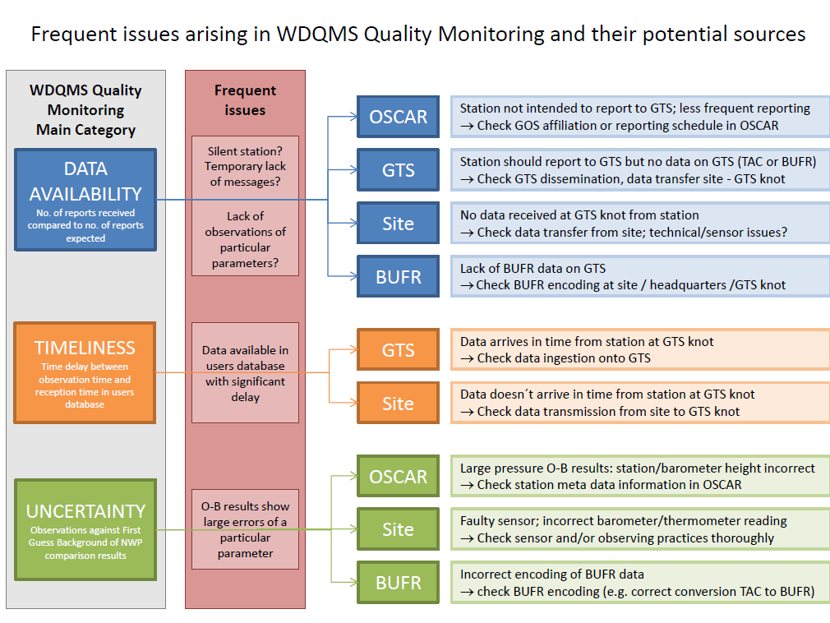

Slide 5
Issues with surface land stations – Level of Priority

Slide 6
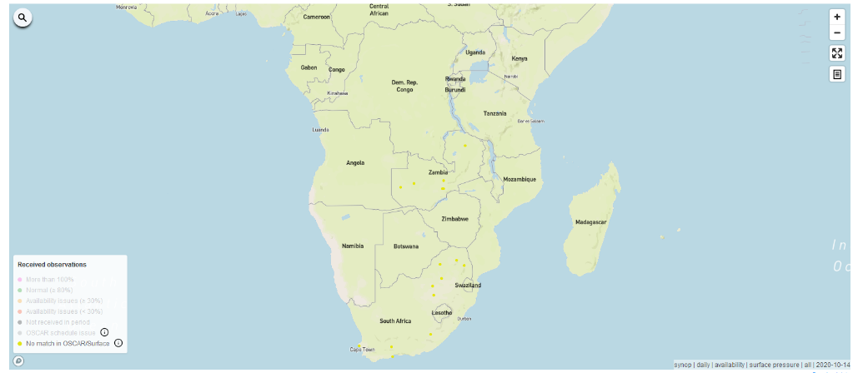
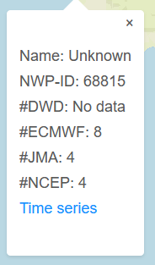
Example of schedule issues
No corresponding station ID in OSCAR/Surface.
  Action: Station to be registered in OSCAR/Surface

Slide 7
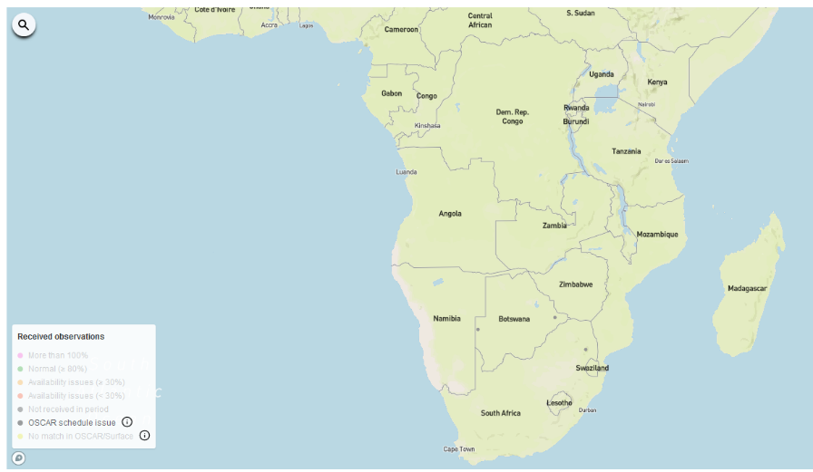
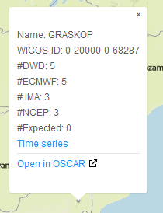
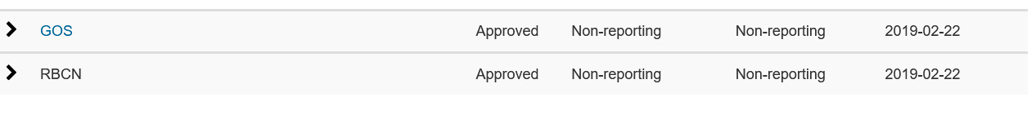
Example of schedule issues
Station not expected to report during this period yet data was received
Stations:
68070
68140
68287

Slide 8
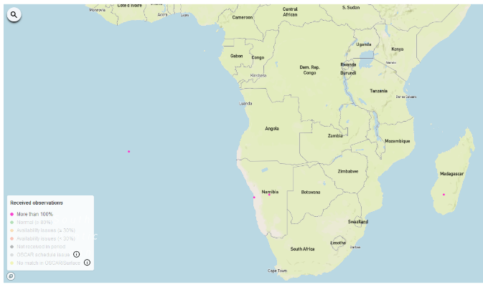
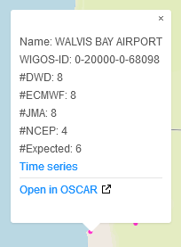
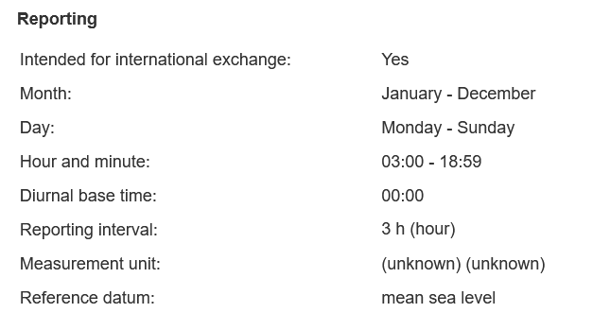
Example of schedule issues
Schedule time and reporting interval not correctly set
Stations:
68098
68110
67152

Slide 9
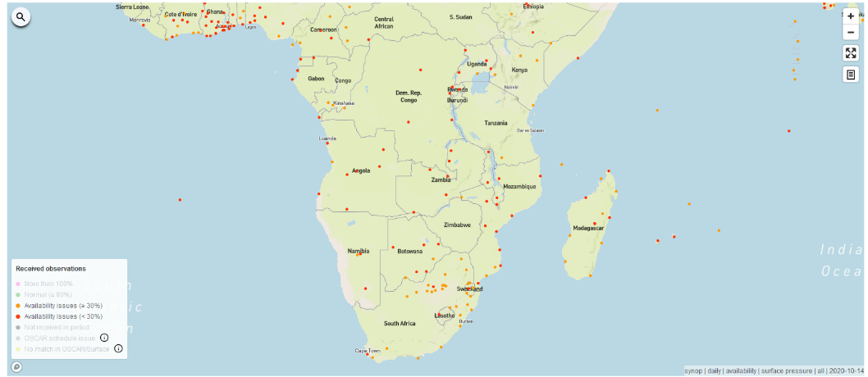
Example of Data Availability issues
Availability issues (≥30%) and (<30%)
RWC to issue a ticket to WDQMS NFP to:
  investigate the cause of the incident
  find a solution (issues often related to incorrect entries in OSCAR/Surface on reporting interval)

Slide 10
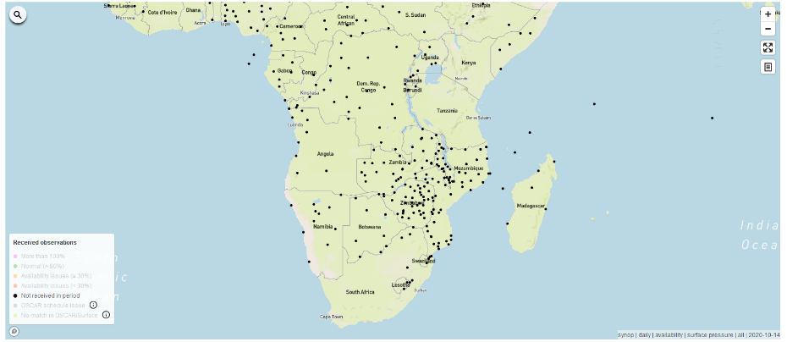
Example of Data Availability Issues
Data not received during period
Station is not intended to report to WIS:WDQMS NFP together with OSCAR/Surface NFP to check GOS affiliation in OSCAR/Surface
Technical issue at site: WDQMS NFP to work with WIS NFP Issues related to data transmission or sensor malfunctioning
Station data is expected in the WIS but no data available

Slide 11
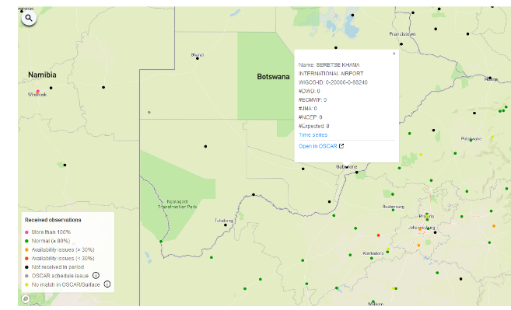
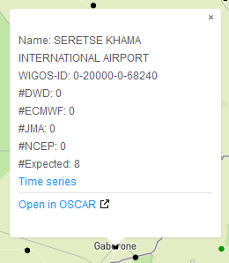
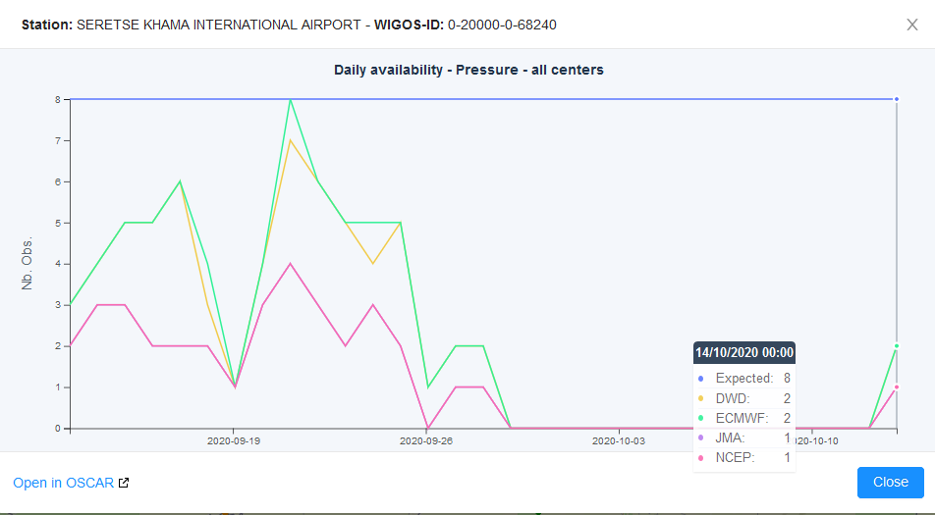
Example of Data Availability Issue
STATION 68240: SERETSE KHAMA INTERNATIONAL AIRPORT
No data available from 30 September 2020 to 13 of October 2020 (13 days)
Ticket concerning data issue will be raised after 5days i.e. on 4 October 2020.

Slide 12
Station started reporting to GTS again on
14th October 2020
Data outage

Slide 13
WDQMS NFP to get in touch with OSCAR/Surface NFP OR Technicians for information on cause of incident

Slide 14
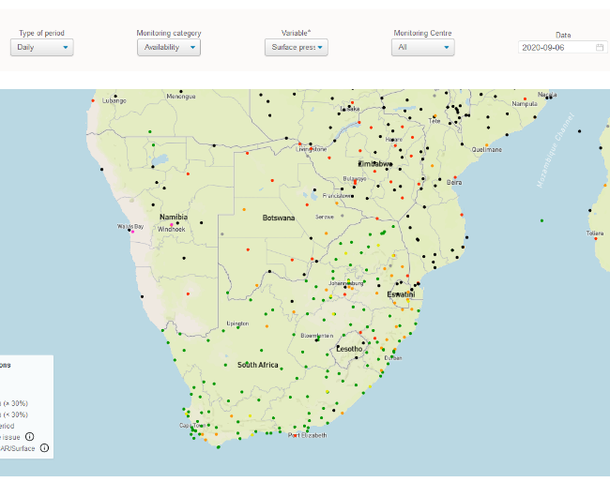
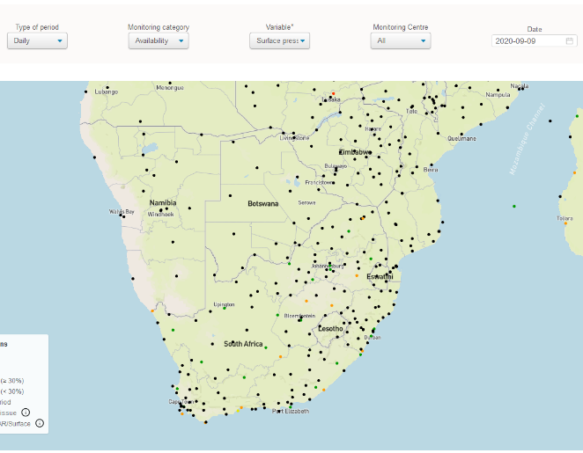
Example - data outage of entire country/ies
Most of the observations for SADC countries were not received during the period 8 to 10 September 2020 (This incident is to be rectified ASAP!)
Ticket to be issued to the country (or several countries) to make them aware of the lack of their data (they might not know that their data are missing on GTS).
RWC getting in touch with the RTH/WIS directly but still keeping the countries in question informed that RWC directly contacted the WIS experts.

Slide 15
WDQMS NFP to get in touch with their own GTS/WIS colleagues because it is not clear whether the incident is really related to WIS connections or other issues

Slide 16

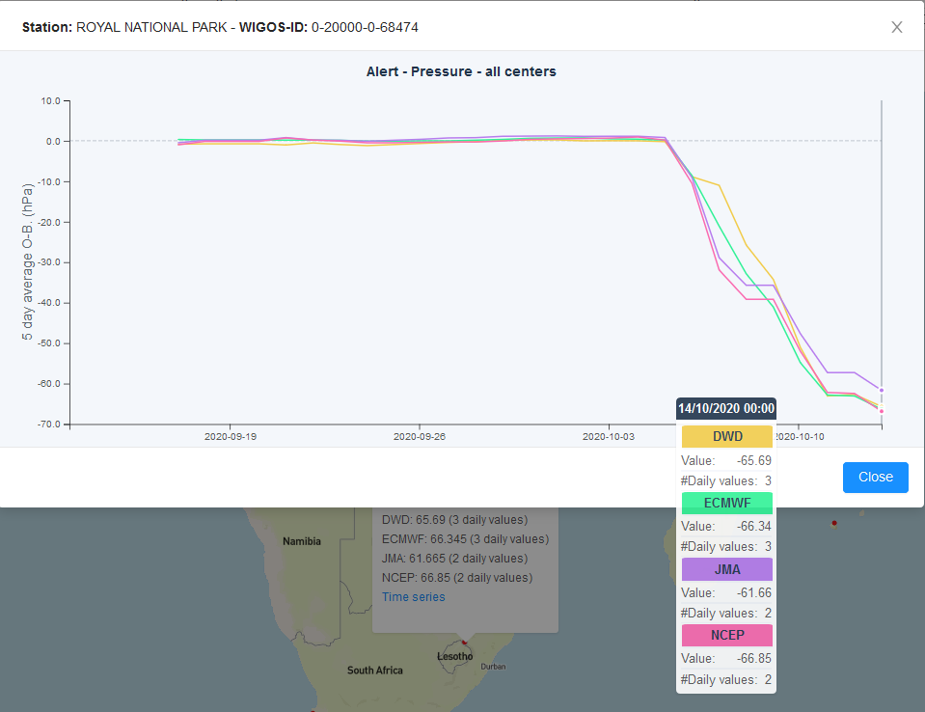
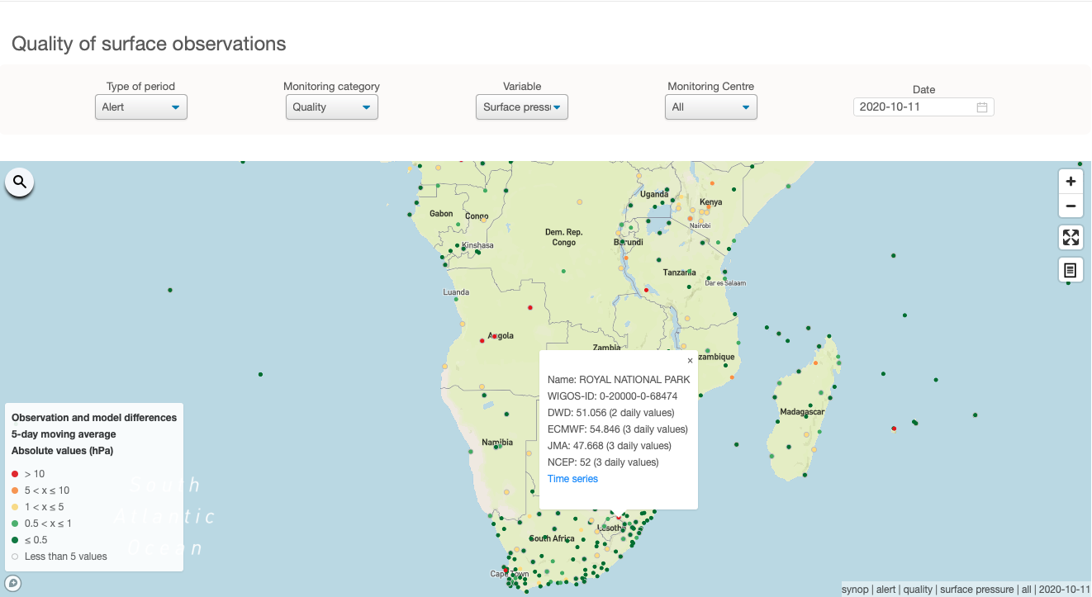
Example of Data Quality Issue
STATION 68474: ROYAL NATIONAL PARK
    Low pressure O-B results (≤ 1 hPa) but since 06th October 2020 the O-B results dropped significantly (≥ - 60 hPa) for all monitoring centres
    Potentially sensor drift leading to increasing wrong measurements at site
    RWC would have to raise a ticket related to this incident after 5 days
    the latest, i.e. on 11th October 2020 (high priority )

Slide 17

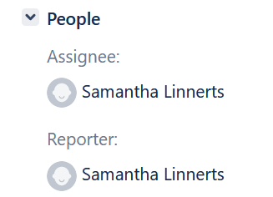
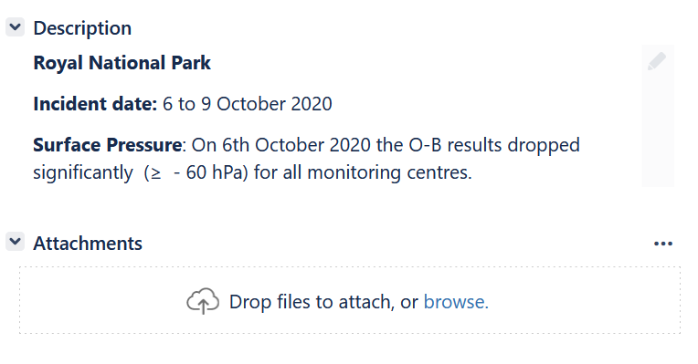

Slide 18
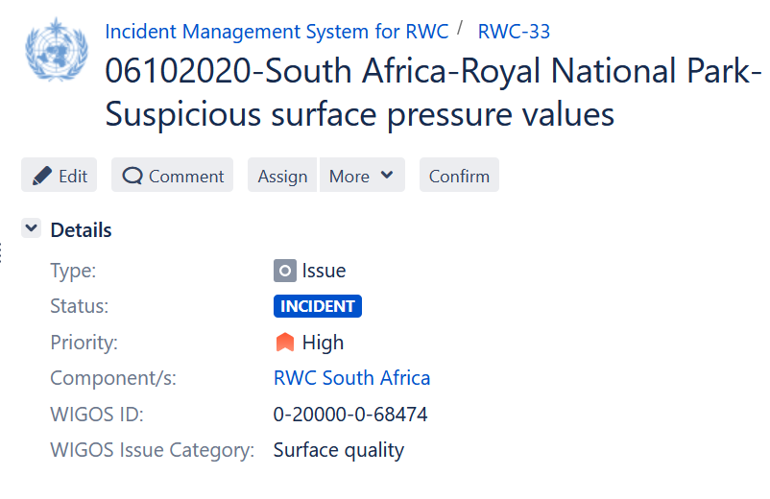
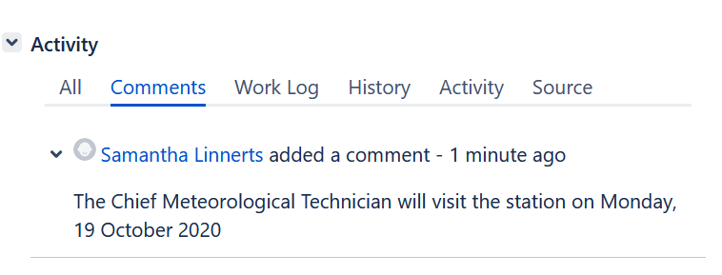
Converted to incident Problem ongoing for >5days

Slide 19
Incident Rectification
Next step:
If the incident has been rectified by the country , NFP to inform RWC
The RWC will check whether the incident ticket can be closed or has to be kept open due to ongoing non-compliance and underperformance compared to the WDQMS performance targets →
In the case of ongoing non-compliance, the RWC will ask the NFP to take further actions
RESOLVED

Slide 20

Thank you
Samantha.linnnerts@weathersa.co.za
https://community.wmo.int/activity-areas/wigos

