Slide 1
Online Workshop for RWC in RA I – SADC,
19 – 21 October 2020
Frequent issues arising in WDQMS Quality
Monitoring and their Potential Source
Credit to Ms Tanja Kleinert

Slide 2
WDQMS monitoring main category
Data Availability is calculated from number of reports received compared to number of reports expected, according to the required number of bulletins that are listed in OSCAR
Timeliness is time delay between observation time and reception time in users database.
Uncertainty, observation against First Guess Background of NWP comparison results

Slide 3
Frequent issues related to Data Availability
Stations do not provide any data to GTS although they are listed as being operational and affiliated to GOS in OSCAR/Surface, called “silent stations”.
Temporary lack of messages
Lack of observations of particular parameters

Slide 4
Frequent issues related to Data Availability (cont.)
Actions to be taken related to Data Availability issue:
OSCAR, stations not intended to report to GTS
Check GOS affiliation or reporting schedule in OSCAR
GTS, Station should report to GTS but no data on GTS
Check GTS dissemination, data transfer site – GTS knot
Site, No data received at GTS knot from station
Check data transfer from site, tecnical/sensor issues?
BUFR, Lack of BUFR data on GTS
Check BUFR encoding at site/headquarters/GTS knot

Slide 5
Frequent issues related to Data Availability, from current RWC activities
There is no corresponding station ID in OSCAR/Surface (yellow dots)
Check metadata in OSCAR/Surface
Surface stations
facilityType: seaFixed, lakeRiverFixed, lakeRiverMobile, landFixed, landMobile, landOnIce and airFixed
International Exchange == True
Observes one of the variables monitored (pressure, temperature, precipitation, wind)
Upper Air stations
StationClass: upperAirRadiosonde, upperAirPilot
Only currently «operational» or «partlyOperational» stations are considered.
The operating status of the network/program affiliated with the variable is used
Timo Proescholdt, OSCAR/Surface webinar #15, April 2020

Slide 6
Frequent issues related to Timeliness
Data available in user database with significant delay
Actions to be taken related to Timeliness issues:
GTS, Data arrives in time from station at GTS knot
Check data ingestion onto GTS
Site, Data doesn’t arrive in time from station at GTS knot
Check data transmission from site to GTS knot

Slide 7
Frequent issues related to Uncertainty
Observation minus background (O-B) results show large errors of a particular parameter
Actions to be taken related to Uncertainty issues:
OSCAR, Large pressure O-B results: station/barometer height incorect
Check station metadata information in OSCAR
Site, Faulty sensor; incorrect barometer/thermometer reading
Check sensor and/or observing practices thoroughly-
BUFR, Incorrect encoding of BUFR data
Check BUFR encoding (e.g. correct conversion TAC to BUFR)

Slide 8
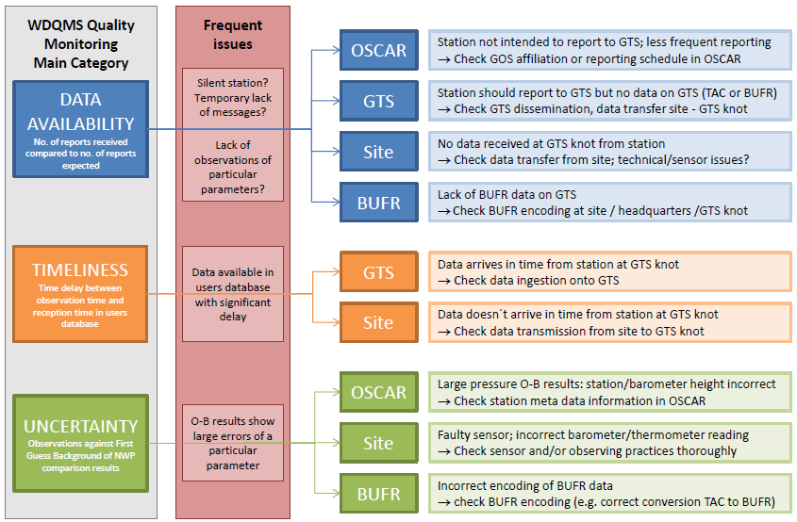

Slide 9
Thank you
https://community.wmo.int/activity-areas/wigos

