Slide 1
Incident Management System for RWCs
using JIRA ECMWF
Webinar for RWC Kenya and RWC Tanzania Operations, 13 August 2020

Slide 2
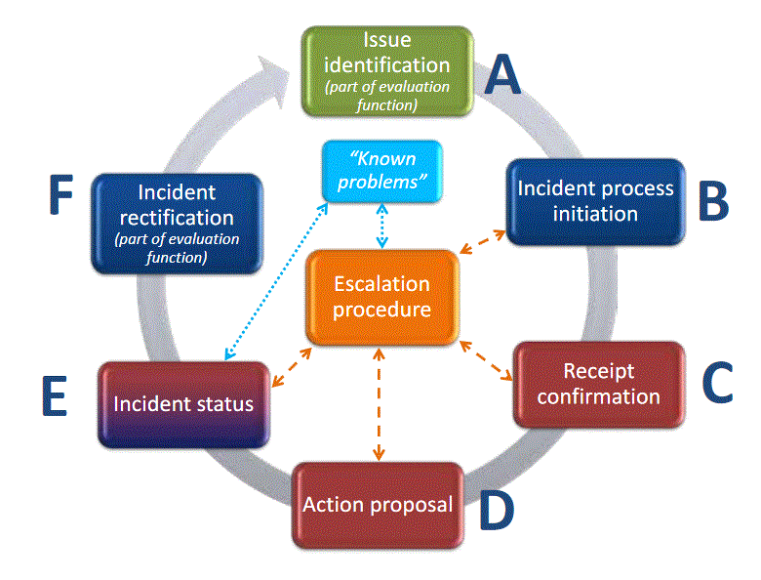
The steps of the Incident Management Process (IMP)
The issue might be closed again before initiating an incident managment process if the performance improved.
Responsibility
RWC or data user
Responsibility RWC
Responsibility RWC
Responsibility RWC
Responsibility
country
Responsibility Contact country → RWC
Responsibility country
Potential need to close IMP and open new IMP due to incident cause by different activator

Slide 3
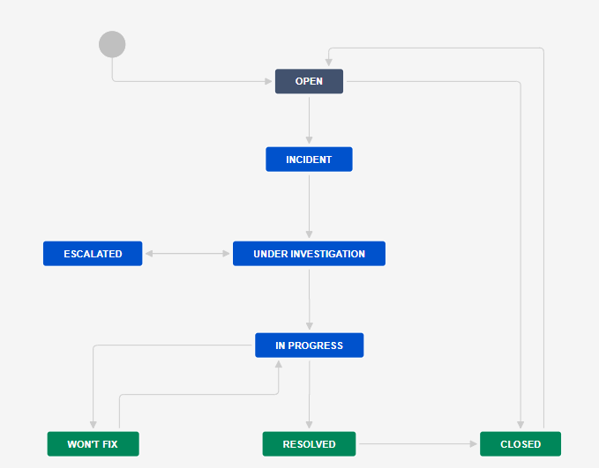
Workflow of the System
All users can raise new issue/ticket
RWC will evaluate the issue
RWC close the ticket if the issue disappeared
RWC decide to raise an incident
RWC change status and wait for proposed solution
NFP receive the ticket and acknowledge that
In some cases, RWC can escalate an incident, e.g. no response from NFP
NFP proposes the solution
NFP provides regular updates
RWC validates the NFP proposal and updates the status
NFP informs RWC about the incident rectification
RWC put a ticket to won’t fix if any incident seems can not be resolved
RWC can reopen a closed ticket
RWC put back a ticket from wo’t fix to in progress if a resolve action identified
RWC to confirm that incident has been resolved
RWC close the ticket if incident has been resolved

Slide 4
Users role
RWCs
Issue new ticket
Reopen a closed ticket
Update the ticket status into incident, under investigation, in progress, resolved, won’t fix, or escalated
WDQMS NFPs (Members)
Monitoring Centres
Issue new ticket
Issue new ticket
Propose resolve actions through comments
Add comments to the ticket, as necessary
Add comments to the ticket, as necessary
Close ticket

Slide 5
Issue Identification
There are several information must be filled in to create a new issue including, i.e. project name, issue type, summary, assignee, component, description, priority, linked issues, WIGOS ID, issue category

Slide 6
Incident Process Initiation
One of the two options must be performed by RWCs when receiving new ticket according to their evaluation:
Convert the ticket into ‘incident’. If it is decided to raise an issue into an incident, RWC must assign this incident to specific Member (NFP) →
Decide ‘no incident’ for the ticket, the issue has been resolved or has disappeared without further action taken by the RWC → ‘CLOSED’
INCIDENT
CLOSED

Slide 7
Receipt confirmation and action proposal from Members
To make the RWC aware that the country has taken over the task of following up the incident, NFP/ Member must acknowledge the incident. RWC will confirm the ticket when receive acknowledgement from NFP →
Potential comments should be added to the ticket
NFP should continuously update the ticket status. On the other hand, RWC regulary request update to NFP →
If there is no confirmation from NFP, RWC should contact NFP using other media (e.g. email).
RWC escalate the incident to a WMO Secretariat, that will bring it a higher level (e.g. PR) if necessary →
UNDER INVESTIGATION
IN PROGRESS
ESCALATED

Slide 8
Incident Rectification
If the incident has been rectified by the country , NFP to inform RWC
The RWC will check whether the incident ticket can be closed or has to be kept open due to ongoing non-compliance and underperformance compared to the WDQMS performance targets →
In the case of ongoing non-compliance, the RWC will ask the NFP to take further actions
RESOLVED

Slide 9
Won’t fix incident
WON´T FIX
it might be found that an incident cannot be rectified because no (immediate) action can be taken
In this case, the RWC should put the incident into the log of “Won’t fix”
RWC and/or NFP regularly monitor the incident put in “Won’t fix” and whenever it is found that an action can be taken to rectify the incident, RWC bring the ticket back to “in progress”.

Slide 10
Search function (optional)
Users can search specific issue using three different ways:
Quick search, is the most useful if the search criteria is not complex.
Basic search, is more precise than the quick search, but easier to use than the advanced search
Advanced search, The advanced search is the most powerful of the three search methods. You can specify criteria that cannot be defined in the other searches (e.g. ORDER BY clause). However, you need to know how to construct structured queries using the Jira Query Language (JQL) to use this feature.

Slide 11
Quick search
The Search box is located at the top right of your screen, in the Jira header bar.
To use quick search, just start typing what you're looking for.
Quick search also enables you to perform 'smart' searches with minimal typing. For example, to find all the open bugs in the 'TEST' project, you could simply type 'test open bugs' and quick search would locate them all for you.
To ensure that search is in the RWC project, add word “RWC” as the first word in the search box, e.g. “RWC availability”.
Search box

Slide 12
Basic Search
Choose Issues > Search for issues.
If the advanced search is shown instead of the basic search, click Basic (next to the Search button).
Enter the criteria for the search
Make sure that the “incident management system for RWC” project is selected from the drop down list in Project.

Slide 13
Thank you
www.wmo.int/wigos

