Slide 1
WIGOS Data Quality Monitoring System
(WDQMS)
Introduction to the Incident Management Process

Slide 2
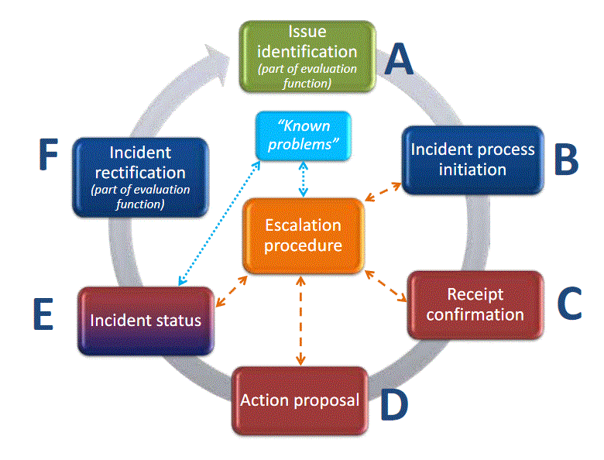
The steps of the Incident Management Process (IMP)
The issue might be closed again before initiating an incident managment process if the performance improved.
Responsibility
RWC or data user
Responsibility RWC
Responsibility RWC
Responsibility RWC
Responsibility
country
Responsibility Contact country → RWC
Responsibility country
Potential need to close IMP and open new IMP due to incident cause by different activator

Slide 3
Non-compliance during evaluation process
Regional WIGOS Centres (RWC) will evaluate the performance of stations of countries under their responsibility on a daily basis by reviewing the performances displayed in the available web tools.
Check the performance concerning the three main quality monitoring categories data availability, timeliness and accuracy regarding the WDQMS performance targets (e.g. GBON requirements).
In the case of any non-compliance of a particular station raise an incident ticket by describing the incident, according to the WIGOS incident management process.
ISSUE IDENTIFICATION – STEP A: part of the evaluation process

Slide 4
ISSUE IDENTIFICATION – STEP A
Once an issue has been reported to the RWC or has been identified by the RWC, the issue will be documented by creating a new ticket.
Each ticket should have a unique ticket number containing a summary / brief explanation of issues raised using the following format: ddmmyyyy-country-station/location-issue (example: 04032020-Chile-Tamuco- suspicious pressure values)

Slide 5
ISSUE IDENTIFICATION – STEP A
RWCs should insert the following information in the ticket:
Project*: ‘Incident Management System for RWC’
Issue type* (issue or incident): in this case “issue”
Summary*: a brief explanation of the issue being raised
Date and time when the ticket describing an issue was created
Country, station name, brief explanation (see ticket number)
Station details, in particular WIGOS station identifier* and network type, station name and WMO Member/country
WIGOS issue category:
Type of observation: surface or upper air,
Category performance: availability, quality or timeliness
* mandatory

Slide 6
ISSUE IDENTIFICATION – STEP A
RWCs should insert the following information in the ticket (cont.):
Reporter: Name of the person and organization that raised the issue, including contact details (email address)
Assignee: RWC being responsible for this station
Full description of the issue, links to other related issues
Priority level according to the Technical Guidelines for RWC on the WDQMS (Annex 2)
RWCs should add the issue to the ticket summary as “issue” and ticket status “open” (not being identified as incident yet).
RWCs should monitor each issue at surface land stations and upper-air (radiosonde) land stations over 5 working days before converting the issue into an incident and initiating the incident management process
INCIDENT PROCESS INITIATION – STEP B

Slide 7
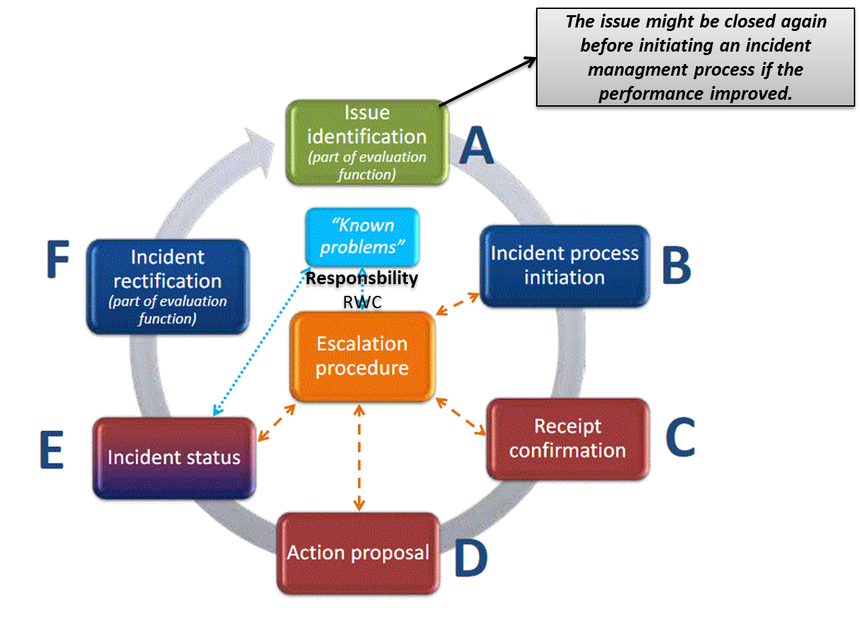
ISSUE IDENTIFICATION – STEP A
If an identified issue has been monitored over the defined periods and the issue has been resolved (or has disappeared) without further action taken by the RWC or the issue is out of RWC´s responsibility, this shall be highlighted by adding “No incident process required”
The issue ticket shall either be closed, or
The performance of the station will be further monitored over the next 2 days before deciding to finally close the issue or to raise an incident.

Slide 8
INCIDENT PROCESS INITIATION – STEP B
RWCs will be responsible for initiating the incident management process.
Once an issue (part A) has been deemed serious enough to be raised as an incident, a notification to the WDQMS NFP of the country is required.
This will involve the following tasks and additions to the ticket:
Convert the issue ticket into an incident ticket
Add date and time of incident raising (process initiation)
Add details of the evaluation results to the ticket why the RWC raised an incident
Assign the incident ticket to a specific member

Slide 9
INCIDENT PROCESS INITIATION – STEP B
Bring the problem to the attention of the country in question, making the ticket available to them and requesting the relevant WDQMS NFP to take corrective action as rapidly as possible
RWCs should convert the ticket into an “incident” in the ticket summary, set the ticket status to open, update the date, status and other relevant parts accordingly.
Awaiting RECEIPT CONFIRMATION – STEP C

Slide 10
RECEIPT CONFIRMATION – STEP C
As soon as the WDQMS NFP of the country has received the incident ticket with the unique incident number from the RWC, actions shall be taken to investigate the cause of the incident and to find a solution.
To make the RWC aware that the country has taken over the task of following up the incident, WDQMS NFP must inform RWC about acknowledgement of the incident including date/time, name of recipient and potential comments
RWC to set the status as “under investigation”
Awaiting ACTION PROPOSAL – STEP D

Slide 11
ACTION PROPOSAL – STEP D
As soon as the country has identified the cause of the incident and found a solution, the WDQMS NFP should alert the RWC of the proposed actions by adding the following information to the incident ticket:
Date/time,
name of NFP and
details of proposed action including timeline to solve the incident and additional relevant comments
WDQMS NFP should update the incident ticket and inform the RWC about the update as soon as possible.
RWC to set the status as “in progress”.
Awaiting INCIDENT STATUS – STEP E

Slide 12
INCIDENT STATUS – STEP E
The WDQMS NFP will regularly provide summarized updates on the status of the incident:
Any significant action that has been taken and which should be recorded
essentially a work log of the actions undertaken during the lifetime of the ticket by adding date/time, organization and name of who is taking action, as well as the resulting status after each action
Routinely to be updated on a weekly basis (including “no change” reports)
At the moment when the incident has been rectified
Awaiting INCIDENT RECTIFICATION – STEP F

Slide 13
INCIDENT RECTIFICATION – STEP F
WDQMS NFP to inform the RWC if and when the incident has been rectified.
RWC will check whether the incident ticket can be closed or has to be kept open due to ongoing non-compliance.
In the case of ongoing non-compliance, the RWC will ask the WDQMS NFP to take further actions, to be recorded in part E.
If the incident ticket can be closed, the RWC will
add a closing date/time to the ticket
inform the WDQMS NFP and the issue reporter and data users
archive the ticket as a “resolved/closed incident” in the ticket summary
The IMP will be completed once the station continuously performs correctly again. → A closed ticket can be reopened again if an issue reoccurs.

Slide 14
KNOWN PROBLEMS LOG, other activators
It might be found that an incident cannot be rectified because no (immediate) action can be taken.
RWC should put the incident into the “Known problems” log (“WON´T FIX”)
One of the most likely known problems that might be identified at the beginning of RWC operations is that stations do not provide any data to GTS although being listed as operational and affiliated to GOS in OSCAR/Surface (“silent stations”).
It also might be the case that actions taken so far have been unsuccessful because the incident has been caused by a different activator. In this case, RWC should close the ticket and initiate a new IMP with a different incident description.

Slide 15
ESCALATION PROCEDURE
In the unlikely event of non-response of the country to the RWC incident reporting and the incident is sufficiently severe, the incident escalation procedure will state who should be contacted at a higher level.
In the most severe cases, this may involve asking the WDQMS NFP if needed to approach the Permanent Representative with WMO of the corresponding country or WMO Secretariat asking for advise and support.
The incident escalation procedure might also be initiated if long-lasting incidents are identified as “known problems” (“WON´T FIX” problems that are ongoing and cannot be solved within the responsibility of the RWC and the WDQMS NFP).

Slide 16
Thank you
Tanja.Kleinert@dwd.de
www.wmo.int/wigos

