Slide 1
WIGOS Data Quality Monitoring System
(WDQMS)
Incident Management System for RWCs
using JIRA ECMWF
Webinar on WDQMS for RWCs in RA I – EAC
2 July 2020

Slide 2
Expected outcomes
After attending in the workshop, participants will:
review the IMS procedures
understand the IMS workflow
be able to access the IMS-JIRA software (ECMWF)
be able to create issues and follow up on their status
be able to provide comments and other feedback to the tickets
be able to change the status of a ticket (RWCs only!)

Slide 3
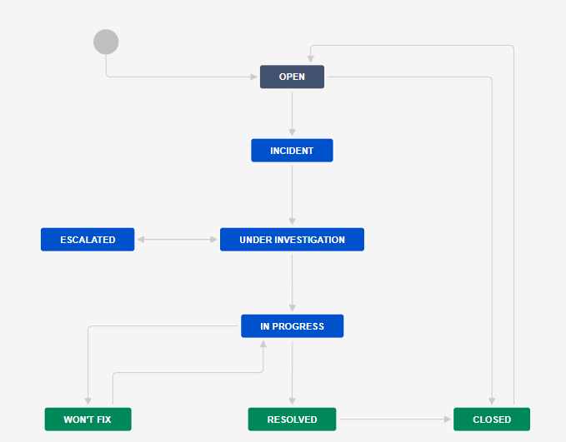
Workflow of the System
Notes:
An initial slide just describing the workflow and its various status

Slide 4
Workflow of the System
All users can raise new issue/ticket
RWC will evaluate the issue
RWC close the ticket if the issue disappeared
RWC decide to raise an incident
RWC change status and wait for proposed solution
NFP receive the ticket and acknowledge that
In some cases, RWC can escalate an incident, e.g. no response from NFP
NFP proposes the solution
NFP provides regular updates
RWC validates the NFP proposal and updates the status
NFP informs RWC about the incident rectification
RWC put a ticket to won’t fix if any incident seems can not be resolved
RWC can reopen a closed ticket
RWC put back a ticket from wo’t fix to in progress if a resolve action identified
RWC to confirm that incident has been resolved
RWC close the ticket if incident has been resolved

Slide 5
Users role
RWCs
Issue new ticket
Reopen a closed ticket
Update the ticket status into incident, under investigation, in progress, resolved, won’t fix, or escalated
WDQMS NFPs (Members)
Monitoring Centres
Issue new ticket
Issue new ticket
Propose resolve actions through comments
Add comments to the ticket, as necessary
Add comments to the ticket, as necessary
Close ticket

Slide 6
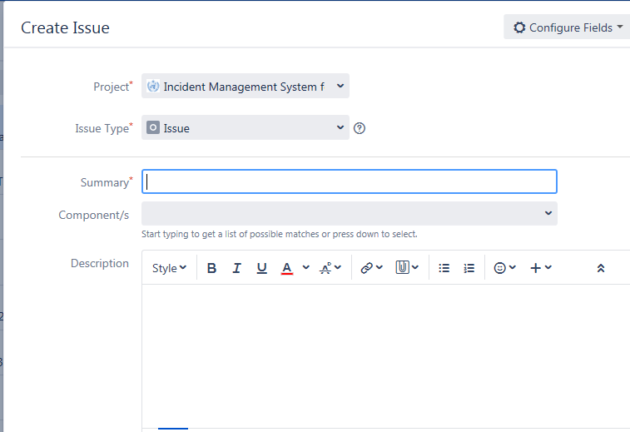
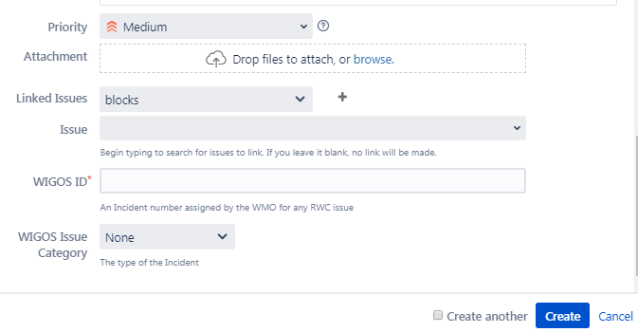
Issue Identification

Slide 7
Fields for new issue
OPEN
Several information must be filled in to create a new issue including:
Project*: ‘Incident Management System for RWC’
Issue type*: ‘issue’ (by default)
Summary*: a brief explanation of issues raised using this format:
ddmmyyyy-country-station/location-issue
example: 02072020-Burundi-Muyinga-suspicious pressure values
If more than one station of a country show the same non-compliance, station/location could be typed e.g. three stations or stations
*mandatory fields

Slide 8
Fields for new issue – cont.
OPEN
Reporter (only appear in RWCs’ account): by default according to the account logged in
Assignee : at the beginning, it will automatically be assigned to RWC, RWC should assign this ticket to Member (NFP) if RWC has decided to raise the ticket as incident
Component: RWC being responsible for this station
Description: Details concerning the issue
Priority: priority level according to the Technical Guidelines for RWC on the WDQMS (Annex 2)

Slide 9
Fields for new issue (cont)
OPEN
Linked issues: if the issue is related with any previous issues
WIGOS ID*: WIGOS Station Identifier (WSI) registered in OSCAR/surface. If more than one station is reported in this ticket, use one of their WSI (details about the other WSIs will go into the Description field)
WIGOS issue category:
Type of observation: surface or upper air,
Category performance: availability, quality or timeliness

Slide 10
Incident Process Initiation
One of the two options must be performed by RWCs when receiving new ticket according to their evaluation:
Convert the ticket into ‘incident’. If it is decided to raise an issue into an incident, RWC must assign this incident to specific Member (NFP) →
Decide ‘no incident’ for the ticket, the issue has been resolved or has disappeared without further action taken by the RWC → ‘CLOSED’
INCIDENT
CLOSED

Slide 11
RWC's response to the new ticket
If decided to be raised as incident
RWC can correct/ edit critical details of the ticket if needed, and add more detailed description
Requesting additional information from reporter as needed
If decided to raise an incident, ticket must be assigned to relevant NFP/ Member
If decided as no incident because issue disappeared

Slide 12
Receipt confirmation and action proposal from Members
To make the RWC aware that the country has taken over the task of following up the incident, NFP/ Member must acknowledge the incident. RWC will confirm the ticket when receive acknowledgement from NFP →
Potential comments should be added to the ticket
NFP should continuously update the ticket status. On the other hand, RWC regulary request update to NFP →
If there is no confirmation from NFP, RWC should contact NFP using other media (e.g. email).
RWC escalate the incident to a WMO Secretariat, that will bring it a higher level (e.g. PR) if necessary →
UNDER INVESTIGATION
IN PROGRESS
ESCALATED

Slide 13
Confirm the ticket when receive acknowledgement from NFP
RWCs confirms the ticket into under investigation

Slide 14
Review and validate action proposal added by Members
RWC receives action proposal added by Member

Slide 15
Incident Rectification
If the incident has been rectified by the country , NFP to inform RWC
The RWC will check whether the incident ticket can be closed or has to be kept open due to ongoing non-compliance and underperformance compared to the WDQMS performance targets →
In the case of ongoing non-compliance, the RWC will ask the NFP to take further actions
RESOLVED

Slide 16
Won’t fix incident
WON´T FIX
it might be found that an incident cannot be rectified because no (immediate) action can be taken
In this case, the RWC should put the incident into the log of “Won’t fix”
RWC and/or NFP regularly monitor the incident put in “Won’t fix” and whenever it is found that an action can be taken to rectify the incident, RWC bring the ticket back to “in progress”.

Slide 17
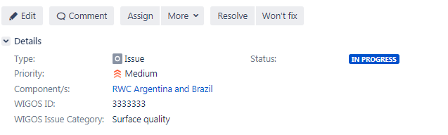
Incident rectification or won’t fix incident
If the incident has been rectified
If an incident cannot be rectified because no (immediate) action can be taken

Slide 18
Won’t fix incident
If it is found that an action can be taken to rectify a “won’t fix” incident

Slide 19
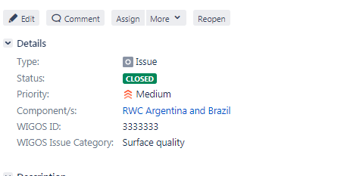
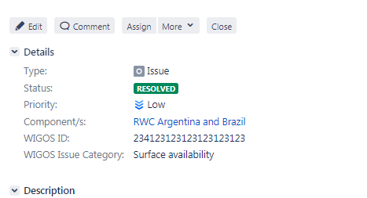
Closure of incident ticket
CLOSED
If the incident has been successfully rectified the incident ticket will be closed

Slide 20
Search function (optional)
Users can search specific issue using three different ways:
Quick search, is the most useful if the search criteria is not complex.
Basic search, is more precise than the quick search, but easier to use than the advanced search
Advanced search, The advanced search is the most powerful of the three search methods. You can specify criteria that cannot be defined in the other searches (e.g. ORDER BY clause). However, you need to know how to construct structured queries using the Jira Query Language (JQL) to use this feature.

Slide 21
Quick search
The Search box is located at the top right of your screen, in the Jira header bar.
To use quick search, just start typing what you're looking for.
Quick search also enables you to perform 'smart' searches with minimal typing. For example, to find all the open bugs in the 'TEST' project, you could simply type 'test open bugs' and quick search would locate them all for you.
To ensure that search is in the RWC project, add word “RWC” as the first word in the search box, e.g. “RWC availability”. Or
Search box

Slide 22
Basic Search
Choose Issues > Search for issues.
If the advanced search is shown instead of the basic search, click Basic (next to the Search button).
Enter the criteria for the search
Make sure that the “incident management system for RWC” project is selected from the drop down list in Project.

Slide 23
Thank you
www.wmo.int/wigos

