Slide 1
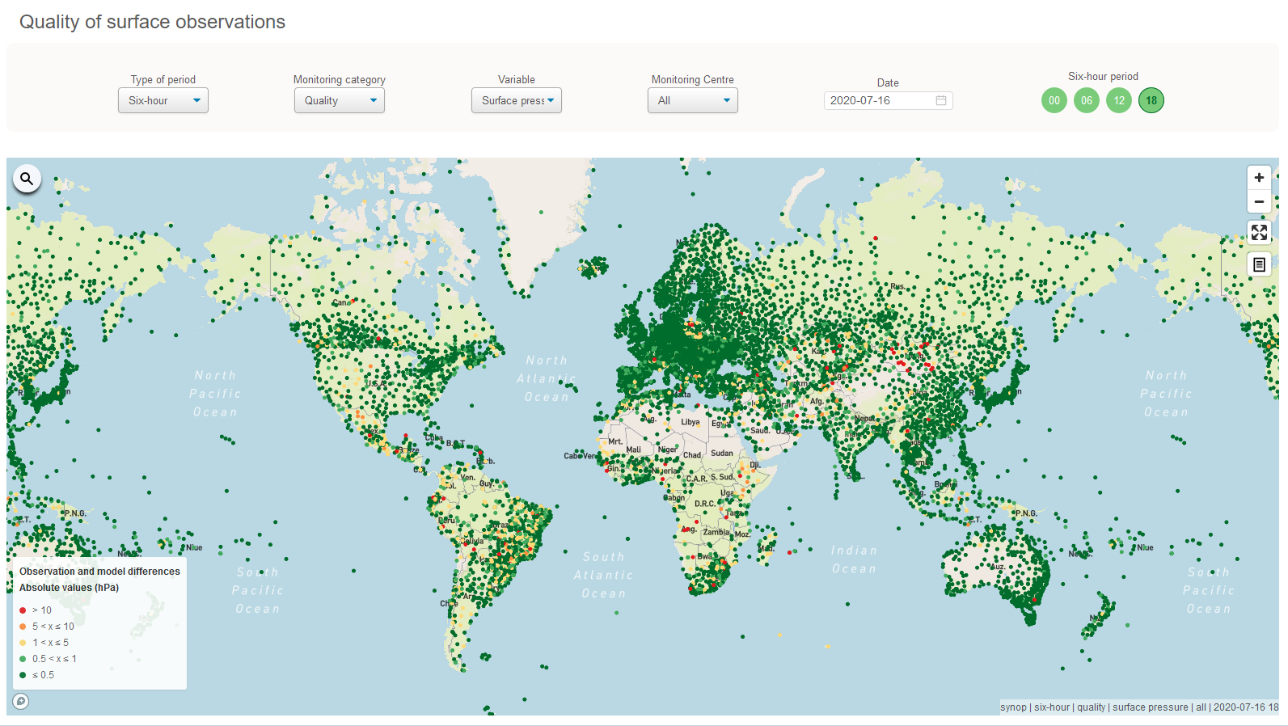
WIGOS Data Quality Monitoring System
(WDQMS)
How to use the WDQMS web tool to monitor quality of surface stations

Slide 2
WDQMS Quality Monitoring Category ‘Quality’
One important aspect of monitoring the health of the GOS is to assess the quality of each individual observation, so that one can assess the average quality of a station for example.
Data quality is one of the three main quality monitoring categories of the WDQMS, besides data availability and timeliness.
All NWP data assimilation systems perform a quality check on the observations before assimilation and observations may not be used because they are blacklisted (e.g. due to known poor quality) or rejected.
NWP monitoring reports are very useful to monitor the quality of GOS stations and are therefore a baseline of the WDQMS.

Slide 3
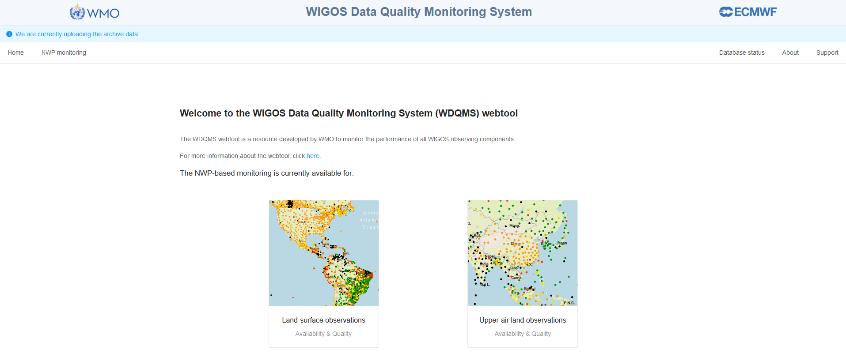
WDQMS web tool
https://wdqms.wmo.int/
WDQMS web tool provides ‘Quality’ performances as Observation against Background (O-B) values averaged over a selected period (6-hourly or daily) ➔ Select ‘Quality’
Input from four Monitoring Centres:

Slide 4
Variables monitored in the WDQMS web tool
The WDQMS web tool offers the selection of a particular variable for evaluation (e.g. surface pressure/geopotential height, 2m temperature, 10m zonal wind component, 10m meridional wind component, 2m relative humidity)
Land stations in mountainous areas report geopotential instead of surface pressure → not all WIGOS Monitoring Centres assess geopotential height

Slide 5
Display of ‘All’ or particular MC
The WDQMS web tool allows selecting results of a particular WIGOS Monitoring Centre or the aggregation of all centres.
If ‘All’ is selected the results of all WIGOS MCs are combined into one figure concerning ‘Quality’.
The WIGOS MC results might differ due to various reasons → See Potential differences in results of WIGOS Monitoring Centres for more details
For quality the NWP model whose background field is closest to the observed value will be displayed in the performance maps as it exhibits the best performance result.
If at least one WIGOS Monitoring Centre (MC) shows low (good) O-B results (green dots) most likely the issue is related to the corresponding WIGOS MC which shows larger O-B results
→ no action required by RWC

Slide 6
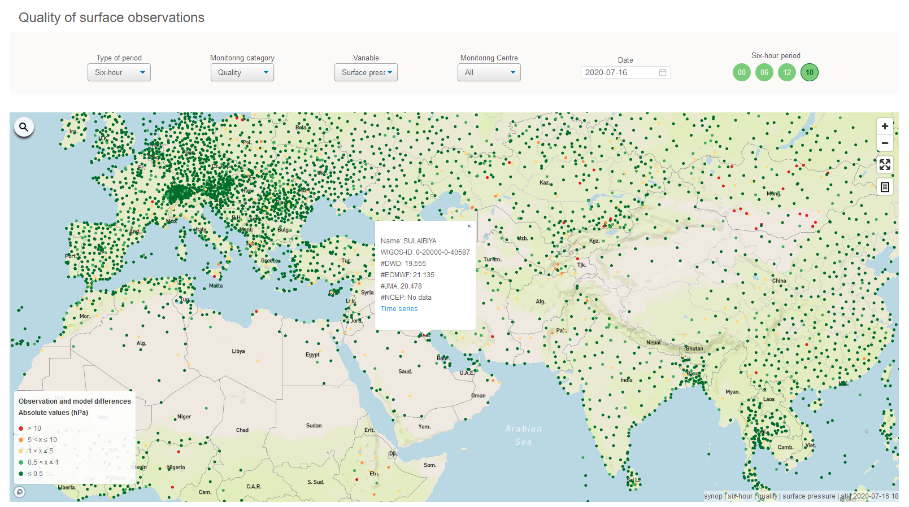
Detailed performance of a particular station for ‘Quality’
By clicking on a particular station the WDQMS web tool displays more details about the quality performance of a station
A popup window displays:
the WIGOS Station Identifier (WSI) and station name
the O-B values of a selected WIGOS MC or each WIGOS MCs (if ‘All’ selected under ‘Center’) of the selected variable (e.g. surface pressure)

Slide 7
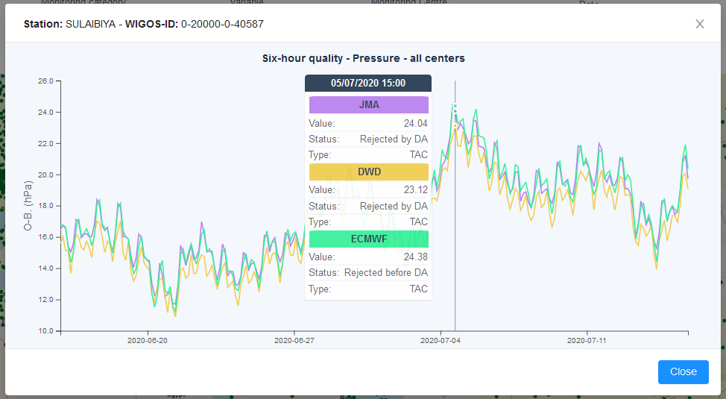
Time series of a particular station for ‘Quality’
The popup window contains a link to the stations´ time series displaying the O-B results of the previous periods (6h/daily steps) for each WIGOS MC (WIGOS MCs with the same results will overlap, the cursor popup information will show all results of each WIGOS MC)

Slide 8
Bias, trueness and precision
The bias is used as a measure of trueness and is calculated as the average of O-B results over a certain period.
The targets regarding trueness are stated such that the bias should be close to zero for all measured variables.
The standard deviation is the quantitative measure of precision. The targets for precision are applied to the standard deviation of O-B results over a certain period for each of the observed variables.
All three measures – bias, trueness and precision - are assessed daily and monthly. Also, the 5-day moving average of daily calculated standard deviation of O-B will be calculated for all variables and compared to the respective prescribed threshold.

Slide 9
Gross errors
The number of gross errors in a month (number of single observations whose O-B results exceed the prescribed threshold) will be computed for each variable at each station.
The station will be flagged as an issue when the percentage of gross error per variable is larger than 15% of the total observations of that variable in the month.
For different variables different thresholds are defined. The thresholds proposed for land surface observations as outlined in WMO-No. 1224 are:
10hPa for surface pressure or 100 m for geopotential height
10 K for 2-metre temperature
15 m/s for wind vector
0.30% for relative humidity.

Slide 10
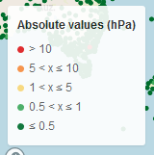
Evaluation of surface pressure O-B results

Slide 11
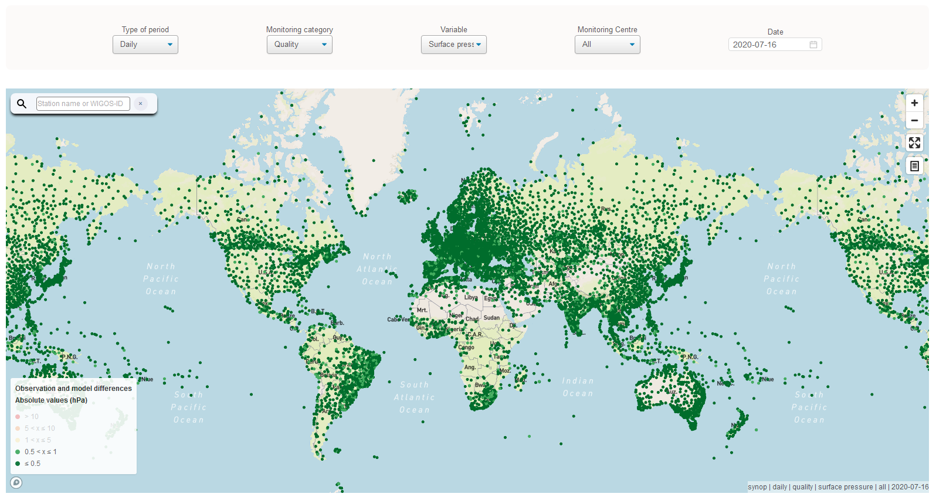
Absolute pressure obs values ≤ 1 hPa
Stations shown as green dots
The quality of pressure observations is good, the station is performing well ➔ no action required ☺

Slide 12
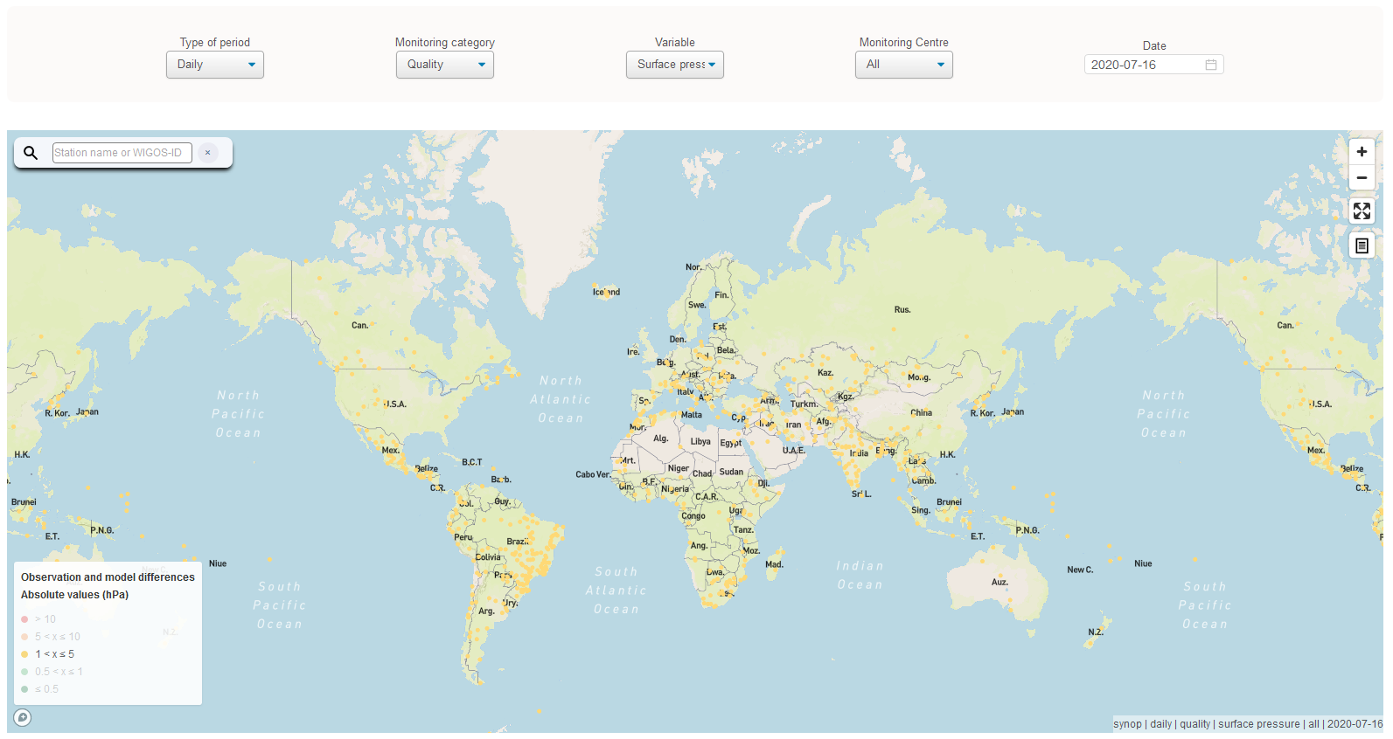
Absolute pressure obs values 1 - 5 hPa
Stations showing yellow dots have quality issues
If they continue to appear having quality issues especially when selecting ‘All’ Centers and the ‘Daily’ display ➔ action: RWC to initiate an IMP with medium priority ( ) asking WDQMS NFP to take actions to investigate the cause of the incident and to find a solution

Slide 13
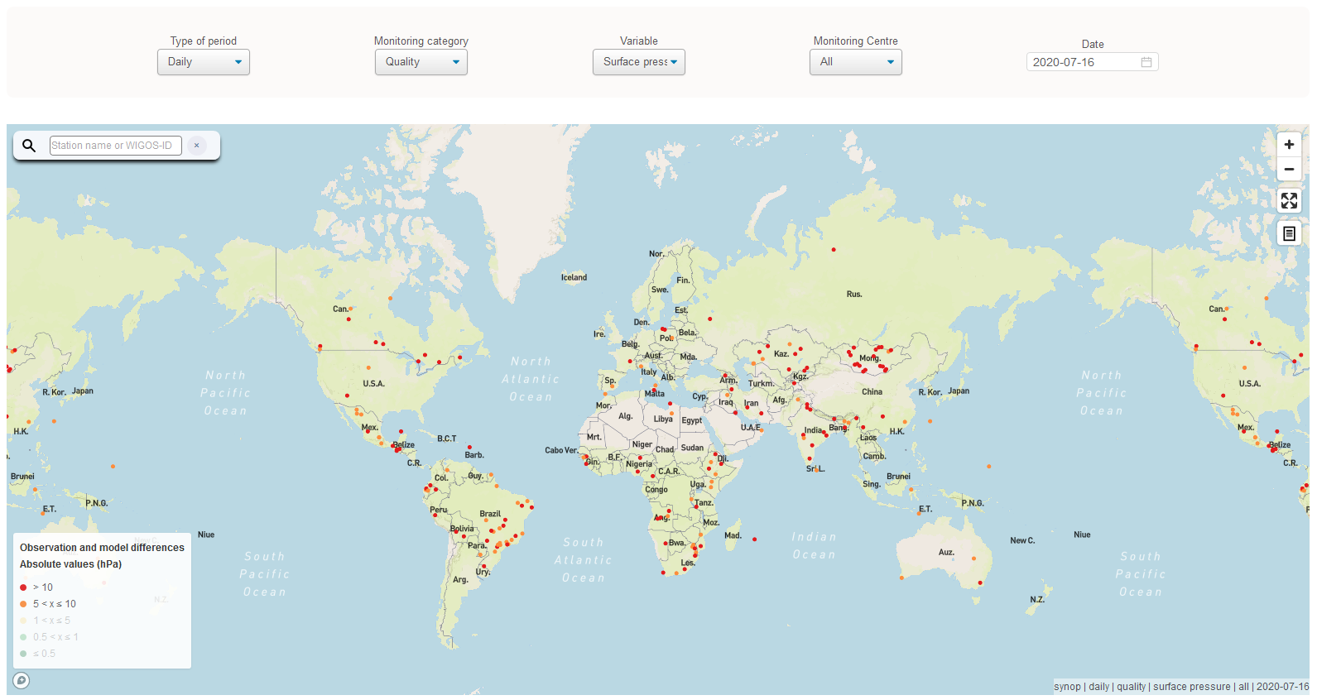
Absolute pressure obs values > 5 hPa
Stations showing orange or red dots have large quality issues
If they continue to appear having quality issues especially when selecting ‘All’ Centers and the ‘Daily’ display ➔ action: RWC to initiate an IMP with high ( ) or very high priority ( ) asking WDQMS NFP to take actions to investigate the cause of the incident and to find a solution

Slide 14
Reasons for quality issues in pressure obs
Large O-B results in surface pressure observations are in most cases related to the following causes:
Sporadic incorrect measurements or readings at site action ➔ if the issue is reoccurring RWC should initiate incident management process (IMP) on quality by contacting WDQMS NFP asking to take appropriate actions to avoid such issues in future
Incorrect metadata being used as background for data assimilation by WIGOS MCs (either from OSCAR/Surface or BUFR messages) action ➔ RWC should initiate IMP by contacting WDQMS NFP to work with OSCAR/Surface NFP to check the barometer height and station height in OSCAR/ Surface and/or BUFR metadata as well as MC FP
See issue No. 1
See issue No. 2

Slide 15
Reasons for quality issues in pressure obs
Large O-B results in surface pressure observations are in most cases related to the following causes (cont.):
Apparent sensor drift leading to increasing wrong measurements at site action ➔ if the RWC identifies continuously increasing O-B results in all WIGOS MC outputs the RWC should initiate an IMP by contacting WDQMS NFP asking to take appropriate actions to solve the issue.

Slide 16
Example of issues in data quality 63881 SUMBAWANGA (Tanzania)
Issue No. 1
Issue No. 1 (occasionally occurring large errors):
Station 63881 SUMBAWANGA showed large pressure O-B results of approximately 80 hPa on 19th August 2019 in all WIGOS MC outputs
19th August 2019

Slide 17
Example of issues in data quality 63881 SUMBAWANGA (Tanzania)
Issue No. 1 (cont.):
Looking into the SYNOP messages of 63881 for 19th Aug 2019 it turned out that the pressure report for the particular synoptic hour at 15 UTC seemed to be suspicious compared to the other pressure reports of the day.
During the day the reported surface pressure at station level was 820-822 hPa
Reported pressure at station level at 15 UTC: 891.6 hPa
Most likely this was a result of an instrument reading error or typing error when encoding the message!
RWC to initiate IMP if this reoccurs more frequently!

Slide 18
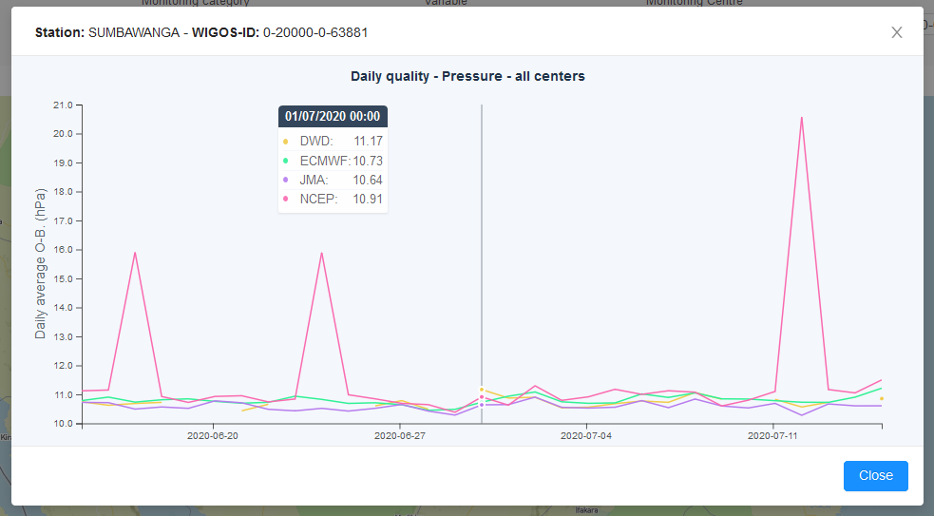
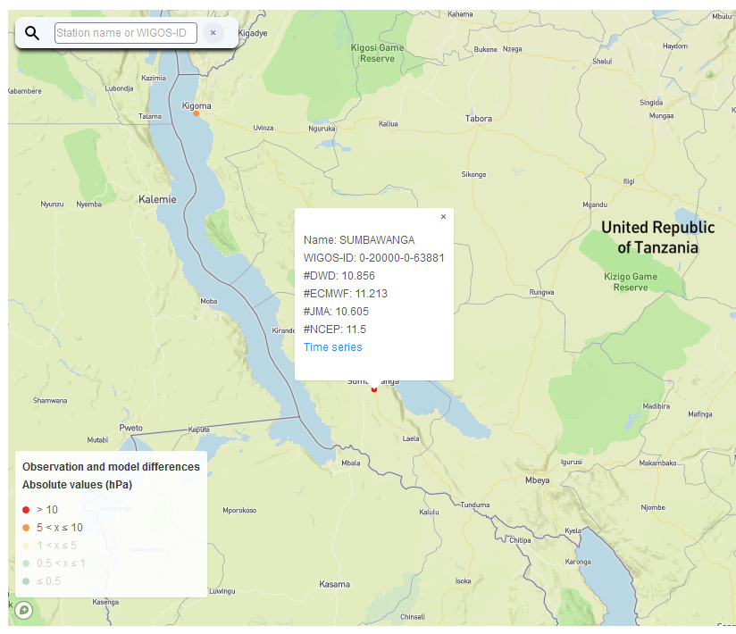
Example of issues in data quality 63881 SUMBAWANGA (Tanzania)
Issue No. 2
Issue No. 2 (ongoing and constant large errors):
Station 63881 SUMBAWANGA shows constant large pressure O-B departures of appr. 10 hPa since a long time in all WIGOS MC outputs
This is most likely related to incorrect entries of the barometer height in OSCAR/Surface and in BUFR messages issued by TMA

Slide 19
Example of issues in data quality 63881 SUMBAWANGA (Tanzania)
Issue No. 2
Ongoing issue
May/June 2020 performance
July/August 2019 performance

Slide 20
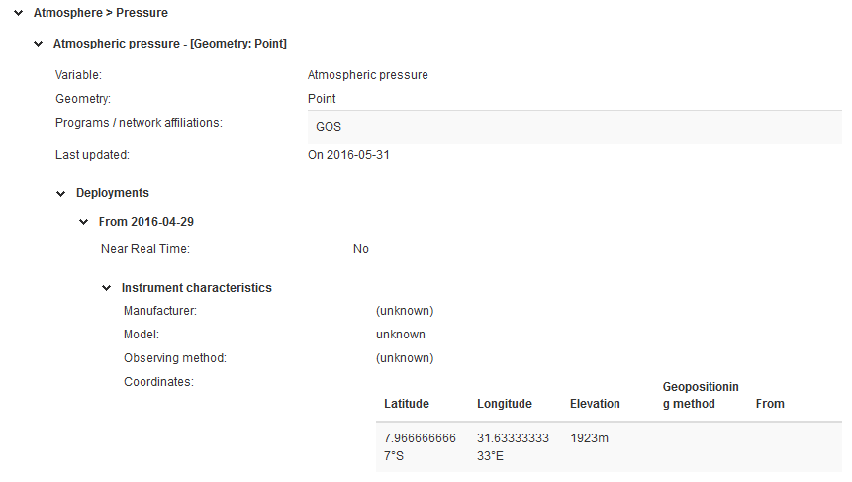
Example of issues in data quality 63881 SUMBAWANGA (Tanzania)
Issue No. 2 (ongoing and constant large errors):
OSCAR/Surface metadata repository refers to an elevation of the barometer in 1923 m
See also https://oscar.wmo.int/surface/#/search/station/stationReportDetails/0-20000-0-63881

Slide 21
Example of issues in data quality 63881 SUMBAWANGA (Tanzania)
Issue No. 2 (ongoing and constant large errors):
According to other tools such as Google related websites displaying altitude or ’Gladstone Family’ the elevation of the station is in 1856 m See also https://weather.gladstonefamily.net/site/HTSU
RWC to initiate IMP asking WDQMS NFP to work with OSCAR/Surface NFP to take appropriate actions to rectify the incident

Slide 22
Other O-B results
NWP models base on observations from the respective regions
The observations are interpolated to the model layers
O-B results of pressure observations are quite reliable because the pressure can be interpolated to the relevant levels quite well
However, large O-B results of temperature and relative humidity are often caused by model biases. Especially in winter times and in areas with steep orography models cannot always resolve strong temperature inversions and thereby might lead to wrong 2m temperature or 2m relative humidity forecasts.
Therefore O-B results of the variables 2m temperature and 2m relative humidity have to be considered with care.
Hence, IMP should only be raised in case of ongoing large errors in O-B results with an increasing trend → stations showing or dots

Slide 23
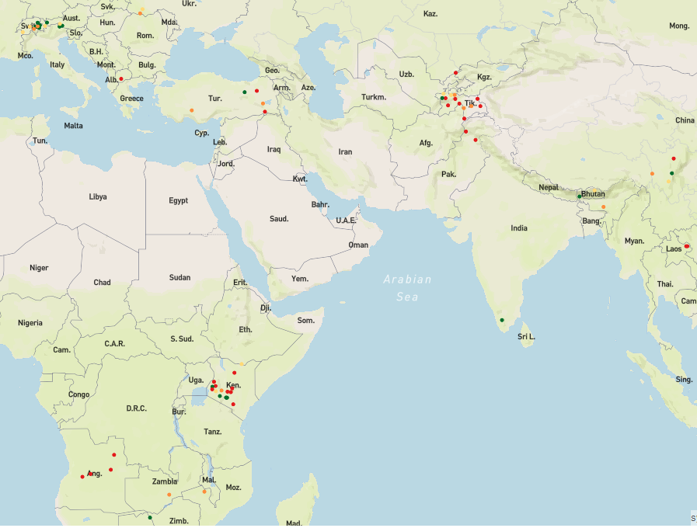
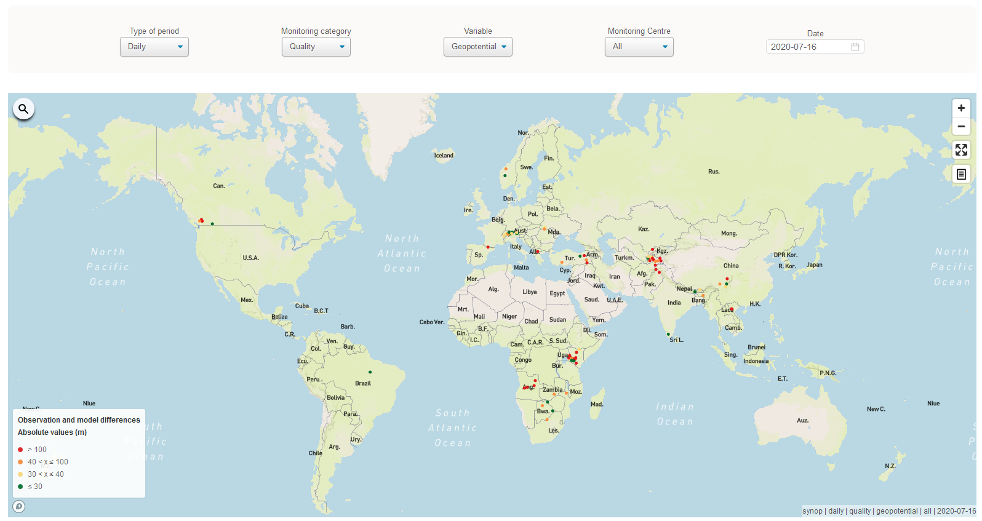
Geopotential height O-B daily results
O-B results for land stations in mountainous areas which report geopotential height instead of surface pressure
Same procedure as for pressure observations: → stations showing orange and red dots have quality issues
If they continue to appear having large quality issues ➔ action: RWC to initiate an IMP with high ( ) or very high priority ( ) asking WDQMS NFP to take actions to investigate the cause of the incident and to find a solution

Slide 24
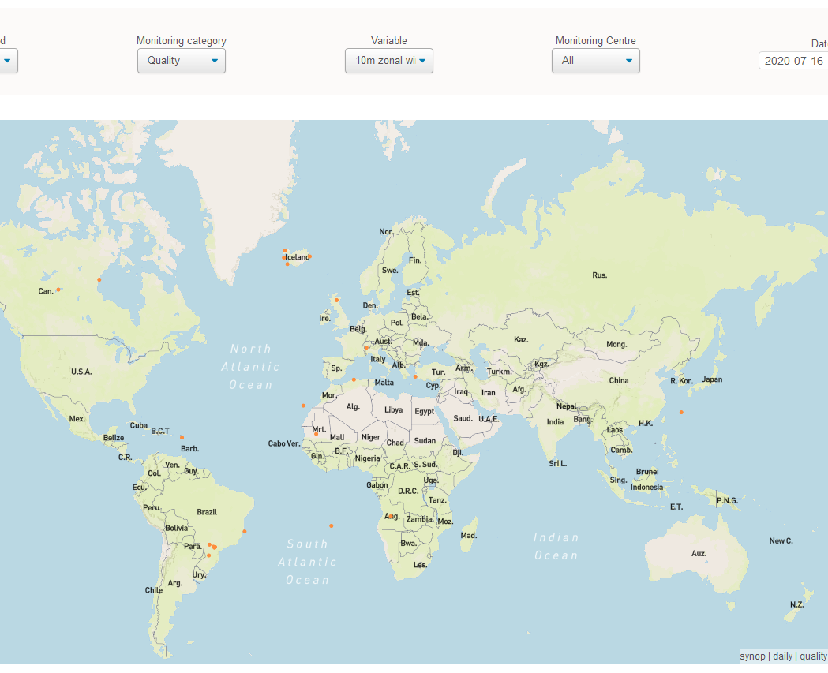
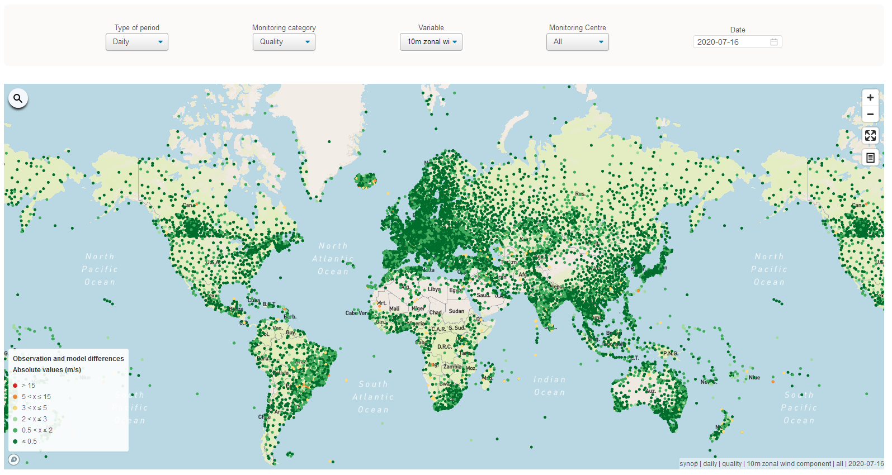
10m zonal wind O-B daily results
No red dots on 16th July 2020

Slide 25
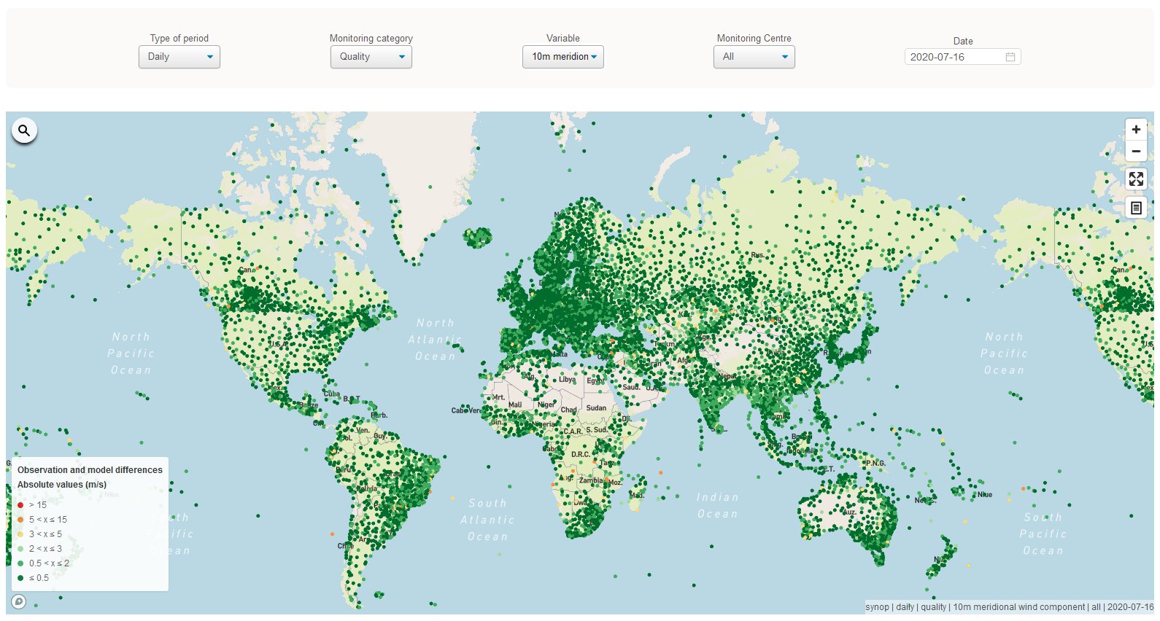
10m meridional wind O-B daily results
No red dots on 16th July 2020

Slide 26
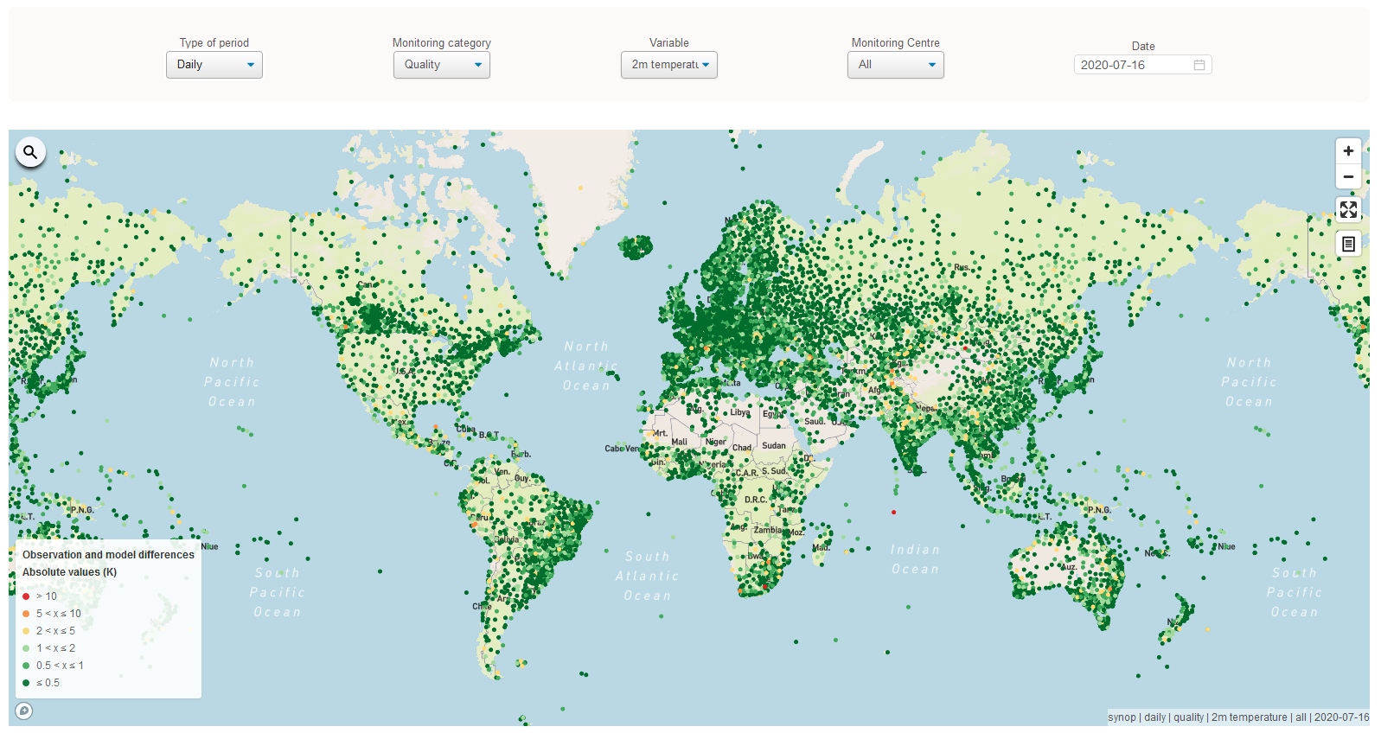
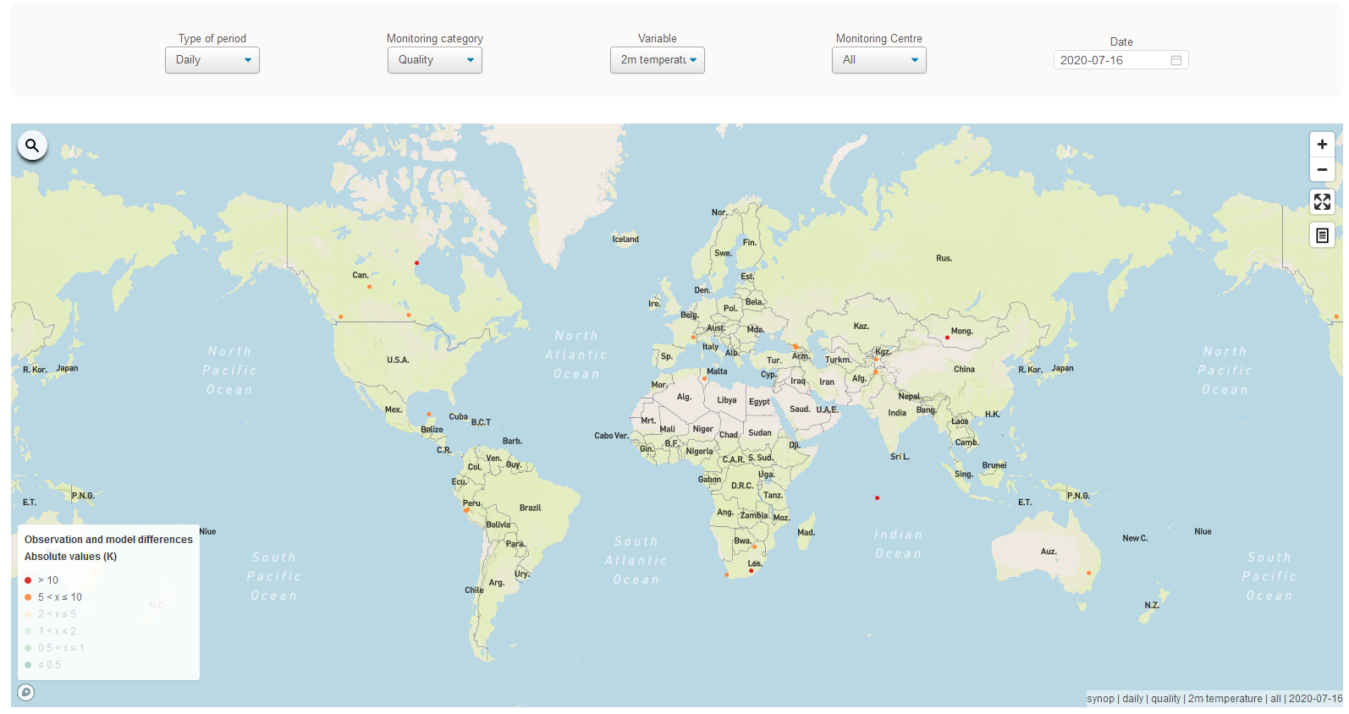
2m temperature O-B daily results
Three red dots on 16th July 2020

Slide 27
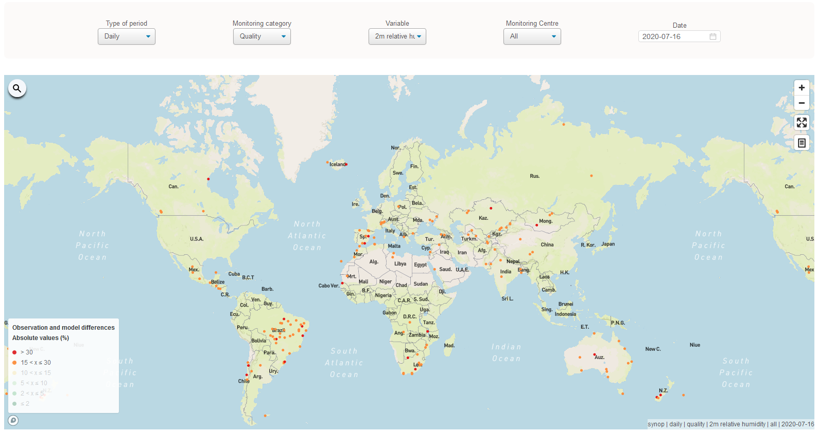
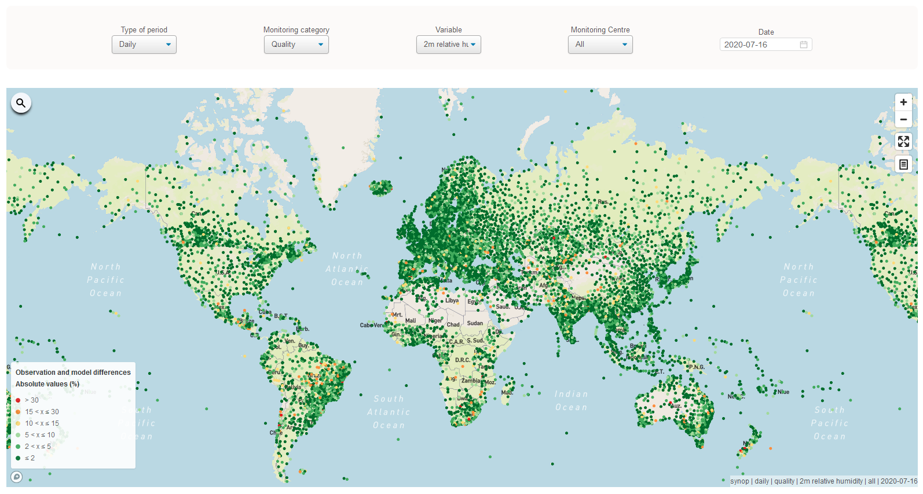
2m relative humidity O-B daily results
Several red dots on 16th July 2020 (>30% O-B RH difference)

Slide 28
RWC starting to operationalize…
When a RWC is starting its WDQMS operations they should initiate incident management processes for long-term ongoing issues in surface pressure O-B results first before getting into detail with special incidents of particular stations or other variables:
Ongoing and constant large O-B results which are most likely related to incorrect OSCAR/Surface metadata on barometer or station height of the station in question

Slide 29
Thank you
Tanja.Kleinert@dwd.de
www.wmo.int/wigos

