Slide 1
Introduction to quality
monitoring of surface stations,
the case of pressure observations
zulkarnain@wmo.int

Slide 2
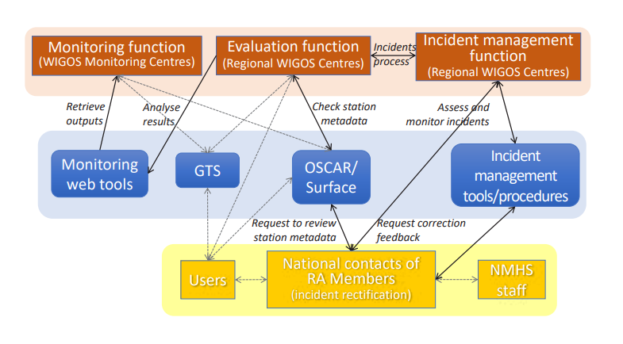
Recalling the WDQMS (Processes)
WMO-No.1224, Technical Guidelines for Regional WIGOS Centres on the WIGOS Data Quality Monitoring System

Slide 3
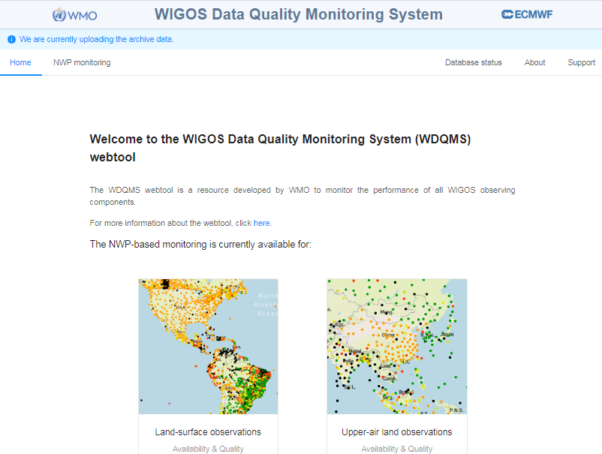
Recalling the WDQMS (Webtool)
Operational since March 2020, https://wdqms.wmo.int
Monitoring reflects observations as seen by WIGOS monitoring centers. Currently: DWD, ECWMF, NCEP and JMA
The current version of the web tool provides monitoring of availability and quality for land-based surface and upper-air observations
Monitoring by 6h and daily intervals
WDQMS webtool obtains station metadata information from OSCAR/Surface

Slide 4
Monitoring categories
There are 3 main categories have been identified to be most important for measuring the performance of the system against a set of targets:
Data availability: total number of meteorological bulletins received during a defined period compared to the required number of bulletins
Timeliness: delay between the nominal observation time of a particular observation message issued at a Member site and reception time at the user database (will be available in the future).
Quality/Accuracy: combining trueness and precision, mainly derived from “observation minus background” (O-B) NWP results from Global NWP Centres for parameters such as air pressure, air temperature, wind and relative humidity observations.

Slide 5
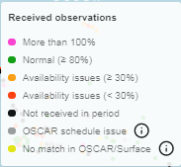
Determining monitoring performance for Data Availability, the case of surface observations
compare the observations received with the expected observations based on OSCAR / GBON requirements.
If no schedule listed in OSCAR/surface, default scheduled will be applied (per 3h), for GBON baseline (per 1h)
Avalaibility indicator of surface observations

Slide 6
Determining monitoring performance for quality, the case of surface observations
Depends on the feedback from several NWP data assimilation systems - mainly the O-B departures - and the quality/accuracy indicators to be considered are trueness, precision and gross error .
for surface observations only trueness has been implemented in the web tool
Color indicator examples of differences between observations and models for surface pressure

Slide 7
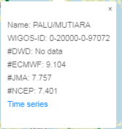
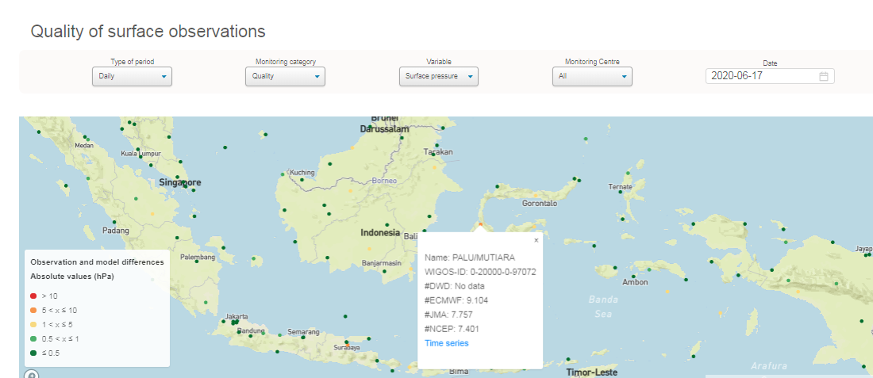
Example of a quality issue in surface observations, the case of pressure observations

Slide 8
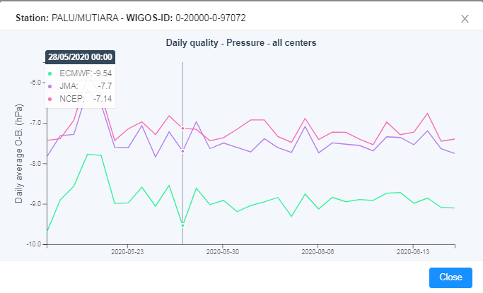
Example of a quality issue in surface observations

Slide 9
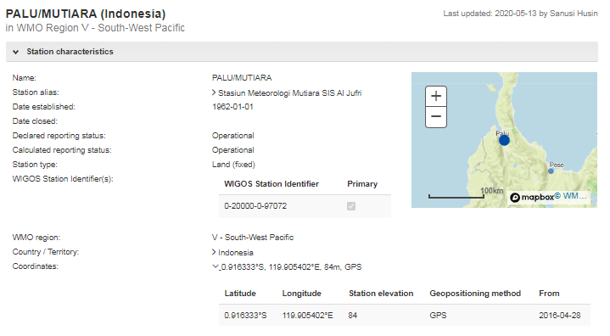
Example of a quality issue in surface observations (metadata in OSCAR/Surface)

Slide 10
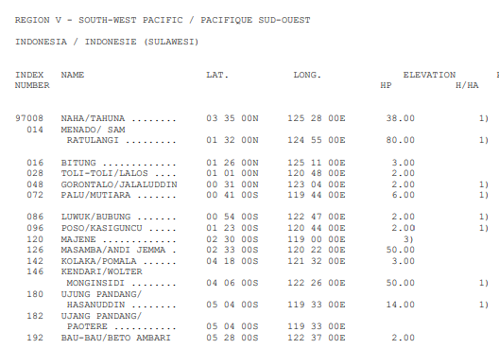
Station metadata in another sources
WMO Publication No. 9, Volume A
*Important notes:
for comparison only, not to decide which metadata is correct
WMO No. 9, Volume A, Observing Stations and WMO Catalogue of Radiosondes have been replaced by OSCAR/Surface

Slide 11
Thank you
https://community.wmo.int/activity-areas/wigos
https://etrp.wmo.int/WDQMS

