Slide 1
How the quality results are produced by NWP monitoring centers, and the differences between them
Cristina Prates
cristina.prates@ecmwf.int
With thanks to :
WDQMS web tool users
Reading, 22 June 2020

Slide 2
WDQMS: NWP-based quality monitoring system
DA systems are based on methods that combine prior knowledge of the atmosphere (Background) with observations in a optimal way taking into account statistical information about the errors of both pieces of information (Kalney, 2003).
Significant improvements in assimilation techniques and numerical weather forecasts in the 1980’s (short range forecast errors comparable in magnitude with observation errors) prompted the use of background fields as a quality control tool. DA systems have been used as diagnostic facilities to monitor the performance of the observational network (Hollingsworth et al., 1986).
The monitoring of data quality in WDQMS relies on the feedback from 4 NWP data assimilation systems (DWD, ECMWF, JMA and NCEP) - mainly the O-B departures.

Slide 3
WDQMS: NWP-based quality monitoring system
Observation-minus-Background (O-B) departures is the difference between the observed value and the model equivalent available from the NWP assimilation system.
Background is derived from short-range model forecast using an observation operator. For direct measurements, the observation operator performs interpolations in time and space (mapping from the model space to observation space). Date/Time as well as location (Lat, Lon and height) need to be accurate. For surface pressure the barometer height is essential.
Surface pressure is the most important in situ observed quantity for global NWP forecasting, and in some cases the only observed surface quantity over land used in the global atmospheric DA. In mountain areas, the stations report the geopotential height of a standard pressure level instead of mean sea level pressure, and some Centres (e.g. ECMWF and JMA) are able to assimilate these observations and provide O-B departure values.
The bias, or systematic error, is used as a measure of trueness (the only quality indicator implemented in WDQMS for surface) and is calculated as the average of O-B departures over a certain period.

Slide 4
NWP-based quality monitoring system
Statistical O-B anomalies (large departures) resulting from the mismatch between observations and model short range forecasts can have different causes:
inaccurate metadata (impact on the calculation of the model counterpart, i.e., Background);
poor quality observations (e.g. instrumental errors);
model errors (e.g., error in forecasting a cyclone deepening).
It can be difficult to differentiate between some of the causes, mainly between observation issues and model errors. Therefore having access to monitoring results from different NWP centres in WDQMS is an advantage as it allows to better diagnose the cause of some statistical anomalies, and to disentangle observation errors from model errors. If at least on model says the observation is good quality we can TRUST!!!

Slide 5
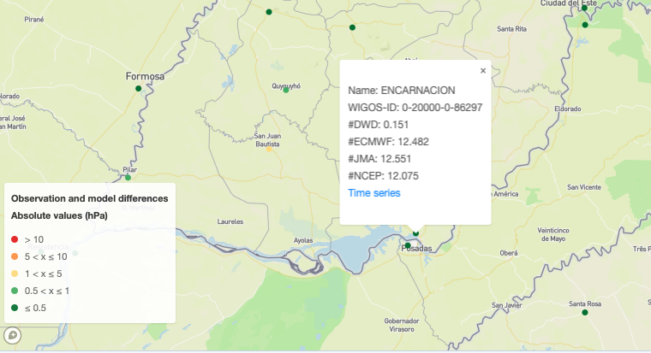
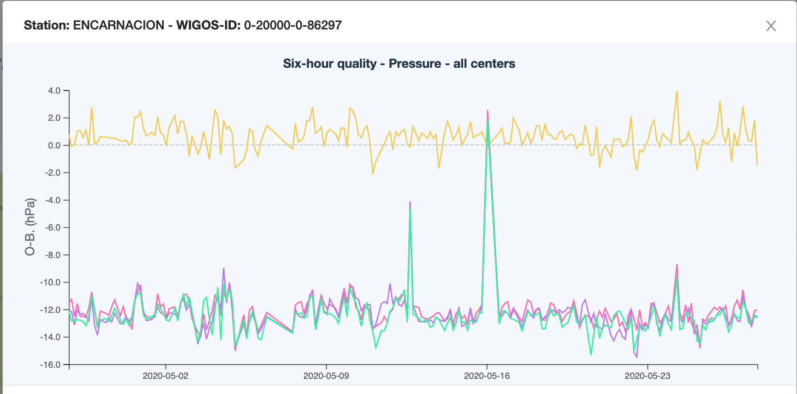
WDQMS: metadata impacting the quality of the observations
ENCARNACION (Paraguay)
“I am trying to understand the source of error that shows in this station ….., for surface pressure. …only 1 model (DWD) shows no error, while the other models have exceptionally large systematic errors.” Martina Suaya in Moodle
DWD
Smallest O-B departures averaged over the 6-h period.
ECMWF
JMA
NCEP

Slide 6
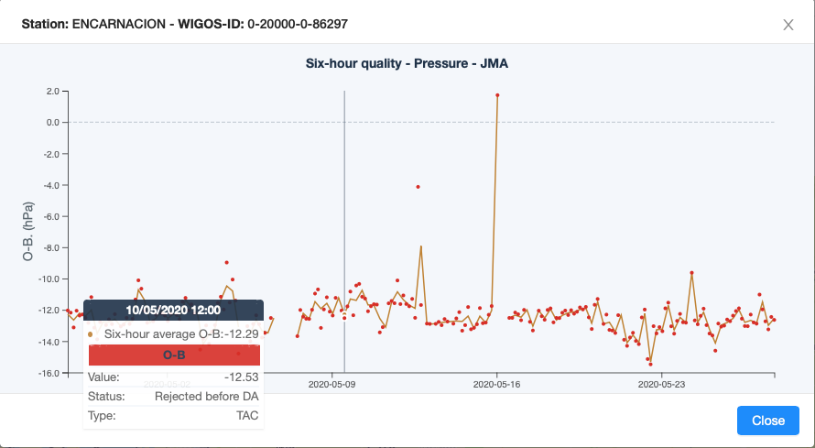
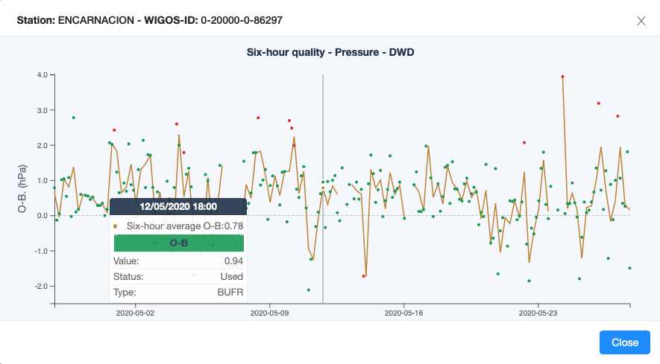
WDQMS: metadata impacting the quality of the observations
Typical metadata issue that has a huge impact on the quality of surface pressure. Barometer height (or the station height) is used to derive the Background value for the surface pressure at the station level. If the height is not correct a systematic error will show in O-B statistics, well illustrated here by three of the models (JMA,NCEP and ECMWF).
Information of station height or barometer height is
missing in OSCAR/Surface for ENCARNATION. (https://oscar.wmo.int/surface/index.html#/search/station/stationReportDetails/0-20000-0-86297).
ECMWF is using 90m as station height, which comes from the Vol A legacy and not from OSCAR/Surface. DWD is using a more accurate value for the station height.
DA system relies solely on OSCAR/Surface metadata in the case of the old format (traditional alphanumeric code -TAC) reports, whereas in the new format (Binary Universal Format for the Representation of Meteorological Data -BUFR) this information is also included in the report.

Slide 7
WDQMS: Differences in NWP monitoring reports
But we need to bear in mind the way the four different NWP DA systems deal with observations:
NCEP, provides information only on the data that pass a quality control step prior to DA, therefore part of the data available that is deemed to be of poor quality or duplicate is filtered out and not available to the DA.
ECMWF, provides monitoring information of all observations available to the DA, even data deemed to be of poor quality (rejected and/or blacklisted by the system). Observations may not be available when a serious coding issue prevents the acquisition system to extract any meaningful value. Assimilates surface pressure observations hourly and geopotential height for some high-altitude stations.
DWD doesn’t provide O-B values if the observation is not considered in the assimilation. And they tend to assimilate surface pressure observations every 3h rather than hourly.
JMA provides O-B values even if the observation is not used in the assimilation although they tend to assimilate surface pressure observations every 3h rather than hourly. Also assimilate geopotential height in some high-altitude stations.

Slide 8
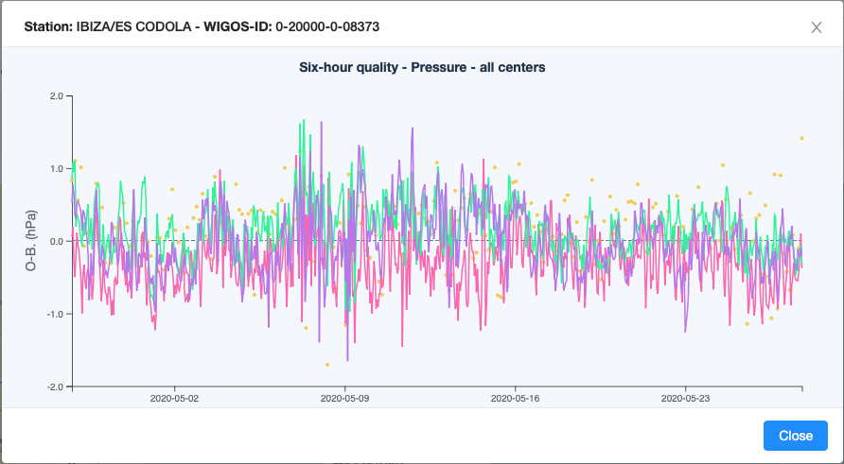
WDQMS: Differences in NWP monitoring reports
There many reasons for pressure observations being discarded:
Poor quality;
Thinning (Temporal and Spatial);
Model resolution (orography and land/sea mask).
IBIZA/ES CODOLA (Spain)
DWD doesn’t provide the Background for observations that are not considered in the assimilation. For this station only considers observations every 3h.

Slide 9
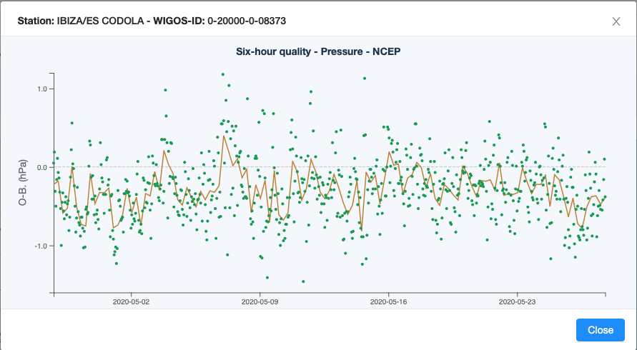
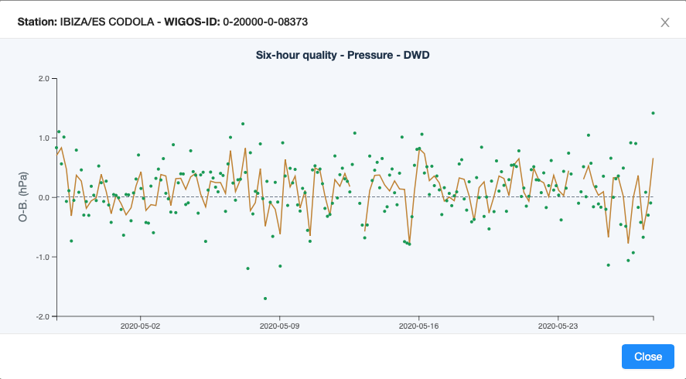
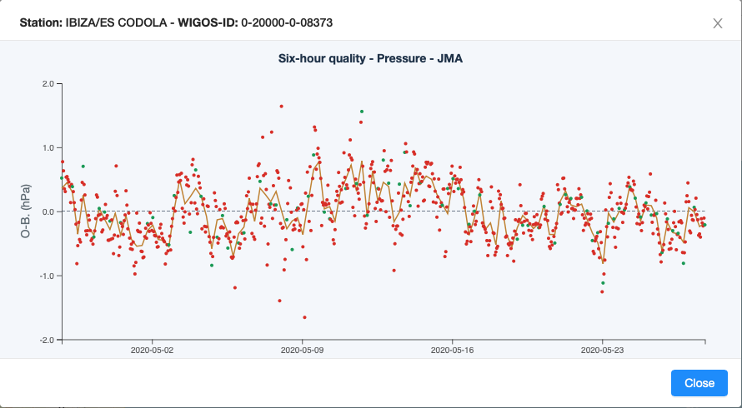
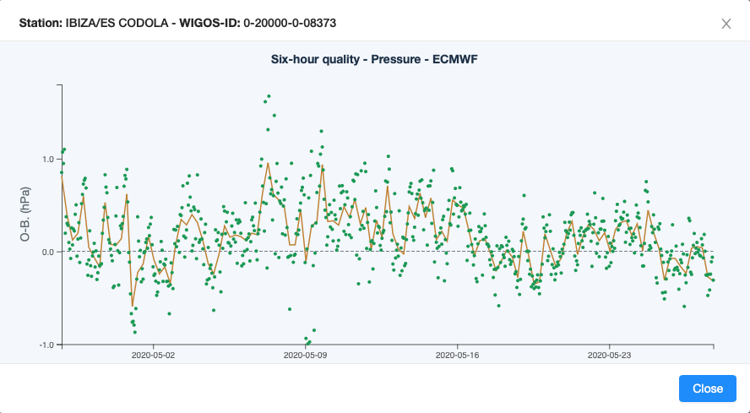
WDQMS: Differences in NWP monitoring reports
Used
Not Used
Temporal thinning in the observation usage
IBIZA/ES CODOLA (Spain)
NCEP
DWD
JMA
ECMWF

Slide 10
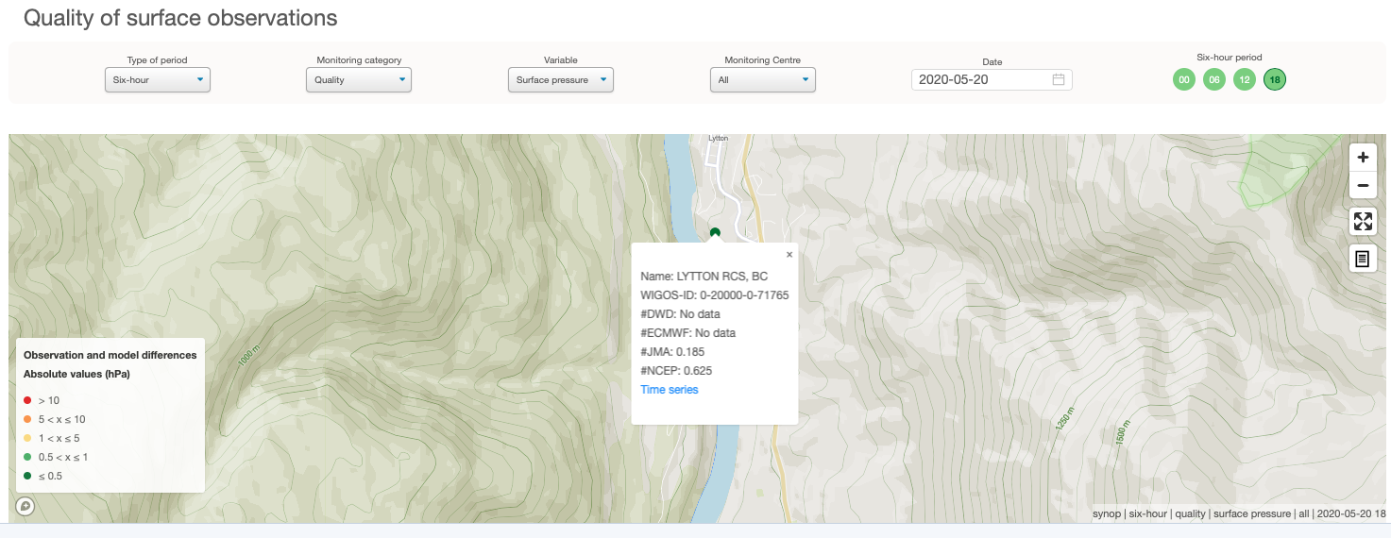
WDQMS: Differences in NWP monitoring reports
Orography (linked to model resolution)
LYTTON RCS, BC (Canada)
Station situated in a steep valley, although the station height is only 220m.
Model resolution is not high enough to represent the station properly in the valley.
DWD model height: 1300 m. ECMWF model height: 1090.5 m.

Slide 11
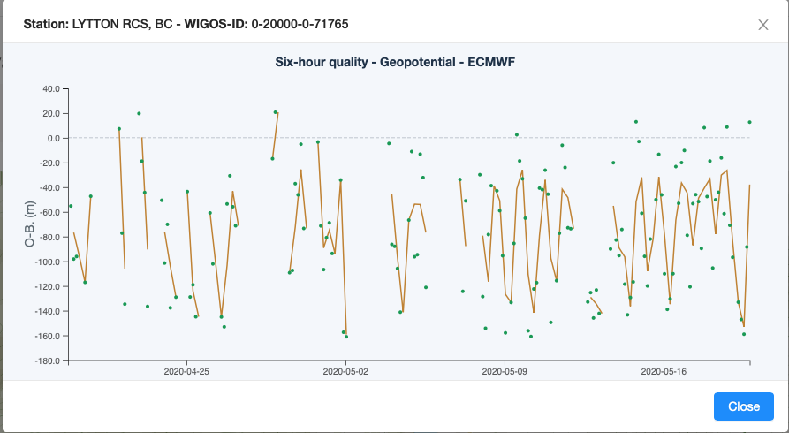
WDQMS: Differences in NWP monitoring reports
Orography (linked to model resolution)
LYTTON RCS, BC (Canada)

Slide 12
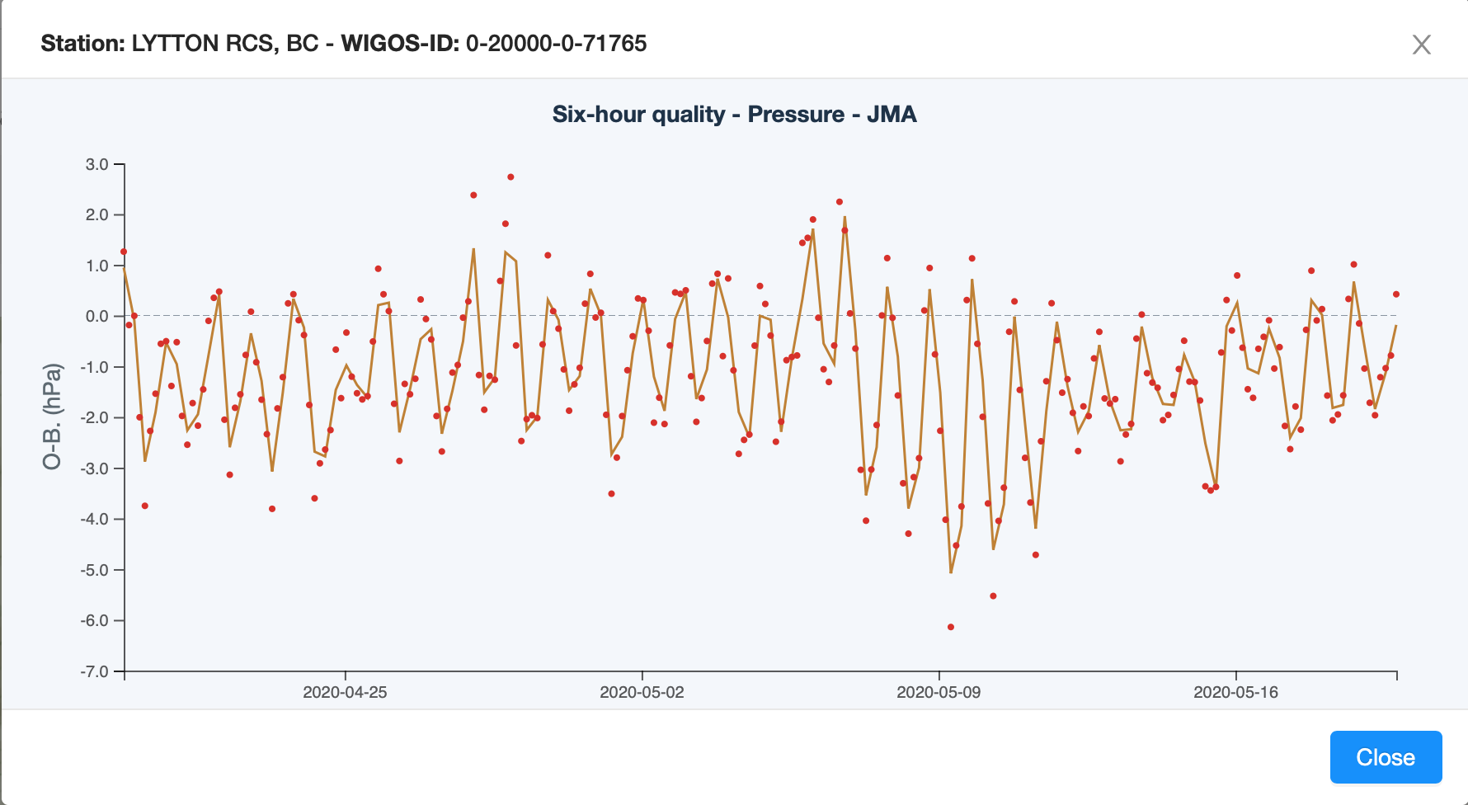
WDQMS: Differences in NWP monitoring reports
Orography (linked to model resolution)
LYTTON RCS, BC (Canada)

Slide 13
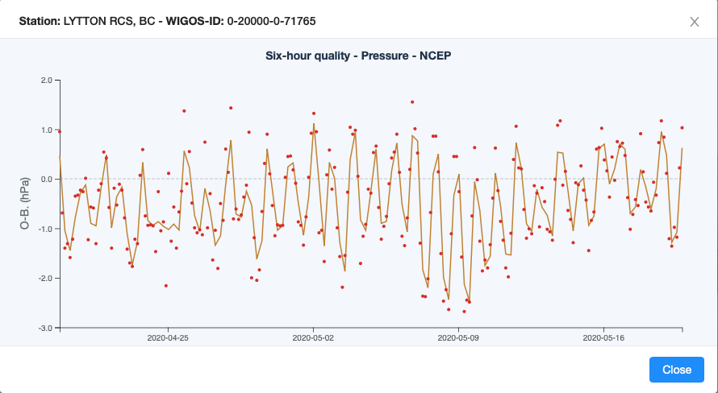
WDQMS: Differences in NWP monitoring reports
Orography (linked to model resolution)
LYTTON RCS, BC (Canada)

Slide 14
References:
Hollingsworth, A., Shaw, D., Lönnberg, P., Illari, L., Arpe, K., & Simmons, J. (1986). Monitoring of observation and analysis quality by a data assimilation system. Amer. Meteor. Soc., 114, 861-879.
Kalnay, E. (2003). Atmospheric modelling, data assimilation and predictability. Cambridge University Press.
Thank You for listening!
Questions?

