Slide 1
GCRF African SWIFT - Science for Weather Information and Forecasting Techniques
Project Aims
Significant improvements in weather forecasts in Africa, and the tropics, from hourly to seasonal timescales.
Build capability among UK and African partners to improve, maintain and evaluate operational tropical forecasts in future.
Develop African capacity for sustained training of forecasters.
WP-R1 - Users & Communication
WP-R2 - Forecast Evaluation
WP-R3 - Satellite Remote Sensing
WP-R4 - Nowcasting
WP-R5 - Synoptic Methods
WP-R6 - Sub-seasonal to Seasonal Prediction
WP-R7 - Convection-Permitting Ensemble Forecasts
Effective use of forecasts to benefit African people and nations
User engagement and forecast evaluation
Physical science research
Knowledge exchange, training & documentation
WP-C1 - Operational Training & University Programmes
WP-C2 - Weather Forecast Testbeds
WP-M1 - Management
WP-M2 - Legacy
https://africanswift.org/
https://africanswift.org/

Slide 2
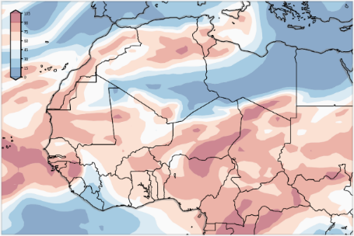
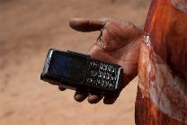
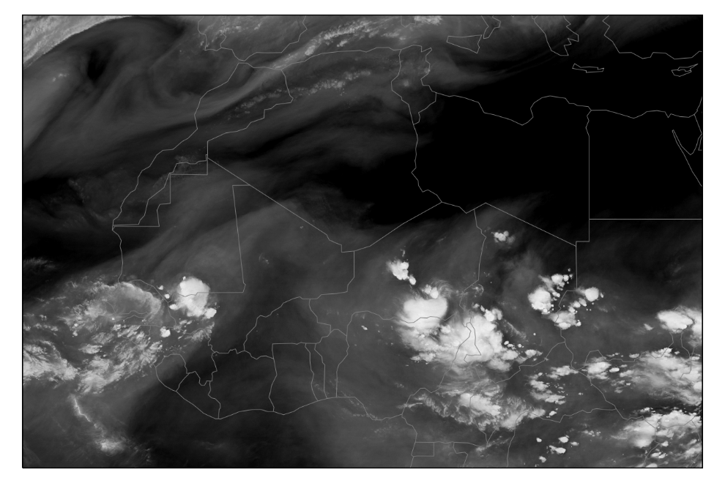
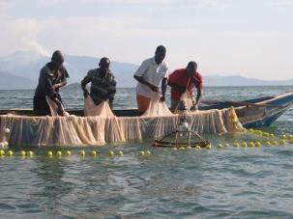
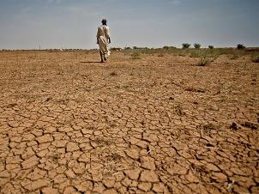
GCRF African SWIFT - Science for Weather Information and Forecasting Techniques
SMS alerts
Fisherman
Farmers
Addressing Poverty, Hunger, Health, Economic development, Climate resilience …
Hourly (nowcasting) to seasonal forecast timescales
£7.8 million of funding over 4 years 2017-2021 (sponsored by Global Challenges Research Fund)
Focus countries: Senegal, Ghana, Nigeria, Kenya
10 African partners (ANACIM and UCAD, GMet and KNUST, NIMET and FUTA, UoN and KMD, ICPAC and ACMAD).
5 UK partners (UoL, UoR, NCAS, CEH and UKMO) plus WMO.
Funds 12 scientists (postdocs) in Leeds and Reading and 4 in Africa.
Funds 2 Research Scientists and the Programme Science Director in ACMAD.
https://africanswift.org/
https://africanswift.org/

Slide 3
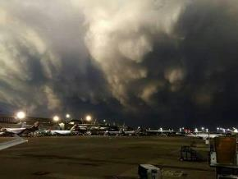
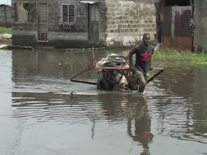
GCRF African SWIFT - Science for Weather Information and Forecasting Techniques
Improved weather info and hazard warnings from hours to a season, reaching into many sectors of society and addressing the SDGs by addressing Poverty, Hunger, Health, Economic development, Climate resilience…
Public
Farmers
Fisherman
SMS alerts
Aviation
Training (WP – C1) is Led by the PSD with Lead Scientist (Doug Parker) and SWIFT was involved in:
Teaching and training at WMO Severe Weather Forecast Demonstration Project (SWFDP) for W/A (Togo-2018);
Organized and sponsored Summer School on Tropical Meteorology of West and East Africa (Kumasi-2019);
Organized and sponsored Training Workshop in using NWCSAF (Kumasi-2019);
Organized and sponsored Forecasting Testbed on Nowcasting, Synoptic and Forecast Evaluation (Kenya-2019);
Organized and sponsored operational forecasting Testbed on Sub-seasonal to Seasonal Forecast (Kenya-2019);
With SAWIDRA organize Forecast Demonstration Exercise at ACMAD with EAMAC and ECAS (2019);
Preparing Forecasters Handbook for East Africa.
https://africanswift.org/

