Slide 1
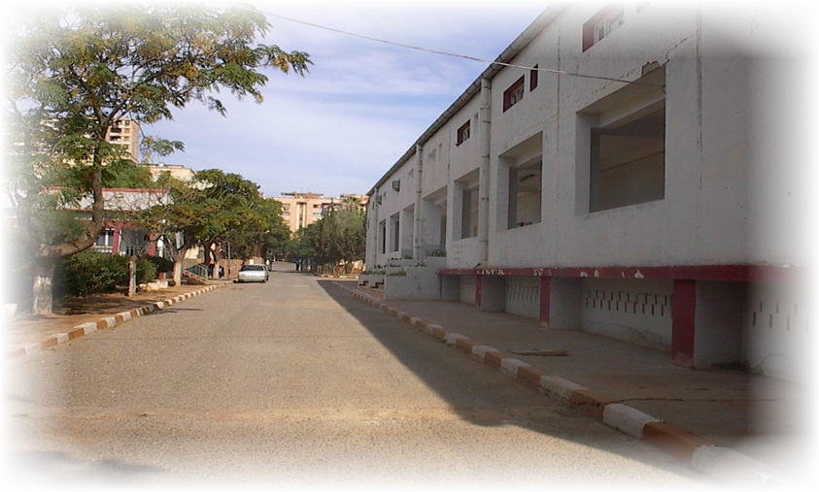
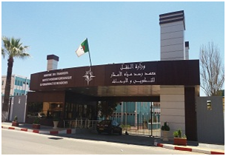
MINISTERE DES TRAVAUX PUBLICS ET DES TRANSPORTS
Hydrometeorological Institute of Training and Research (IHFR) Oran-Algeria
Presented by:
Mr TABET AOUL Mohammed
Responsible for pedagogical affairs
Caire Octobre 2019

Slide 2
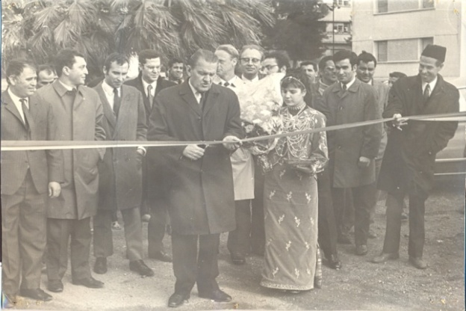
1970
Creation to train meteorological personnel of different levels and to ensure specialization and qualification in meteorology.
1973
Approved as a Regional Meteorological Training Center of the World Meteorological Organization (WMO) and as such, it is responsible for training meteorologists in African countries.
1989
Erected in National Institute of Higher Education, under administrative supervision of the Ministry of Transport and under the supervision of the Ministry of Higher Education.
HISTORY
Hydrometeorological Institute of Training and Research
2
21
150

Slide 3
Hydrometeorological Institute of Training and Research
Under the administrative supervision of the Ministry of Public Works and Transport
Under the pedagogical supervision of the Ministry of Higher Education and Scientific Research
CRegional Centre for Professional Training in Meteorology (CRFPM) of the World Meteorological Organization (WMO)
Notes:
Agréé comme Centre Régional de Formation Professionnelle en Météorologie (CRFPM) de l'Organisation Météorologique Mondiale (OMM), A ce titre, il a la charge de former les météorologistes pour les pays Africains.

Slide 4
missions
1
Provide initial training in meteorology
2
Provide improvement and recycling in meteorology.
Hydrometeorological Institute of
Training and Research
3
Provide specialization courses.
4
Promote research and development in meteorology.
2
27

Slide 5
ORGANIZATION & STRUCTURE
OF THE IHFR
General management
S / Directorate of Administration and Finance
Service staff
Accounting department
S / Direction of Pedagogical Affairs
Education, internship and continuing education
Physics and dynamics of the atmosphere
Measuring instruments
HydrométéorologY
Climatology & data processing
GénéraL options
Hydrometeorological Institute of
Training and Research
4
27

Slide 6
INFRASTRUCTURE
AND CAPACITY
A computer center
Broadband Internet Connection Network
A field of meteorological experimentation
A library (about 6600 titles for 17710 books)
13 classrooms rooms TP & courses for Weather OBS, Weather instruments,
5 Laboratories
Two amphitheatres
A conference room
A micro computer room
a pedagogic block (R+1)
The Hydrometeorological Training and Research Institute (LH.F.R.) is located on an area of ​​about 17 hectares east of Oran and also houses the regional offices of the National Office of Meteorology..
INFRASTRUCTURE
AND CAPACITY
4
27

Slide 7
HOME STRUCTURE
A restaurant
A boarding school
A block of 21 studios
Two block of 148 bedrooms
INFRASTRUCTURE
AND CAPACITY
4
27

Slide 8
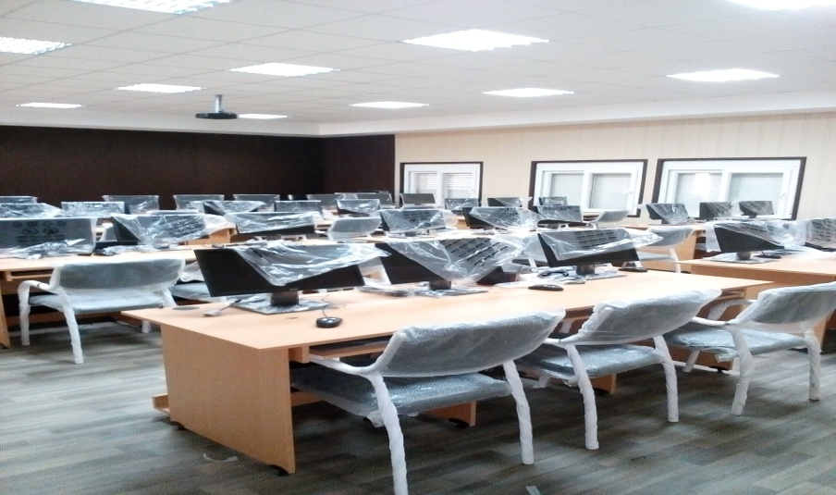
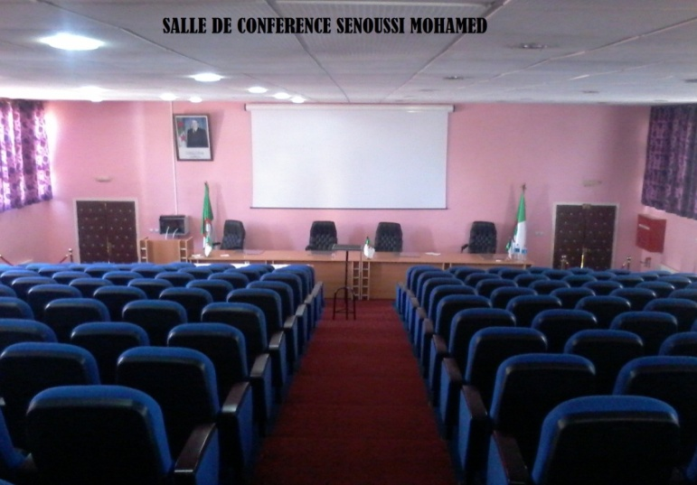
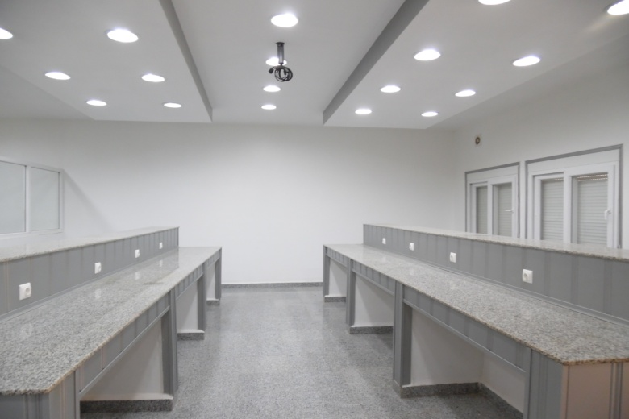
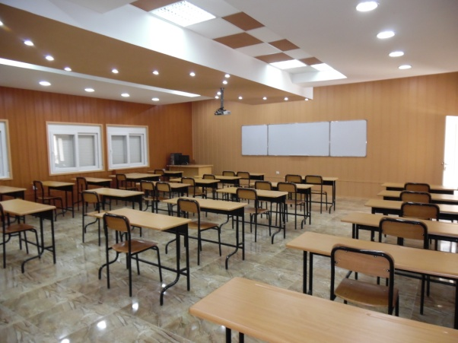
Microinformatic Room
Conference room
INFRASTRUCTURE
AND CAPACITY
Eléctronics laboratory
Classrooms
4
27

Slide 9
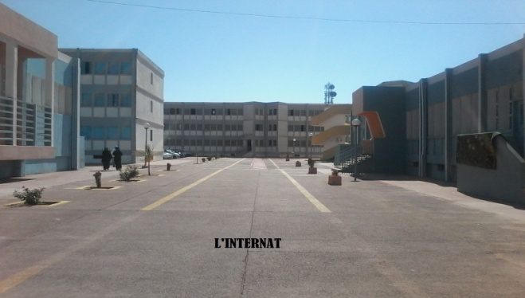
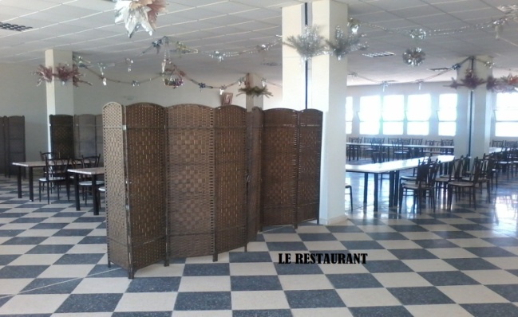
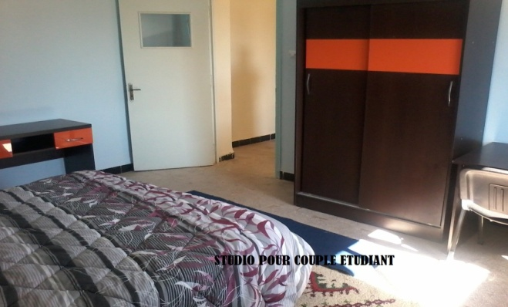
CAPACITY BUILDING HOME
New residence composed of: Two R + 2 buildings totaling 148 rooms (capacity of 296 beds)
A R + 2 building of 21 studios
A university restaurant for 300 meals
A cafeteria
A room for reception
A prayer room
Aprayer room
INFRASTRUCTURE
and CAPACITY
4
27

Slide 10
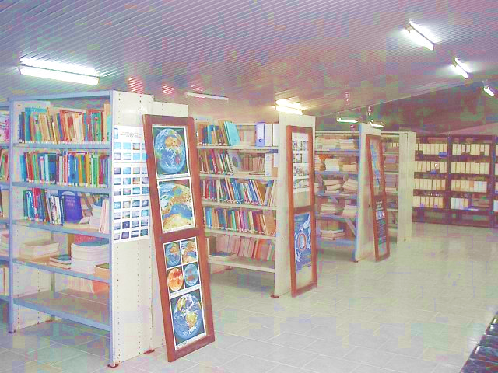
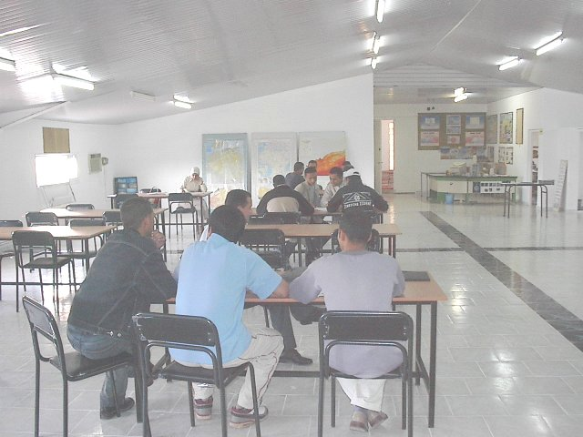
STRENGTHENING EDUCATIONAL STRUCTURES
LIBRARY (Area: 1000 m2)
Services :
Registration and home loans reserved for the staff of the weather complex (students and teachers).
Free and free documentary consultation for registrants. Free on-site consultation for non-registered.
Desk research done on request to service staff.
INFRASTRUCTURE
AND CAPACITY
4
27

Slide 11
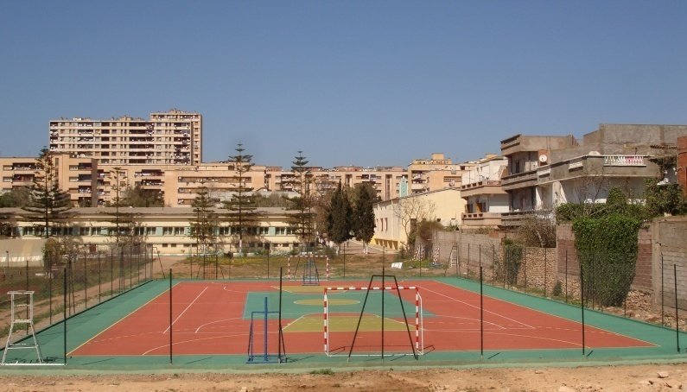
STRENGTHENING SPORTS STRUCTURES
INFRASTRUCTURE
AND CAPACITY
Multisports ground
4
27

Slide 12
S / DIRECTION OF PEDAGOGICAL AFFAIRS
Department of Education, Internships and Continuing Education
Department of Physics and Atmospheric Dynamics
Department of Climatology and Data Processing
Department of hydrometeorology
Department of instruments
S/DIRECTION OF
PÉDAGOGICAL AFFAIRS
4
27

Slide 13
TRAINING & CONDITIONS REGISTRATION
Duration: 5 years
Entry level: BAC scientific, mathematical or technical series
Duration: 2 years 1/2
Entry Level: BAC series Natural Sciences or Maths
Engineer
of State
Technician
Superior
S/DIRECTION OF
PÉDAGOGICAL AFFAIRS
4
27

Slide 14
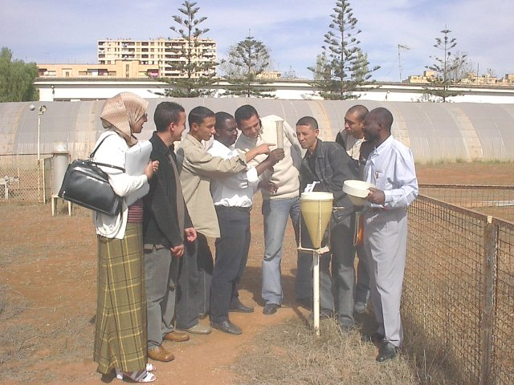
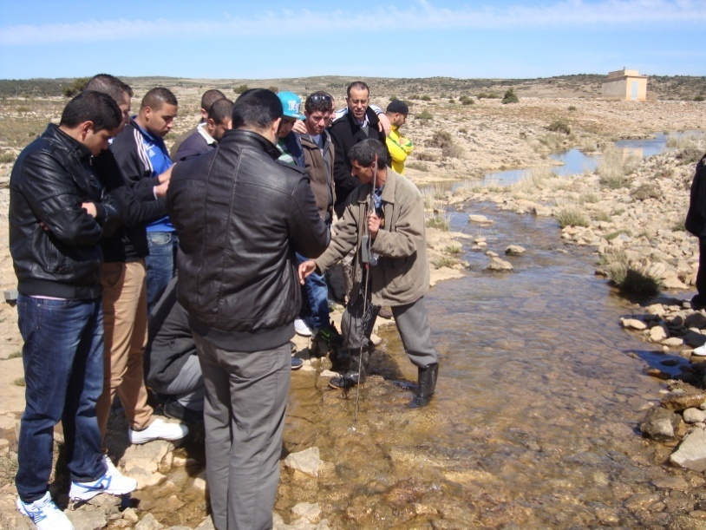
SPECIALIZATION COURSES
Digitalforecasting
Climatology
Climate change
Hydrology
Tropical meteorology
agrometeorology
Bioclimatology
Instrumentation
NTERNSHIPS & RESEARCH
4
27

Slide 15
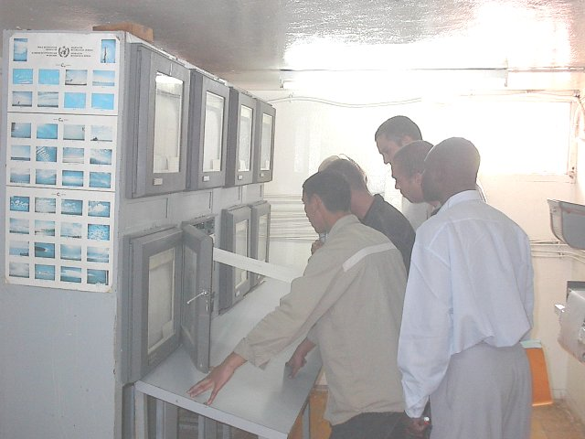
QUALIFICATION COURSES
The I.H.F.R. issues Qualification Certificates (OMM Standard) for:
Meteorological observation in Surface and Altitude
Observation Agro Meteorological
Weather forecast
Climatology
Meteorological Instrumentation
INTERNSHIPS & RESEARCH
4
27

Slide 16
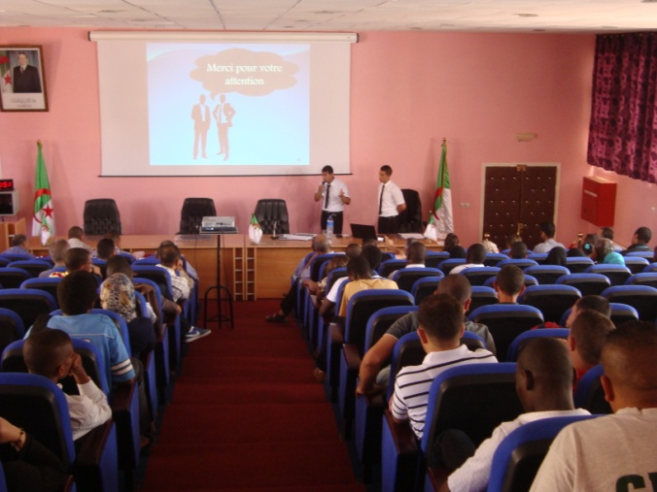
RESEARCH
In the field of research, the IHFR undertakes studies and works of national and regional interest relating to::
Digital forecasting
Climatology - Climate Change
Hydrology
Tropical meteorology
agrometeorology
bioclimatology
Instrumentation
This work is supported by the teaching staff and students of I.H.F.R. in collaboration with Meteorological Services and Universities.
INTERNSHIPS & RESEARCH
4
27

Slide 17
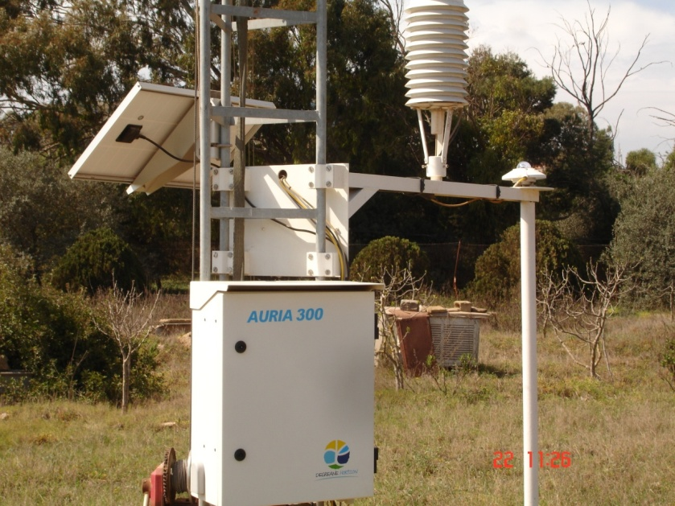
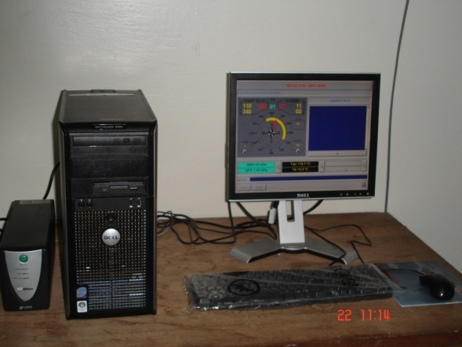
STRENGTHENING EDUCATIONAL STRUCTURES
Automatic weather station
The IHFR has strengthened its surface measurement system by acquiring in 2010 two automatic weather stations, powered by solar panels, each equipped with a 10 m air pylon.
Measured parameters:
Solar radiation
Air temperature
Humidity of the air
Strength and direction of the wind
rainfall
Wet time
EQUIPMENTS MIS
IN PLACE
4
27

Slide 18
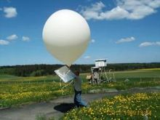
altitude observation station
STRENGTHENING EDUCATIONAL STRUCTURES
In 2010, the IHFR set up an observation station at altitude.
Measured parameters:
Atmospheric pressure (GPS system)
Air temperature
Humidity of the air
Strength and direction of the wind
EQUIPMENTS MISE
IN PLACE IN IHFR
Continuous reception of a new R + 1 structure adjoining the instrument park to make it an observation station at the surface and at altitude.
4
27

Slide 19
Computer Center Equipments
Staff computing center
03 positions: i7; 1T disk, 2Gb graphics card, 16Gb ram, inverter, 21 '' screen
03 positions for trainee: 2030, 500 Gb disc, ram 4Gb
01position, 9th generation HP server
EQUIPMENTS MIS
IN PLACE
4
27

Slide 20
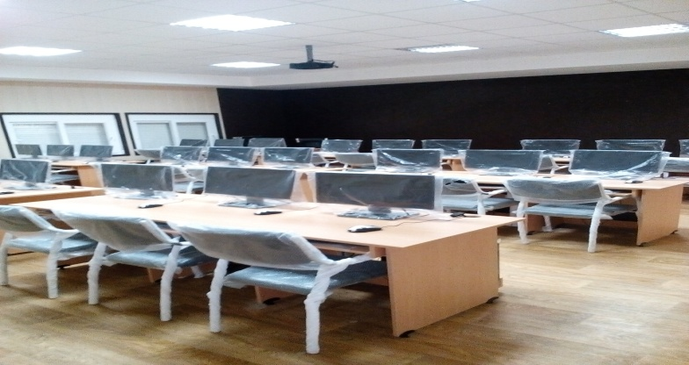
Computer Center Equipments
Computer room-2:37 postes
Computer room-1:28 postes
01 teaching position: i7; 1T disk, 2Gb graphics card, 16Gb ram, inverter, 21 '' screen
36 stations: i5, 500 Gb disk, ram 8Gb, inverter, 19 '‘
screen Datashow HD
Motorized projection screen
01 teaching position: i7; 1T disk, 2Gb graphics card, 16Gb ram, inverter, 21 '' screen
27 stations: i5, 500 Gb disk, ram 8Gb, inverter, 19 '‘
screen Datashow HD
Motorized projection screen
EQUIPMENTS MIS
IN PLACE
4
27

Slide 21
Computer Center Equipments
The Digital Prediction Center
Teacher (01 positions) :
i7; 1T disk, 2Gb graphics card, 16Gb ram, inverter, 21 ''
screen Hp A1 plotter printer
Datashow HD
Motorized projection screen
Interns (16 positions)
i5, 500Gb disk, ram 8Gb, 2Gb graphics card, inverter, 19 '' screen
EQUIPMENTS MIS
IN PLACE
4
27

Slide 22
Technical staff ensuring teaching tasks
22
HUMAN RESSOURCES
27
27

Slide 23
Staff ensuring administrative tasks
18
HUMAN RESSOURCES
27
27

Slide 24
Support staff
33
HUMAN RESSOURCES
27
27

Slide 25
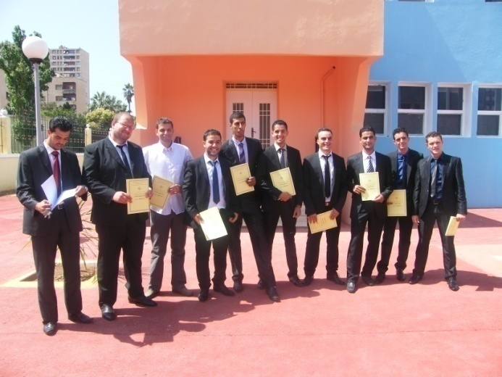
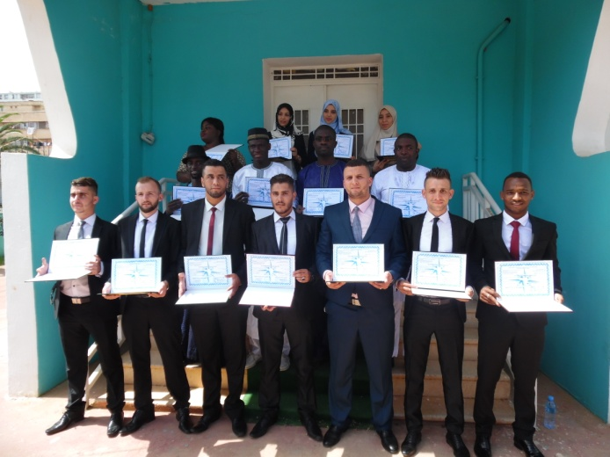
TRAINING REPORT
2005-2017
TRAINING REPORT 2005-2017
10
27

Slide 26
Graduate international students State Engineer of Meteorology 2005-2017
2005-2017
35
TRAINING REPORT
2005-2017
32
03
10
27

Slide 27
Foreign Students Graduate Technician Higher than Meteorology Period 2005-2017
32
TRAINING REPORT
2005-2017
21
11
10
27

Slide 28
Foreign students State Engineer & Senior Technician Graduates and schoolchildren
123
TRAINING REPORT
2005-2017
99
24
10
27

Slide 29
Graduate Algerian students State Engineer & Senior Technician
2012-2017
243
TRAINING REPORT
2005-2017
10
27

Slide 30
Distribution of graduates Algerians & Foreigners by sex
TRAINING REPORT
2012-2017
27
27

Slide 31
Specialization courses in Weather Observation
2005-2017
TRAINING REPORT 2005-2017
27
27

Slide 32
Continuing Education
For the benefit of the National Office of Meteorology (ONM)
TRAINING REPORT
2005-2017
27
27

Slide 33
Continuing Education
For the benefit of the National Agency for Hydraulic Resources (ANRH)
TRAINING REPORT
2005-2017
In favor of Côte d'Ivoire's meteorological service
27
27

Slide 34
Continuing Education
For the benefit of the National School of Sciences of the Sea and
the development of the Littoral.
TRAINING REPORT
2005-2017
27
27

Slide 35
LES ATOUTS
Long experience in the field of diploma training
The facilities of the IHFR are of the highest quality and have benefited from a comprehensive renovation plan. They offer students excellent working conditions and accommodation.
The programs meet all the requirements for the "meteorologist" and "meteorological technician" categories in accordance with the "Manual on the Implementation of Meteorological and Hydrological Education and Training Standards", WMO.No-1083.
Exceptional support from the Algerian Government in terms of scholarships for foreign students
ASSETS
27
27

Slide 36
Exchange on matters of common interest;
Use the expertise and advice of either party to respond to a need or to resolve a problem that is not necessarily common to the parties;
A first concrete action is the creation of an online training of "meteorologist", in line with the WMO-IPB, associating all our institutions, dividing the roles between us, and open to the entire French-speaking community (DIDIER Reboux , KONE Diakaria, ABANE Hakim Geneva 2018)
TRACKS
27
27

Slide 37
WE
YOU
THANK
OF
YOUR
ATTENTION

