Slide 1
WMO Leadership and Management Programme for Senior Management Of NMHSs In RA-II & RA-V 26-30 Aug 2019, Singapore Managing Financial Resources
By
Group 3: Bangladesh, Cook Island,
Nepal and Pakistan

Slide 2
Seq
Organization structure
Observational Network
Management of Financial resources
Purpose of the budget
Benefits of the budget
Effective financial management
PMD’s budget case
Issues and challenges
Recommendations

Slide 3
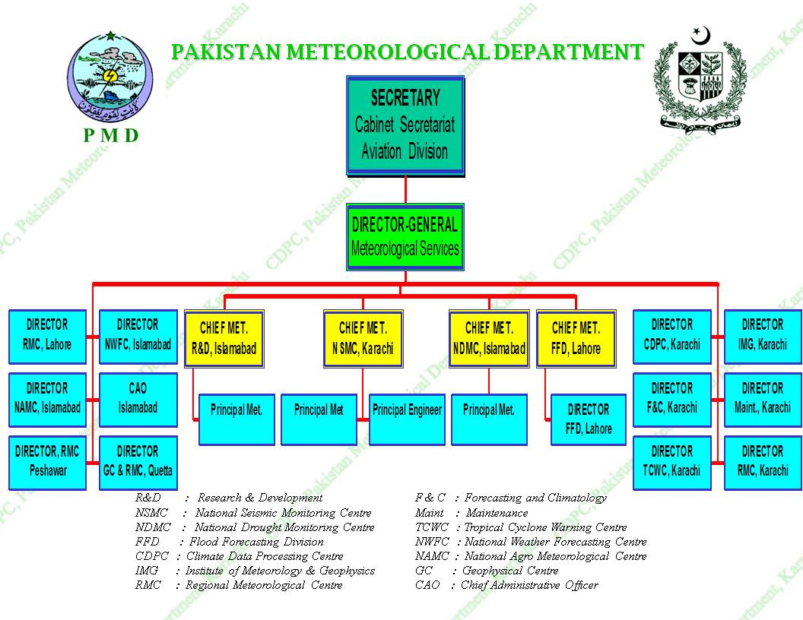
Organizational Structure

Slide 4
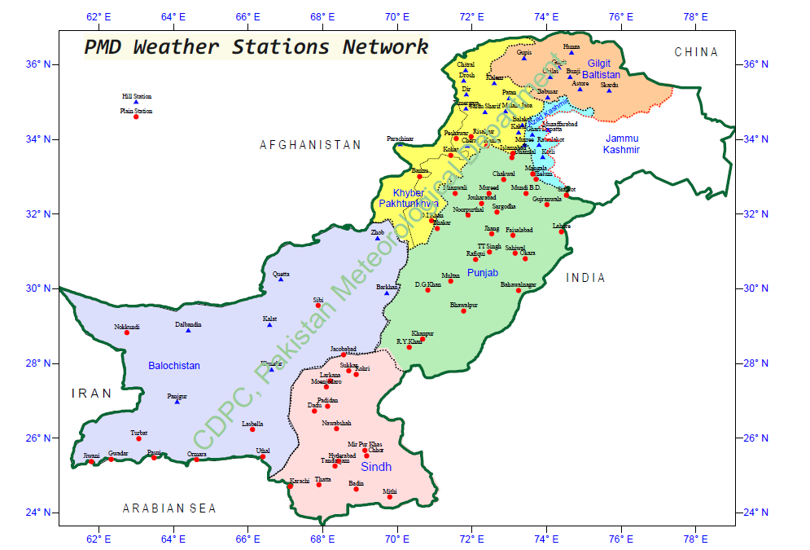
Observing Stations = 105
Regional Centers = 5

Slide 5
Services Offered
Aviation (24 sites certified as per ISO 9001:2015)
Agromet
Drought monitoring and EW
Flood forecasting
Public weather forecasting
Marine weather service (for Metarea-IX)
GLOF monitoring and EW
Seismic monitoring and Tsunami EW

Slide 6
Managing Financial Resources of NMHS
A financial management of NMHS requires:
a planning and management of financial resources,
the allocation and spending of funds on operations of NMHSs,
accountability and reporting.

Slide 7
Purpose of Budgets
Meets the organization objectives,
Coordinates activities amongst the different sections of the organization,
Motivates managers,
Evaluates and improves performance,
Budget information helps managers and employees understand the organization objectives,
Allocation of resources must be aligned with the strategic objectives of the organization,
It also identifies the scarce resources .

Slide 8
Benefits of Financial Management
Financial management helps NMHSs to:
Make effective and efficient use of resources;
Achieve the organizational objectives;
Provide information to support decision-making;
Become accountable to Govt/funding agencies and gain their respect and confidence; and
Prepare for long-term financial sustainability.

Slide 9
Effective Financial Management
Budget preparation keeping organization objectives.
Smart allocation of funds to different sections so as the setout objectives are easily met.
Managing a budget is generally considered as an unwelcome task.
But being an important management task it requires an appropriate allocation of time.
Should be treated as part of the overall management of resources and activities of NHMS.
Should be regularly monitored and accounts kept audit-ready at any time.

Slide 10
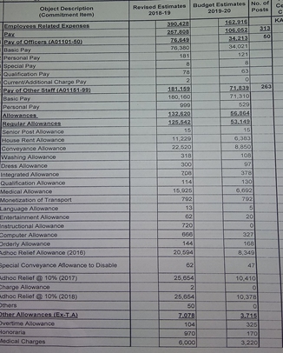
PMD-Karachi Office Budget Allocation 2019-20
Budget Item | Amount allocated (Million PKR)
Employees cost | 162.9
Operating expenses (communication, utilities, staff travel etc) | 3.05
Physical assets (Furniture, computers HW & SW/IT, machinery etc | 13.23

Slide 11
PSDP Projects, 2019-20
Project Title | Cost (Million PKR)
Establishment of Specialized Medium Range Weather Forecasting Center (SMRFC) and Strengthening of Weather Forecasting system in the Islamic Republic of Pakistan | 23.532
Installation of Weather Surveillance Radar at Karachi in the Islamic Republic of Pakistan | 160.000
Installation of Weather Surveillance Radar at Multan in the Islamic Republic of Pakistan | 50.000
Reverse Linkage Project Between Pakistan Meteorological Department and Marmara Research Centre (MRC), Turkey (IDB) | 40.000
Total | 273.532

Slide 12
Issues and Challenges
Lack of finances/scarcity of appropriate funds to keep up pace with changing technology.
Lacking strategic foresight and planning.
Climate change-induced increase in weather extremes and Hydro-Met disasters has put extra burden on already limited budgets of NMHSs.
Ever increasing public and end-user’s demand of more precise, site-specific and flawless weather forecasts/advisories/EW.
Impact-based quantitative forecasts to be handily helpful to disaster response agencies.
So, competence and innovation in financial management has become a dire need now.

Slide 13
Issues and Challenges - Capacity
Technology | Existing | Deficiency
Meteorological Data Observatories AWS Wind Profilers | 97 Districts 45 NIL | 40 Districts 400 8
Hydrological Data Radars River Gauges (Telemetric) | 7 (65% Area Coverage) NIL | 13 50
Dissemination/Awareness SMS/Cell Broadcast FM Radio | SMS (Limited) | Cell Broadcast FM Radio
Research/Monitoring MRU/CRU | Limited Research | MRU/CRU

Slide 14
Issues and Challenges - Capacity
Technology | Deficiency | Near future plan
Meteorological Data Observatories AWS Wind Profilers | 40 Districts 400 8 | 10 Districts 100 08
Hydrological Data Radars River Gauges (Telemetric) | 13 50 | 3 (Khi, Sukkur Multan) 10
Dissemination/Awareness SMS/Cell Broadcast FM Radio | Cell Broadcast FM Radio | Cell Broadcast 01
Research/Monitoring MRU/CRU | MRU/CRU | 01

Slide 15
Summary and Recommendations
Limited budgetary resources should be enhanced adequately.
Raise the competency and innovation of financial managers.
Adopt the latest technology to cope with the emerging challenges.
Govts should be convinced for increasing budgets with realization of socio-economic benefits the NMHSs earn through their services.
NMHSs may think of raising their income through cost recovery from the users.

Slide 16
Thank You !

