Slide 1
The WMO Integrated Global Observing System;
Status of pre-operational phase, plans for transition to operational phase;
(presentation originally developed for Congress-18 to introduce draft resolution 6.1(1)/4))
Lars Peter Riishojgaard
WMO Secretariat

Slide 2
The WIGOS Pre-Operational Phase (2016-2019) decided by Cg-17 in 2015
Increased emphasis on regional and national activities
Five main priority areas:
WIGOS Regulatory Material, supplemented with necessary guidance material;(already covered under draft resolution Cg-18 6.1(1)/3);
WIGOS Information Resource, including the Observing Systems Capabilities analysis and Review tool (OSCAR), especially OSCAR/Surface;
WIGOS Data Quality Monitoring System (WDQMS);
Regional Structure; Regional WIGOS Centers;
National WIGOS Implementation, coordination and governance mechanisms; undertaken by Members, supported by items I-IV

Slide 3
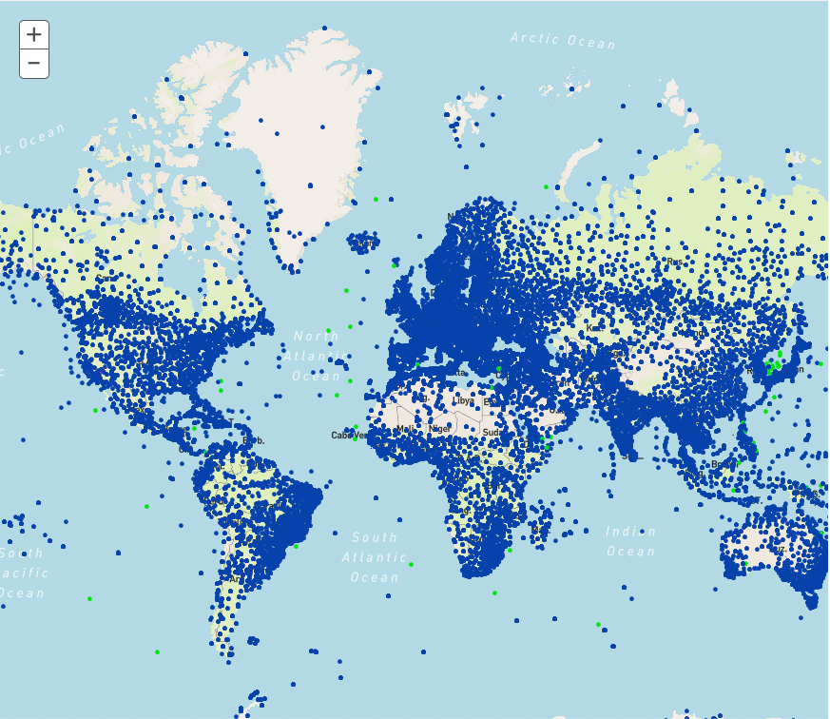
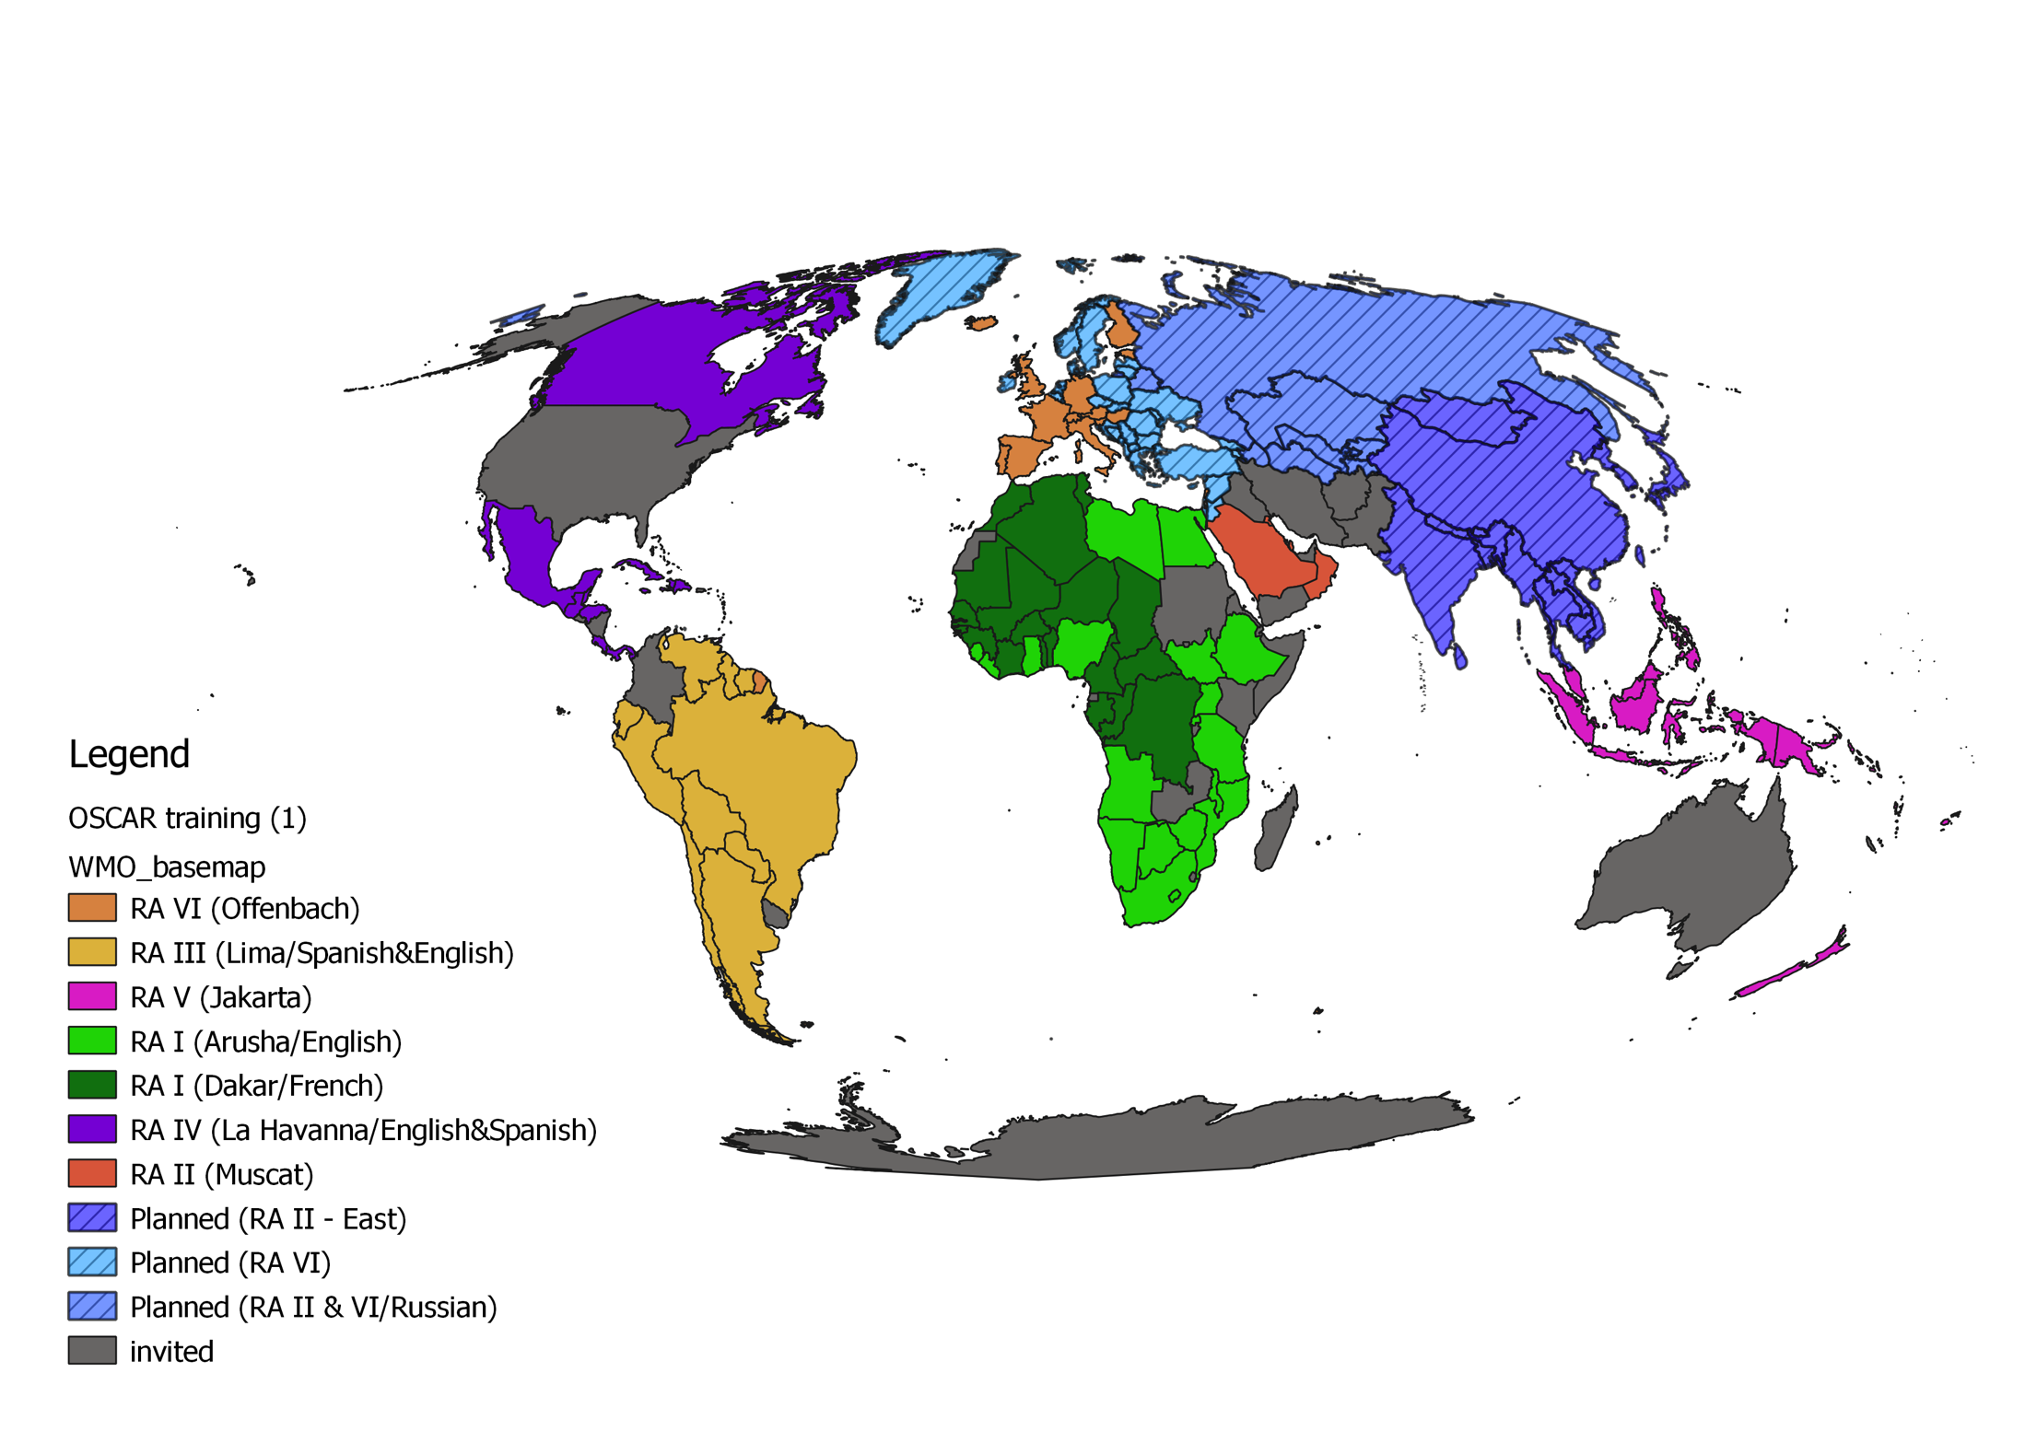
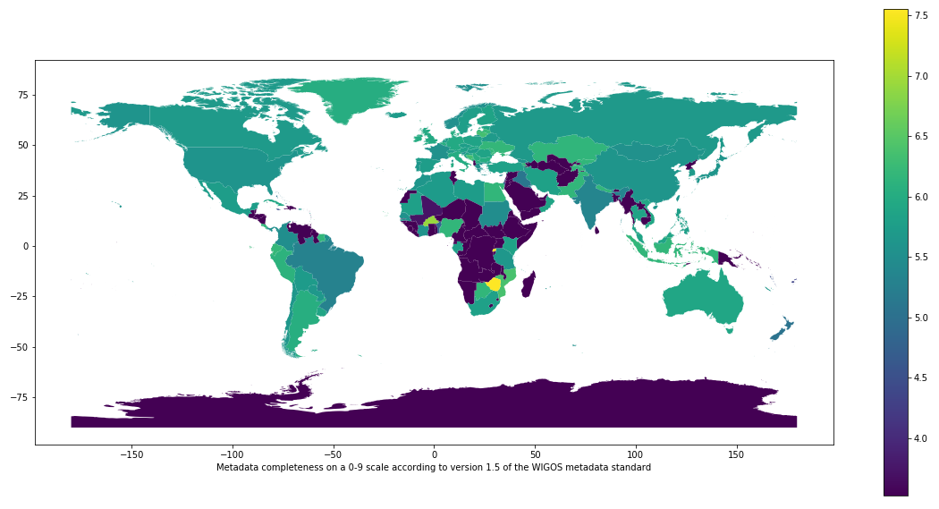
II. WIGOS Information Resource (Observing Systems Capabilities and Review, OSCAR)
Three operational databases supporting WIGOS:
OSCAR/Requirements, in which “technology free” requirements are provided for all WMO application areas;
OSCAR/Space, listing the capabilities of all satellite sensors;
OSCAR/Surface, list surface-based capabilities; developed by MeteoSwiss for WMO, operational since May 2016;
OSCAR homepage
WIGOS self portrait (OSCAR); stations operating on June 6 2019
OSCAR training delivered worldwide
OSCAR metadata completeness (lighter colors is better)

Slide 4
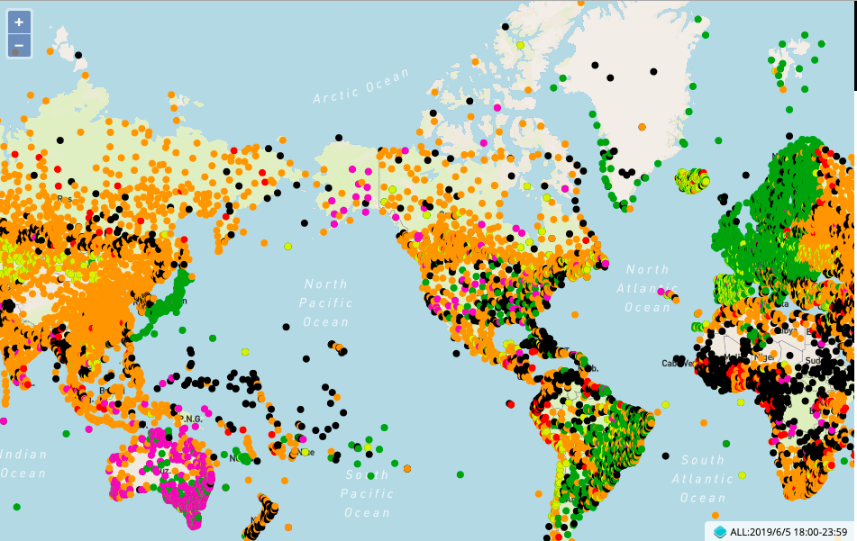
III. WIGOS Data Quality Monitoring System
Tool to measure how well WIGOS is functioning
Real-time monitoring of performance
data availability (implemented) and quality (in development),
searchable by region, country, station type, period, etc.
for all WIGOS components (GOS, GAW, WHOS, GCW, GCOS),
Incident management component for mitigation of issues
WDQMS data delivery; surface pressure observations exchanged internationally, June 5 2019, 18Z
Current status:
Pilot project on NWP-based monitoring: data from ECMWF, NCEP, DWD, JMA;
Data analysis and web display tool now being developed in pre-operational mode by ECMWF

Slide 5
IV. Regional WIGOS Centers (RWC)
What?
Critical support of national WIGOS Implementation especially for
OSCAR/Surface; input and updating of metadata, QC
WDQMS; monitoring and coordination of mitigation efforts
How?
To be decided by the WMO Regions – in alignment with existing cultural, linguistic and/or political groupings
The relatively slow pace of engagement of NMHSs in RWC development has been a risk factor for WIGOS!
Recent signs of progress have been encouraging
Region I: RWC pilot planned in East Africa (Kenya and Tanzania); South Africa has submitted proposal; interest from Morocco;
Region II : China and Japan have RA-II approved RWC pilots; national commitment from Saudi Arabia; interest from India and Russia;
Region III: Plans for Virtual RWC approved by RA-III-17 in November 2018;
Region IV: CMO has expressed interest; Canada, USA may help; to be discussed during Cg-18
Region V; Formal decision by RA-V-17 in October 2018 to request Australia and Singapore to submit RWC proposal; encouraging Fiji, Indonesia to join;
Region VI: successful RWC operating in pilot mode thanks to EUMETNET; tentative plan for RWCs also in Russia/Belarus and Croatia (specifically for marine observing systems). Interest also from Greece, Italy, Turkey.

Slide 6
V. National WIGOS Implementation
Almost all Members have had exposure to both the WIGOS concept and to the specifics of the WIGOS Technical Systems via dedicated WIGOS Workshops arranged by the WMO Secretariat in all Regions;
A majority of Members have had at least some level of activity in using the OSCAR/Surface database to manage their surface-based observing systems;
Assessment of national observing capabilities made for several Members;
A small number of countries have developed and approved their National WIGOS Implementation Plans;
The bulk of the national WIGOS implementation work is expected to take place once the Regional WIGOS Centres are fully functional and once National WIGOS Implementation Plans have been developed and approved.

Slide 7
Res. 6.1(1)/4: WIGOS is now mature enough to transition from project to operational status, as basic WMO infrastructure, with the following six priority areas:
National WIGOS implementation;
Implementation of the Global Basic Observing Network and the Regional Basic Observing Networks;
Operational deployment of the WIGOS Data Quality Monitoring System;
Operational deployment of Regional WIGOS Centres;
Further development of the Observing Systems Capability Analysis and Review (OSCAR) databases and integration with other system elements;
Fostering a culture of compliance with the WIGOS technical regulations.
Request Infrastructure Commission to develop a plan for these activities for the 2020-2023 period and submit to EC-72 for approval

Slide 8
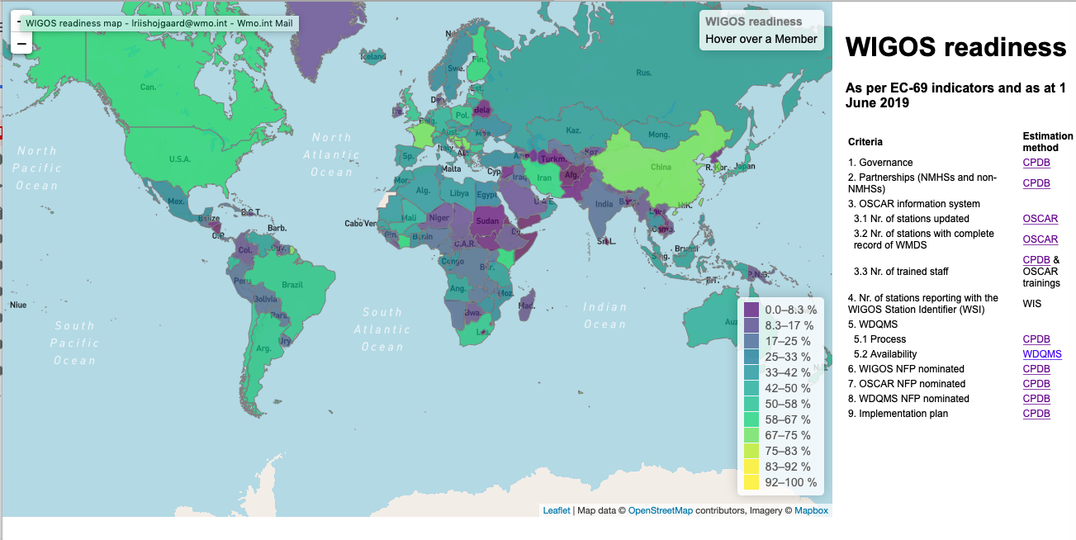
Fostering a culture of compliance Monitoring of WIGOS Implementation by country; 1st step

