Slide 1
The WMO Global Basic Observing Network (GBON)
Lars Peter Riishojgaard
WMO Secretariat, Geneva

Slide 2
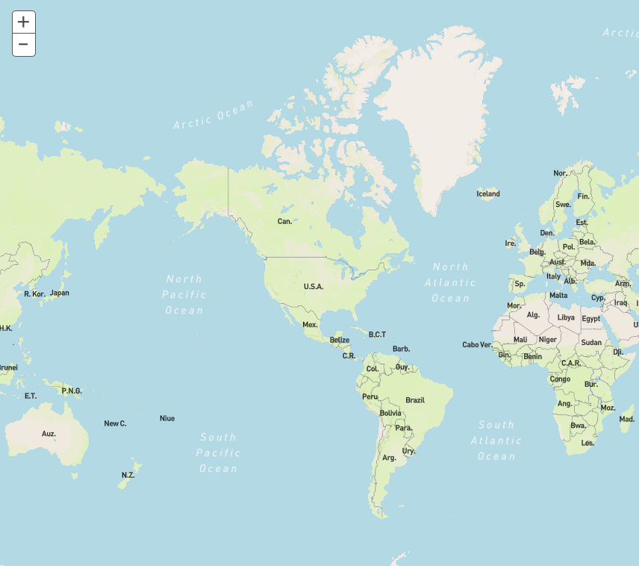
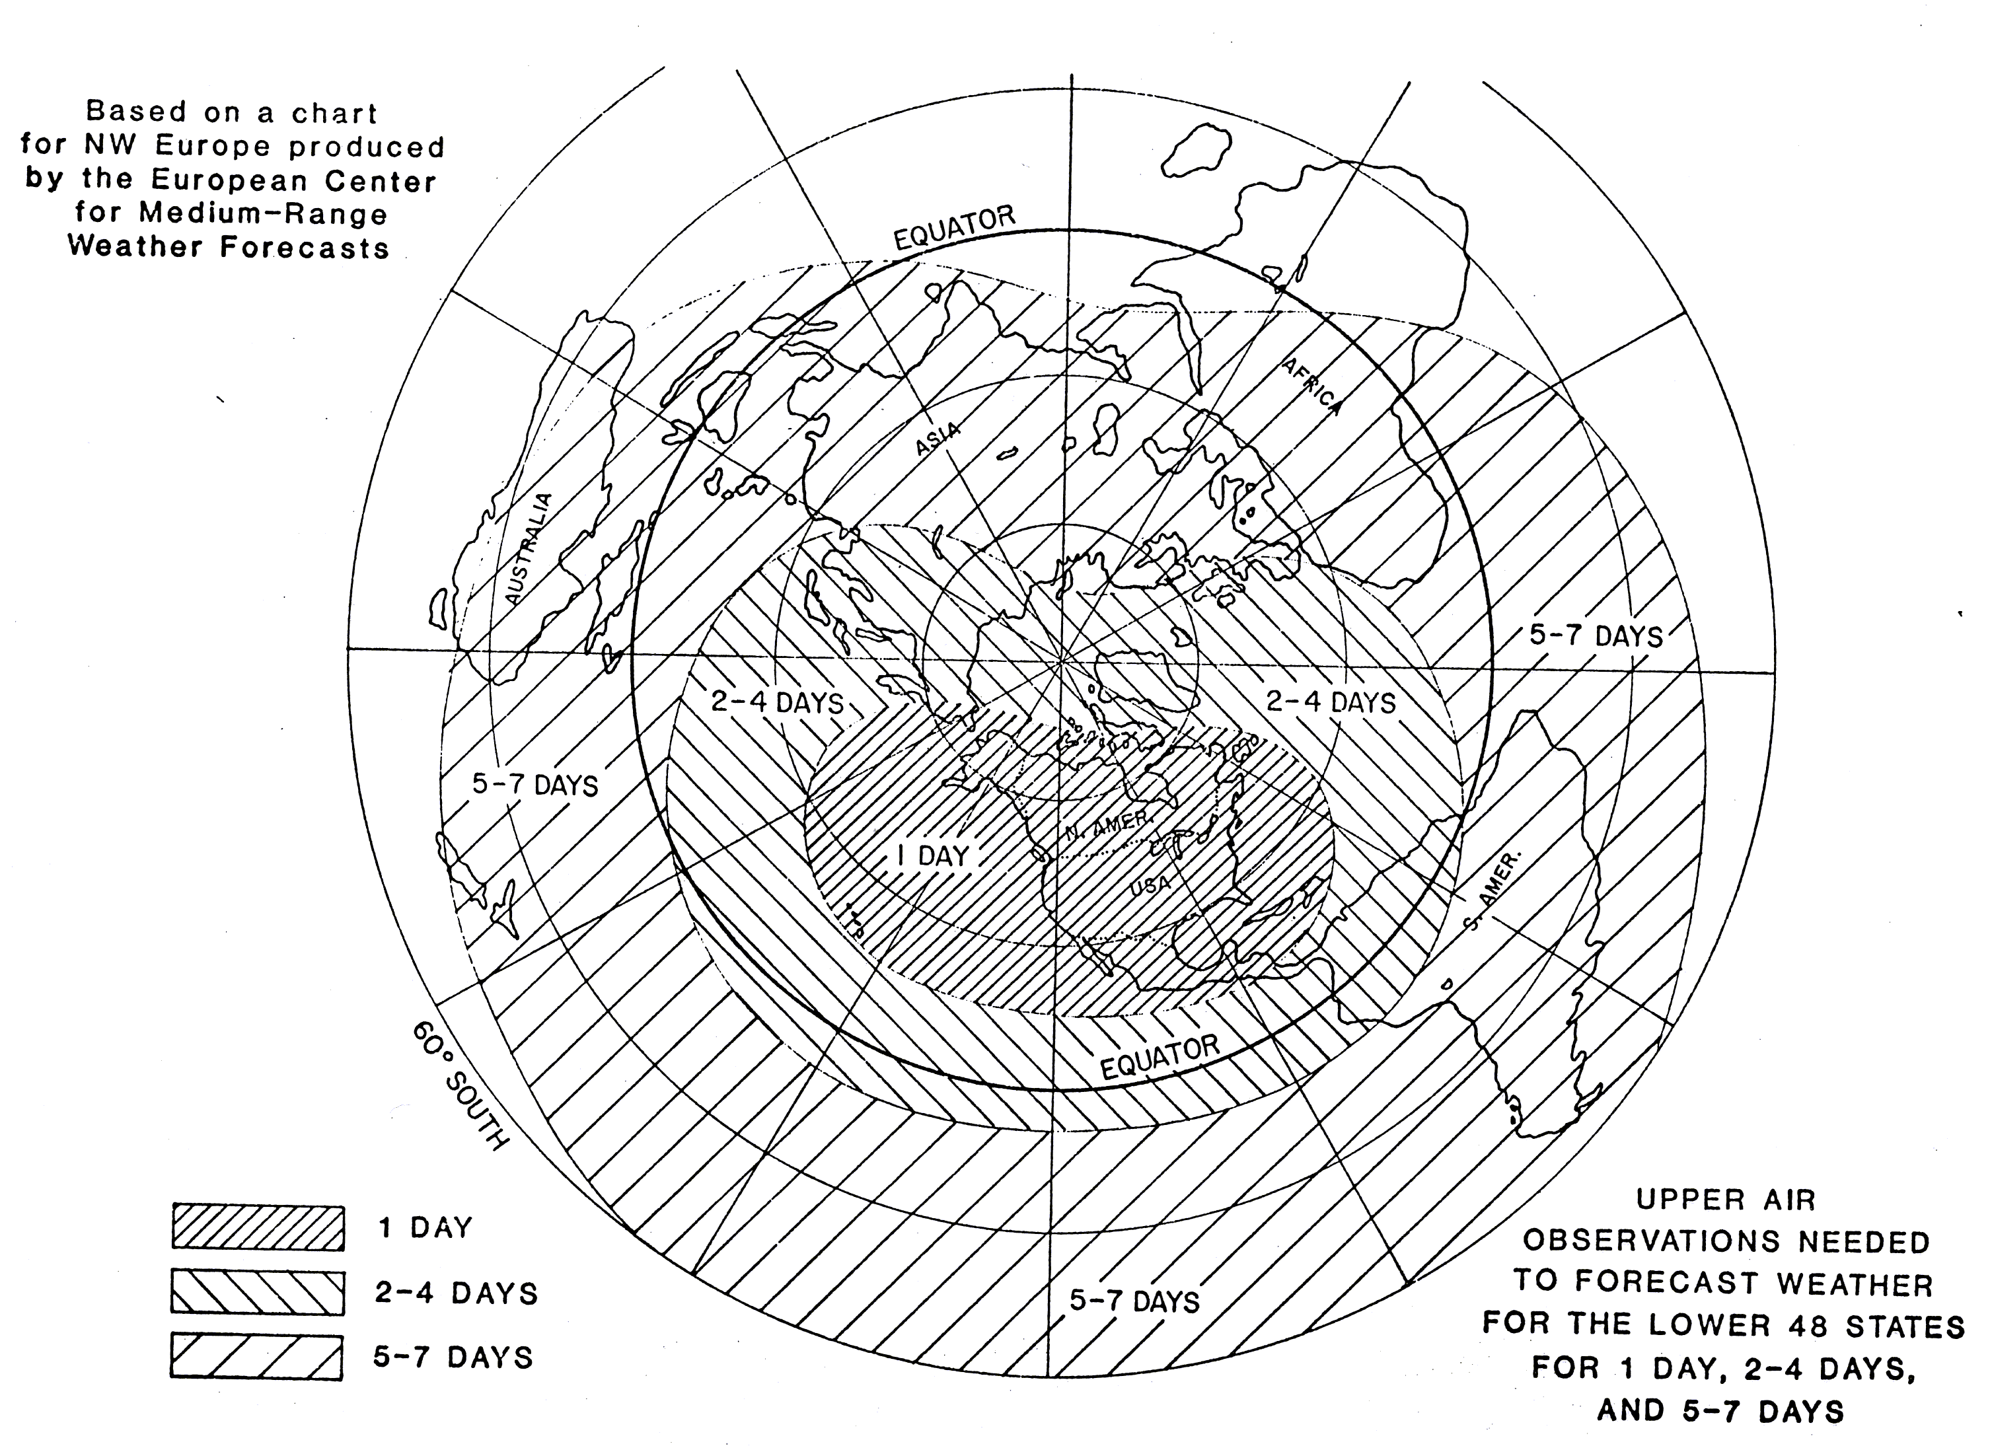
Problem statement: Why focus on observations?
Lack of observations severely limits efforts to understand and predict weather and climate patterns, both locally and globally;
Weather prediction beyond 3-4 days for any location requires observations from the whole world.
“Meteorology knows no boundaries”
“Corollary: In meteorology, ignorance knows no boundaries”
Example: Lack of observations in red area limits 7-10 day forecast skill in green area
1 day
Required coverage of observation for weather prediction over CONUS at various ranges.
2-4 days
5-7 days

Slide 3
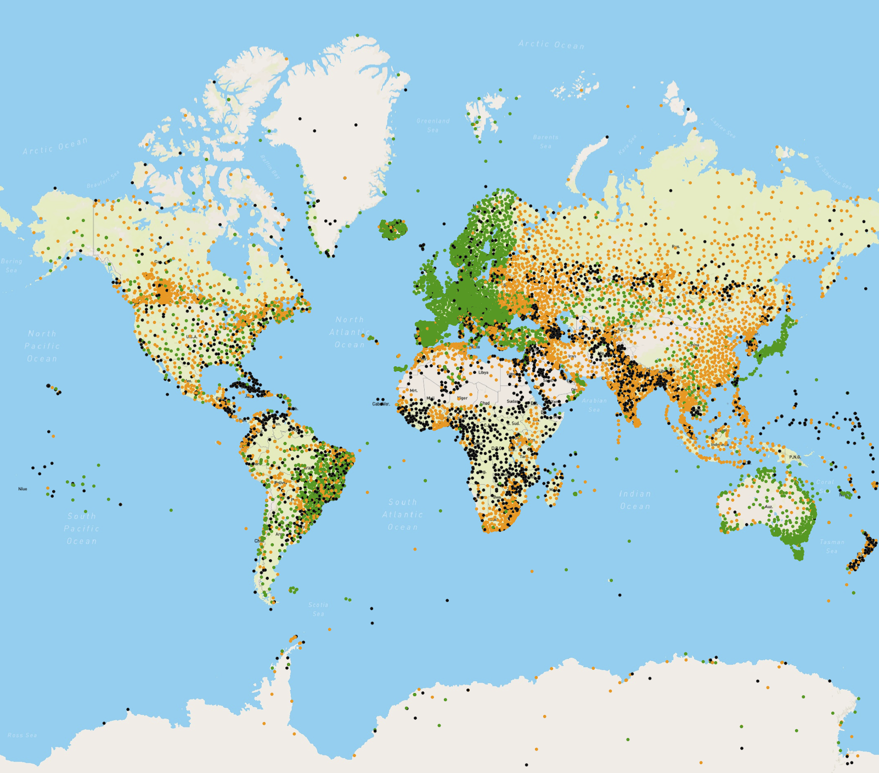
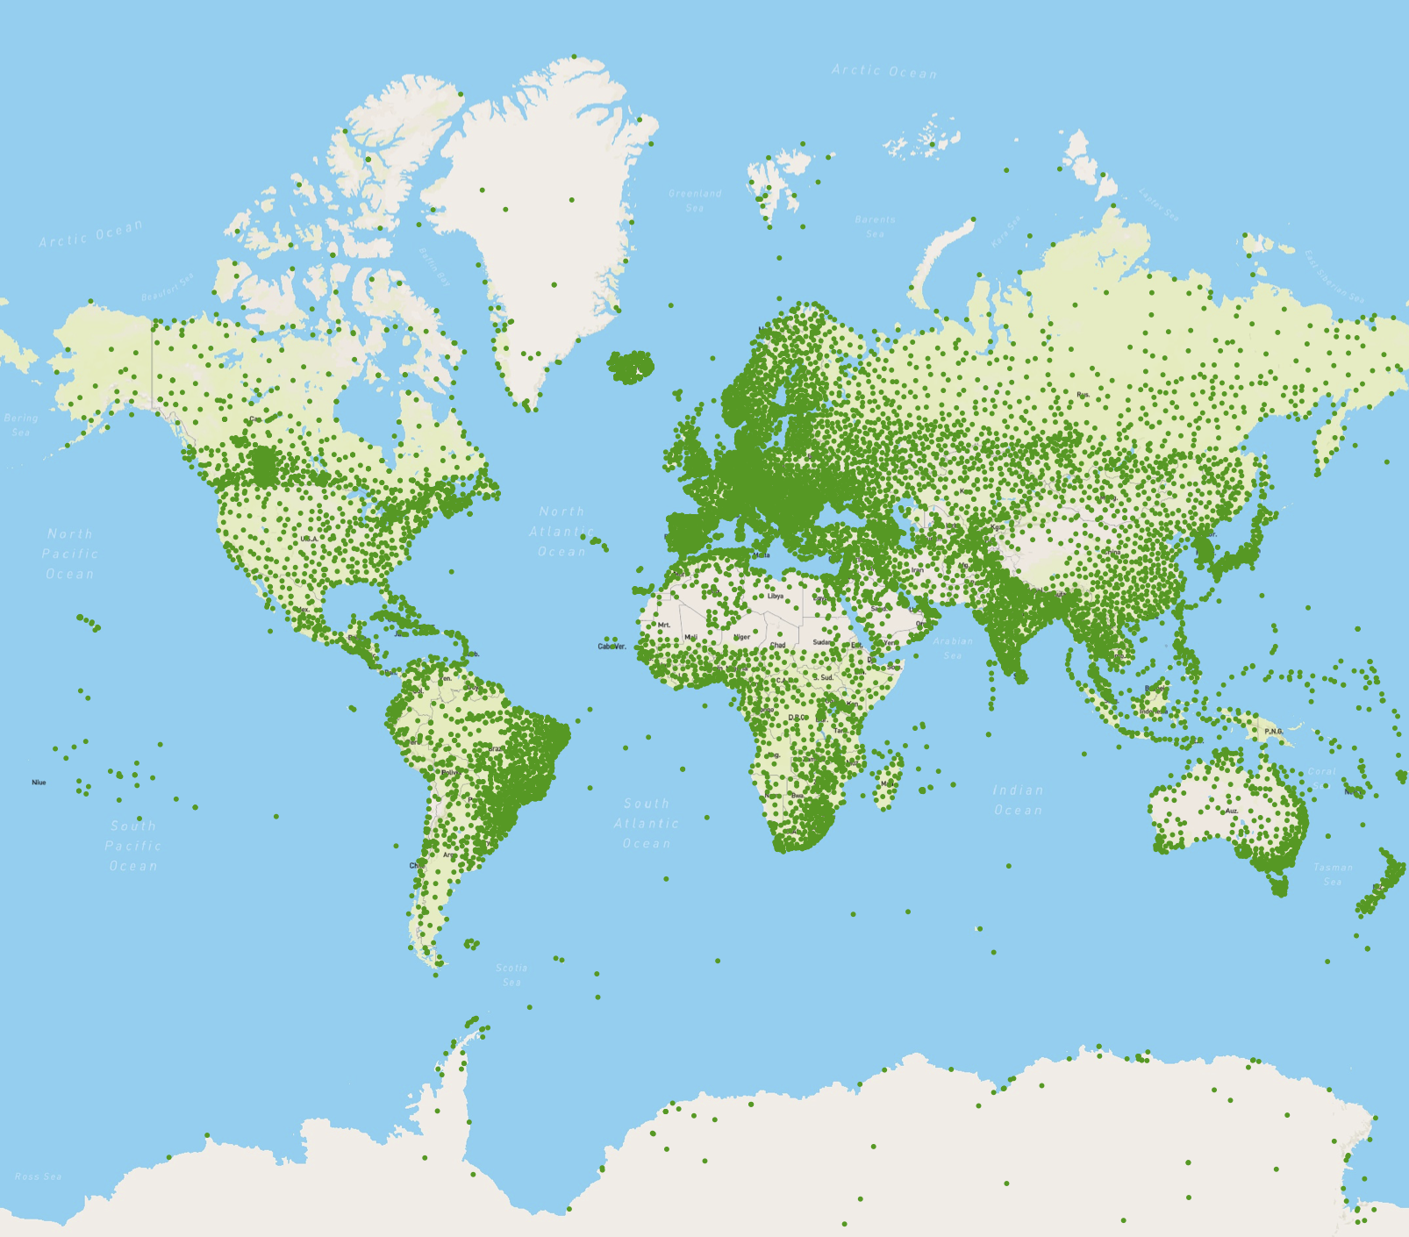
Problem statement (II): Where do we currently fall short?
Global Basic Observing Network (GBON): Congress-approved WMO initiative to turn data coverage map green
WMO monitoring: Current exchange of observations for NWP (surface pressure); only green areas meet requirements; black indicates silent stations, orange and red underperforming stations

Slide 4
What is GBON and who implements it?
GBON represents a new WMO commitment (approved by Cg-18 June 7 2019) to supplying adequate observational input to global NWP; regulatory material to specify mandatory spatial and temporal resolution of network;
GBON will be implemented by the WMO Members, in international collaboration where needed;
Many WMO Members already comply with proposed GBON provisions (e.g. Japan, Western Europe, S America); no further action is needed;
Some Members could comply with the GBON requirements; the observations are made, but not currently exchanged (e.g. USA, China); new data exchange practices need to be adopted;
Some Members do not have adequate local (national) resources available to meet GBON requirements (e.g. Africa, South Pacific); use WMO guidance to help direct internationally funded development projects toward GBON compliance;
Additional funding needs, globally (USD):
Capital investment: 350 M
Annual operating costs: 150 M
(estimated cost of existing Global Observing System: 2-5 B/yr)

Slide 5
Next steps and role of OSCAR
Reguatory material / nomination process:
Draft regulatory material already exists (estimated 95% complete);
Drafting to be completed during planned Nov 2019 Workshop; this will include process for nomination of GBON stations;
Draft RM to be discussed during initial session of new WMO Infrastructure Commission in April 2020
Submitted to EC-72 for approval in June 2020;
OSCAR
Will serve as station catalog for GBON;
GBON network affiliation to be registered in OSCAR;
OSCAR may need functionalities that calculate GBON compliance;
Pre-population of certain flags/parameters, depending on station type, e.g. International Exchange (Y), Near-real time (Y), exchange schedule;

