Slide 1
Webinar #9 – WIGOS implemementation steps
6 May 2019
Timo Pröscholdt WIGOS project office

Slide 2
Agenda
Introduction
WIGOS Implementation steps & metrics
Feedback and discussion (all)

Slide 3
The OSCAR/Surface webinar
Monthly webinar with varying topic
Audience are OSCAR/Surface Focal Points and Users
Every first Monday of the month 11h UTC
Hosted in the WMO Webex
Please suggest topics

Slide 4
National WIGOS implementation steps
(with focus on OSCAR/Surface and WDMS)
Timo Pröscholdt
WIGOS Project Office

Slide 5
National WIGOS Planning
First step of the WIGOS Planning is to understand:
What does it mean to implement a WIGOS concept of integration, partnership, data sharing, culture of compliance, etc.in “our” (NMHS) national approach to observations?
What are future strategic requirements, needs and priorities in front of “us” (NMHS)?
What are the steps to put the national WIGOS Framework in place?
What is the purpose of N-WIP?
Notes:
What are future national strategic requirements, priorities and biggest gaps in observations, systems, processes, capabilities, etc.

Slide 6
Two basic steps in National Implementation
Development of a National Observing Strategy (the example can be found at: https://www.wmo.int/pages/prog/www/wigos/documents/Principal_Docs/OSS_eBook.pdf) and
Development of a National WIGOS Implementation Plan (N-WIP), building on the National Observing Strategy
Notes:
N-WIP should specify expected deliverables and outcomes, priorities, activities, timeline, resources, responsibilities, etc. needed for:
(a) Establishment of national WIGOS governance, coordination and implementation mechanisms and team;
(b) Development of national partnerships;
(c) Identification and mitigation of critical gaps in the WIGOS component observing systems (national RRR process implementation);
(d) Sustained and standardized operation of national observing networks/systems;
(e) Operational implementation of WIGOS Metadata Standard through populating the OSCAR/Surface database and keeping its content up-to-date;
(f) Monitoring availability and quality of their observations through the WDQMS and taking corrective actions as necessary;
(g) Capacity development of staff managing and operating national observing networks/systems.

Slide 7
“WIGOS Ready” level
OSCAR/Surface: completed WIGOS metadata of all observing stations across all WIGOS components for which observations are exchanged internationally;
WIGOS metadata compliance achieved;
WIGOS Station Identifiers: implemented;
WDQMS: national process for acting on quality problem information received from the WDQMS in place;

Slide 8
“WIGOS Ready” level (cont.)
National WIGOS governance, coordination and implementation mechanisms established;
Nominate national WIGOS focal points and OSCAR FPs;
WIGOS implementation coordinated with the implementation of WIS and other WMO key priorities.

Slide 9
Executive Council (EC-69) WIGOS indicators
National WIGOS governance mechanism: in place (I=1/0); ¹⁾
National WIGOS partnership agreements for integration and open-sharing of observations from NMHSs and non-NMHSs sources: in place (I=1/0); ¹⁾
OSCAR/Surface and the WIGOS Metadata Standard: OSCAR/Surface being populated and updated with WIGOS metadata for which observations are exchanged internationally (I=1/0) with the following sub-indicators:
3.1: Number of reporting stations updated by Member in OSCAR/Surface ≥1. ²⁾
3.2: Number of reporting stations included in OSCAR/Surface with all Metadata Standard mandatory elements ≥1. ²⁾
3.3: Number of staff trained in OSCAR/Surface ≥1. ¹⁾
WIGOS Station Identifiers: implemented (I=1/0) with the following sub-indicator
4.1: Number of stations reporting in WIS with the WIGOS ID > 0. ³⁾

Slide 10
Executive Council (EC-69) WIGOS indicators (cont)
WIGOS Data Quality Monitoring System (WDQMS): national process for acting on quality problem information received from the WDQMS in place (I=1/0); ¹⁾
- Sub-indicator 5: % of reporting stations making available observations at frequency and timeliness as specified in OSCAR/Surface ≥ 70. ⁴⁾
National WIGOS focal point: nomination completed (I=1/0); ¹⁾
National OSCAR/Surface focal point: nomination completed (I=1/0); ¹⁾
National WDQMS focal point nomination completed (I=1/0); ¹⁾
National WIGOS Implementation Plan adopted/approved (I=1/0); ¹⁾

Slide 11
OSCAR/Surface metrics (Executive Council 69)
3) OSCAR/Surface and the WIGOS Metadata Standard: OSCAR/Surface being populated and updated with WIGOS metadata for which observations are exchanged internationally (I=1/0) with the following sub-indicators:
3.1: Number of reporting stations updated by Member in OSCAR/Surface ≥1. ²⁾
3.2: Number of reporting stations included in OSCAR/Surface with all Metadata Standard mandatory elements ≥1. ²

Slide 12
OSCAR/Surface metrics (Executive Council 69) (cont.)
5) WIGOS Data Quality Monitoring System (WDQMS): national process for acting on quality problem information received from the WDQMS in place (I=1/0); ¹⁾
- Sub-indicator 5: % of reporting stations making available observations at frequency and timeliness as specified in OSCAR/Surface ≥ 70. ⁴⁾

Slide 13
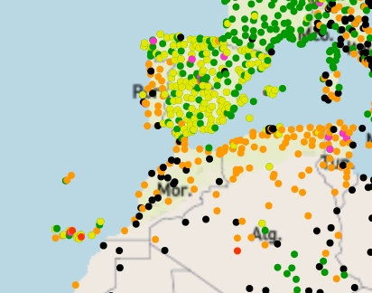
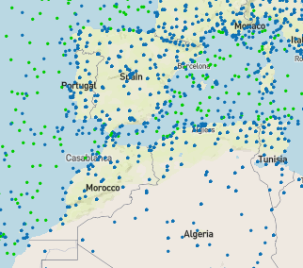
Interplay between OSCAR/Surface and WDQMS
WDQMS uses basline information from OSCAR
List of stations
Number of expected
WDQMS draws points on map and colors them as a function of OSCAR metadata and received observations

Slide 14
Thank you
www.wmo.int/wigos

