Slide 1
The WMDS Code tables
(WIGOS Metadata Standard)
Luís Nunes, Luisa Ickes
WIGOS Project Office

Slide 2
Outline
The ICG-WIGOS TTs related to OSCAR/Surface (TT-WMD, TT-OD, TT-WDQMS, TT-WSI)
The 18th World Meteorological Congress, June 2019
Updates to the Manual on WIGOS and the WMDS
The WMDS code tables updates
The XML encoding of the code tables

Slide 3
The ICG-WIGOS TTs related to OSCAR/Surface
Relevant Task Teams of the Inter-Commission Coordination Group on WIGOS (ICG-WIGOS) related to OSCAR/Surface:
Task Team on WIGOS Metadata (TT-WMD) is responsible for developing and maintaining the WIGOS Metadata Standard (WMDS) and its code tables
Task Team on OSCAR Development (TT-OD) is responsible for the development of OSCAR/Surface
Task Team on WIGOS Data Quality Monitoring System (TT-WDQMS) is responsible for developing the WDQMS concept and assisting its implementation – including providing monitoring results to OSCAR/Surface
Task Team on WIGOS Station Identifiers (TT-WSI) is responsible for the transition plan of the WIGOS Station Identifiers, which are a critical element of OSCAR/Surface

Slide 4
Some relationships
WIGOS Metadata Standard
TT-WMD
Code tables
TT-OD
Web interface
OSCAR/Surface
TT-WSI
XML files
TT-WDQMS
Data Quality Monitoring System

Slide 5
The 18th World Meteorological Congress, June 2019
WIGOS Technical Regulations
WMO-No.49, Volume I, Part 1
WMO-No.1160, Manual on WIGOS,
WMO-No.1192, WIGOS Metadata Standard,
New draft editions have been circulated to Members (Dec.2018-Feb.2019) which are available at:
http://www.wmo.int/pages/prog/www/wigos/WRM.html
Updates to the draft editions of Manual on WIGOS and of WMDS are going to be submitted to Congress, to be soon made available at:
http://meetings.wmo.int/cg-18/English/Forms/AllItems.aspx

Slide 6
The WMDS code tables
The code tables of the WIGOS Metadata Standard
Are part of the WMDS, but are managed separately
To be part of the WMO Codes registry, which is part of the Manual on Codes (WMO-No.306),
TT-WMD is responsible for their development and maintenance,
Github is now being used for tracking and approving changes to the code tables,
The Github area for the WMDS code tables is public (anyone can comment) from here:
https://github.com/wmo-im/wmds

Slide 7
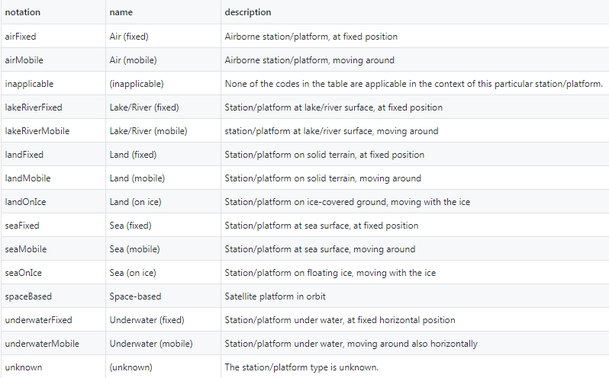
What is a code-table?
Example: 3-04 Station/platform type
The type of station

Slide 8
Other code-lists
Code-list have a numbering schema that link them to the WIGOS Metadata Standard
For example
Observed variable (1-01)
WMO Region (3-01)
Operating Status (3-09)
Data format (7-07)
Full list

Slide 9
Updated code tables
New updated versions of the code tables:
Are available since March 2019
They are being prepared to be published for experimental purposes,
For the moment they are available at (non-official):
(English version)
https://github.com/wmo-im/wmds/tree/master/tables_en

Slide 10
The XML encoding of the code tables
Stations (in OSCAR) are represented as a XML file based on the WIGOS metadata standard (WMDR)
The schema of the WMDR XML can be obtained from http://schemas.wmo.int/wmdr/
The information contained in this XML file is based on the codelists/codelist values

Slide 11
The XML encoding of the code tables - example
The Codelist values can be referenced in the XML file using links to the corresponding codelist:
Example 1:
Example 2:

Slide 12
Final remarks
OSCAR/Surface is the tool to implement the WMDS
The WMDS is part of the WIGOS Technical Regulations
The WIGOS code tables are part of the WMDS, but managed separately
New versions of the code tables are available in Github, but soon to be published
The code tables are used by OSCAR/Surface both:
by the web interface
at the XML files
NFPs for OSCAR/Surface are encouraged to follow and to contribute to the further development of the code tables

Slide 13
Thank you
For further information
www.wmo.int/wigos

