Slide 1
The WIGOS Station Identifiers (WSI)
Luís Nunes
WIGOS Project Office, WMO Secretariat

Slide 2
Outline
Recap on the basics of the WIGOS Station IDs
Procedures for assigning WIGOS Station IDs
New recommendations from TT-WSI
Final remarks, followed by Q&A

Slide 3
Outline
Recap on the basics of the WIGOS Station IDs
Procedures for assigning WIGOS Station IDs
New recommendations from TT-WSI
Final remarks, followed by Q&A

Slide 4
Recap on the basics of the WIGOS Station IDs (1)
The WSI is part of the WIGOS Metadata Standard via the "Station/platform unique identifier, 3-06" [WMO-No.1192]
Members are requested to implement WSIs following the:
WMO Technical Regulations (WMO-No.49) - Regulatory material
Manual on WIGOS (WMO-No.1160) - Regulatory material
Guide to WIGOS (WMO-No.1165) - Guidance material
New editions of the Technical Regulations and the Manual on WIGOS are being prepared with new draft provisions, to be submitted to Congress 18, June 2019 that are available at: http://www.wmo.int/pages/prog/www/wigos/WRM.html

Slide 5
Recap on the basics of the WSIs (2)
1st block (number) | 2nd block (number) | 3rd block (number) | 4th block (character)
WIGOS Identifier Series | Issuer of Identifier | Issue number | Local Identifier
Allows future expansion | Allows to distinguish between identifiers issued by different organizations | Allows sub-delegation | Allocated to station
0 | 0…65534 | 0…65534 | 16 characters
1st block (number) | 2nd block (number) | 3rd block (number) | 4th block (character)
WIGOS Identifier Series | Issuer of Identifier | Issue number | Local Identifier
Allows future expansion | Allows to distinguish between identifiers issued by different organizations | Allows sub-delegation | Allocated to station
0 | 0…65534 | 0…65534 | 16 characters
1st block (number) | 2nd block (number) | 3rd block (number) | 4th block (character)
WIGOS Identifier Series | Issuer of Identifier | Issue number | Local Identifier
Allows future expansion | Allows to distinguish between identifiers issued by different organizations | Allows sub-delegation | Allocated to station
0 | 0…65534 | 0…65534 | 16 characters
1st block (number) | 2nd block (number) | 3rd block (number) | 4th block (character)
WIGOS Identifier Series | Issuer of Identifier | Issue number | Local Identifier
Allows future expansion | Allows to distinguish between identifiers issued by different organizations | Allows sub-delegation | Allocated to station
0 | 0…65534 | 0…65534 | 16 characters

Slide 6
Example of a WIGOS Station ID (3)
WIGOS Identifier Series (number) | Issuer of Identifier (number) | Issue Number (number) | Local Identifier (characters)
0 | 20000 | 0 | 06700
Example of station GENEVE-COINTRIN (Switzerland)
Please note that:
WIGOS Identifiers do not have meaning in themselves
Users must not interpret any patterns they see in WIGOS IDs
Users should use OSCAR/surface to look up the metadata for the station associated with the WIGOS station identifier.

Slide 7
Outline
Recap on the basics of the WIGOS Station IDs
Procedures for assigning WIGOS Station IDs
New recommendations from TT-WSI
Final remarks, followed by Q&A

Slide 8
General requirements for assigning WSIs (1)
Members shall:
issue WSIs for stations/platforms within their geographic area of responsibility that contribute to a WMO or co-sponsored programme
ensure that no WSI is issued to more than one station
make available to WMO the updated metadata each time a new WSI is issued
Members should (before issuing a station identifier):
ensure that the operator of a station/platform has committed to providing and maintaining WIGOS metadata for that station/platform

Slide 9
Flow-chart for assigning a WIGOS ID
WIGOS ID Series
(number)
Use "0"
Station already has a WMO Programme ID?
Issuer of ID
(number)
YES
Use a number from a WMO Programme
Check table "Observing Programmes with international system for assigning station identifiers" to find a value in range 20000-39999
NO (new station)
Territory has an ISO 3166-1 code?
Use your territory’s 3 digit ID code Check table ISO 3166-1 to find the value in the range 1-9999
NO
YES
Contact WMO Secretariat to allocate a value for the territory: range 10000-11999
Territory has defined its procedures for Issue Number and Local ID?
Issue Number
(number)
NO
Normally, use "0" for Issue #
YES
Use "0"
Use them!
Local ID
(characters)
… and choose a local ID that gives a unique combination: Issuer/Issue#/Local-ID
Use existing WMO ID

Slide 10
General requirements for assigning WSIs (2)
Each observing station must have at least one WIGOS ID associated with it
Observing stations that have identifiers from a WMO Programme:
may continue to use those, they are not required to have additional identifiers created
if a station take on new responsibility the WIGOS ID can also be used in the new context
It is possible for a station to be associated with more than one WIGOS identifier, but it is desirable to associate as few identifiers as possible.
if a station is already associated with a WIGOS ID, or is associated with an ID issued by a WMO or partner programme, an additional WIGOS ID should not be issued
Do you need to take into account the type of station, or the Programme to be affiliated, for assigning WIGOS ID? NO!
How do you describe the type of station, the Programme affiliation, the variables observed, the instruments used, etc => GO to OSCAR/Surface!

Slide 11
Decision 15 (EC-70) - process under which the WMO Secretary-General will issue WSIs (I)
Annex 1/I - Procedure for a Station Operator to apply for a WSI:
It is intended to guide the operator of a station through the process of assigning a WSI for that station.
It also applies to users running data rescue activities that need to allocate a WSI for a station for which they have discovered data:
Steps
1. Verify that a WIGOS station identifier is needed
2. Provide evidence that the station meets the requirements to be allocated a WSI
3. Apply for a WSI
4. Invoking the escalation procedure

Slide 12
Decision 15 (EC-70) - process under which the WMO Secretary-General will issue WSIs (II)
Annex 1/II- Procedure for the Secretary General to issue a WSI:
It is intended to be used in circumstances where it is necessary to record metadata about a station but no Member considers themselves to be in a position to issue a WSI for that station:
Steps
1. Invoking the procedure
2. Validating the application
3. Escalation of the application
4. Identification of stations whose metadata have been recovered through data rescue activities

Slide 13
Table “Issuer of Identifier”
Range of Issuer of Identifier | Category of issuer | Method of allocating | Procedures for issuing Issue Number and Local Identifier
0 | Reserved for internal use by OSCAR | OSCAR allocates the value. | Determined by OSCAR.
1-9999 | Member State or territory for which there is an ISO 3166-1 numeric country code | ISO 3166-1 three digit numeric country code (by convention leading zeroes are not shown in WIGOS Identifiers). See ISO web site and click on "Officially assigned codes" (on the left of the screen) | Issuer identifies its own procedures. Further guidance is available in the section "Guidance on recommended practices for the allocation of 'issue number' and 'local identifier' for Member states and territories that have an 'issuer of identifier' allocated to them".
10000-11999 | Member State or territory for which there is no ISO 3166-1 numeric country code | WMO Secretariat allocates an available number on request. | Issuer identifies its own procedures. Further guidance is available in the section "Guidance on recommended practices for the allocation of 'issue number' and 'local identifier' for Member states and territories that have an 'issuer of identifier' allocated to them".
12000-19999 | Reserved for future use | To be determined. | To be determined.
 | Identifiers in the ranges 20000-21999 and 22000-39999 are intended only to be used to allocate WIGOS identifiers for observing facilities that had one or more pre-existing identifiers.
20000-21999 | WMO Secretariat for identifiers associated with WMO Programmes | Details are provided in the section "Allocation of 'issuer of identifier' for station identifiers associated with WMO Programmes". | Details are provided in the section "Allocation of 'issuer of identifier' for station identifiers associated with WMO Programmes".
22000-39999 | WMO Secretariat for identifiers associated with programmes of Partner organizations | Details are provided in the section "Allocation of 'issuer of identifier' for station identifiers associated with WMO co-sponsored programmes". | Details are provided in the section "Allocation of 'issuer of identifier' for station identifiers associated with WMO co-sponsored programmes".
40000-65534 | Reserved for future use | To be determined. | To be determined.
65535 | Missing value (reserved value in Table Driven Code Forms)

Slide 14
“Observing Programmes with an Int. System for Assigning Station ID”
Issuer of Identifier | Category of station identifier | Method of allocating Issue Number | Method of allocating Local Identifier
20000 | World Weather Watch land station with sub-index number (SI) = 0 | 0: station defined in WMO-No. 9 Volume A on 1 July 2016. Any other positive number: to distinguish between different observing facilities that used the station identifier in the past. | Use the block number (II) and the station number (iii) as a single five digit number IIiii (with leading zeroes). Example: station 60351 would be represented by 0-20000-0-60351
20001 | World Weather Watch land station with sub-index number (SI) = 1 | 0: station defined in WMO-No. 9 Volume A on 1 July 2016. Any other positive number: to distinguish between different observing facilities that used the station identifier in the past. | Use the block number (II) and the station number (iii) as a single five digit number IIiii (with leading zeroes). Example: upper air station 57816 would be represented by 0-20001-0-57816
20002 | World Weather Watch Marine Platform (moored or drifting buoy, platform, etc.) | 0 - platform for which the identifier was in use on 1 July 2016. Any other positive number - to distinguish between different platforms that used the same identifier at different times. | Use the region/platform number combination A₁b_{w}n_{b}n_{b}n_{b} Examples: the data buoy 59091 would be represented by 0-20002-0-59091. The World Weather Watch list of data buoys lists two buoys with identifier 13001. The buoy most recently used at the time WIGOS station identifiers were introduced is allocated 0-20002-0-13001 and the second is issued identifier 0-20002-1-13001 (note - the Issue Number is different from that for the first buoy).
20003 | Ship identifier based on ITU call sign. | 0 - ship allocated the identifier more recently on 1 July 2016. Any other positive number - to distinguish between different ships that used the same ship identifier at different times. | Ship call sign. Example: the (now obsolete) weather ship C7R would be represented by 0-20003-0-C7R.
20004 | Ship Identifier - issued nationally | 0 - ship allocated most recently on 1 July 2016. Any other positive number: to distinguish between different ships that used the same ship identifier at different times. | Ship identifier. Example: the fictitious shop XY123AB would be represented by 0-20004-0-XY123AB
20005 | AMDAR aircraft identifier | 0 - aircraft most recently issued the identifier on 1 July 2016. Any other number: to distinguish between different aircraft that used the same aircraft identifier at different times. | Aircraft identifier. Example: aircraft EU0246 would be represented by 0-20005-0-EU0246.
20006 | ICAO airfield identifiers | 0 - airfield most recently allocated the identifier on 1 July 2016. Any other positive number: to distinguish between airfields that used the same airfield identifier at different times. | ICAO airfield identifier. Example: Geneva airport (LSSG) would be represented by 0-20006-0-LSGG.
20007 | Ship IMO number (hull number) | 0 - ship to which the IMO number was most recently allocated on 1 July 2016. Any other positive number: to distinguish between ships that used the same IMO identifier at different times. | Ship identifier. Example: ship 9631369 would be represented by 0-20007-0-9631369.
20008 | Global Atmosphere Watch Identifier | 0 - station to which the GAW identifier was most recently allocated on 1 July 2016. | Three character GAW identifier. Example: Jungfraujoch JFJ would be represented by 0-20008-0-JFJ.
20009 | WMO Satellite Programme | 0 | Three digit satellite identifier with leading zeroes (recorded in Common Code Table C-7 of WMO-No. 306, Manual on Codes Volume I.1) Example: METEOSAT 10 (with identifier 057) would be represented by 0-20009-0-057.
20010 | WMO Weather Radar | 0 | Unique key used to cross-reference information about a single radar within the WMO radar database (note: this key was not previously published) Example: Station with record number 121 would be represented by 0-20010-0-121.
20011-21999 | Reserved for future use. | To be determined. | To be determined.

Slide 15
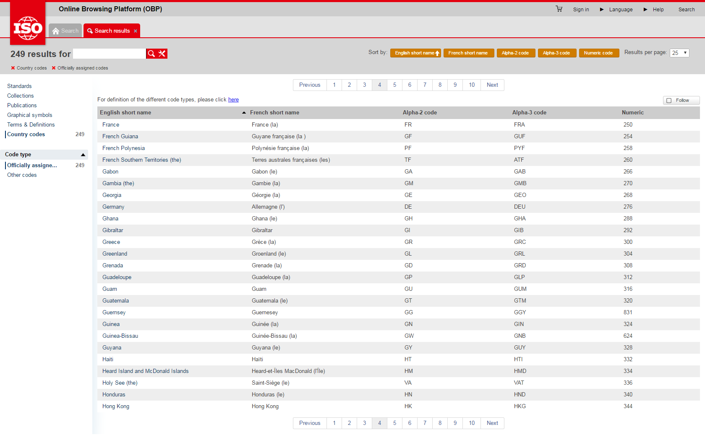
Table “ISO 3166-1 numeric code” (https://www.iso.org/obp/ui/#search)

Slide 16
Table “Partner IDs”
Issuer of Identifier | Category | Issue Number | Local Identifier
22000-39999 | Identifiers for marine systems administered through JCOMMOPS. Note: JCOMMOPS coordinates some marine observing systems to avoid technical incompatibilities. | Determined by JCOMMOPS | Determined by JCOMMOPS.
22001-39999 | Reserved for future use. | To be determined. | To be determined.

Slide 17
Outline
Recap on the basics of the WIGOS IDs
Procedures for assigning WIGOS IDs
New recommendations from TT-WSI
Final remarks, followed by Q&A

Slide 18
Task Team on WIGOS Station Identifiers
ICG-WIGOS has established in early 2018 a Task Team on WIGOS Station Identifiers (TT-WSI) and agreed on its ToRs
The TT-WSI activities started in June 2018
The first face-to-face session, held in September 2018 at Oslo, Norway, proposed a set of conclusions and recommendations (next slides)
They also discussed and further developed the WSI draft transition plan

Slide 19
Proposed new structure (1)
There is currently complete freedom for Members to define their own schema
Propose that the following constraints are imposed:
Issue number (3rd block) to have common slots reserved for different types of organizations, e.g. 0-9 for NMHS, 10-19 for other public organizations,
Length (#characters) of local identifier (4th block) = to use the whole set of 16 characters,
For each Issue number, the Local identifier shall contain only uppercase or lowercase, not a mix
Details of exactly which characters are allowed and what the common slots are to be agreed with subject matter experts (IPET-CM)

Slide 20
Third Party Organizations (2)
Third party organizations and Programmes, such as Copernicus Climate Change Service (C3S), should be officially recognized as WMO partners with the authority to issue WSI
Conditions (such as timeframe, etc), and procedures will be clearly established;
Recommendation is to define a set of codes (tentatively 40000…) for WMO recognized partners to use in Block 2 of the WSI;
The case of the WMO Secretary General issuing a WSI where the National Focal Point is unwilling/unable to do so is a specific case of such a third party
Procedure for the WMO SG to assign WSI (EC-70, June 2018) will be reviewed and adjusted, in order that all such requests are treated as similar to that of a third party organization

Slide 21
Dual inclusion of WMO ID and WSI in BUFR messages (3)
Notice period for transition from traditional WMO to new WSI in BUFR (dual inclusion in header) to be from 6-3 months in advance
Due to the structure of the BUFR message, the old and the new identifier will continue to be transmitted together

Slide 22
Minimal set of WIGOS Metadata mandatory fields to register a station (4)
Currently >20 WIGOS Metadata elements are required (Mandatory and Conditional)
This is too much for many issuers, especially third parties, to register a new station in OSCAR/Surface
It is recommended to have just a few mandatory WIGOS metadata elements (WSI, Name, Lat, Long, Altitude, Contact) as a minimum to register a new WSI
This list must be enforced in OSCAR/Surface

Slide 23
Documentation of WSI schemas (5)
To ensure the preservation of the long term record, documentation shall be preserved in perpetuity
Global data centres are ideally placed to offer this, such as the GMDC in Asheville

Slide 24
Test environment (6)
Under leadership by ECMWF, voluntary Members to provide test data that includes WSI, initially using an FTP site
Several Members (Brazil, Australia) expressed their intention to contribute; Other Members considering joining the experiment: UK, Switzerland (Israel already sending BUFR reports with WSI)
Initially planned to run from October to December 2018, at the request of various Members, ECMWF agreed to extend it into mid 2019 (end date TBD)

Slide 25
WSI Transition Plan (7)
Themes:
1 - Identification of issues to be addressed by Members
2 - Advice and tools for members to address issues
3 - Testing environment
4 - Resolving issues with exchange of information
Structure of the Plan
A) Background
B) Objectives
C) Timescale (~2 years)
D) Approach
E) Tasks, Activities and Responsibilities
F) Communication & outreach
G) Project Management and Risks

Slide 26
Outline
Recap on the basics of the WIGOS IDs
Procedures for assigning WIGOS IDs
New recommendations from TT-WSI
Final remarks, followed by Q&A

Slide 27
Final remarks (with request for homework!)
The National Focal Points for OSCAR/Surface have a critical and increased role in implementing the WSIs at national level, in cooperation with WIGOS National Focal Points
All participants are strongly encouraged to:
Review the current new draft provisions in Manual on WIGOS for Cg.18
Consider the recommendations from TT-WSI including
participation at the WSI experiment with ECMWF
reviewing and contributing to the WSI transition plan
Work with the OSCAR/Surface and WIGOS NFPs towards developing a national schema for assigning WIGOS IDs
Provide feedback to the Secretariat, via the WIGOS Project Office (http://www.wmo.int/pages/prog/www/wigos/contact.html)
Contribute and enhance engagement with the OSCAR/Surface Resources Portal: http://etrp.wmo.int/moodle/course/view.php?id=146

Slide 28
Thank you
lfnunes@wmo.int
www.wmo.int/wigos

