Slide 1
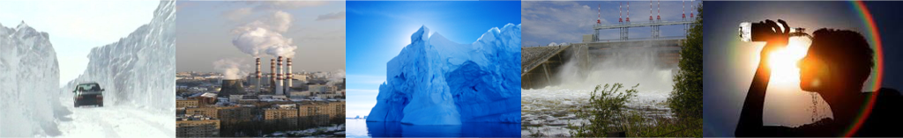
Weather and Climate Air Quality Ice Water Availability Extremes
Hiring and Preparing NMHS Meteorologists
for the Future:
Drivers and Considerations
Jennifer Milton
Director, National Operations
Meteorological Service of Canada
PWS Competencies Coordinator
Weather Ready Nations Steering Committee
WMO, Geneva
October 23 – 24, 2018

Slide 2
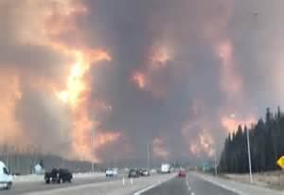
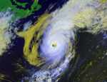
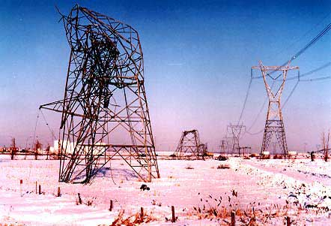
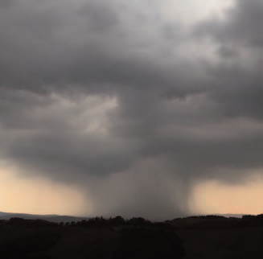
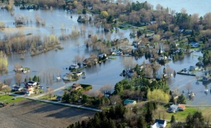
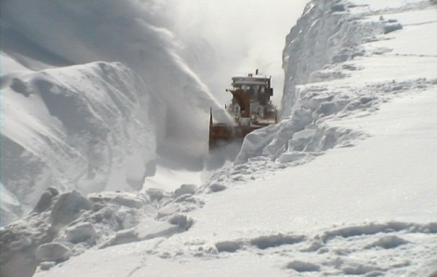
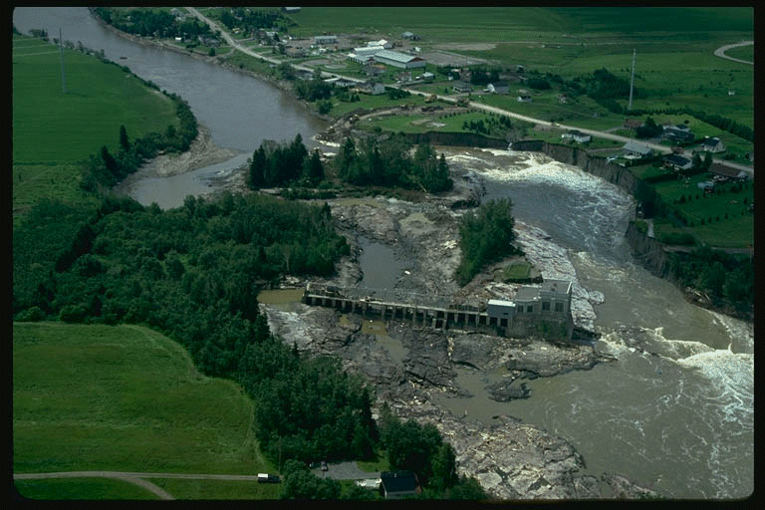
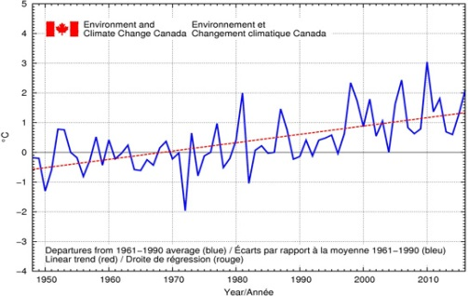
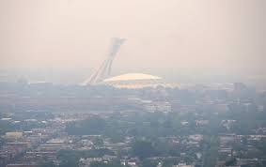
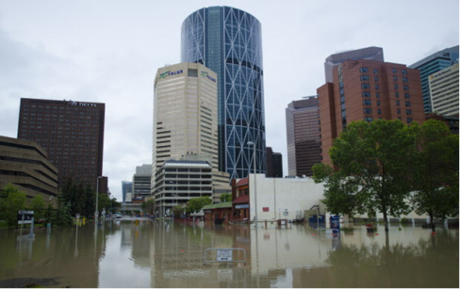
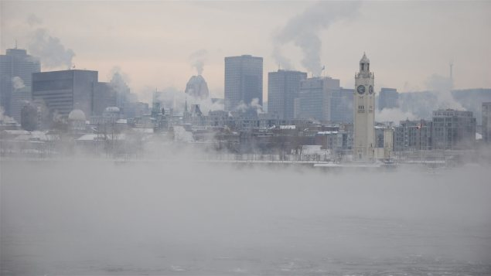
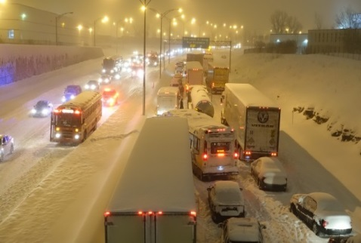
Multi-scale information for multiple hazards
Notes:
Canada is a country of significant weather and climate extremes, from ice storms and blizzards, to heat waves and hurricanes.

Slide 3
Impact-based Forecasting
… Having the most powerful dissemination tool (or hazard based warnings) does not imply the warning system will convey the most understandable, complete and useful information needed to support users in their decision making process… (MSC- vigilance project)
… From ‘‘What the weather will be’’ to ‘‘what the weather will do’’ – (Weather Ready Nations)

Slide 4
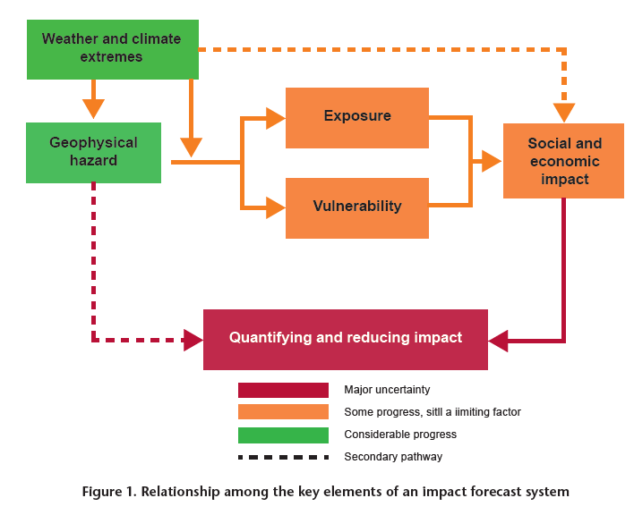
Impact-based forecasting

Slide 5
Impact-based Forecasting
What was said…
- Establish or work in collaboration with other experts and Partners (multi-disciplinary)
- Scope of information, data sharing, archiving and representation of this information
- Integrate knowledge of potential impacts and risks in prediction process
- Adapt and communicate information as a function of vulnerability/exposure of users. Provide information about uncertainties.
- Perception of risk- social sciences
- Verification of content and usefulness of information received and communicated
- Use of data analytics within the services

Slide 6
Preparing for the present and future
Are there significant changes (ongoing/expected) within the meteorological/hydrological business (that will impact IBFS)?
Are we hiring people with the adequate educational background and qualifications and insight to address these changes?
Is there a need to review the requirements of the basic qualifications of meteorologists? And will international references need to be adapted?
As new work functions are put in place, is hired staff well tooled? (background knowledge, identified competencies, training requirements)

Slide 7
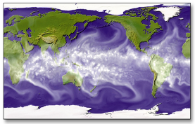
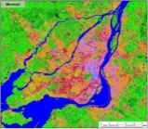
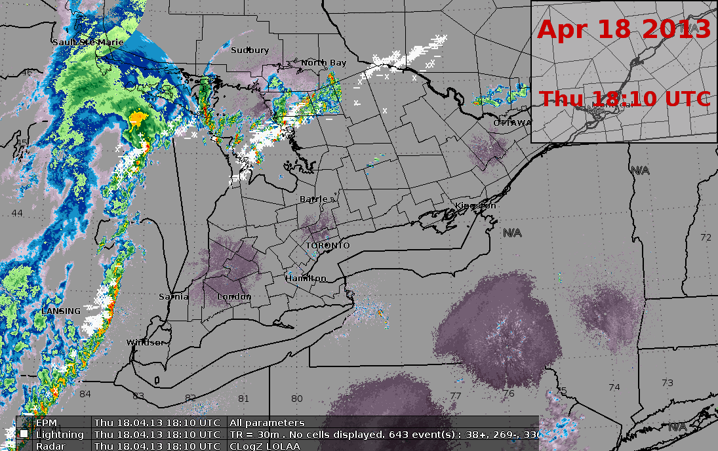

Drivers in the evolution of services
Innovations & Technologies
-WIGOS, WIS
- Satellite (ex: Goes-16), Space Weather
- Radar technologies
- Integrated data platforms
- Sectoral Prediction Systems (ex: wild fire, heath and health, AQ, urban..):
- Tools supporting production of new products and services
R&D and Technical Transfer
- Global Data Processing and Forecasting Sysrems
- Data assimiliation
- Model resolution and parametrisations supporting more skillful predictions
- Coupled atmosphere-ocean-land-(ice) systems
- EPS
- Towards seamless multi-scale
Big Data/Open Data
- Observation Networks & Model outputs
- Volume of information in prediction centers
- Data intepretation
- Access, archive and delivery of variety of info
- Expertise in data management, mining, analytics, services

Slide 8
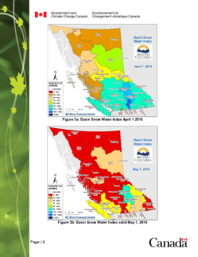
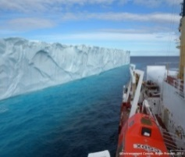
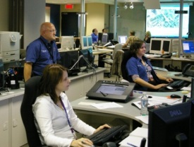
Drivers in the evolution of services
Societies & the environment
- Environmental & climate change. Increasing urbanization
- Partners/Users
- Sector relevant meteorological and environmental information
- Strenghten resiliency
- Increase sustainability
- Authoritative Voice
- New communication technologies/
interoperability
Workforce
- Demographics
- Recruitment
- Education and Universities
- Changing roles
- Workforce planning
- Training requirements and professional development
- Competency frameworks
Decision support and user focus (services)
- Weather & impact Preparedness
- Impact-based warnings – Vigilance approach
- Incorporating Social science research
- Sectoral focus (AQ, Health, EMO, marine and ice)
- Water, Marine, Public, Climate & Aviation Services – target centric

Slide 9
Public Weather Service Delivery Competency Framework
Revision of PWSD Competencies (2018)
  Top level competencies
  Second level competencies/performance indicators
  Background knowledge
  Main changes to wording, and integrating from initial 1+4 sub sections to 1+3
Recommendation (CBS-MG) (Geneva, 29 March 2018)
EC-70 approved (2018)
Consistent with the approach of WMO Guide to Competency (WMO‑No. 1205)
Facilitate assessment of competency levels for work associated with the provision of Public Weather Services

Slide 10
Top Level Competencies in PWSD
Public Weather Forecaster (Fundamental) | Weather broadcasters and communicators | PWS Advisers supporting disaster prevention and mitigation and other user activities. | Persons engaged in the development and delivery of meteorological and hydrological products and services
Analyse and monitor continually the evolving meteorological and/or hydrological situation. | Maintain awareness of the evolving meteorological and/or hydrological situation, updated forecasts and warnings, and impacts of anticipated conditions. | Monitor continually the evolving meteorological and/or hydrological situation, updated forecasts and warnings, and impacts of anticipated conditions. | Maintain awareness of developments in technology, and science which facilitate the development and improvement of products and services to meet user requirements.
Forecast meteorological and hydrological phenomena and parameters. | Assemble meteorological and hydrological information that meet user needs for communication and delivery. | Develop and adopt procedures and services to meet user needs and facilitate impact assessments. | Develop applications, products and services that meet user requirements.
Warn of hazardous meteorological and hydrological phenomena. |  | Develop and manage relationships with Disaster Prevention Mitigation users and other stakeholders. | Develop and manage relationships with users and other stakeholders.
Communicate meteorological and hydrological information and potential impacts to internal and external users. | Communicate meteorological and hydrological information and potential impacts via broadcast and other media. | Communicate meteorological and hydrological information and potential impacts to internal and external users and engage in outreach activities.
Ensure the quality of meteorological and hydrological information and services. | Ensure the quality of meteorological and hydrological information and services. | Ensure the quality of meteorological and hydrological information and services. | Ensure the quality of meteorological and hydrological information and services.
EC.70:A PWS Forecaster should have successfully completed the Basic Instructional Package for Meteorologists (BIP-M) .

Slide 11
BIP-M (Basic Instruction Package – Meteorologists)
The acquisition of knowledge concerning physical principles and atmospheric interactions, methods of measurement and data analysis, behaviour of weather systems (through the synthesis of current weather data with conceptual models), and the general circulation of the atmosphere and climate variations;
The ability to apply knowledge based on the use of scientific reasoning to solve problems in atmospheric science and to participate in the analysis, prediction and communication of the impacts of weather and climate on society.
  .. Basis for the development of expertise and further specialization..
  WMO-No. 49, Technical Regulations, Volume I: General Meteorological Standards and Recommended Practices
  (2015 – updated 2017)

Slide 12
BIP-M (Basic Instruction Package – Meteorologists)
Basis for Classification as Meteorologists:
  Completion of university degree – BSc and/or post-grad in meteorology
  Required (AMP)/recommended qualifications
  Requirements are defined as learning outcomes: Study/educational programmes
Main components:
  Foundation topics in math, physics + additional related sciences
  Atmospheric sciences (physical met, dynamic, synoptic, climatology)
  Overarching understanding of non-independent processes (system)
  (And communication, data analysis and use of data)
These are not the competency frameworks:
  Support /enable these in being developed and implemented
  WMO-No. 1083, Manual on the implementation of education and training standards in Meteorology and Hydrology, Volume I – Meteorology (2012)

Slide 13
Is there a need to review the BIP-M?
Are we hiring people with the adequate educational background and qualifications to address these changes?
Is there a need to review the requirements of the basic qualifications of meteorologists?
EC-70 – Resolution 32: Review the BIP-M and BIP-MT through the EC Panel of Experts in ETR
  Workshop planned 27-28/11/2018:
  Identify if they still meet professional requirements?
  Develop a protocol for the review of the BIP-M and BIP-MT
  Identify potential issues with modifying or with current BIPs
  Survey questions sent to National Focal Points on BIP-M (and MT).. Consultant working with WMO-ETRP

Slide 14
Is there a need to review the BIP-M?
Preliminary observations:
  Only some indications of understanding of the impacts of weather hazards & climate.
  Very little indication of understanding of users of meteorological information in BIP-M
  References to Teamwork is related to organizational teams
  Developments in Data analytics
  Risk assessments
  Evolution of functions (as through IBF, and increase potential for use of data) will require a variety of educational background and mastering of complementary skills.
  Communication (within BIP-M) is defined with respect to transmission of info in a timely manner as per format
  But Communication is more than format.. It is about relevant content.
  ‘personnel engaged in transmitting or exchanging information effectively’ (Merriam Webster))
  Range of global requirements may need to be parsed per career streams

Slide 15
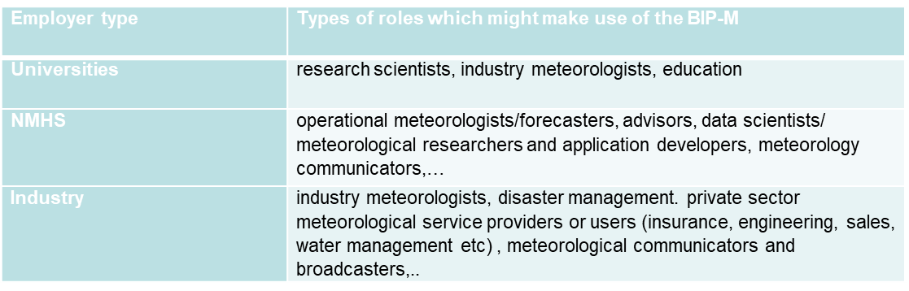
Is there a need to review the BIP-M?
Users:
(Coordinating Committee (CoCOM) for the Standing Committee of Heads of Training Institutions (SCHOTI), 2018)
Potential Impacts of reviewing BIP-M:
  On university curricula and degrees
  On hiring requirements and criteria
  On continuous training
  On current competency frameworks referring to the BIP-M as required or recommended qualifications. On the BIP-MT
Notes:
Or Aeronautical Meteorolo

Slide 16

Summary
BIP
Competency Frameworks
Training Requirements and Offerings
Prediction Services/IBF
R&D and Technical Transfer
Society requirements (& the environment)
Decision support and user focus
Workforce
Innovations & Technologies
- RTCs
- Affiliated training
providers
- IBF community
Big Data/Open Data
https://public.wmo.int/en/resources/training/wmolearn

