Slide 1

OSCAR/Surface: Authentication, authorization and API
OSCAR/Surface Webinar
5 November 2018
Online recording
Federal Department of Home Affairs FDHA
Federal Office of Meteorology and Climatology MeteoSwiss

Slide 2
The OSCAR/Surface webinar
Monthly webinar with varying topic
Audience are OSCAR/Surface Focal Points and Users
Every first Monday of the month 11h UTC
Hosted in the WMO Webex
Please suggest topics

Slide 3
Outline
The OSCAR/Surface webinar
Authentication vs. Authorization
OSCAR/Surface security architecture
  eIAM and OSCAR
  How to create a new user
  Common issues
Authentication for the API
Q&A

Slide 4
Authentication
Authentication is used by a server when the server needs to know exactly who is accessing their information or site.
Authentication is used by a client when the client needs to know that the server is system it claims to be.
In authentication, the user or computer has to prove its identity to the server or client.
Usually, authentication by a server entails the use of a user name and password. Other ways to authenticate can be through cards, retina scans, voice recognition, and fingerprints.
Authentication by a client usually involves the server giving a certificate to the client in which a trusted third party such as Verisign or Thawte states that the server belongs to the entity (such as a bank) that the client expects it to.
Authentication does not determine what tasks the individual can do or what files the individual can see. Authentication merely identifies and verifies who the person or system is.
Source: https://www.bu.edu/tech/about/security-resources/bestpractice/auth/

Slide 5
Authorization
Authorization is a process by which a server determines if the client has permission to use a resource or access a file.
Authorization is usually coupled with authentication so that the server has some concept of who the client is that is requesting access.
The type of authentication required for authorization may vary; passwords may be required in some cases but not in others.
In some cases, there is no authorization; any user may be use a resource or access a file simply by asking for it. Most of the web pages on the Internet require no authentication or authorization.
Source: https://www.bu.edu/tech/about/security-resources/bestpractice/auth/

Slide 6
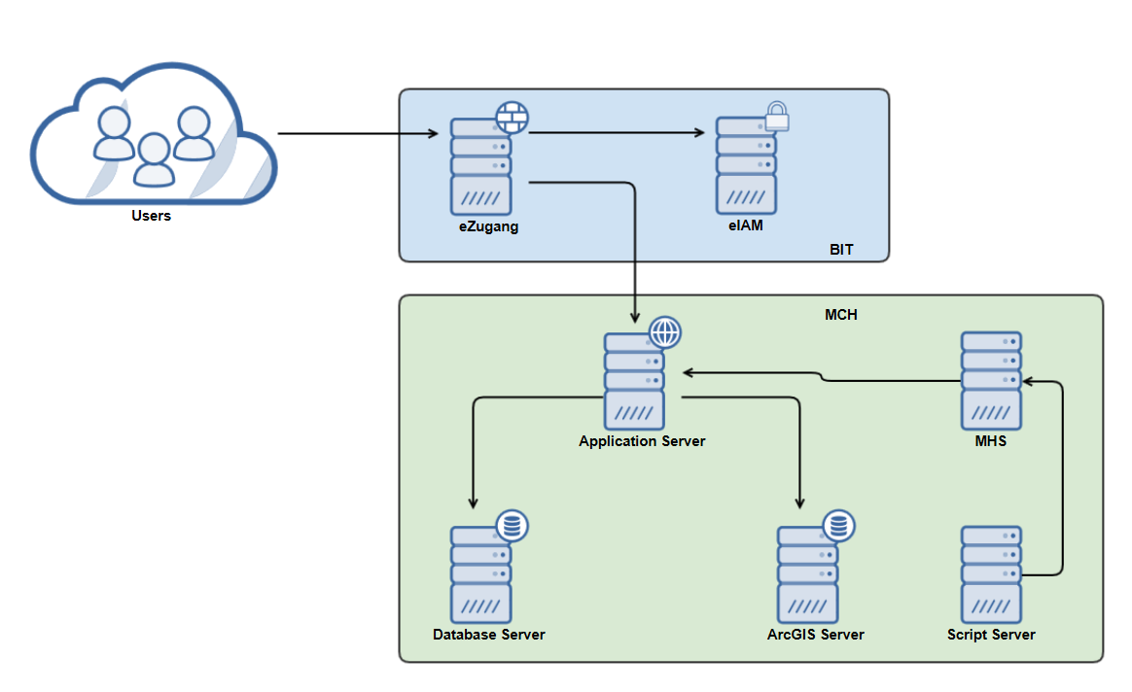
OSCAR/Surface security architecture
Authentication
Authorization

Slide 7
OSCAR/Surface security architecture (II)
Authentication against eIAM
  Send username password to eIAM
  Reset password
Authorization in OSCAR/Surface
  User role (National Focal Point for a country, station contact)
  Can edit station/stations
  Can access API

Slide 8
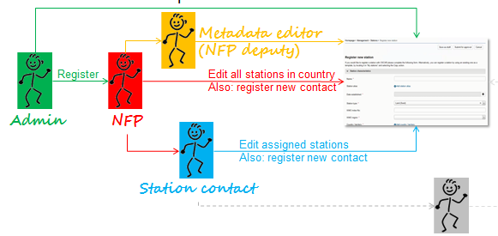
How to get an account?
There are two ways to get an account
Designation as National Focal Point (NFP) for OSCAR/Surface by Permanent Representative
NFP, or other delegee, creates a user in OSCAR/Surface

Slide 9
Registration in OSCAR
Once the account is created in OSCAR/Surface, the user receives an email, requesting registration with the OSCAR/Surface Electronic Identity and Access Management System (EIAM).
While the user account has been created in OSCAR/Surface already, the user needs to register with EIAM once and link the EIAM account with the OSCAR/Surface account.
Once this is done, the user can then logon to OSCAR by entering the EIAM username and password.

Slide 10
Common issues
Email used to register in eIAM is not the same as in OSCAR/Surface (re-register in eIAM with correct email, change email in OSCAR)
Users register multiple times in eIAM, access OSCAR with wrong account (use right account)
Password forgotton (follow eIAM procedures)

Slide 11
OSCAR/Surface API
OSCAR/Surface User Interface XML upload
  All NFPs are authorized
  Paste in XML (one-time, ad-hoc change)
OSCAR/Surface API
  All NFPs are authorized
  NMHSs
    NFP can download token from web application
    User/Programme can then upload XML using API
  Data Centers and instrument experts can also be registered as machine users

Slide 12
OSCAR/Surface API
The API uses an authentication token instead of username and password
Token is valid for 12 months
  Revoked if not used for 3 months
  Reminder is sent by e-mail 2 and 1 months in advance
To obtain the token, logon to OSCAR and download it from the management console
Attention: The token is only shown once. Download and safe in secure location
Supply token in HTTP header together with (XML) payload

Slide 13
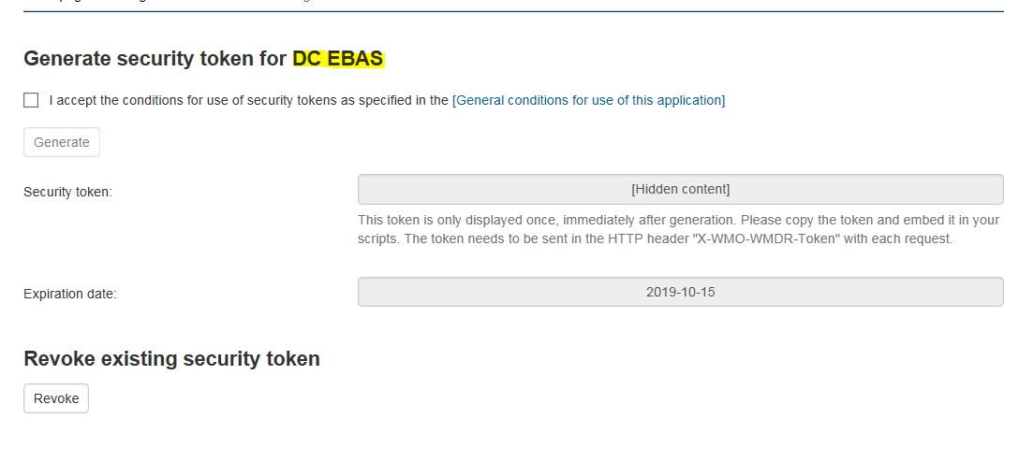
Example
Download token from management console
Upload XML file to API by supplying the token in the header
curl --header "X-WMO-WMDR-Token: #MYTOKEN#“ --data-binary @#XML_FILE# https://oscar.wmo.int/surface/rest/api/wmd/upload

Slide 14

Attention
Test XML and API on http://oscardepl.wmo.int/surface
before submiting it to live DB!

Slide 15

Thank you
Questions?

Slide 16
Annex i

Slide 17
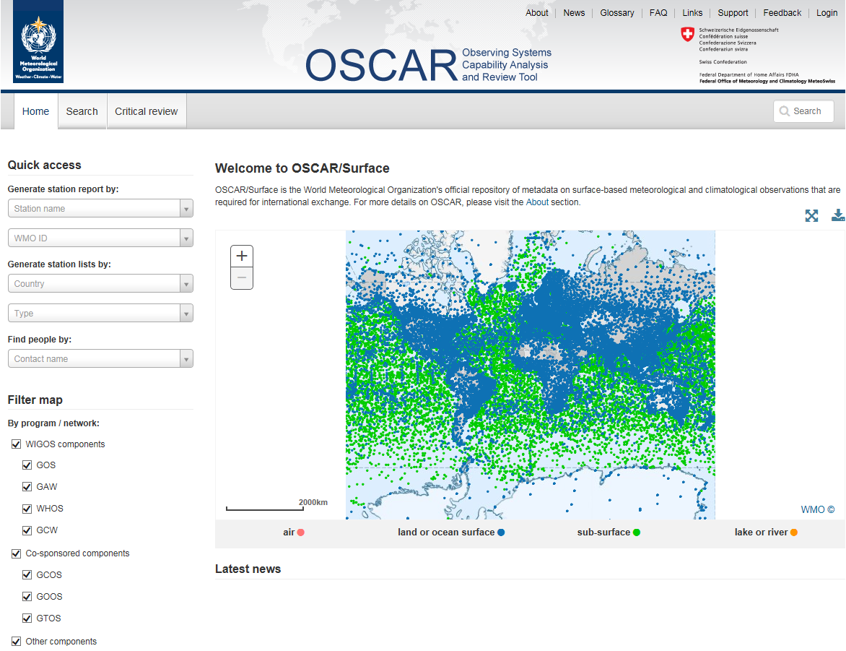
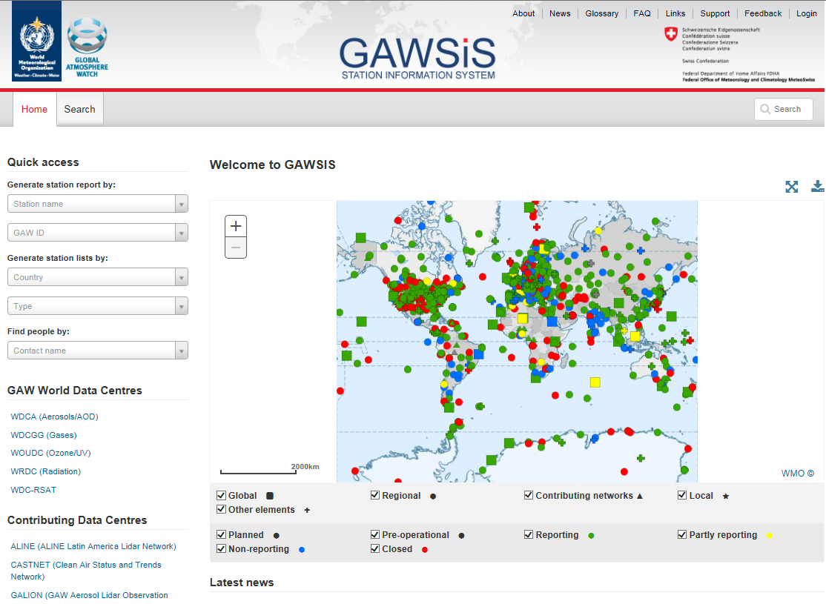
How to register in OSCAR or GAWSIS
1. check if you are already included in the list of available contacts
https://oscar.wmo.int/surface
https://gawsis.meteoswiss.ch/GAWSIS

Slide 18
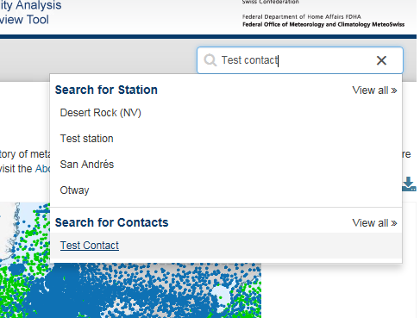
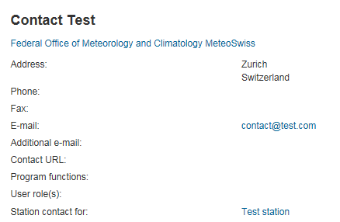
How to register in OSCAR or GAWSIS
check if you are included in the list of available contacts
On the «free text search» field type your name
As soon as your name appears select it to view your contact details
Check if your email is correct
  If your name does NOT appear in the search results ask your national focal point to add you in the list of contacts (personal info needed: first name, last name, email, organization, city, country). A compatriot colleague already registered in the application can also add you as contact. As soon as you are included in the contacts list you will receive a confirmation email with a link to the application URL.
If your name is included you can continue with the following registration procedure.

Slide 19
How to register in OSCAR or GAWSIS
2. Click on "login“ on the top-right of the page.

Slide 20
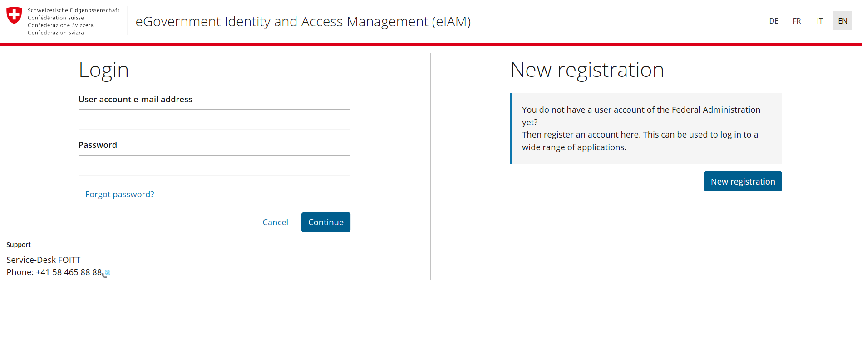
How to register in OSCAR or GAWSIS
3. complete the following steps for the attribution of the username and password
Choose the language...
…and click on «new registration»

Slide 21
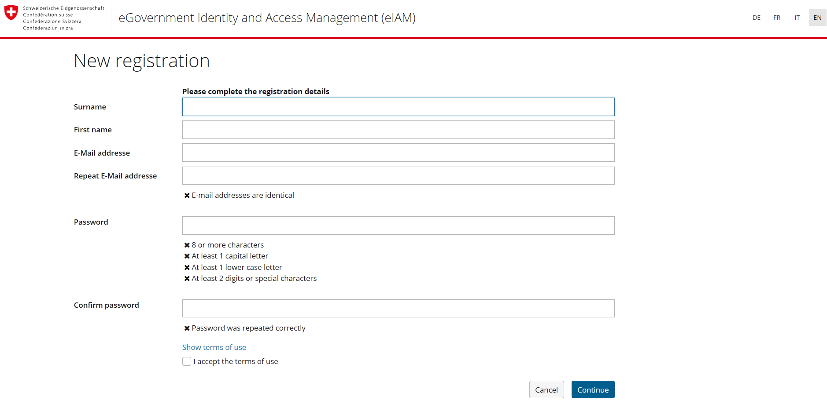
How to register in OSCAR or GAWSIS
3. complete the following steps for the attribution of the username and password
Fill out the form,
do not forget to use the same email as in your contact details…
….then click on «continue»

Slide 22
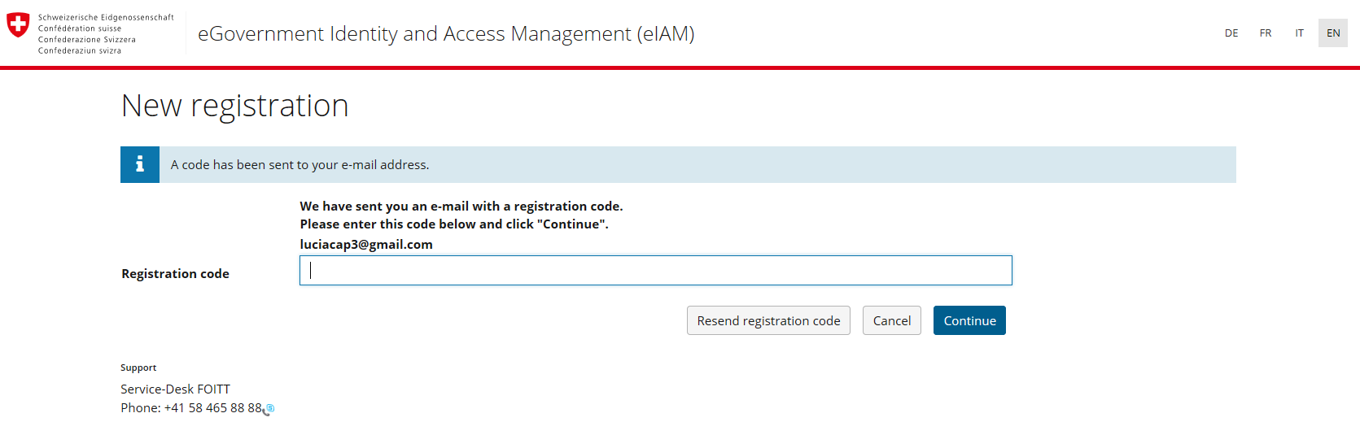
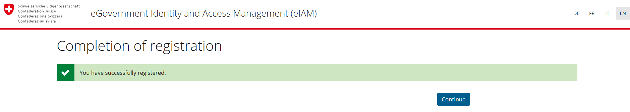
How to register in OSCAR or GAWSIS
How to register in OSCAR or GAWSIS
3. complete the following steps for the attribution of the username and password
Check your email for the validation code and insert it…
..then click «next»
Now that you have created an account click on «continue» to request access to the application

Slide 23
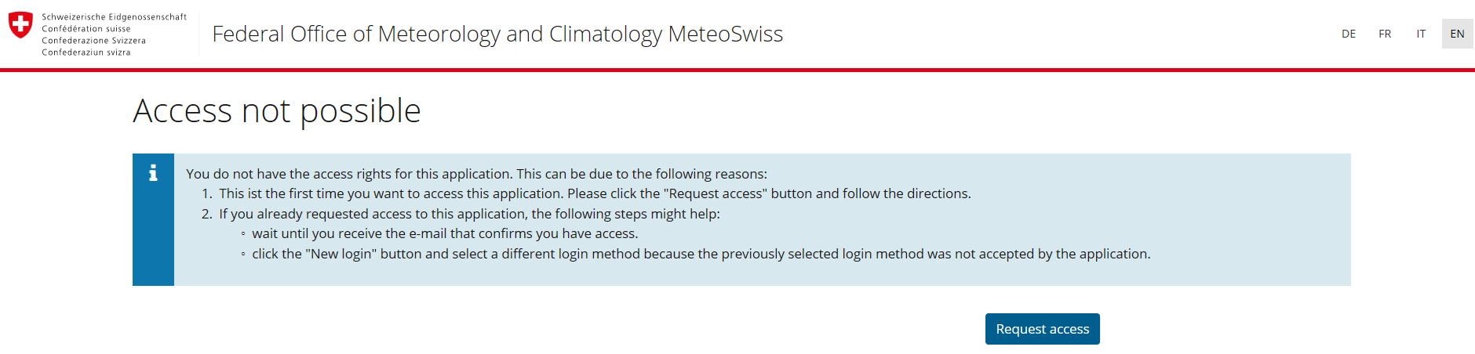
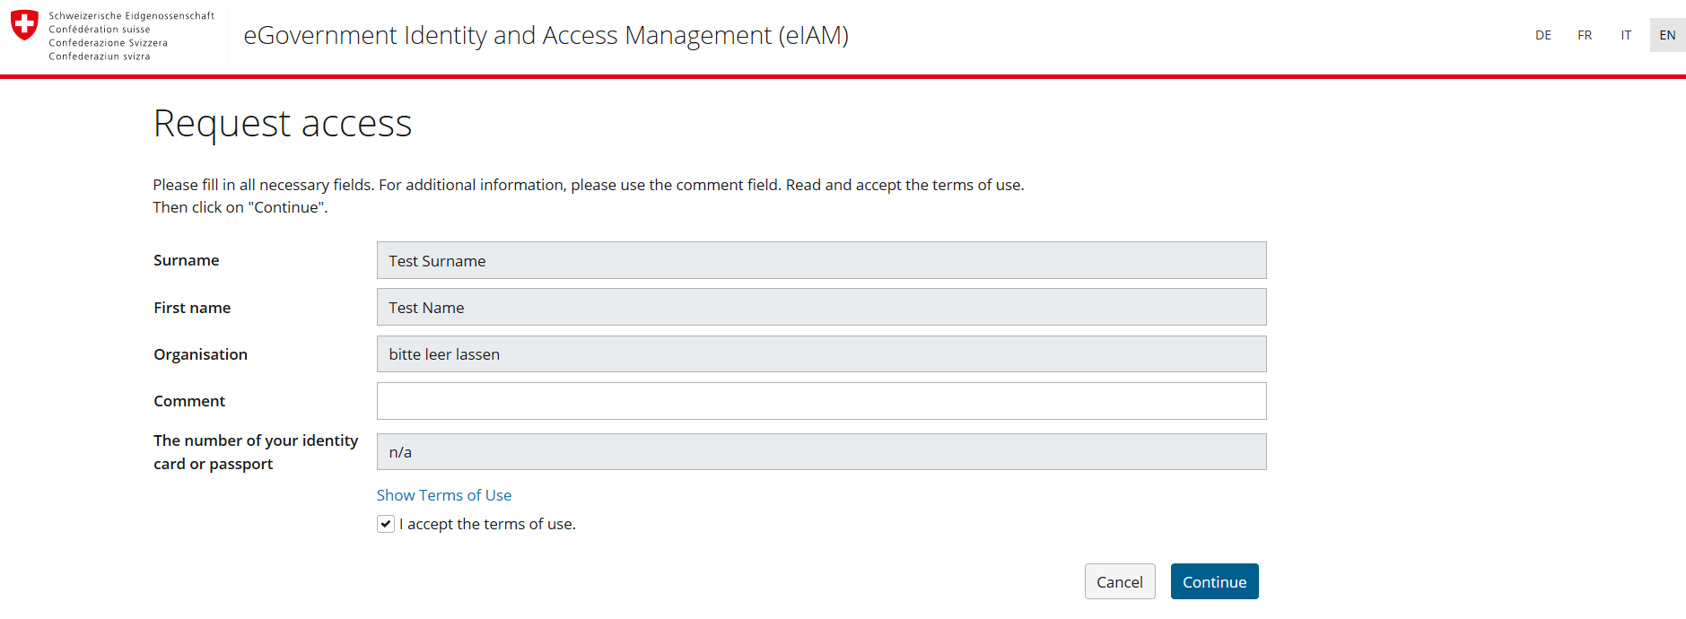
How to register in OSCAR or GAWSIS
How to register in OSCAR or GAWSIS
4. Request access to the application
click on «request access»….
…. Accept the terms of use and click on «continue»
Your registration is complete, go back to the application and login to add/edit information

Slide 24
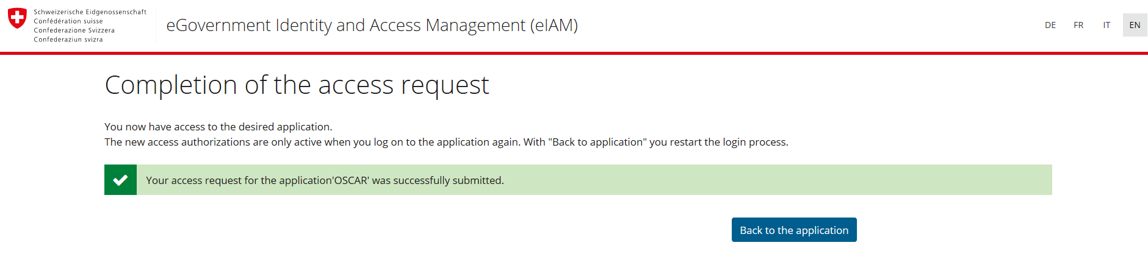
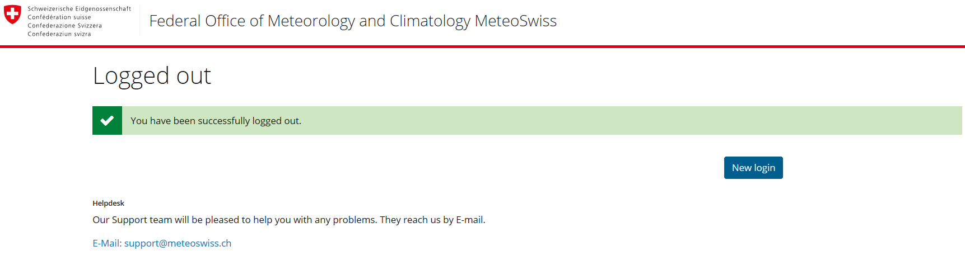
How to register in OSCAR or GAWSIS
How to register in OSCAR or GAWSIS
4. Request access to the application
Click on «back to the application»
Your registration is complete, go back to the application and login to add/edit information

