Slide 1





4th International
Distance Learning Program
in Basic Hydrological Sciences
for Asian Region (WMO RA-II)
16th October to 30th November 2017
Organized by
National Water Academy, Pune

Slide 2
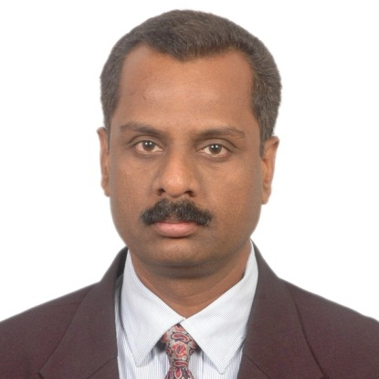
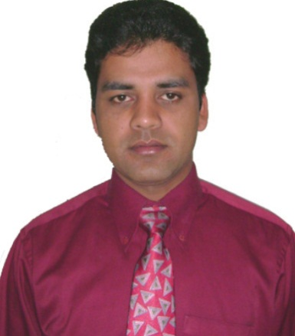
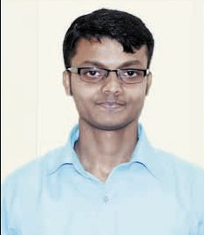
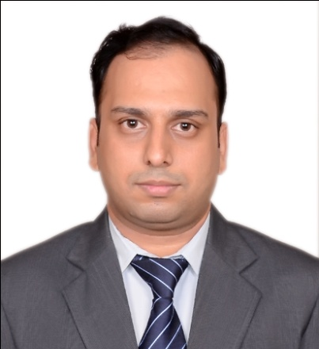
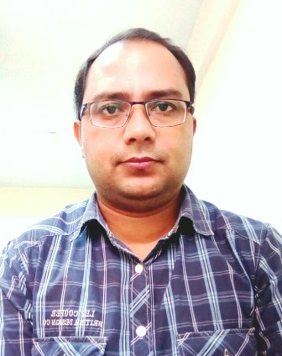
Course Instructors from NWA
Dattakumar Chaskar
Director
Sunil Kumar
Director
Sidhartha Mitra
Director
Manish Rathore
Deputy Director
Deepak Bhatt
Deputy Director

Slide 3
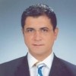





Course Facilitators from
WMO & COMET
Mustafa Adiguzel
WMO
Matt Kelsch
COMET
Claudio Capponi
WMO
Dr. Patrick Parrish
WMO
Nirina Ravalitera
WMO
Bruce Muller
COMET

Slide 4
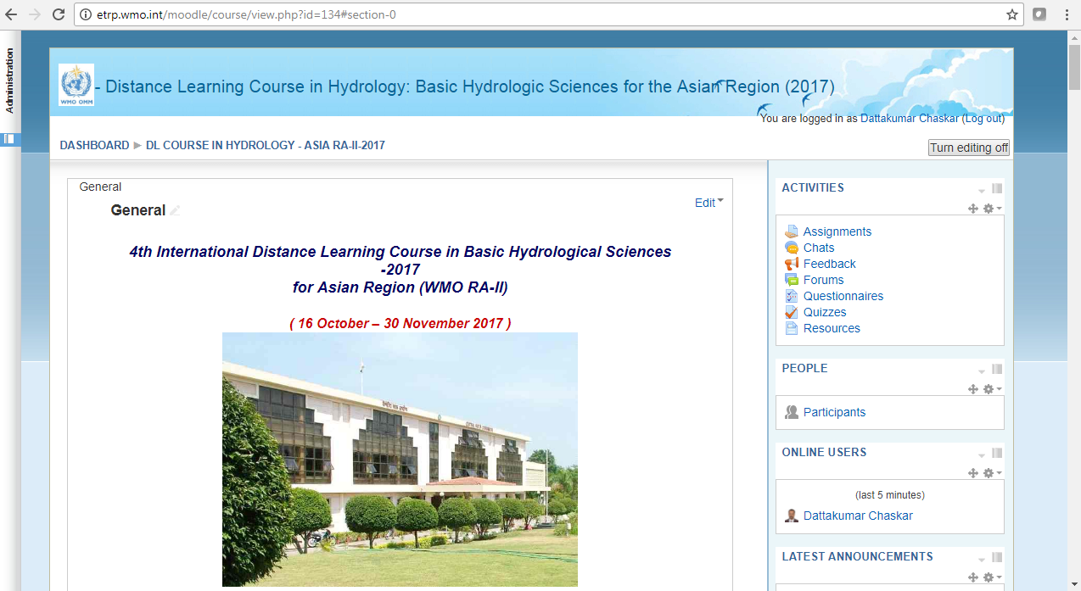
Course Website
http://etrp.wmo.int/moodle/course/view.php?id=134

Slide 5
The Course
The course was designed to meet the needs of hydrological forecasters who work with hydrologic data, particularly in flood forecasting and design flood analysis.
The course was intended to provide an understanding of ground, surface, and atmospheric forms of water and to prepare the participant for its application & further study in hydrologic methods and forecasting.

Slide 6
Participating in this webinar
This webinar is conducted in Listen Only mode due to constraint of bandwidth with many participants
Please feel free to ask questions during this session.
You may ask a question by typing it into the questions box.

Slide 7
Country wise Participants
State/ Central Organisation | No of Participants
Fiji | 2
India(IMD) | 2
Myanmar | 5
China | 2
State of Kuwait | 2
Argentina | 1
Kazakhstan | 4
India ( CWC & State Govt) | 47
Total | 65

Slide 8
Course Components
Set up your profile (Pre-course Activity)
Complete the module on “Understanding Hydrological Cycle”
( Pre-Course Activity)
Live Orientation Webinar on 16 October at 1100 hrs IST
17 Distance Learning Modules and Quizzes
  8 modules are mandatory
  1 module optional
  Your choice for an additional 2 out of 8 options
Live Closing Session (1500 Hrs IST, 4 December 2017)
Participate on the Course forum – at least twice weekly
A short final writing assignment
Completing all of these will earn you a Certificate of Completion for the course

Slide 9

Required Modules
Pre-Course Activity
( 56 participants)
Avg Grade : 91
Week 1
NWA
( 58 participants)
Avg Grade : 88
Quiz Avg Grade : 34.5 (59 No.)
Asgmt Avg Grade : 83 ( 59 No.)

Slide 10

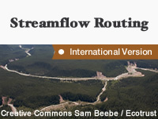

Required Modules
Week 2
( 58 participants)
Avg Grade : 89
( 55 participants)
Avg Grade : 87
Optional Module for this week
NWA:
Derivation of Unit Hydrograph
20 Participants took this module
Avg Grade : 33

Slide 11


Required Modules
Week 3
( 56 participants)
Avg Grade : 88
( 56 participants)
Avg Grade : 90
( 57 participants)
Avg Grade : 87

Slide 12

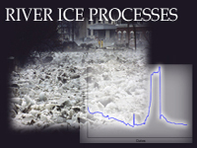


Elective Modules
Week 4
Any two electives out of 8 modules
NWA :
Flood frequency Analysis-Part-II
( 40 participants)
Avg Grade : 34
NWA:
Flood forecasting Techniques
( 23 Participants)
Avg Grade : 33
21
87
Dam failure Concepts & Modelling
19
88
16
82
23
93
31, 85
22, 90

Slide 13
Week 5
Completing all the required & optional modules
&
Starting with Final writing Assignment

Slide 14
Required Modules
Week 6 & 7
Submission of Final writing Assignment
Course Evaluation Survey
Concluding Webinar

Slide 15
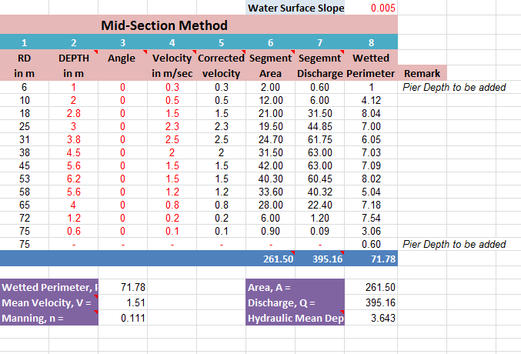
Assignment on Measurement of River Discharge

Slide 16
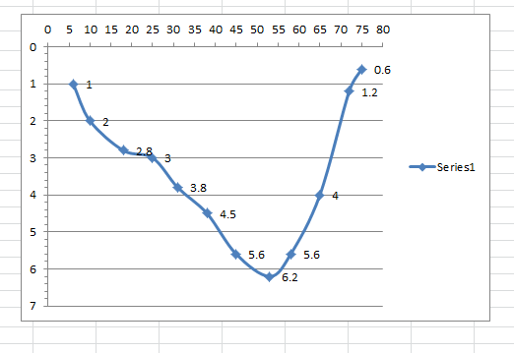
Assignment on Measurement of River Discharge

Slide 17
Final Writing Assignment
Till Today, we have received 54 final writing assignments
Option A: Discuss the work responsibilities of your office.
  Option B: Report about your local hydrological conditions.
  Option C: Outline the strengths and weaknesses of your local hydrologic forecasting system.

Slide 18
Certificate of participation
The list of the participants who have earned a Certificate will be shown shortly
54 participants are eligible for award of certificate today
Results of 11 participants are on hold.
It will be printed at WMO, Geneva
Will have signature of WMO/COMET/NWA officers
May take a month or two to reach the participants

Slide 19

List of 54 participants who have successfully completed the course activities & have earned the Course Completion Certificate
First name | Surname
Pankaj | Sharma
Jingyue | Di
Fengwen | Xu
Raj | Apoorva
Leela | G
Sivakumar | S J
Siddhartha | Biswas
Kumar | Pradeep
Shrivastav | Minesh Chadrakant
Parag | Bhagwat
Swapnali | Barman
Mathew K | Jose
Arasu | A Meenakshi Sundara
Adhikari | Saroj
Mohammad | Rashad Kassem Yousef
Debapriya | Roy
Sharda | Yadav
Rachana | Kulkarni

Slide 20
List of 54 participants who have successfully completed the course activities & have earned the Course Completion Certificate
First name | Surname
Debabrata | Paul
Manish Shankar | Sant
Purandare | Pradeep
Singh | Nupur
P Devender | Rao
Bharath Kumar | Reddy K
Jangir | Renuka Kumari
Yogeetha | S
Thara | N
Sridevi | A
Parijat Gogoi | Chetia
Padmadevi | M
Sumana | Saha
Parmod | Kumar
Swapan Bikas | Kar
Vijay | Teeparthi
Chinmoyi | Roy
Anurag | Mishra
Nehalben Raysinh | Bhuria

Slide 21
List of 54 participants who have successfully completed the course activities & have earned the Course Completion Certificate
First name | Surname
Ritwik | Chatterjee
Praveena | J
Pravat Rabi | Naskar
SUMANTA | DEY
Pranjit | Shil
Kapadnis | Pooja R
Anjana | Mondal
War War | Khaing
Biak Ro | Lian
Sobhan | Mishra
Win Nwe | OO
Fahad | Al Otaibi
Saniya | Beisenbaeva
Maitreyee | Majumder
Tun Tun | Naing
Jhansyrani | Parivel
Kyaw Min | Hlaing

Slide 22
Results of the following 11 Participants are withheld as they have yet to complete the minimum course requirement
They can complete the modules/quizzes/assignments in the next Four days i.e. by FRIDAY and we will consider them for award of certificate.
Rashmi | krishnamurthy
Debnath | Samir
Assel | Namazbayeva
Gulim | Maratkyzy
Choudhari | Gaurav R
Ramazan | Abdulkhair
Sajiva | Nand Sharma
Joseph | Kabuyawa
Anubhav | Nautiyal
Rajesh | Hingmire
Tomás Manuel | Calvi

Slide 23
Feedback
Appreciation of modules & Format of the course
Less Time available to complete the modules
Routine Office work
Broadband connectivity
One or two participants had difficulty in downloading the modules
Pl. complete the Course Evaluation Survey
Link is available at course website in last week activities. ( 28 participants have taken the survey )

Slide 24
After the Course
The website will be accessible.
All modules will be accessible
Forum will be on
The discussions can go on.
The participants may still pose questions to instructors not only pertaining to hydrology but also other areas of water resources
May take some time for instructors to reply.

Slide 25
After the Course
You can go through other modules from Met-Ed website as per your interest
You can send your nomination for any program of your interest at NWA : Either for DL or regular program

Slide 26
Advanced Course
Next Course : Advanced Topics in Hydraulics, Hydrological Sciences and Hydrometeorology for RA-II : 2017-18
Will be held in feb- March 2018
Participants who have completed Basic course will only be eligible to apply.
This advanced course is designed to meet the needs of hydrological forecasters who require more advanced training in selected hydraulic and hydrological modeling topics.
You all are invited to apply for this course

Slide 27
Any questions ?

Slide 28
Thank You

