Slide 1
Guidelines for Public-Private Engagement (2024 edition) and the new legal database Tatsuya Kimura Director, Public-Private Engagement (PPE) Office World Meteorological Organization (WMO) Secretariat 5 December 2025
Leadership and Management Workshop for Senior Management of RA IV Caribbean Members

Slide 2
Outline
Guidelines for Public-Private Engagement (2024 edition), which includes Guidelines for Legislative and Institutional Arrangements for Public-Private Engagement
Legislation Database now available
The latest developments in Japan –
Appendix: Links to various materials

Slide 3

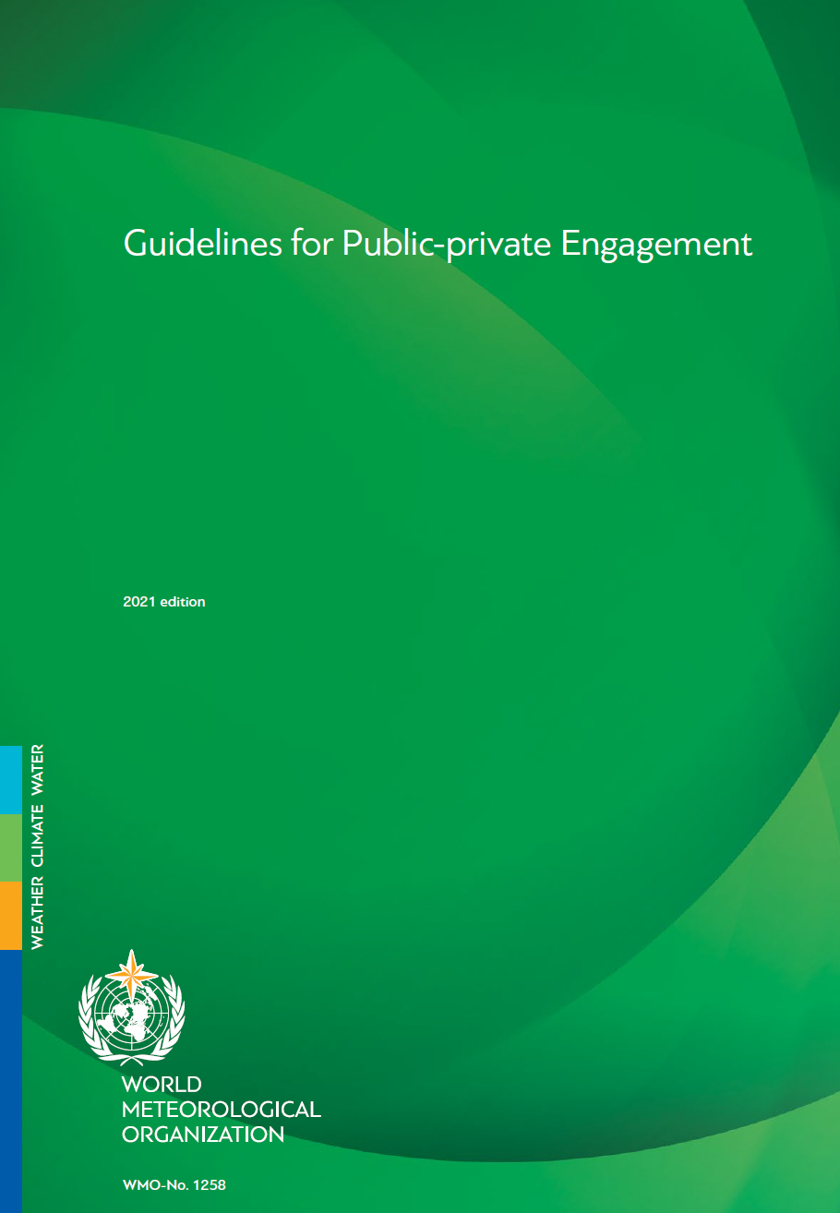

Revised Guidelines for Public-Private Engagement (2024 edition) (1/6)
The revised version of the WMO Guidelines for Public-Private Engagement (WMO-No. 1258) were endorsed by EC-78 in June 2024 and the six official language versions have been published by January 2025.
Revision’s Background
The WMO Guidelines for Public-private Engagement (WMO-No. 1258) were endorsed by EC-72 in 2020.
The Guidelines provide principles and specific guidance to inform and facilitate actions by WMO and its Members.
Since the publishment of the Guidelines, there have been
a few policy developments in WMO, and
Members’ emerging needs on support to the legislative and institutional framework to promote Public-Private Engagement (PPE) (see pp. 1-2 of INF. 6(1) of EC-78).

Slide 4
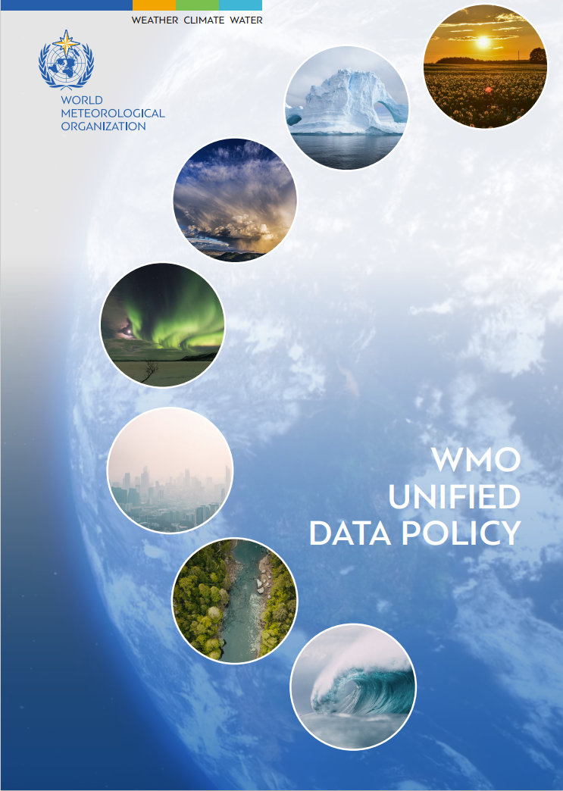
Revised Guidelines for Public-Private Engagement (2024 edition) (2/6)
Purposes of the revision
To provide up-to-the-date guidance to WMO Members and RAs
The primary revision includes two parts:
Changes to the body text, reflecting the WMO Unified Data Policy and the WMO Strategic Plan 2024-2027, and
Addition of an annex on the legislative and institutional framework to promote PPE; it provides cases of laws and regulations collected from Members, and templates of such framework, which is identified as one of the vital PPE-enabling factors at the national level by the Geneva Declaration 2019 and the Guidelines.

Slide 5
Revised Guidelines for Public-Private Engagement (2024 edition) (3/6)
New Annex (1/3)
The new Annex, Guidelines for Legislative and Institutional Arrangements for Public-Private Engagement is intended to
identify key elements of legislative/institutional arrangements through which PPE can be facilitated (Sec. 4)
share good practices (Sec. 5) and
provide options as templates (Appendix) to Members
so that Members can refer to (1) many other Members’ latest practices and (2) templates when they consider amending or establishing a law, an act, a decree, or institutional arrangements to promote PPE, taking account of the Member’s situation and environment.

Slide 6
Revised Guidelines for Public-Private Engagement (2024 edition) (4/6)
New Annex (2/3) – How?
The Secretariat has collected Members’ laws and other instruments that govern their meteorological activities,
from Members’ and int’l organizations’ websites as well as
from Members on the opportunity of a WMO survey conducted in 2018 on national strategic planning and legislation and
other occasions, such as gathering contributions to White Paper #2.
Concrete provisions of laws, decrees and regulations from about 120 Members and specific initiatives broadly related to PPE were reviewed and analyzed.
When selecting good practices, geographical balance was taken into account.
For many provisions on the objectives and functions of NMHSs and the interpretation of terms related to PPE, the Model Hydrometeorological Services Bill implemented by the Caribbean Meteorological Organization (CMO) was referenced.

Slide 7
Revised Guidelines for Public-Private Engagement (2024 edition) (5/6)
New Annex (3/3) – Contents
The cited provisions and their characteristics have been verified with the respective Members.
Introduction
Objectives of the Guidance Material
Necessity of Legislative and Institutional Arrangements for PPE
Putting in Place Legislative and/or Institutional Arrangements for PPE
Referenced Practices Related to Legislative and Institutional Arrangements for PPE
Concluding Summary
References
Appendix (Reference Templates of Legal and Institutional Provisions for Public-Private Engagement, expected to serve as a reference in the revision of relevant law and decrees by Members)
→ On dialogue, partnerships, multidisciplinary collab and cap development, fulfilment of / compliance with international commitments, stakeholders’ observation data, quality assurance, authoritative voice, making data widely available

Slide 8
Revised Guidelines for Public-Private Engagement (2024 edition) (6/6)
There is no one-size-fits-all because the situation
depends upon Members
Expected Action
The specific legal and institutional items referred to in this guidance material should be regarded as options that Members or territories may wish to apply according to its national circumstances.
There is no one-size-fits-all legal or institutional system for PPE

Slide 9
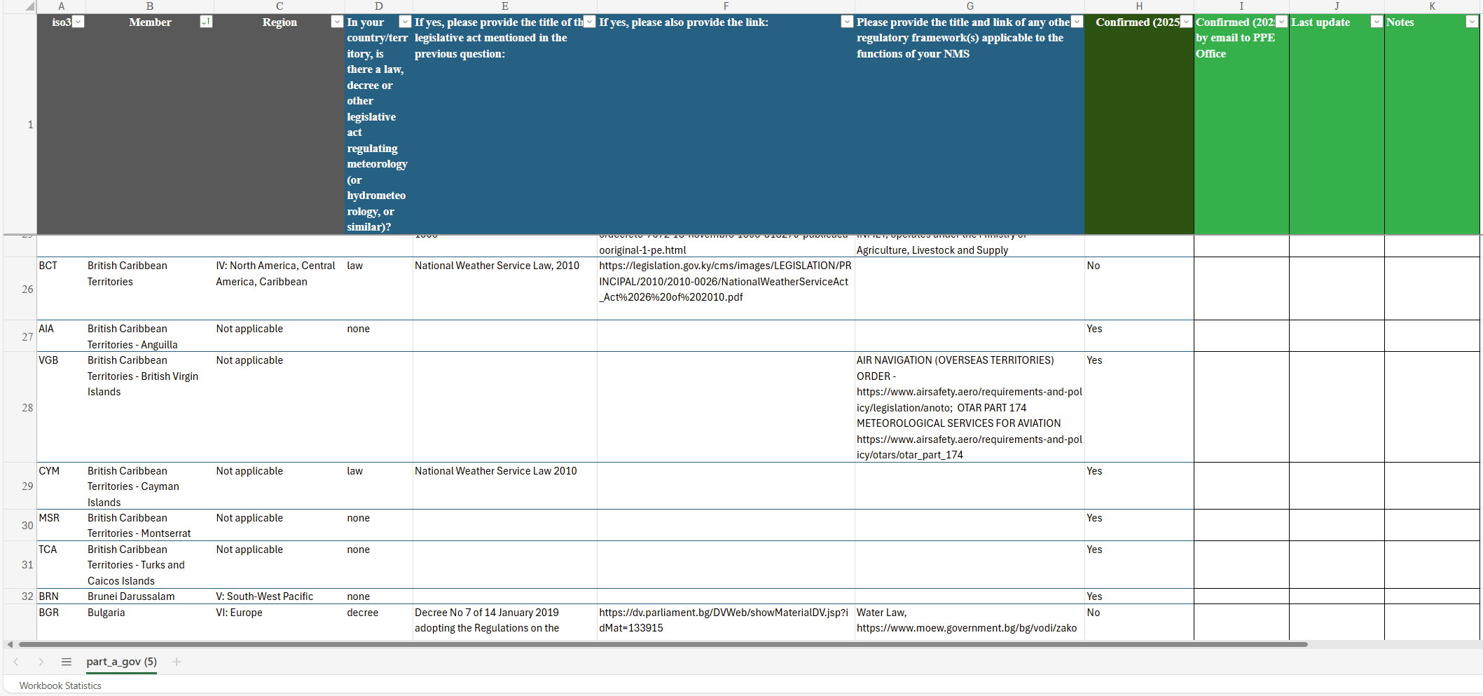
New Database! Members’ laws and decrees regulating meteorology and hydrology per country (1/2)
The database compiles Members’ national laws and decrees regulating meteorology and hydrology. It serves as a reference tool to reinforce the role of National Meteorological and Hydrological Services (NMHSs) through national legislation, and to facilitate strategic partnerships among stakeholders in the public, private and academic sectors.
It is expected to be used in conjunction with the Guidelines for Public-Private Engagement (2024 edition), endorsed by the EC last year. This database is currently accessible in read-only mode to anyone with the URL or to the Secretariat staff.
The link to the database is here (to be linked from the WMO PPE webpage very soon).

Slide 10
New Database! Members’ laws and decrees regulating meteorology and hydrology per country (2/2)
The database is organized by the following four categories, accompanied by information on updates:
Type of legal instrument
Title of legal instrument
Link to the legal instrument
Any other regulatory framework
The database is an initiative of the Secretariat (PPE Office!) to support WMO Strategic Plan, Objective 5.2 Nurture WMO strategic partnerships, assisted by the Planning, Foresight and Performance (PFP) Office in seeking confirmation from Members through its Data Collection Campaign 2025.
Please note that not all Members confirmed relevant data during the Data Collection or when it was shared with Members in August 2025 at a location different from the link above.

Slide 11
The latest developments in Japan
The amendment to the Meteorological Service Act (link to an older version), which includes strengthened regulations on forecasting services provided by foreign corporations, was unanimously passed and enacted in the national congress this morning.
From the perspective of appropriate operation of the forecasting service licensing system, the following measures will be implemented:
Mandatory designation of a domestic representative or agent when applying for a license
Revocation of licenses through simplified procedures when the whereabouts of the domestic representative or agent are unknown
Public disclosure of names and other information of individuals who conduct forecasting service without obtaining a license in violation of the Meteorological Service Act

Slide 12
Useful Links
Webpage for WMO Public-Private Engagement (PPE)
Geneva Declaration – 2019
Guidelines for Public-Private Engagement (2024 edition)
Legal database (to be linked from the WMO PPE webpage above soon)
WMO-HMEI Code of Ethics Guiding Public-Private Engagement
Online training course on Public-Private Engagement (PPE)
White Paper #1 and #2
Summary reports of Open Consultative Platform
Public-Private Engagement Interviews
WMO Call to All Stakeholders to Collaborate on the Development of Artificial Intelligence (AI) and Machine Learning (ML) Environmental Monitoring and Prediction Technologies, Tools and Applications (brochure)

Slide 13
Thank you

