Slide 1
Leadership and Management Workshop for Senior Management of RA III and IV Caribbean Members Practical Exercise 3: “Preparing a basic plan to strengthen strategic communications at NMHS” Group No. [ ] Members: [ ] Port of Spain, Trinidad and Tobago 1-5 December 2025

Slide 2
Objective of this exercise
Based on your own experience and the expériences and good practices shared in this workshop, draft a plan with a list of concrete actions to strenghten strategic communications and increase visibility in your NMHS.

Slide 3
Guidelines for this exercise
The exercise is intended to foster collaborative learning based in your practical experience, expertise, and perspectives.
The outcome should reflect the common views of the group, but if necessary, specific aspects of each country could be included.
It is recommended to use in this template.
Each group will designate a speaker to present the outcomes, and all team members have to be prepared to answer to clarification
Time for team work: 60 minutes, presentation 8 minutes/team
Slides to be sent to Ms Choi echoi@wmo.int

Slide 4
Groups composition for Practical Exercise 3
Group 1: Dale Destin, Shakeer Baig, Jaime Paul, Zhuan Sweeney, Rodney Martinez
Group 2: Sabu Best, Marshall Alexander, Denel Dixon, Jason Ernest, Eunjin Choi
Group 3: Ronald Gordon, Shawn Boyce, Gerard Tamar, Gilbert Miller, Haley Anderson
Group 4: Albert Martis, Kerry Powery, John Bowleg, Sharlene Smith, Paul Bugeac
Group 5: Evan Thompson, Jeffrey Jennings, Sharon Archie, Joseph Isaac, Kenneth Kerr
Group 6: Vigil Saltibus,, Holly Hamilton, Jeffrey Simmons, Arlene Aaron-Morrison,Arlene Laing
Hydrological Advisers
Resource persons

Slide 5
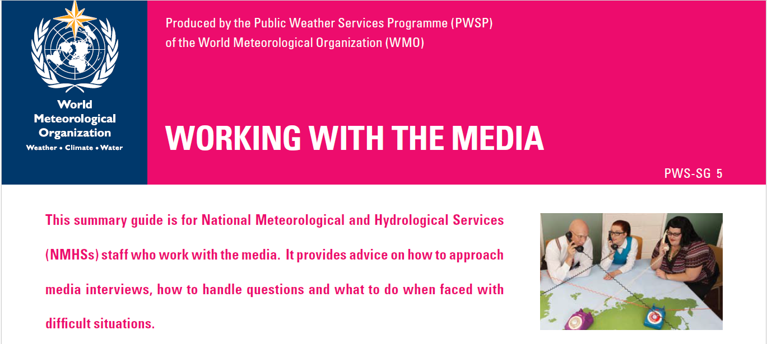
Preparing your strategic communication strategy
Media Guide for WMO Information and Public Affairs Focal Points at National Meteorological and Hydrological Services

Slide 6
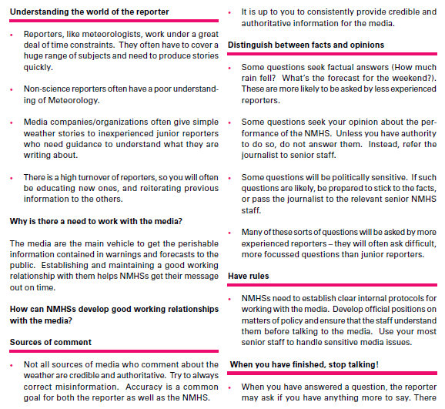
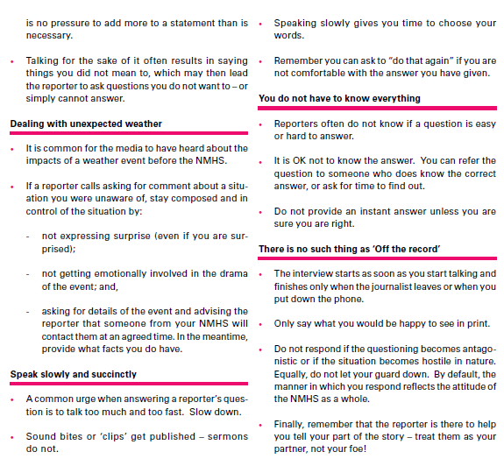

Slide 7
Proposed sequence of activities as part of Strategic Communications Plan for NMHSs
No. | Activity | Potential resources

Slide 8
Thank you!

