Slide 1
Leadership and Management Workshop for Senior Management of RA III and IV Caribbean Members Fundamentals of crisis management Dr. Arlene Laing and Rodney Martinez Port of Spain, Trinidad and Tobago 1-5 December 2025

Slide 2
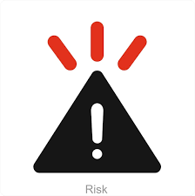
What is a Crisis?
Definition:
A crisis is an unexpected, disruptive event that threatens an organization’s people, operations, reputation, or assets and requires urgent decision-making under uncertainty.
Key characteristics:
High threat
Limited time
Uncertainty
Need for coordinated response

Slide 3
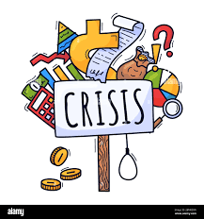
Types of Crises
Examples:
Disasters (storms, earthquakes, forest fires)
Technological failures (cyberattacks, system outages)
Human-caused crises (industrial action, oil spills, accidents, misconduct,)
Health emergencies (pandemics)
Reputational crises (media scandals)

Slide 4
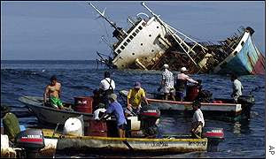
The Crisis Management Cycle
Prevention/Mitigation
Preparedness
Response
Recovery
Learning &
Improvement

Slide 5

Prevention & Mitigation
Identify vulnerabilities
Conduct risk assessments
Implement safeguards
Strengthen resilience
BUSINESS CONTINUITY MANAGEMENT!

Slide 6

Preparedness
Crisis plans and protocols
Communication templates
Training and simulations
Resource and supply readiness
BUSINESS CONTINUITY MANAGEMENT!

Slide 7

Crisis Response
Core actions:
Detect and assess the situation
Activate the crisis team
Implement business continuity measures
Manage internal & external communication

Slide 8

Crisis Communication Principles
Be timely, transparent, and accurate
Use a single, credible spokesperson
Coordinate messaging across channels
Monitor information and counter misinformation

Slide 9

Recovery & After-Action Review
Restore operations
Support affected stakeholders
Conduct after-action evaluations
Update business continuity plans and procedures

Slide 10
Incident Command Systems (ICS) Training
Connect with local disaster management offices who may offer such training or may know where training is offered

Slide 11

Key Takeaways
A crisis requires quick, informed decisions
Preparedness is the strongest defense
Communication is critical at every stage
Continuous learning strengthens future resilience
Refer to WMO Business Continuity Guidelines
Task Team members available to help

Slide 12
Thank you!

