Slide 1
Leadership and Management Workshop for Senior Management of RA III and IV Caribbean Members Resource Mobilization and Partnerships: Good Practices and Guidelines Daniel Kull​ Director, Development Partnerships ​ 3 December 2025

Slide 2
TABLE OF CONTENTS
WMO’s Approach to Resource Mobilization
WMO Channels of Support to Members
Good Practices and Guidelines
Guidance Note and Next Steps for 2026
The WMO Commons and Emerging Opportunities with the Private Sector

Slide 3
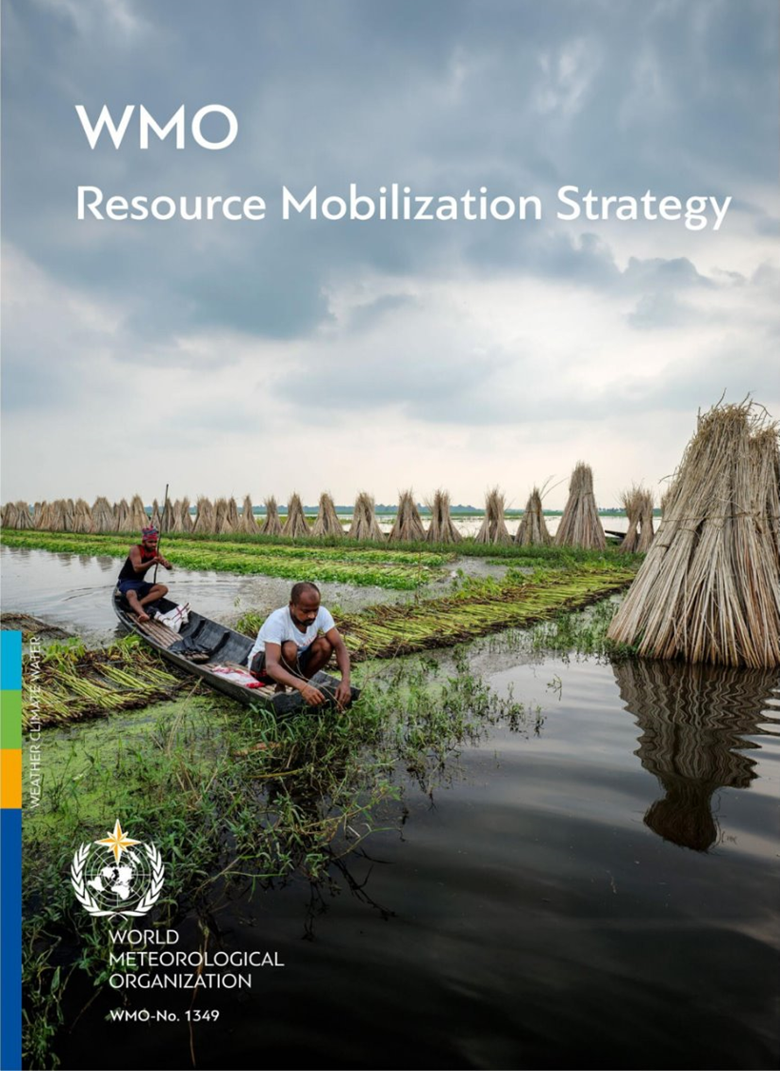

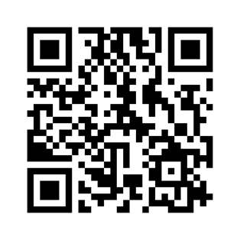
WMO Resource Mobilization Vision​
​
… mobilize voluntary contributions and partnerships for technical assistance and capacity development and effectively leverage them, in cooperation with stakeholders, to help WMO Members better provide weather, climate, water and related environmental services…
WMO Resource Mobilization Vision​

Slide 4
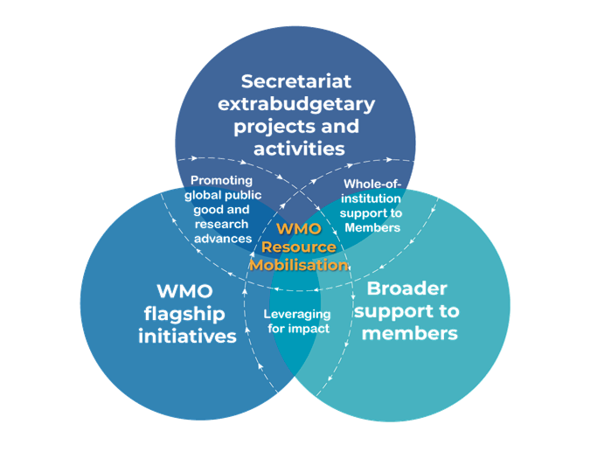



WMO’s Approach to Support Members – Three Spheres
INCREASE
Extrabudgetary projects and activities, including technical assistance, capacity development, development projects, research-innovation based activities, and WMO global programs requiring resources beyond regular budget
STRENGHTEN
WMO flagship initiatives, where investments support delivery and implementation across regions- EW4All and GBON
ENHANCE
Broader support to Members, including supporting development partners to deliver technically appropriate needs-based investments and assisting Members to directly mobilize resources
Whole-of-institution support to Members
Promotion of global public good & research advances
Leveraging for impact

Slide 5








Key Priorities for Resource Mobilization and Partnerships
Traditional Donors
Financing Opportunities
Partner Network
Member-to-Member
WMO alignment
Communicate Results
PPPE
Objective 1 - Deepen strategic partnerships and financing opportunities with traditional bilateral donors, funding agencies, MDBs and climate finance institutions.
Objective 2 - Identify and actively engage new financing opportunities including joint initiatives, co-financing, and regional/multilateral funding instruments
Objective 3 - More actively pursue foundations, commercial enterprises, and other non-public entities while ensuring due diligence
Objective 4 – Facilitate continuous engagement, information exchange, and visibility across WMO´s partner network.
Objective 5 - Support Member to Member engagement in WMO and Partner projects. Enhance VCP.
Objective 6 - Ensure alignment between WMO priorities, Member needs, and donor interests through coordinated outreach and dialogue
Objective 7 - Communicate Results and Impact to Members, Donors, and Partners.

Slide 6
WMO Channels of Support to Members

Slide 7

WMO Channels of Support to Members
WMO Engagement Framework
WMO Implemented Projects
Voluntary Cooperation Programme (VCP)
Facilitated Strategic Partnerships
Technical Assistance (TA)

Slide 8













WMO Implemented Projects
Purpose: technical and capacity development services
Project development process
Member needs aligned to donor interests
Co-design with NMHSs & ROs
Donor requirement
Engagement with technical teams
Target: Multi-year, multi-partner initiatives. Regional and Single country projects in Member countries
WMO Role: Implementing partner, fiduciary agent, technical lead
Funding: up to 25,000,000 CHF

Slide 9




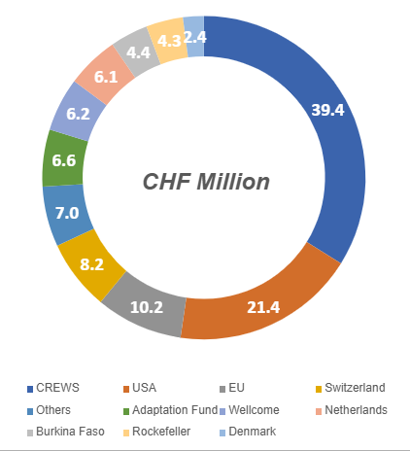







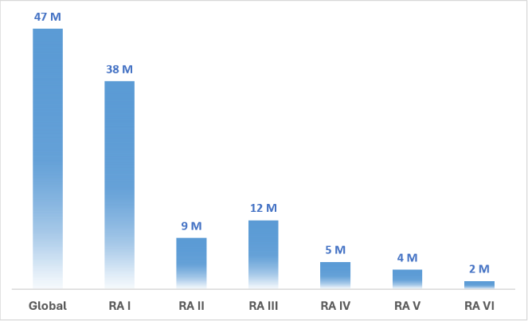

WMO Extrabudgetary Portfolio Overview (as of 25 Nov)
Example of EW4ALL Projects
XB Projects
Major Funding Partners (CHF)
Active XB Projects
Pre-Approved XB Projects
Funding Partners (CHF)
52
59
Active Projects
Active Projects
14
Pre-Approved Projects
Antigua and Barbuda, Cambodia, Chad, Fiji, Ecuador, Ethiopia, Somalia
11
116 M
CHF Active Projects
WMO Budget: CHF 5.5 Million
Of 52 started in 2024
83 M
CHF Active Projects
2026-2031
127 M
77 M
CHF Active Projects
CHF Pre-approved projects (11)
116
CHF Million
63 M
Niger, Somalia, South Sudan, Uganda and Tanzania
CHF Pipeline projects (48)
Pre-Approved Highlights
WMO Budget: CHF 2.4. Million
Regional Distribution (CHF)
January 2024 – January 2028
Regional Distribution of active projects (M CHF)
CHF 12.9 M “AFDB Proposal”
CHF 10.9 M “HydroSOS BaNe” (AF)
CHF 11.8 M “Drin Basin” (AF)
CHF 9.5 M “Lake Chad” (AF)
CHF 8.6 M “Saudi Arabia”
Bangladesh, Haiti, Liberia, Mozambique, Somalia
WMO Budget: CHF 726,000
January 2024 – December 2025
More than 80 countries worldwide
WMO Budget: CHF 39.4 Million
WMO project portfolio supports EW4ALL – mainly Pillar 2
EW4ALL contributions from WMO project portfolio

Slide 10


Project Overview in RA III and IV (as of 25 Nov)
Active Projects in RA III and IV
Approved
4
CREWS Caribbean 2.0
CREWS Haiti
CREWS ASW Belize
CREWS ASW Cuba
ENANDES (AF)
ENANDES + (SDC)
HydroHub Phase II (IDB)
UNDP GCF EW4All Project (Antigua and Barbuda)
GCF CREWS Scale up of Caribbean MHEWS (Trinidad and Tobago, Belize)
Active Projects in RA IV (4.9 M CHF)
3
Active Projects in RA III (12.4 M CHF)
Cross Regional & Global Projects
Pre-Approved
CREWS Dominican Republic
3
Cross Regional
Swedish Contribution to EW4All (HaitI)
Intra-ACP Climate-Services Programme (Jamaica)
HydroHub Phase II (SDC; Costa Rica, Argentina)
Pipeline
2.7 M
CHF
CREWS ASW Saint Lucia
CREWS ASW Strengthening Radar Data (Belize, Jamaica, Suriname, Guyana)
CREWS EW4All Accelerator 2.0 (Dominica, Guyana, Suriname)
Enhancing Climate Change Adaptation Capacity in Costa Rica and Panama (AF)
La Plata basin improved water quality (AF)
7
Global
US DoS: FFGS & EWS-F
Acc. Action for Extreme Heat & Health (Wellcome)
Transforming Climate Sciences and Services for Health (Wellcome/Rockefeller)
Climate Science Information for Climate Action
IClimate Action (EU)
30.7 M
CHF
Notes:
GCF CREWS Scale up in grey since it’s not really a WMO project -

Slide 11





WMO Implemented Projects - CREWS
Overview: Multi-country financing mechanism to establish risk-informed early warning services.
Since 2017, +396 million people in 45 countries have gained access to forecasts and early warning services developed or enhanced with CREWS support.
Eligibility: LDCs and SIDS
Focus:
Scaling up investments
Vulnerable and fragile states
Country ownership
Sustaining investments
Implementing partners:

Slide 12



WMO Implemented Projects - CREWS
GCF & CREWS – Simplified Approval Process
Accelerated Support Window (ASW)
Multi Year Projects
Country Projects: USD 3–5 million (3–5 years)
Regional Projects: USD 5–7 million (5–7 years)
Small-scale and short-term assistance
budget:
up to USD 250 (12 months)
Fast-track access to GCF finance: up to USD 25 million per project
Submission:
Submission by implementing partners (WMO, UNDRR, WB)
Country endorsement
Approval by the Steering Committee
Submission:
(A) direct by the country; (B) implementing partners endorsed by the country
Simplified 6-week approval process
Eligibility: countries with successful CREWS programmes
Submission:
GCF procedures

Slide 13
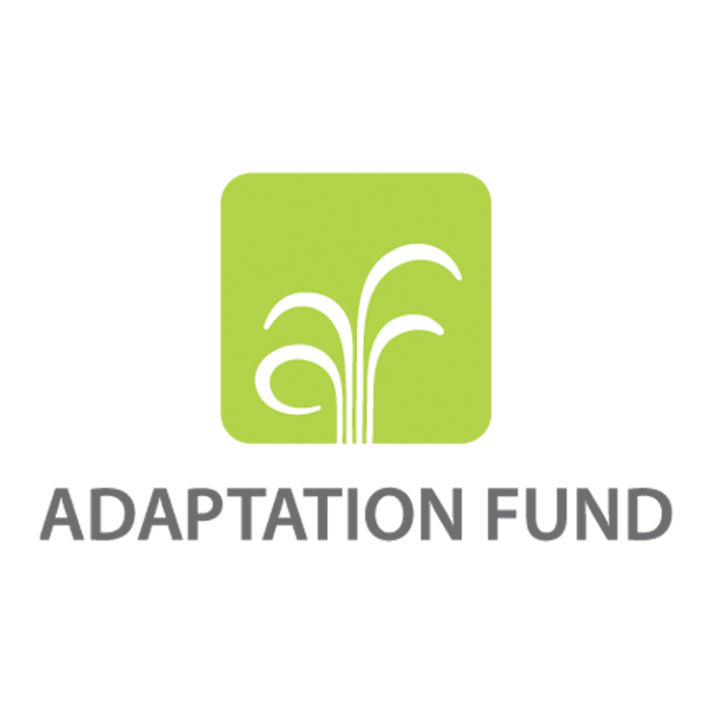
WMO Implemented Projects – Adaptation Fund
Engagement
Process
Overview: Multilateral climate fund targeting adaptation.
Regional Projects
WMO is an accredited Implemented Entity
Proposal developed in coordination with the RO and Members
Year-round submission
Board evaluation to the submissions on April and October.
aprox. 2 years to start implementation
Up to USD 30M
Three-step process:
Pre-concept note
Concept note
Full proposal
Eligibility: Developing countries parties of Kyoto Protocol
Focus:
Action, Innovation, Learning/Sharing
Based on national needs and priorities
Support vulnerable communities
Single-country Projects
Up to USD 25M
Two-step process:
Concept note
Full proposal

Slide 14

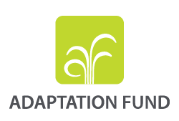














Alliance for Hydromet Development
Coalition of 15 international development, humanitarian & climate finance institutions committed to closing the Hydromet Gap

Slide 15

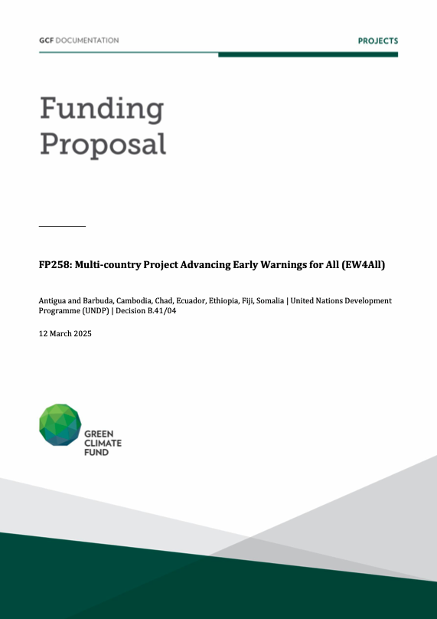
WMO–GCF Collaboration
MoU (2017): Established strategic collaboration
Expert Services (2018–): Tools, trainings, and proposal support for NDAs/DAEs/NMHSs
Technical Partner: Scientific inputs for AEs (UNDP, UNEP, UNICEF)
Readiness Delivery Partner (2025– ): Supporting integration of hydromet services into national climate planning
CREWS–GCF Projects: Scale-up work in Togo and the Caribbean; nine more in the SAP pipeline.
Accreditation pre-screening (2025-)

Slide 16





Technical Assistance (TA)
Example – Recent Request
Purpose: address strategic needs through high-value interventions in non-WMO projects.
From INDRHI– (Instituto Nacional de Recursos Hidráulicos) Dominican Republic to support
World Bank funded project on:
Modernization of the Information System and Hydrometric Network of the National Institute of Water Resources
Focus: provide technical expertise by mobilizing and collaborating with partners to ensure quality and best practices.
WMO TA:
Hydrometric network assessment and optimization in the Yaque del Norte basin, including technical specifications for equipment.
Data management and hydrological forecasting system improvements.
Capacity development, including training and expert support.
Coordination and engagement with INDRHI, the World Bank, and national authorities.
WMO Role: Provide technical assistance to ensure strong developement of NMHS ans warning services
Cost recovery process
Currently under discussion with INDRHI on the direct contracting of WMO, pending final scope, budget validation, and approval.

Slide 17

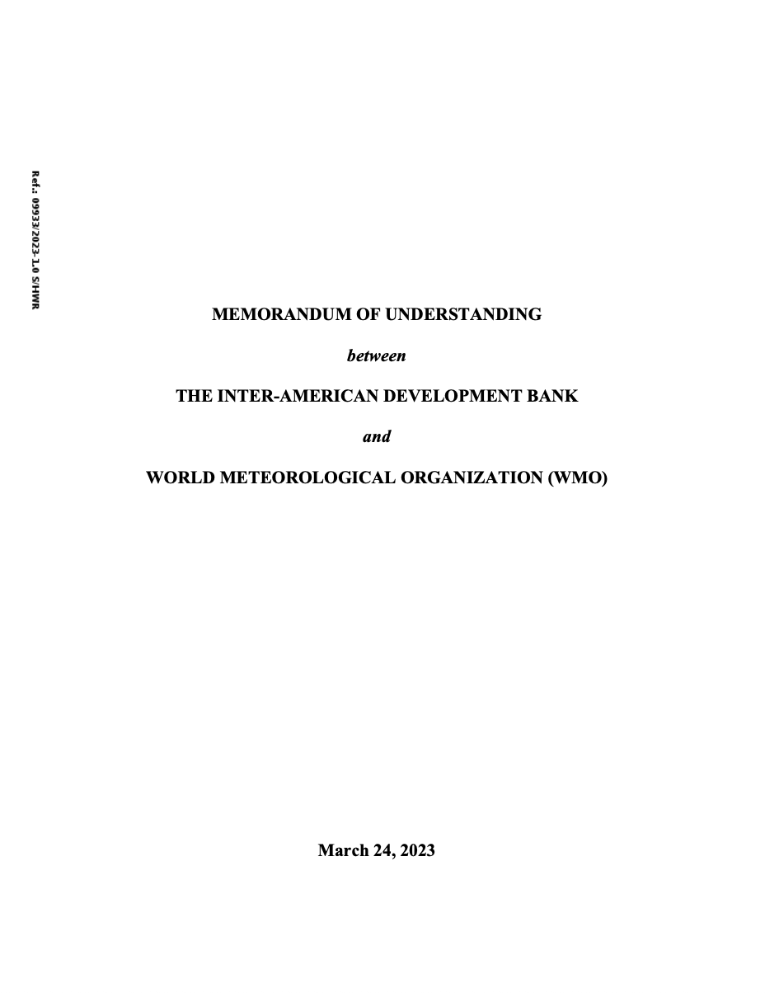
WMO – Inter American Development Bank
2023: MoU
2025: 2 Technical Cooperation
9 Key Collaboration Areas:
Global Water & Climate Dialogue
Development of Technical Products
Capacity-Building in LAC
Innovation for Water Security
Cross-Sectoral Planning Support
Support to the Early Warnings for All Initiative (EW4All)
Hydromet Development Alliance & SOFF Collaboration
Information Exchange & Joint Action Planning
Staff Exchanges
Proposal 1: WMO Technical Assistance under the Ready and Resilient Americas (RG-T4696) Programme ​
Objective: Develop, validate and pilot a conceptual model for Impact-Based Early Warning Systems (IBEWS) to guide future IDB investments in LAC
Proposal 2: Detailed Methodology for the Development of a National Hydromet Roadmap
Objective: Assess of hydrometerooloal services to support water-resources management in Paraguay
Status
Technical and financial proposal submitted to IDB
Awaiting feedback on preferred option and next steps
WMO team ready for further discussion

Slide 18
Voluntary Cooperation Programme (VCP)
Purpose: Quick-response, flexible, country-led
Fields of Support under the VCP
(Resolution 68, WMO Cg-18)
Legislation and national planning for NMHSs​
Short- and long-term fellowships​
Short-term training seminars​
User engagement for applications & service delivery​
Observing and data-processing systems​
Contingency planning for disasters​
Other areas proposed by the SG or Executive Council​
Focus: Facilitates small-scale, Member-to-Member support.
WMO Role: Matchmaking, coordination, reporting
Funding: up to 15- 20,000 USD

Slide 19
Good Practices and Guidelines

Slide 20




“4 Rs”of Resource Mobilization at the Country Level
Responsibility
Relationships
Realistic vision
Readiness
Notes:
Responsibility:
Global engagement and dialogue generates the clouds but national action and advocacy “makes it rain”!
Addis Ababa Action Agenda for Financing for Development (July 2015)
endorsed by the UN General Assembly
“...each country has primary responsibility for its own economic and social development and the role of national policies and development strategies cannot be overemphasized.”
“...respect each country’s policy space and leadership to implement policies for poverty eradication and sustainable development...”
“International public finance plays an important role in complementing the efforts of countries to mobilize public resources domestically...”
“…align activities with national priorities, including by reducing fragmentation...”
“…promote country ownership and results orientation...strengthen partnerships for development... increase transparency and mutual accountability.”

Slide 21
Relationships​​​​
Government Apex Bodies
(MoF, Office of PM, etc.)
MDB/Fund governance
Parliament & Public
Designated Authorities
Parent Ministry
Int’l partner/donor headquarters
Stakeholder Ministries
NMHS
Int’l partner/donor national offices
Stakeholder Agencies
Stakeholder NGOs, firms, etc.

Slide 22
Realistic vision
Future annual budget
Status in government
Ability to attract and retain qualified staff
Staff training needs and opportunities
Fit-for-purpose infrastructure
Fit-for-budget infrastructure (“total cost of ownership”)
Capacity and market for revenue generation
Opportunities for co-production and public-private engagement
Sustainability of investments!
Benchmarked Costs
Station type | Capital Costs | Annual O&M Costs
AWS | $56,000 | $12,100
Manual upper-air | $1.5 - $2.0 million | $424,000
Auto upper-air | $0.8 - $1.5 million | $289,000
Doppler radar | $2.5 - $4.0 million | $177,000
Hydrology (river) | $28,000 -$45,000 | $9,000 -$24,700
Source: Grimes, D.R.; Rogers, D.P.; Schumann, A.; Day, B.F. (2022). Charting a Course for Sustainable Hydrological and Meteorological Observation Networks in Developing Countries. World Bank, Washington, DC.

Slide 23

Readiness
Service delivery strategy in place or being developed
Legal framework which clearly defines roles, responsibilities, authorities and potential role of private sector in place
Gap assessment to identify investment priorities (Country Hydromet Diagnostics)
Stakeholder consultations and market research to identify revenue, co-production and public-private engagement (PPE) opportunities
Detailed modernization roadmap with costed investment plan
Cost-benefit analysis
Project management, fiduciary and coordination capacity
Project structure (NMHS as implementing agency?)
Many development partners make grants available to support readiness

Slide 24

Climate Finance Decision-Making in a Stakeholder-Driven Process​
Key Actors in National-level Climate Finance Mobilization
National Planning Processes &
Country Ownership Principle
National planning Processes
The Country Ownership Principle​
Key Actors in National-level
Climate Finance Mobilization
Role of National Designated Authorities
Role of project pro-ponents
Role of NMHS
Role of other actors

Slide 25
Guidance Note - Enhancing the Role of NMHS in Mobilizing Climate Finance at the National Level

Slide 26
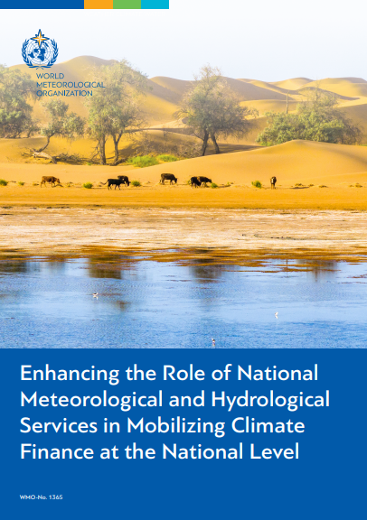
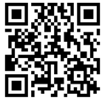





Guidance Note - Enhancing the Role of National Meteorological and Hydrological Services in Mobilizing Climate Finance at the National Level
WMO has published a Guidance Note on enhancing the role of NMHS in Mobilizing Climate Finance at the National level with the following primary objectives:​
Provide comprehensive insights into climate finance actors and processes at the national level.
Highlight climate finance decision-making principles and NMHSs' role as key drivers in the mobilization process.
Identify opportunities for collaboration with funding agencies and national stakeholders to propose projects aimed at strengthening institutional capacity.
Outline strategies for empowering NMHSs through initiatives focused on vision setting, strategy development, and enhanced agency perception for resource mobilisation both for the country's climate ambitions and for the NMHSs

Slide 27

Value of NMHS’ Inputs for Climate Finance Mobilization
Donors may be hesitant to finance projects as climate action without a solid underpinning of the climate science showing the causal link between the current or expected climate variation and the investment’s ability to address any potential impacts.
Climate science, data, information, and analysis bridge this by establishing a climate science basis for any selected climate action.
NMHS knowledge supports upstream country investment planning to understand what and where investments may be most needed.
Underpin with the necessary data and information where climate impacts are being felt; may be experienced in the future; and what response measures should be developed as investments to address these impacts.

Slide 28


NMHSs require Training on Resource Mobilization
Demonstrating Value Requires Leadership
The empowerment of NMHSs as being central to national level decision-making will require leadership.
NMHSs need strong visionary leaders who can see the big picture and think strategically to bring about innovative changes to develop institutional and infrastructural capacity and to sustain it.​
Leadership involves
A vision that secures buy-in at all levels of the agency;​
A strategy that is deliberate in expanding the NMHS’s role to support decision-making at the national level; and​
A shift in perception that reframes the NMHS from being only a technical agency to one that enables national development and prosperity.​

Slide 29
Next Step : Building NMHS Capacity to Access Climate Finance
Develop Training Modules
Training & Guidance
Scale up national and regional capacity on climate finance access, proposal development, and reporting.
2026 workshops planned for RA III and RA IV, and a national workshop in Uganda
Donor Mapping Activities
Enhancing the Role of NMHS in Mobilizing Climate Finance at the National Level.
Climate Finance Dialogues
Institutional Frameworks
Co-organize dialogues with regional development banks, UN partners, and bi-lateral donors and climate funds to connect NMHSs with potential financiers.​
Support Members in integrating hydromet priorities into national climate and development finance strategies, including joint resource mobilization.

Slide 30
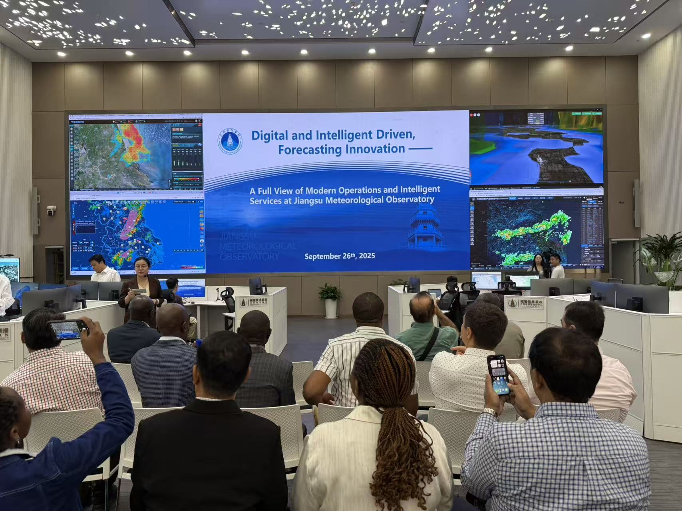
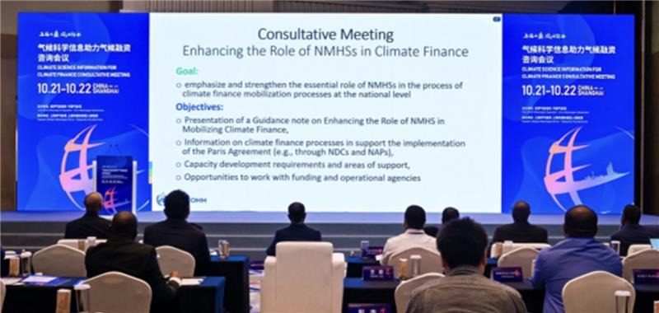
Operationalizing the Guidance Note: National Workshop on Accessing Climate Finance
Climate Services to Enhance Access to Climate Finance for Senior Directors of NMHSs in Beijing and Nanjing in 2025
Uganda Pilot
Country Challenges
Limited institutional and technical capacity for proposal development
Weak coordination with national authorities and low visibility in financing frameworks
Need for stronger strategic communication, negotiation skills, and climate-finance literacy
WMO First Consultative Meeting on Climate Science Information for Climate Finance in Beijing in 2024
Activities
Write shops on proposal development
Resource mobilization capacity of the NMHS
Engagement with NDAs, and pro-active outreach to in-country missions/ Embassies,
Communication of SEBs
Integration and alignment with NDCs and NAPs

Slide 31
The WMO Commons and Emerging Opportunities with the Private Sector

Slide 32

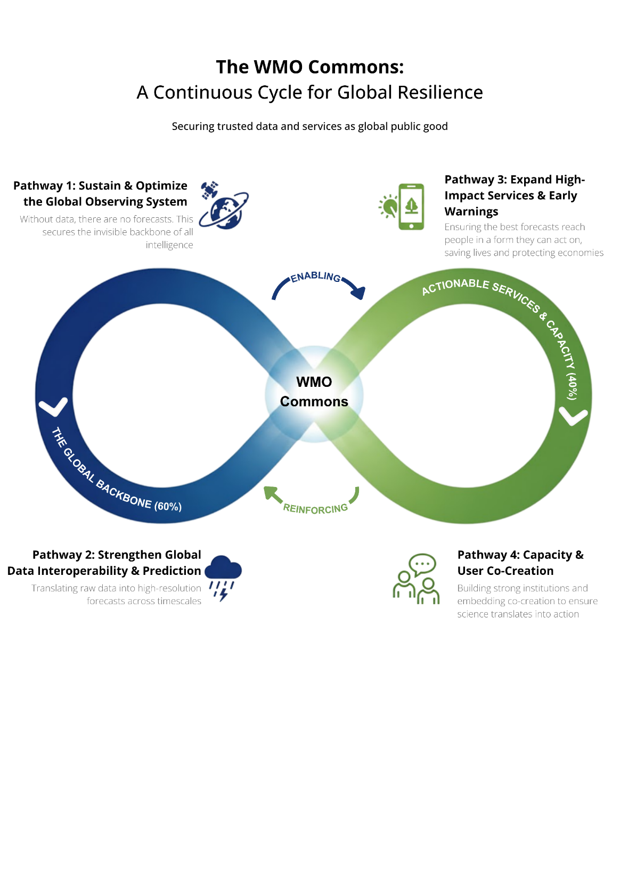
WMO Weather, Climate and Water Intelligence Commons
A Financing Partnership for a Resilient Future
The Ask: Commit, Join and Advocate
What it is: a global pooled financing partnership to safeguard and strengthen the public backbone of weather, climate and water intelligence
Goal: mobilize at least $100m over 5 years, leveraging the billions already invested
How it works: channel contributions to four investment pathways; track impact in real time; drive solutions with the community
Why now: to secure and enhance trusted data/services as global public goods and close the climate intelligence divide

Slide 33

WMO Investor Forum
Following the Investor Forum, early signals of interest are emerging​ from private sector actors to invest in observational infrastructure​ and support open data under the WMO Commons.​

Slide 34
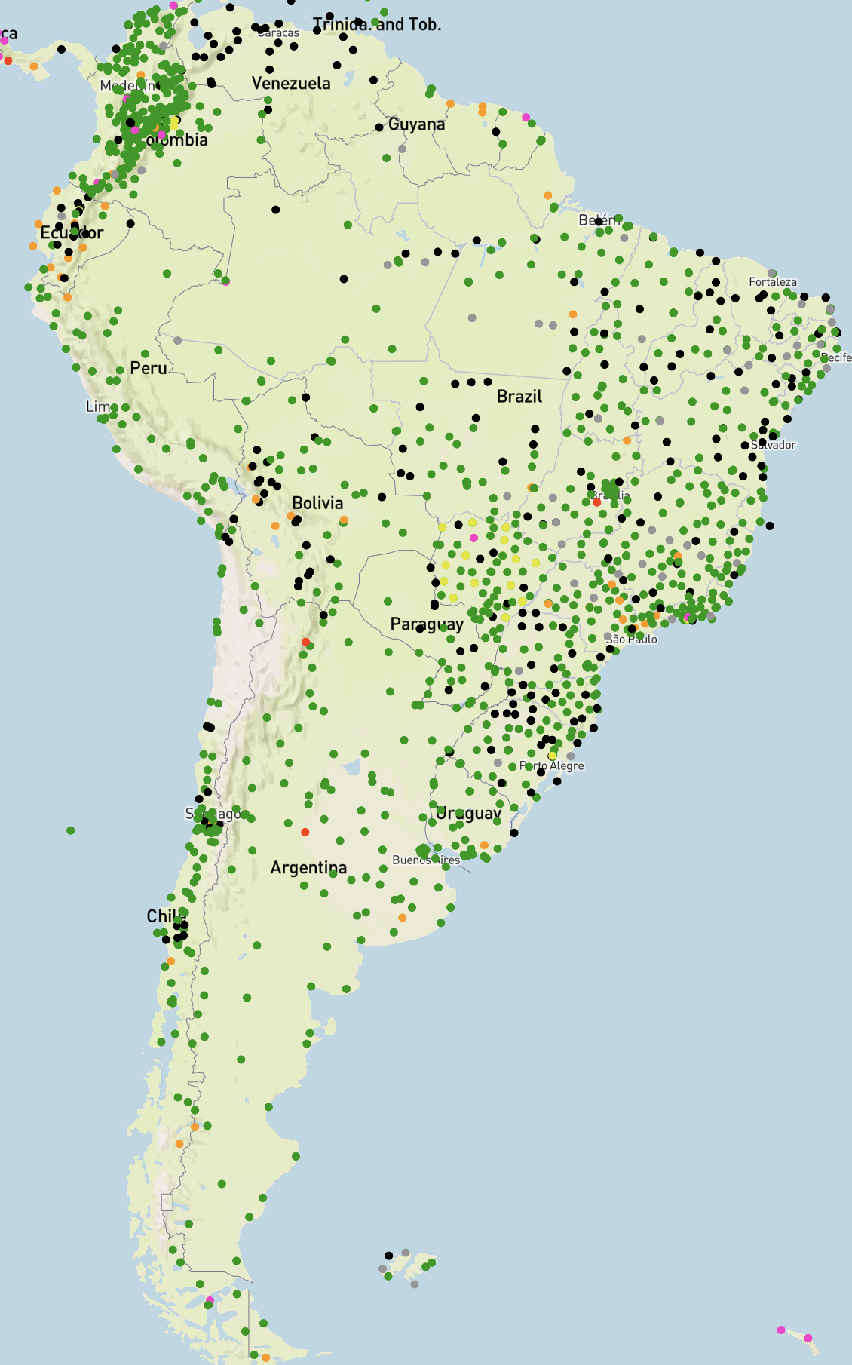


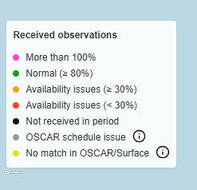
Private-Sector Interest in South America under the WMO Commons
Limited Coverage of Surface Land Observations (global NWP) from the WIGOS Data Quality Monitoring System (WDQMS) – as of 25 November 2025
Opportunity
Approach
Mutual Value
Interest from the private sector to expand weather-station coverage in Argentina and Brazil, strengthening open data and improving global and regional forecasts while delivering mutual value under the WMO Commons.
Jointly develop a pilot business case for private-sector installation of weather stations in Brazil and Argentina, ensuring open data, WMO standards, and integration with global forecasting systems.
Strengthens the WMO Commons as a platform for open, co-financed data sharing — expanding observation networks while enabling the private sector to improve local forecasts and resilience through a public-private collaboration model.

Slide 35
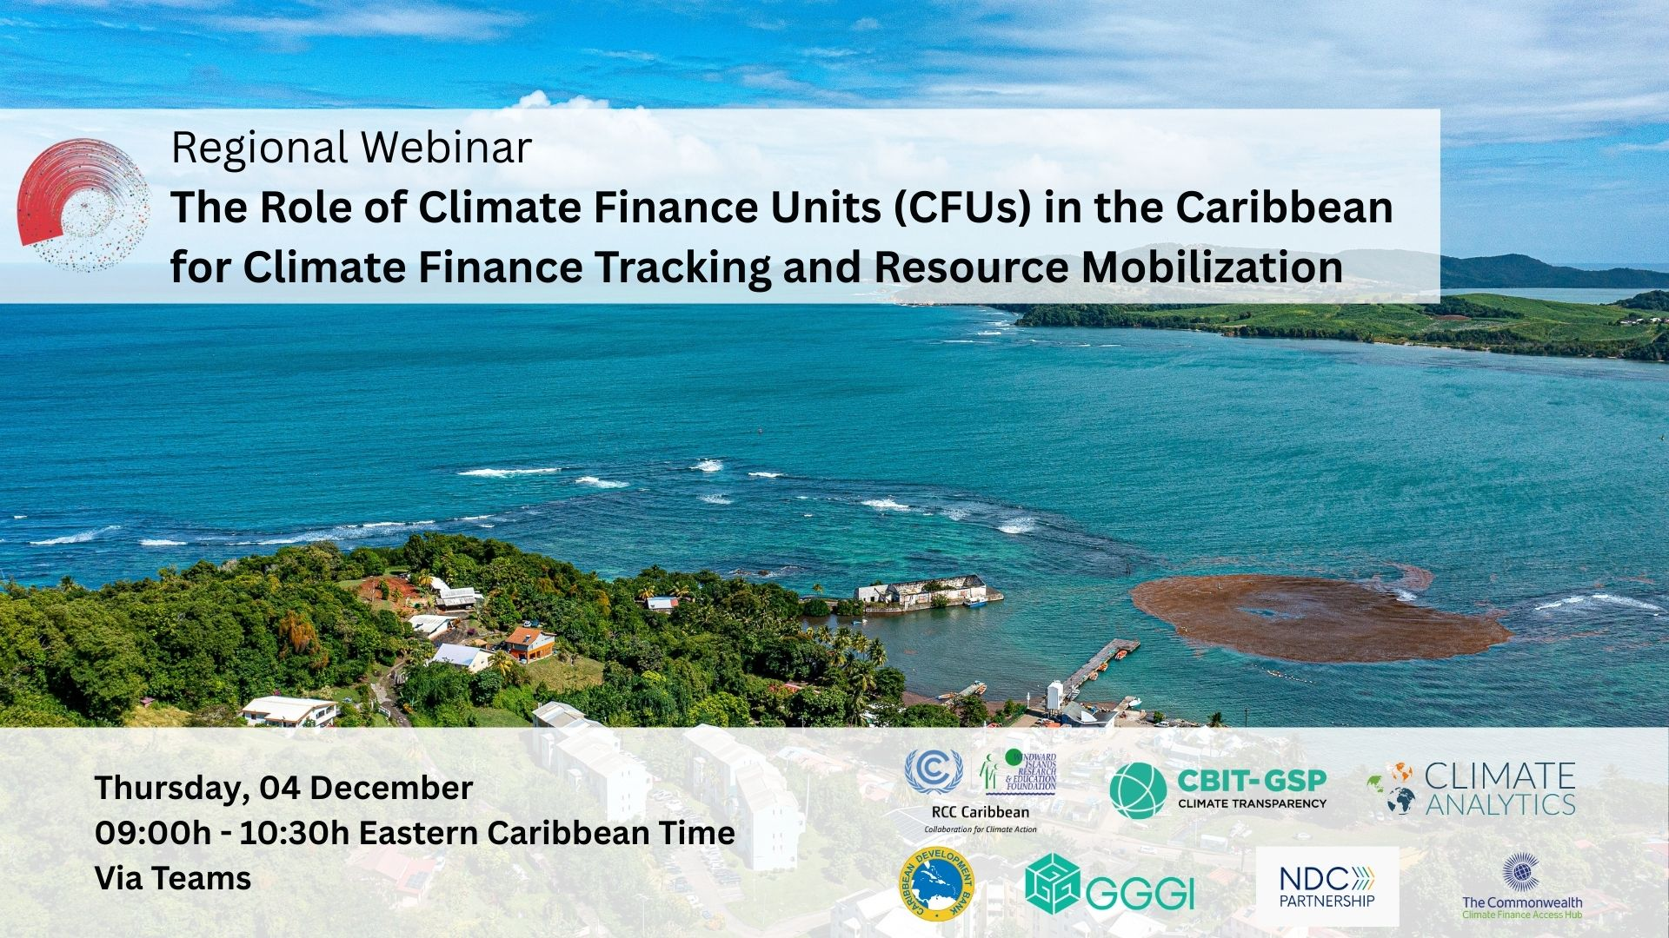


Slide 36
Q & A Thank you!

