Slide 1


Competency management
Paul BUGEAC
Coordinator, Learning and Development
WMO Education and Training Office

Slide 2

The competence of an institution in delivering services is based on its leadership and the competence of its staff

Slide 3
Competency is the ensemble of the knowledge, skills, and behaviors required to perform specific tasks in the fulfillment of a job responsibility.
Acquiring competency in specific areas requires ongoing job-specific education and training throughout an individual’s career.

Slide 4

WMO 49 defines competency as the knowledge, skills and behaviours required to perform specific tasks in the fulfilment of a job responsibility
When is a person considered as being COMPETENT in operational activities?
When he/she has the specific qualification?
When he/she has a PhD in his/her activity?
When he/she has the ability to do the job?
When he/she has a lot of experience in the job?
In simple words: When he/she has the required qualification and DOES the activities according to the job description!

Slide 5
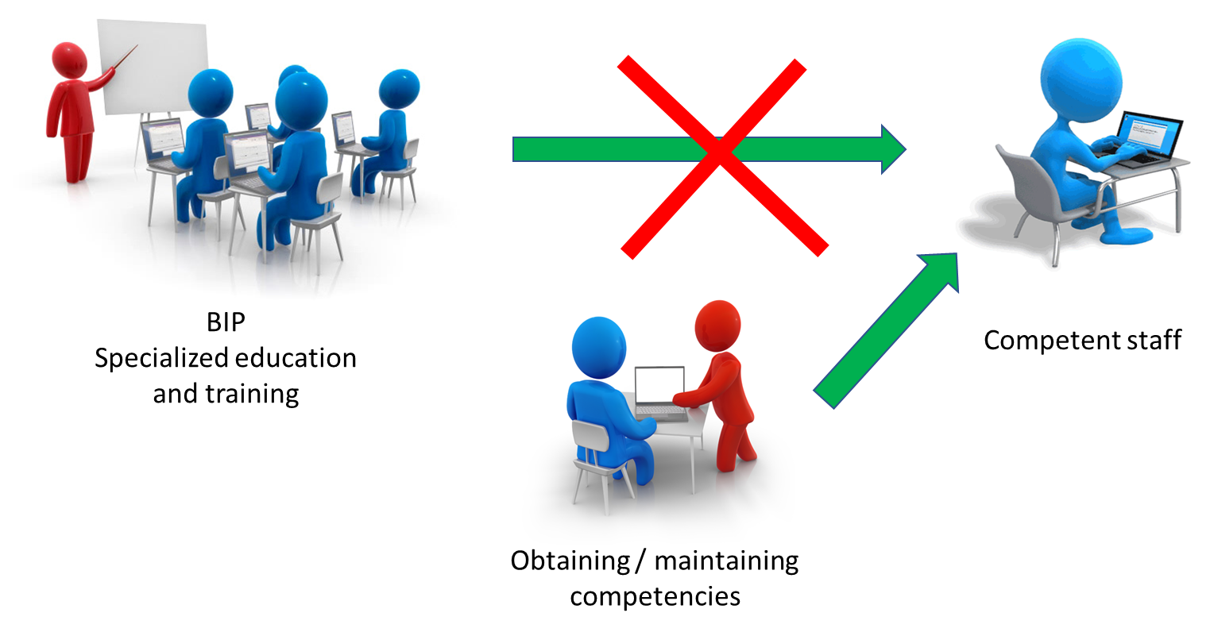

Slide 6


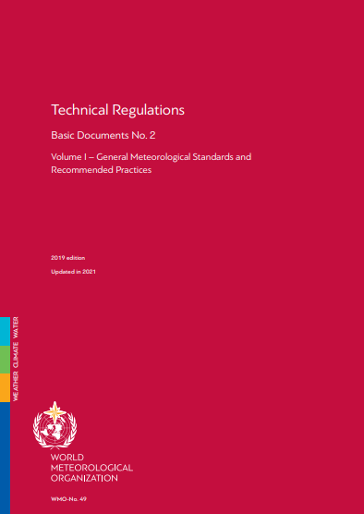

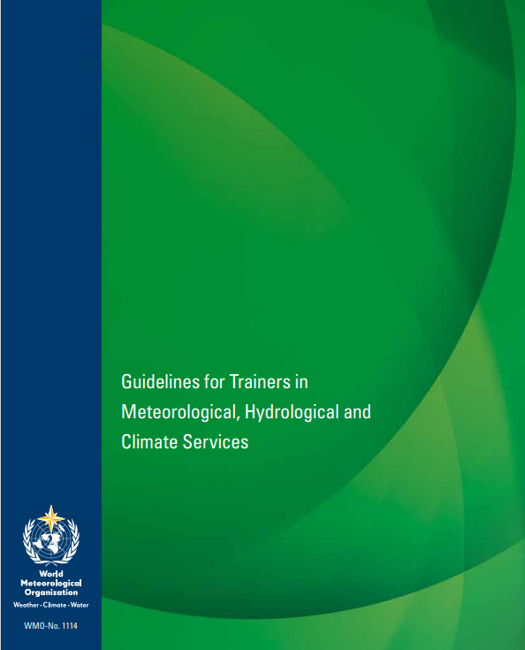


Slide 7

Everything starts with JOB DESCRIPTION
Activities that have to be conducted
  In detail like:
    perform forecast of wind, temperature, weather, clouds and visibility
    Validate information on parameters measured by AWOS
Performance components
(a) Execute routine calibrations on a day-to-day basis in accordance with standard calibration procedures;
(b) Compute the calibration uncertainty in conformity with the SOPs;
These provide references, and the approach shown above should be applied to all performance criteria.

Slide 8
Knowledge and skill requirements
(a) Understanding of general meteorology as described in BIP-MT, including physical meteorology, dynamic meteorology, synoptic and mesoscale meteorology, climatology, meteorological instruments and methods of observations;
(b) Identification of clouds and other meteors using the International Cloud Atlas: Manual on the Observation of Clouds and Other Meteors (WMO-No. 407) as guidance;
(c) Meteorological factors leading to the evolution of significant weather;
(d) Standard operating procedures (SOPs) and prescribed practices for monitoring weather conditions.
(a) and (b) are OK as they are related to learning outcomes. Regarding (c) and (d), they are titles, not indicating the level of expected outcomes.
You can write them as:
(c) describe the meteorological factors leading to the evolution of significant weather;
(d) apply the standard operating procedures (SOPs) and prescribed practices for monitoring
weather conditions.

Slide 9

Job description
A job description summarizes the essential responsibilities, activities, qualifications, and performance criteria for a role.
Also contains the training needed to perform these specific activities
The Job description needs to be focused, describing activities and performance criteria in an unambiguous way
Is the reference point for service delivery, staff recruitment, and competency assessment

Slide 10

Meteorological technician: A person who has successfully completed the requirements of the Basic Instruction Package for Meteorological Technicians.
Meteorologist: A person who has successfully completed the requirements of the Basic Instruction Package for Meteorologists at a university degree level.

Slide 11



The Basic Instruction Package for Meteorologists and the Basic Instruction Package for Meteorological Technicians define the common core of educational requirements of those studying to become a meteorologist or a meteorological technician.
Achieving the learning outcomes as specified in BIP-M or BIP-MT is a pre-requisite to gaining workplace competence
2023
2003

Slide 12
The BIPs are creating connections with the WMO Competency Frameworks
To become an aviation meteorologist, a person needs to acquire the core knowledge and skills as defined in BIP, and to demonstrate the specific competencies, based on underpinning knowledge and skills described in the WMO competency framework

Slide 13
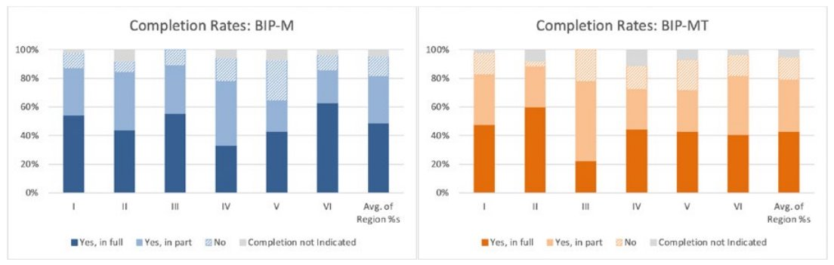
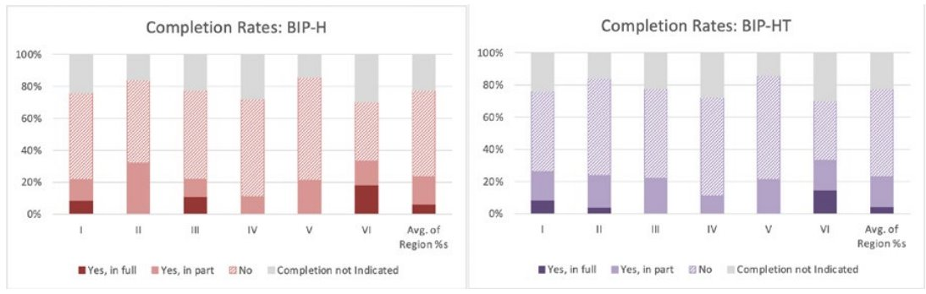

Slide 14




Slide 15




On site
Specialist Training
Competency Assessment
Education
(BIP)
RTCs, other
Training Centres
Formal
Education
Training for BIP compliance
COMPETENT
On-the-Job Training

Slide 16
There are no basic or advanced competencies, only those appropriate for different job functions. Competencies define what must be done, in other words, they describe the basic requirements for successful performance. However, they do not specifically define the level of skill expected, which is expected to grow with experience and professional development. People can be novice or expert and possess the same competencies. They just apply them with varying levels of skill.
Competencies address specific job functions
Competencies should be defined in a way that does not require significant changes over time. The introduction of new tools or data does not alter the responsibility or the need to perform tasks, even if they are accomplished in a different manner. Organisations may choose to adapt the performance criteria to specific technologies employed in the service area.
Top-level competencies are static and independent of technology.
Competency frameworks broadly outline the service delivery requirements for each job function. This ensures that the framework can be applied in any Member’s organisation. Organisations are required to adapt the competency framework to meet their specific operational needs.
Competencies are generic for the service area and are adaptable.

Slide 17
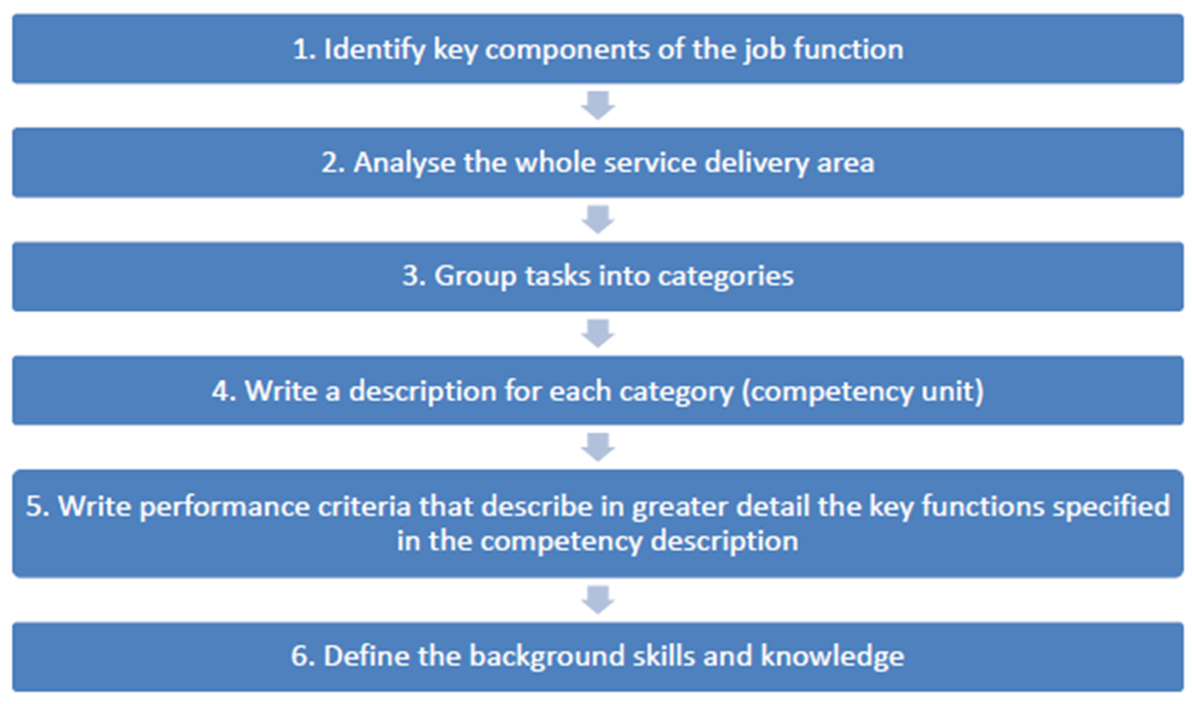

Slide 18
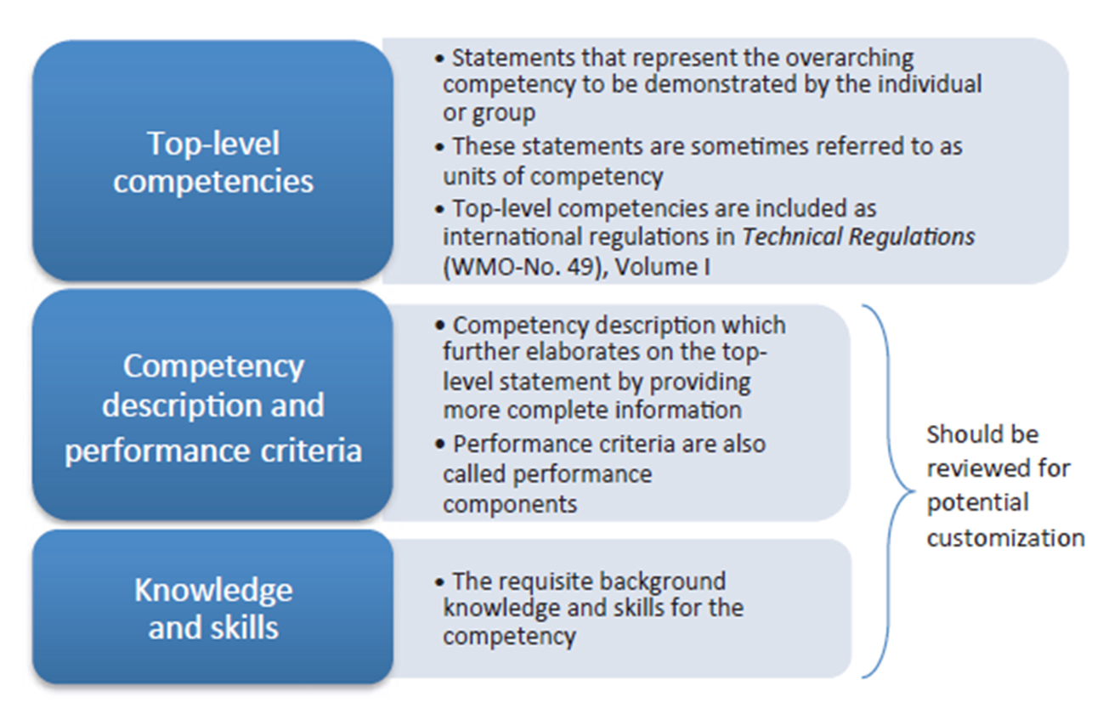

Slide 19
In a job position, not all competencies need to be addressed
In cases of multitasking (as it happens in most NMHSs), only some competencies can apply or combinations thereof
Performance criteria are flexible, and need to be authentic, linked to the performed activities.

Slide 20
The On-the-job training
On-the-job training (OJT) is a practical approach to acquiring competencies and skills needed for a job in a real, or close to real, working environment.
On-the-job training allows employees to gain experience working in situations very similar to those they’ll encounter on a daily basis.
Employees will use the same tools and equipment they need for their job while being guided by an experienced trainer.

Slide 21

Competency assessment
The assessment is performed on those identified tasks and skills for which a rating is selected based on how they do that task, which defines their proficiency level. In other words, a competency assessment measures how (behaviors) someone does the what (task, job).
The individual’s selected proficiency level is then compared with the target level, defining proficiency or skill gaps for each task and skill.
Typically, that is ensuring that people have the skills required to do their current and future jobs. Without competency assessment data, you have no ability to mitigate skill gaps effectively.

Slide 22
Competency assessment tools and objectives
Underpinning knowledge and skills need to be assessed when starting the job
As competency refers to the performance of the individual when performing the activities, the main tool is direct observation, following a check-list consistent with the job description
Performance criteria that can not be assessed using direct observation can use simulations or simulators
Monitoring performed by the supervisor and feedback from stakeholders are useful ingredients in having a clear view of individual performance and competency
Case studies and portfolios demonstrate capacity, but being off-line are not assessing competency
Written tests, quizzes assess memory, understanding of the principles, and some skills. Developing tests to assess competency is very difficult

Slide 23
Qualification is for a lifetime
Competence... is NOT!
Competence needs to be maintained...
and continuously updated!
Competency Assessment
On-the-Job Training
Training
COMPETENT

Slide 24
Without competent, well-trained human resources, the EW4ALL initiative can not be implemented
A structured approach to training and professional development is vital for implementation
A common and authentic starting level of education and training for each member of the operational staff is important to identify the training needs of each member
Training needs to be authentic, and related to the job description, i.e. activities conducted
Expanding the role of the Regional Training Centres to empower the National Training Structures
Guidance on the development of class training events, making training more authentic
Human resource support by the availability of trainers to participate to national training events
Guidance in the Implementation of Competency Management in NMHSs

Slide 25
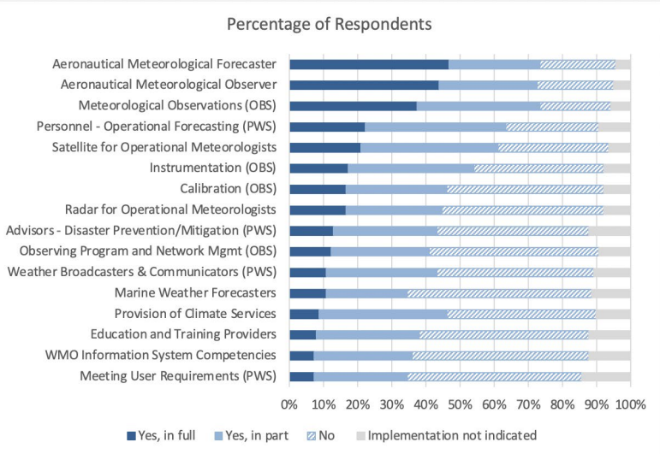
Global implementation rates for the WMO competency frameworks

Slide 26
Challenges in writing a competency framework
Implementation needs to be flexible and authentic
Performance criteria:
Written as expected outcomes of the activities performed for the specific job position
Must provide references if available
Ex:
  Aviation MET reports are issued 2 minutes before reporting time, according to ICAO Annex 3
  Warning on observed raising water level is issued as soon as measurements are available, according to SOP...
Underpinning knowledge and skills:
Written as learning outcomes, NOT as chapters of the curricula
Terms to be avoided: able to, aware of, capable of, generic terms...
Ex:
  Use satellite imagery to identify the potential of convection
  Understand the equation of continuity
  NOT: Potential of convection or equation of continuity

Slide 27
Challenges in the implementation of the competency approach
Difficulty in writing a new job description and designing the processes
To do the activities from the job description staff needs to be trained
Difficulty in finding the needed training programmes
Designation and training of the On-the-Job Trainers and competency assessors
Legislative and procedural issues
Financial support for implementation
Staff reluctance

Slide 28
Benefits of the implementation of a competency approach
Job description is correlated to the required individual performance criteria
The right staff in the right position
Gaps in competence and training needs are identified through assessment
Sustainable approach to capacity development
Strategic planning impact:
Human resources including recruitment
Financial
Operational
Reduced costs and high impact.
Enhanced capability to deliver and sustain quality services
Increased level of confidence in services provided

