Slide 1
Leadership and Management Workshop for Senior Management of RA III and IV Caribbean Members Best Practices in Budgeting and Human Resource Management for Caribbean National Meteorological & Hydrometeorological Services Kenneth Kerr Port of Spain, Trinidad and Tobago 1-5 December 2025

Slide 2
From Scientist to Leader: The Mindset Shift Directors Must Make as a Best Practice
Evolving Beyond Operations
The Leadership Shift Required for NMS Directors:
Most Directors come from scientific/technical backgrounds
Leadership roles require a different mindset
Directors are enablers of work, must understand budgets, procurement & organizational management
Political awareness and negotiation skills become essential
Focusing on system needs - securing resources, building partnerships, influencing national priorities, and protecting your staff
Leadership during crises still requires stepping forward — but not always doing the technical work

Slide 3
Why Budget Planning Matters
Key Reasons:
Ensures financial sustainability of essential services
Supports modernization and infrastructure maintenance
Demonstrates value to government and partners
Protects lives and supports economic sectors
Forces strategical planning—prioritizing what matters most and making difficult choices
Budgeting—it is strategic leadership
Budgeting and HR management are not back-office functions—they directly shape forecast quality, warning services, and public trust

Slide 4
Why Budget Planning is Different in the Caribbean
Unique Realities & Budget Constraints for Caribbean Territories: • Small national economies → limited recurrent budget envelopes
• High operational costs (importation, shipping, customs)
• Exposure to severe weather → high expectations but low resources
• Limited staff capacity → managers must handle technical + financial roles
Implication: NMHS budget planning must be strategic, proactive, and tightly aligned with national priorities to secure stable annual funding

Slide 5
Best Practice 8-Step NMHS Budget Cycle
Needs Assessment (Q1–Q2)
Prioritization & Costing (Q2)
Alignment with National Priorities (Q2)
Pre-Budget Engagement (Q2-Q3)
Formal Submission (Q3)
Negotiation & Strategic Communication (Q3-Q4)
Approval
Implementation & Monitoring (Q1 of new fiscal year)
Biggest leverage points for Caribbean Met Services:
Alignment
Engagement
Strategic Communication
Politically Smartness
Do not focus only on actual submission and approval

Slide 6
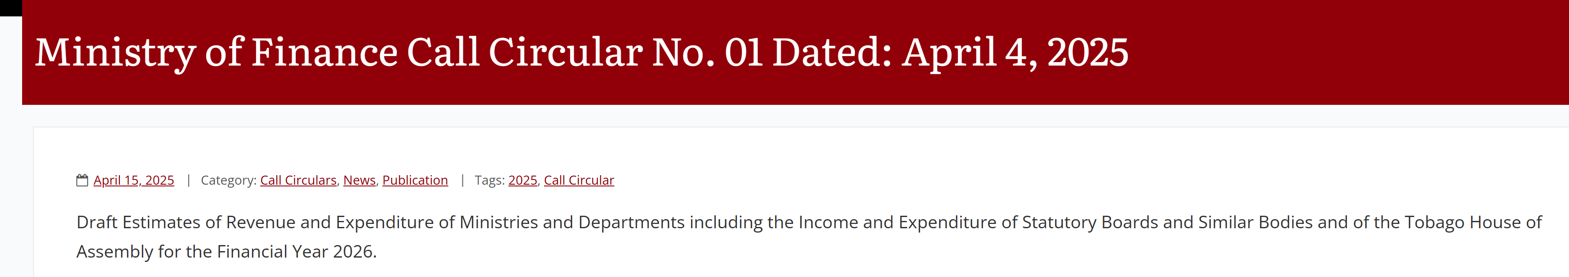
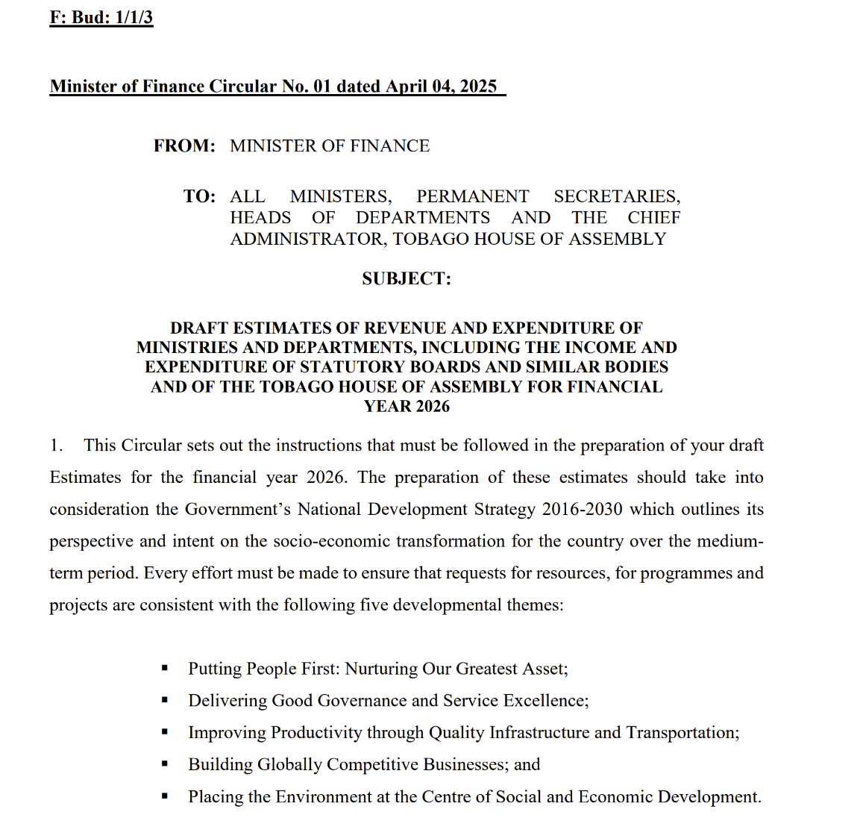
Find Out the Budget Timing
Understand the national budget calendar
Every Ministry of Finance issues a Call Circular, and that document sets the rules:
When submissions are due
What format they must be in
What ceiling or limits may be applied
What the national priorities are

Slide 7
Best Practice- Directors Explicitly Involve Others in the Budget and Needs Assessment Process
Why the Director Must Involve Staff in Budget & Needs Assessment
The Director Leads — The Team Informs
A strong NMS budget comes from shared intelligence across the Service
Why Involve Staff? | Outcome
Staff know the real operational gaps | Accurate, defensible needs list
Multiple perspectives reduce blind spots | Risks identified early
Shared input builds ownership | Higher commitment to implementation
Technical justification becomes stronger | Better traction with Finance
Supports succession planning | Staff learn how budgeting works
Notes:
,

Slide 8
Step 1: Needs Assessment
Purpose: Identify what the NMS actually needs for the coming year:
Review current operations, staffing, and service gaps, regional/Int. travel
Identify critical equipment needing maintenance, calibration, or replacement
AWS downtimes
Estimate consumables (AWS parts, radiosondes, fuel, comms fees)
Assess HR needs: recruitment, training, retention
Cost out major modernization plans
Outcome: A prioritized list of operational
and strategic needs

Slide 9
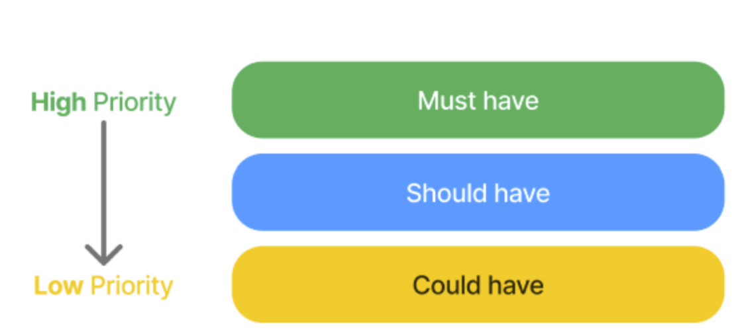
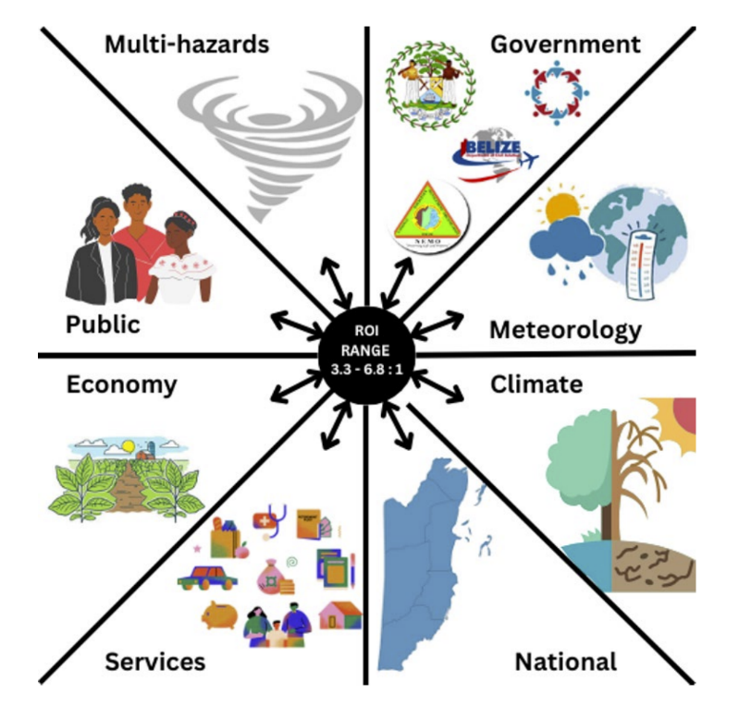
Step 2: Prioritization & Costing
Budgets are tight in the Caribbean, NMHSs must:
Categorize needs into:
Must-have
Should-have
Could-have
Create detailed cost table (recurrent + capital)
Cost each item realistically (market prices, shipping, maintenance)
Link each item to operational impact

Slide 10
MUST-HAVE ITEMS
Core Observing Systems : AWS/Radar maintenance & calibration
Aviation Meteorological Services obligations: WMO/ICAO compliance, competency training/certification
Severe Weather / Hazard Warning Services: 24/7 operations, telecoms, backup power, redundancy
Climate Services tools to support Key Sectors: agriculture, water, health
Basic Operations: Minimum core staffing for operations, office rent/utilities, procurement and financial compliance costs, vehicle maintenance
Mission-critical ICT/network infrastructure: Duty operations utilities, communications (internet, backup power, data links)

Slide 11
SHOULD-HAVE ITEMS
Infrastructure Modernization : Upgrading outdated AWS to newer models, Installing additional stations for improved coverage, Modernized forecasting workstations
Additional forecasters/technicians to reduce fatigue
Staff Training & Capacity Development: Specialized forecasting courses, Management and leadership training, WMO competency refreshers
Public Weather Services Enhancements: Improved website and mobile tools, GIS systems for risk mapping
Data management Improvements: Data visualization software & moderate ICT upgrades, digitization of climate archives, improved quality management systems

Slide 12
COULD-HAVE ITEMS
Public Education Campaigns (large-scale events)
Branding, uniforms, and non-essential refurbishments
Advanced research projects not tied to national priorities
Mobile apps (if a website already serves the purpose)
Non-critical new stations or sensors in marginal areas
Guiding Principle:
✔ Every item must clearly link to operational risk, national obligations, and economic impact
✔ Finance officers fund consequences, not equipment

Slide 13
Step 2: Prioritization & Costing
Why the need to link cost to operational impact?
Finance officers : Understand cause and effect - Draw a straight line between: the cost you’re requesting → and the consequence of not funding it
Ministries of Finance fund based on:
Compliance (national & international obligations)
Risk (lives, assets, and systems at risk if funding is denied)
Cost Avoidance (how spending now prevents bigger costs later)
Economic Impact (aviation, agriculture, tourism, energy, disaster losses)
Submit a risk, obligation, cost, and impact narrative

Slide 14
Linking Cost to Operational Impacts
NMHS Technical Need | What You Want (Technically) | Impact Statement- How You Justify It (Finance Language)
AWS Calibration | $8000 for station sensors calibration | Ensures ICAO compliance, prevents false flood alerts, avoids $150K legal fees cost, protects aviation & DRR
Radar Maintenance Contract | $120,000 annual service contract | Critical for aviation & natural disaster legislation compliance, avoids radar failure in hurricane season, prevents $1 million equipment damage & multi-million-dollar storm losses from delayed warnings
Forecaster Training | $15,000 WMO competency training | Required for ICAO aviation competency, reduces aviation forecast error, prevents $40K per incident in diverted flight costs to the airport authority
Backup Generator | $10,000 generator for power security | Maintains 24/7 national service, enables continuity of national early warning services, prevents disaster misinformation, supports all economic sectors

Slide 15
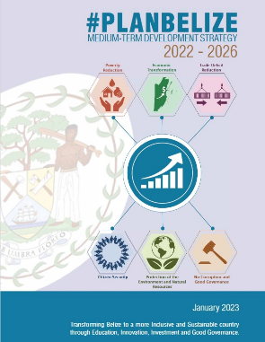



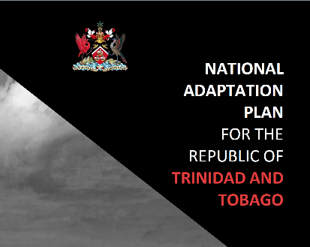

Step 3: Align with National Priorities
Align with:
National Development Plan
Climate Adaptation and Resilience Policies
Disaster Risk Reduction Strategy and Frameworks
Digital government initiatives
Aviation and maritime requirements
Agriculture, water management, energy and tourism priorities
Why? Budgets go where national priorities go
(2025-2035)

Slide 16
Step 4: Pre-Budget Engagement
Networking and relationships matter in budgeting in Caribbean public services
Informal engagement just as important as formal engagement
Engage with:
Budget and Accounts Department, HR Department
Ministry of Finance, Ministry of Planning
Permanent Secretary, Technical budget committees

Slide 17
Step 5: Formal Budget Submission
1. Clear Cost Table
• Simple categories
• No technical jargon
2. Impact-Based Justifications
• Each item linked to:
– Public safety
– Economic impact
– Risk reduction
– National & Other obligations
3. Key Performance Indicators (3–5 only)
• Warning lead-time improvements
• AWS uptime
• Aviation service performance
• Response time for faults
4. Clean Separation of Budget Types
• Recurrent Costs (staffing, license fees
maintenance,)
• Capital Costs (AWS, radar, ICT,
vehicles)

Slide 19
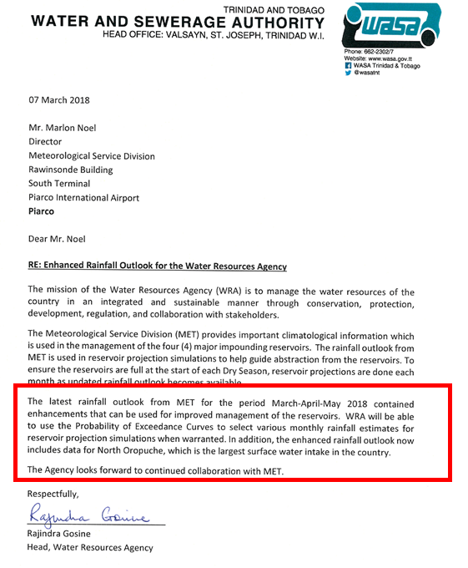
Step 6: Negotiations & Hearings
• Prepare talking points (your defence)
• Bring real examples (failures, successes, disasters)
• Highlight aviation and maritime obligations
Focus your message on: • Lives saved • Economic sectors protected • Risk reduction benefits • Service failures that result from underfunding
Bring endorsements from other ministries when possible

Slide 20

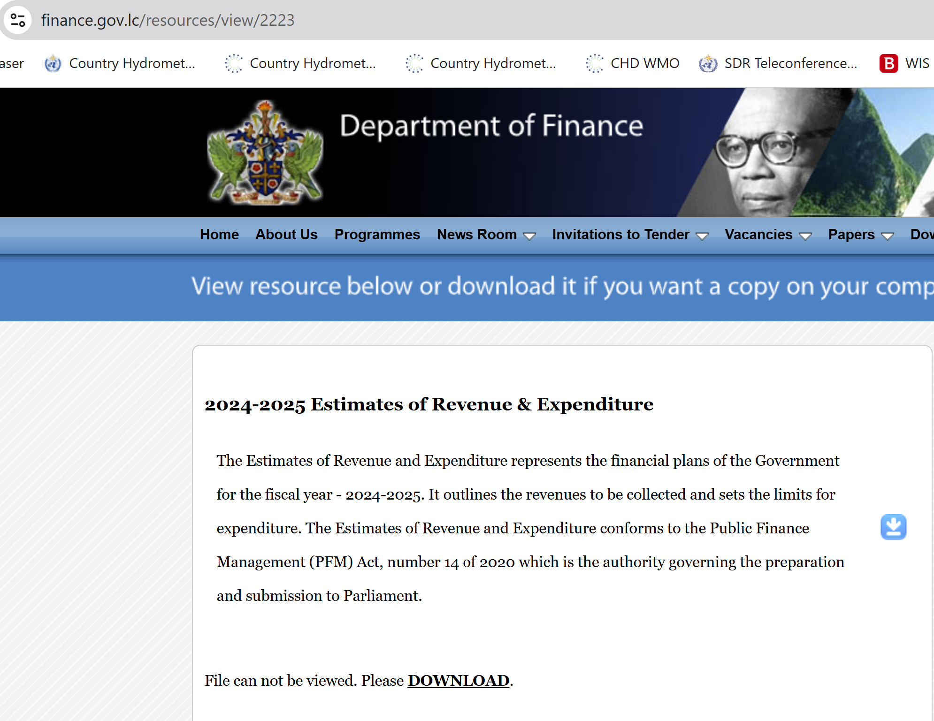
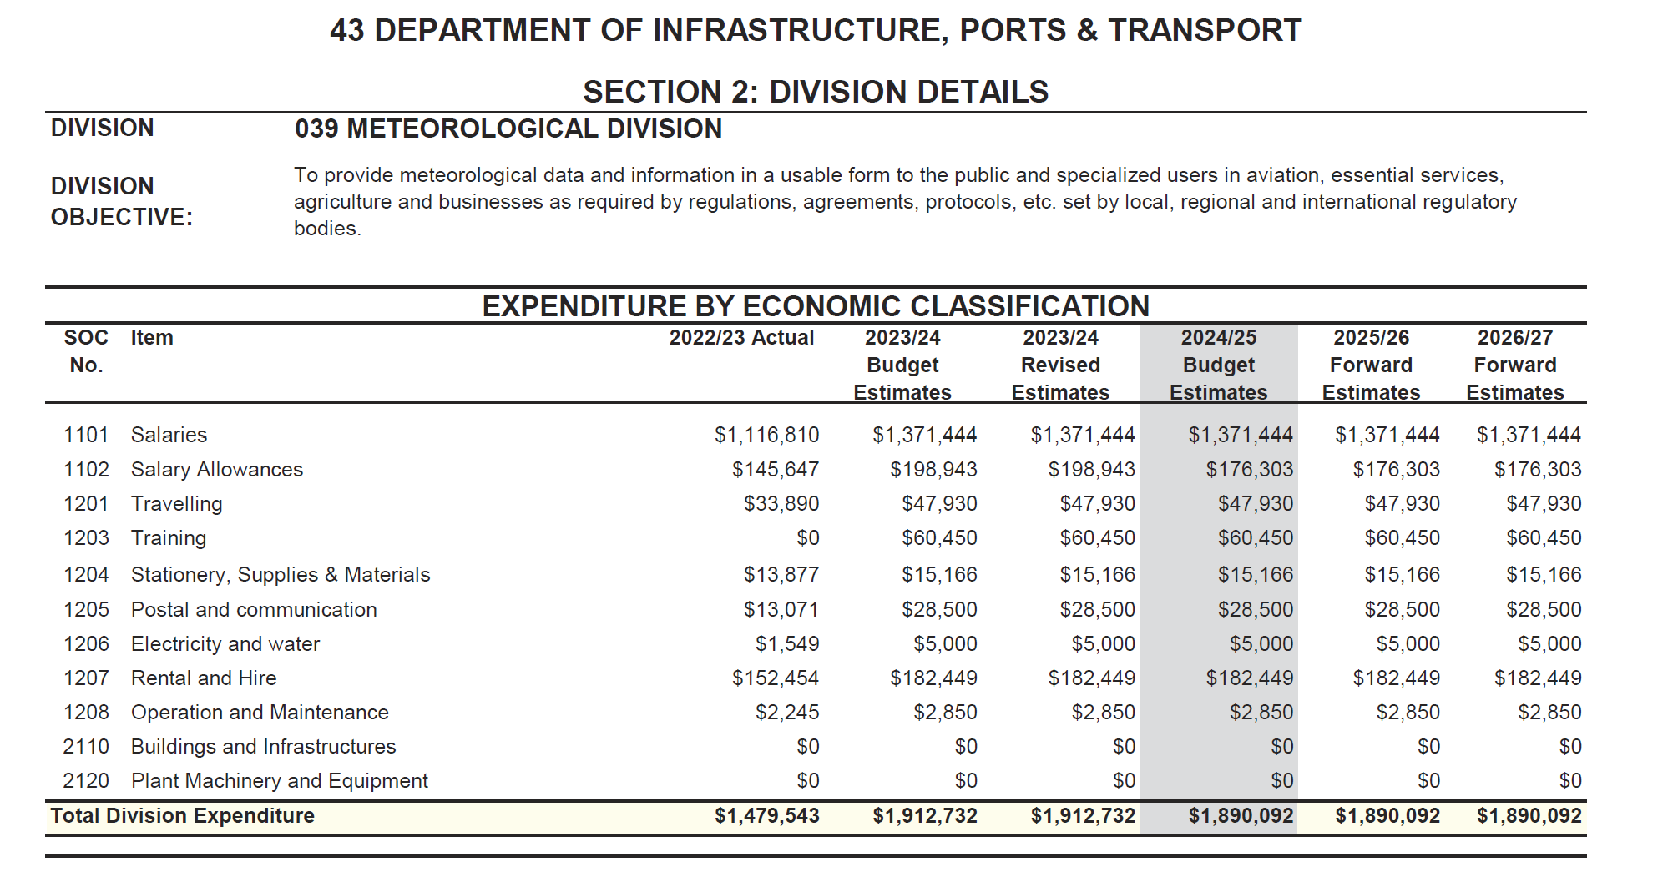
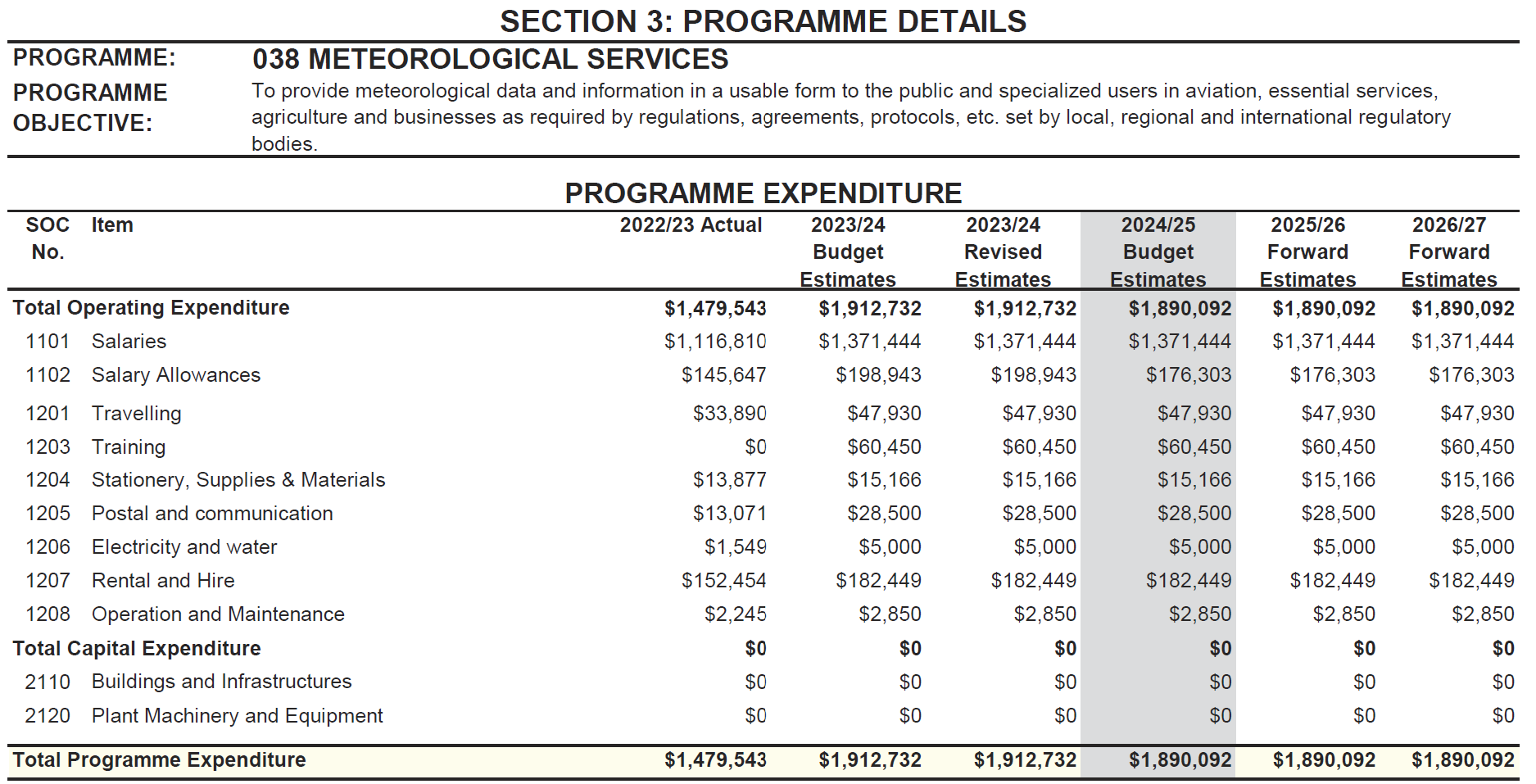
Step 7: Approval

Slide 21
Step 8: Implementation & Monitoring
Use Results-Based Reporting
Track spending against annual work plan
Maintain transparent records
Managing procurement timelines
Evaluate equipment performance
Link expenditures to measurable service delivery outcomes (e.g., improved forecast accuracy)
Report results to Parent Ministry, Finance and Stakeholders (simple year-end report)
Reports must showcase impact and value-for-money

Slide 22
Checklist for All Budget Submissions
Replace technical jargon with simple financial-impact statements
Connect every cost to national priorities (economic development, DRR, agriculture, tourism, water, transport, climate resilience, losses and damages)
Make it politically relevant
Present the “cost of NOT funding this”
Quantify impact where possible (lives, dollars, downtime)
Include one real example of a recent failure, impact, or near-miss
Show that your request is modest, targeted, and cost-efficient
Keep the submission under 3 pages with a 1-page summary (rest in an annex)

Slide 23
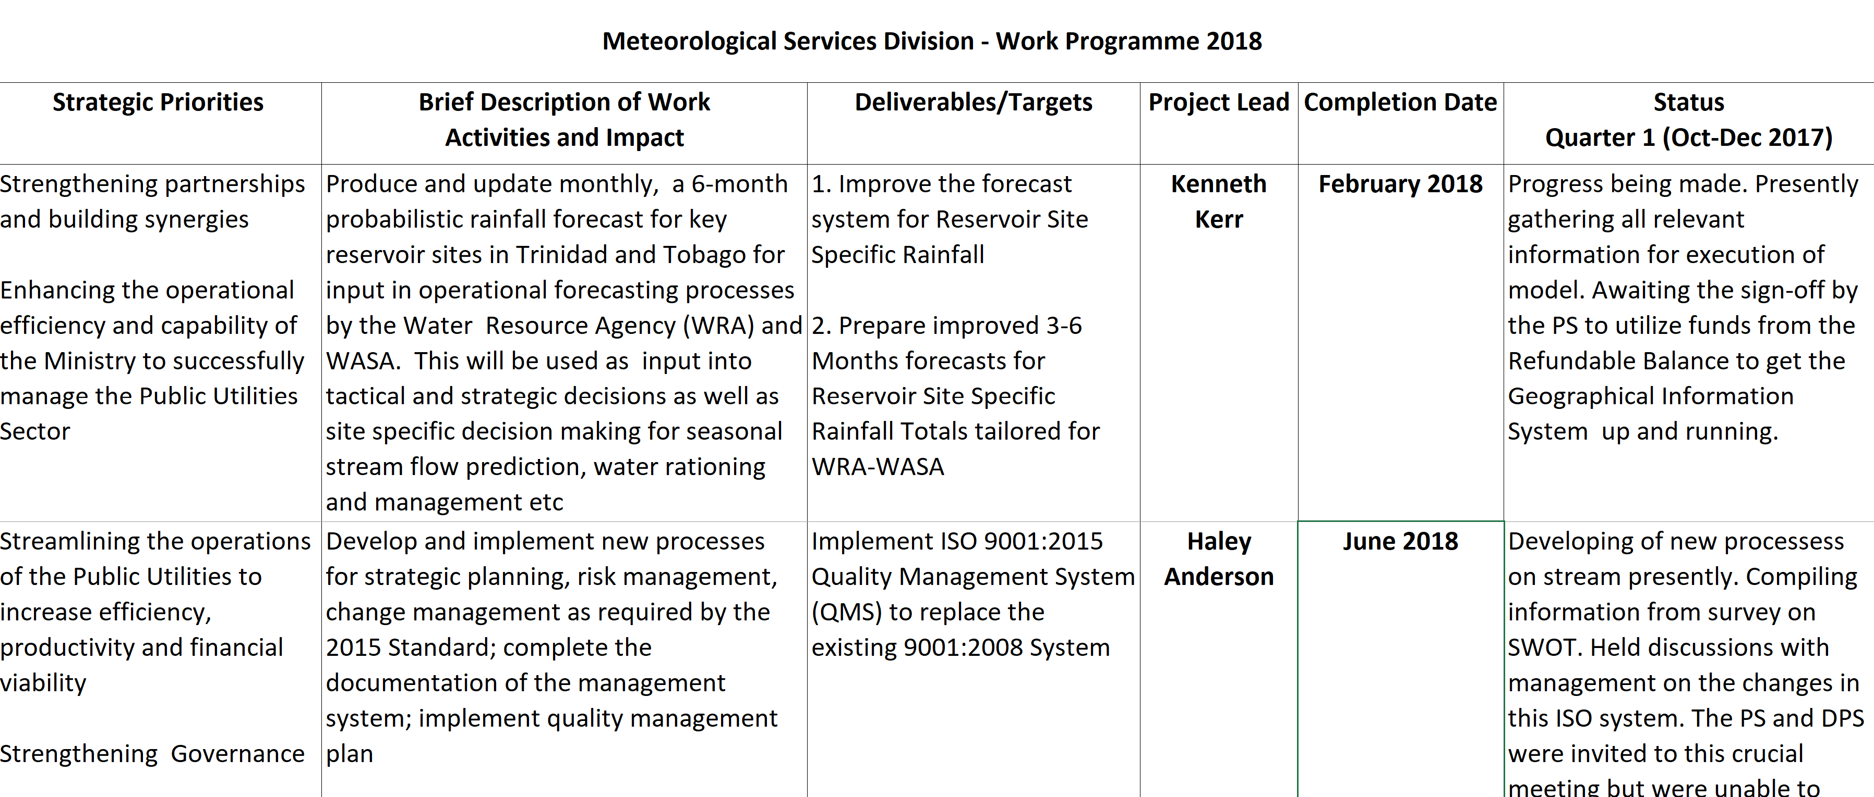
Annual Work Plan Example

Slide 24
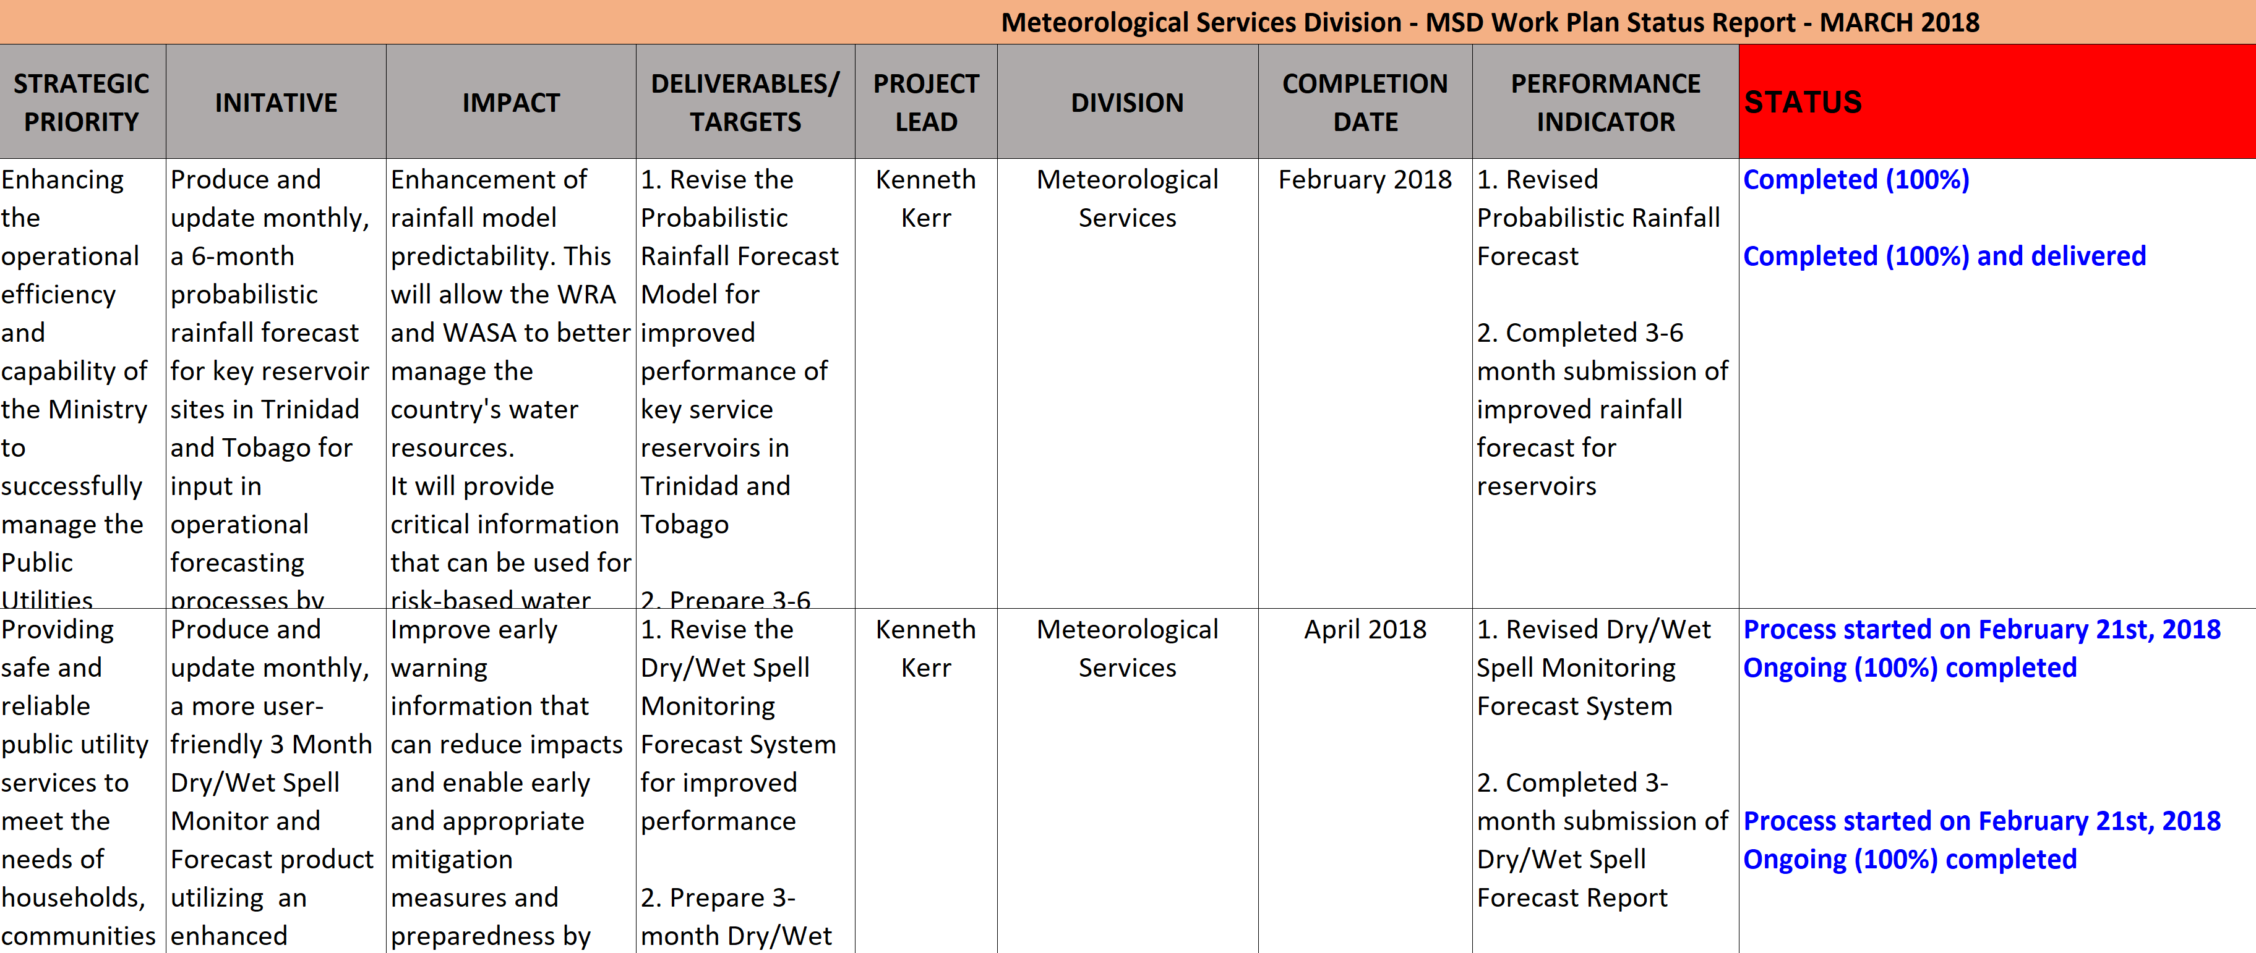
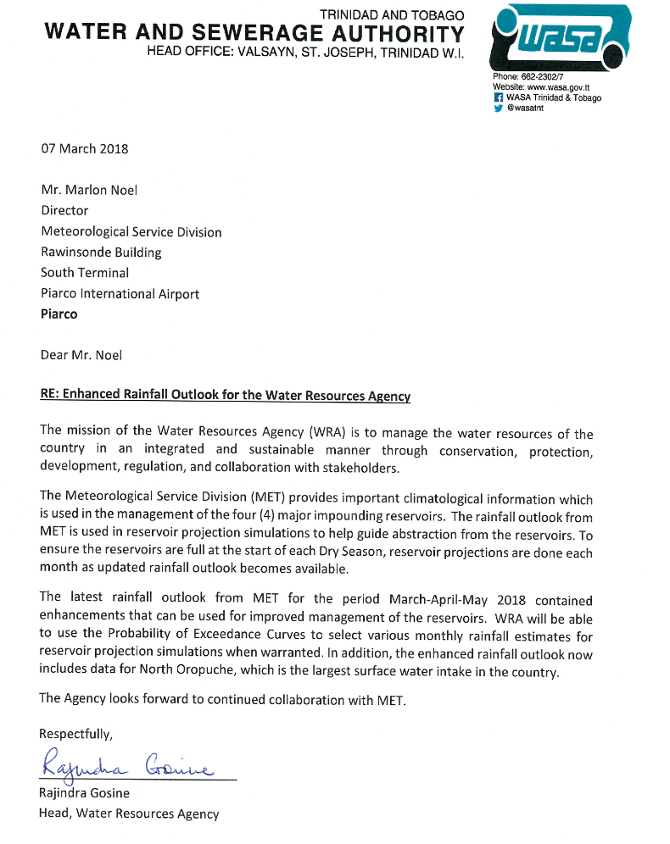
Annual Work Plan Example

Slide 25
Prepare Detailed Operational Plans and Budgets
Translate strategic goals into annual work plans with clear activities, responsibilities, and timelines
Develop multi-year budgets aligned with financial cycles and funding sources
Maintain a 5-Year Financial Plan
Even though budgets are annual, a medium-term plan: • Helps secure capital investments • Reduces fragmentation • Supports modernization roadmaps

Slide 26
Why HR Management Matters in NMHS Operations
NMHS success depends on:
Competent, motivated staff
Continuity of operations (24/7/365)
Ability to respond to crises
Strong technical and leadership capacity
Meeting WMO and aviation compliance standards
Structured Training & Capacity Development
HR Is the System — Not a Support Function
Small Teams = High Vulnerability
=
Operational Risk is high

Slide 27
Why HR Management Matters in NMHS Operations
We also struggle with:
Limited succession plans for retiring officers
Difficulty attracting specialists in instrumentation
Staff burnout, particularly during hurricane season
Competition from aviation authorities, private sector, overseas & other meteorological offices

Slide 28
Best Practice 1: Strategic Workforce Planning
What this includes:
Mapping the skills you currently have
Multi-skilling
Identifying what skills you are losing soon through retirement
Recognizing your ‘single points of failure’—roles that only one person can perform
Preparing successors in advance through mentoring and training
Anticipating new competencies you will need due to modernization—such as AI, Cybersecurity or impact-based forecasting

Slide 29
Best Practice 2: Strengthening Motivation & Workplace Culture
Use low-cost, high-impact strategies:
Celebrating milestones—years of service, successful forecasts, major events handled
Public recognition of achievements
Inclusion in decision-making (making staff feel seen and heard)
Rotate opportunities to represent the NMHS regionally/internationally
Flexible scheduling when possible
Encouraging a culture where learning, mistakes, and feedback are part of growth

Slide 30
HR + Budget Integration
Strong HR management requires:
• Dedicated training budget lines
• Multi-year staff development plan
• Funds for critical roles, succession, and retention
• Budgeting for travel, courses, certification, and tools

Slide 31
Conclusion
Strong HR systems = Strong meteorological services
Better forecasts
Higher reliability
Stronger national trust
Improved disaster readiness
More resilient operations
Technology enables
People deliver

Slide 32
Regional collaboration to reduce costs of calibration, maintenance, and shipping of meteorological equipment
Key Challenges
Calibration abroad is extremely costly
Maintenance downtime is long, and every delay means gaps in data
Shipping costs and customs delays create additional unpredictability
Limited technical capacity across many NMHSs makes it difficult to diagnose problems, maintain instruments, or even communicate effectively with manufacturers.

Slide 33
Regional Calibration and Maintenance Centers
Most effective strategies is making use of regional calibration and maintenance center
Shared WMO-aligned laboratory in the region
This cuts costs, speeds up repair cycles, and builds our own regional technical expertise
Single center could serve multiple states, operating with a cost-sharing model based on usage

Slide 34
Regional Training Program for Technicians (CIMH-led)
Annual technical boot camps for:
AWS
Radar
Network management
Instrument calibration
Co-funded by donors (CREWS, SOFF)
Benefits:
Build in-region expertise
Reduces reliance on foreign contractors
Standardizes maintenance practices

Slide 35
Coordinated Donor Engagement & Co-Financed Projects
Joint proposals to GCF, CDB, CREWS, etc., bring:
larger budgets
standardized equipment
and shared maintenance frameworks.
Modernization becomes both cheaper and easier when done together

Slide 36
Thank you!

Slide 37
What 2
Deliverable 2:
Develop An Assessment of Climate Extreme Indices for T&T
Systematic analysis of observed climate extreme indices from daily rainfall and temperature data to provide an improved understanding of how:
Hot Spells
Hot Days
Warm Nights
Heavy Rainfall
Wet Spells
Drought
Dry Spells
Changed over Trinidad and Tobago in the recent past and will likely change in the very near future.

Slide 38
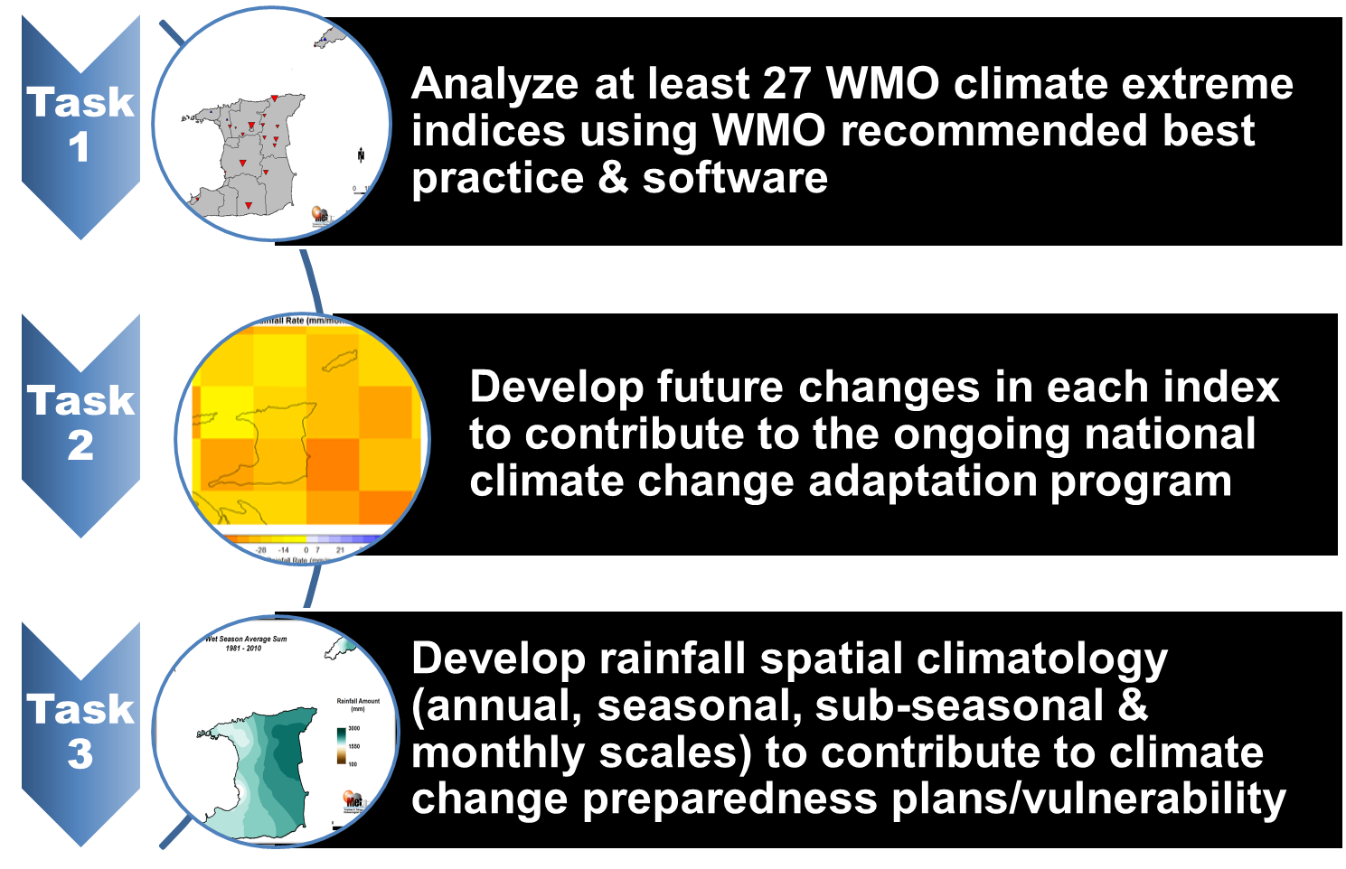
How !

Slide 39
When !
End of August 2018

Slide 40
Expected Impacts
Provide relevant climate service information needed to deal with practical questions on extremes
Provide information services for climate change adaptation strategies
Improve climate risk management capabilities of the country by providing a baseline on climate extremes

Slide 41
What 3
Deliverable 3:
A Tailored WRA-WASA 3-6 Months Reservoir Specific Rainfall Totals Outlook

Slide 42
How !
Implement an improved stochastic method with an ensemble (group) approach to generate consensus rainfall totals at specific reservoir water sheds
Utilize 2 separate sets of predictors: slow evolving SST at specific areas of the Pacific Ocean and the North Atlantic Ocean
Ensemble approach will be used to produce a range of forecast values with upper and lower boundaries within a 68% confidence interval
Forecast output will be a probability distribution of likely rainfall totals up to 6 months (on request up to 12 months) into the future
Will include:
Number of extremely wet days likely per month
Chance of exceeding certain threshold values at reservoirs

Slide 43
When !
End of February 2018

Slide 44
Expected Impacts
Support forecast service requirements of government water resource managers by satisfying forecast services at various timescales & situations
Enable water resources manager to tailor forecasts to better serve water industry needs
Provide critical information that can be used for risk-based water management decision-making

Slide 45
