Slide 1
Leadership and Management Workshop for Senior Management of
RA III and IV Caribbean Members
The International Environment: UN80 and trends of cooperation
Laura Paterson
Port of Spain, Trinidad and Tobago
1-5 December 2025

Slide 2
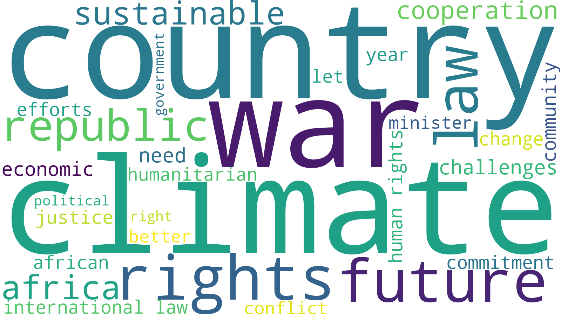
International Environment
Post 1945 order is giving way to a more multi-polar future
Power is dispersing, alliances are being reconfigured, priorities are shifting
Global governance questioned
Estimated $4TN development finance gap
UNGA80 General Debate Speech Word Cloud
Notes:
1. Power is dispersing — not just shifting
The U.S.-led unipolar moment is over, but we’re not in a simple U.S.–China bipolar world either.
Instead, we have a “multiplex” world, with several consequential powers:
China (global economic + regional military power)
India (demographic + economic rise)
EU (regulatory + economic power, fragmented politically)
Middle powers (Turkey, Saudi Arabia, UAE, Brazil, South Africa, Indonesia) acting more independently
Non-state actors (tech giants, cyber groups) influencing global outcomes
This dispersal of power is itself a kind of reset.
2. Alliances and blocs are being reconfigured
Traditional alliances (NATO, U.S.–Japan, U.S.–Korea) are strengthening, but many regions are realigning:
Russia and China are closer than at any point since the 1950s.
Gulf states are pursuing “strategic hedging,” balancing U.S., China, and Russia.
Africa is seeing a recompetition between the West, China, Russia, and increasingly Gulf states.
Countries no longer fit neatly into “aligned” or “non-aligned.” They are acting transactionally.
3. Economic globalization has fractured into blocs
We are entering an era of geo-economic fragmentation:
Supply chains are being re-shored or “friend-shored.”
The U.S. and China are decoupling in critical sectors: chips, AI, rare earths, green tech.
The dollar’s dominance is challenged — not replaced — but diversified around the edges.
This is a reset from “globalization as default” to “globalization if secure.”
4. Technology is now a geopolitical battlefield
AI, semiconductors, biotech, quantum, and space systems are the new strategic territory.
For the first time, tech companies, not states, own much of the critical infrastructure that defines national power.
The AI race is altering alliances, trade, and military planning simultaneously.
5. Conflict is returning to major-power politics
We see simultaneous, interlinked conflicts — something unusual in the post-Cold-War era:
Ukraine
Middle East
The Red Sea and maritime chokepoints
South China Sea
Nagorno-Karabakh, Sudan, Sahel states
Taiwan tension steadily rising
None is isolated; each interacts with great-power competition.
6. The global governance system is struggling
UN, WTO, IMF, and World Bank structures reflect the power balance of 1945–1990, not 2025.
Reform has stalled, so parallel systems have emerged:
BRICS+
Belt and Road Initiative
Regional development banks
Alternative payments systems
This is another sign of systemic reset.
war: 1594
minister: 270
climate: 689
development: 1200
rights: 682
security: 1288
environment: 203

Slide 3
WMO UN80 General Debate Speech Analysis
Global AI-enabled analysis of UNGA80 General Debate speeches for WMO themes
Key findings
  Climate dominates, but stronger for developing countries (G20 2.5, SIDS, 7.7, LDCs 5.15)
  Extreme weather prominent (heat and storms of various types)
  Early Warnings under-represented
  Low visibility of WMO and Meteorological Services
Further similar exercises planned for more climate relevant fora
Key word | Mentions
Climate | 689
Early Warning Systems | 4
Early Warning | 7 (2 non-climate)
Weather | 16
Heat | 41
Storms | 34
Hurricane | 11
Cyclone | 7
World Meteorological Organization | 1
Cryosphere of Glaciers | 6
Climate Information | 1
Meteorological Service | 0
Hydrological Service | 0
Systematic Observation | 0
Notes:
Climate Dominates: 152 countries referenced climate; Tuvalu (25 mentions), Somalia (17), Kenya and Samoa (15 each) were most vocal.
Early Warning Systems Underrepresented: Only 5 countries (Botswana, Malawi, Liberia, Zimbabwe, Saudi Arabia) mentioned early warning systems or early warnings relating to meteorology —highlighting advocacy gaps.
Cryosphere Mentions Minimal: 6 countries referenced glaciers or cryosphere (Bhutan, Nepal, Iceland, Peru, Tajikistan, Kyrgyzstan).
Extreme Weather Prominent: Heat (41 mentions) and storms (34 mentions) were frequent, especially among SIDS and African nations. Hurricanes (11 mentions) and cyclones (7 mentions) were also evident.
WMO Visibility Low: Direct mentions of WMO or meteorological services were rare. Solomon Islands were the only country to directly mention WMO, quoting our State of the Climate Report. No country referred to their ‘meteorological service’.

Slide 4
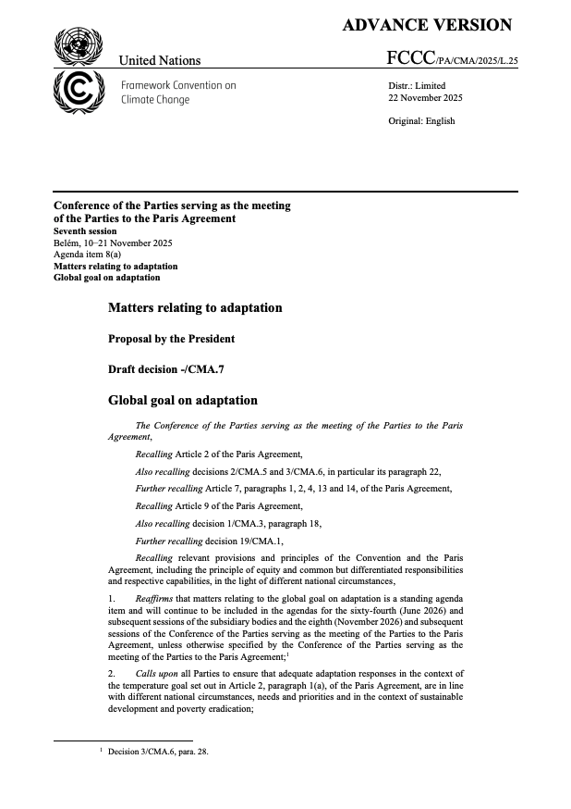
COP30
1.5 °C overshoot recognition – more severe weather and climate events coming
Building on 1st Global Stocktake which recognized importance of early warning systems, science, systematic observations, SOFF and CREWS.
COP “Global Mutirão” calls for efforts to at least triple adaptation finance by 2035
IPCC AR6 WG2 recognises EWS as adaptation options that have broad applicability across sectors and provider greater benefits to other adaptation options when combined.
COP30 Agreed Global Goal on Adaptation indicators – formally ties our activities to adaptation efforts
Level of establishment of MHEWS
Level of climate services
Level of MH monitoring and impact-based fc systems, inclu monitoring stations
# of people covered
Level of systematic observation
(FCCC/PA/CMA/2025/L.25)

Slide 5
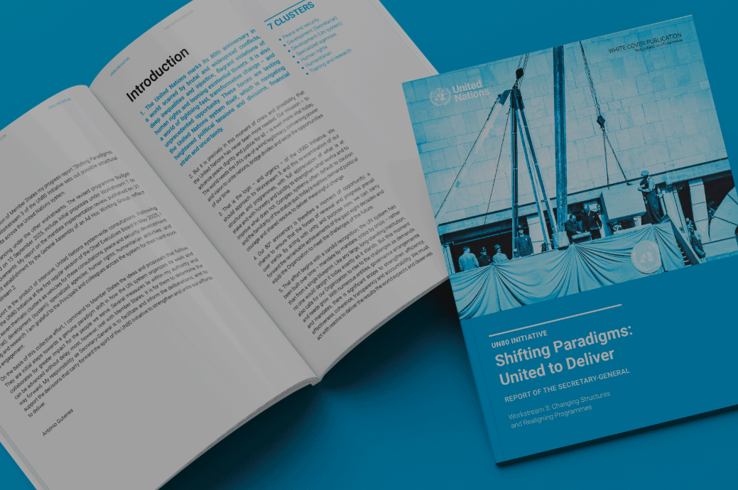
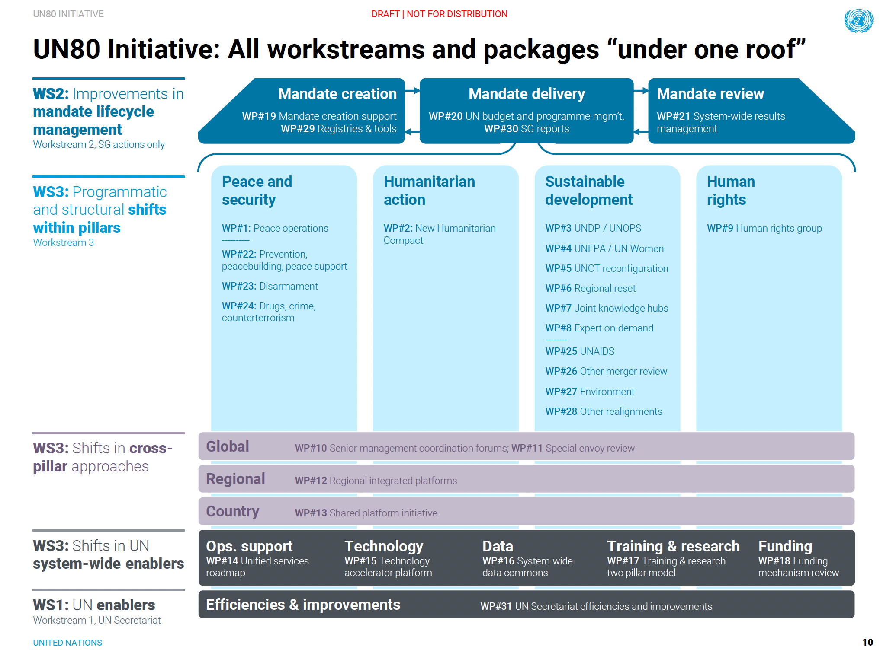
UN80 Initiative
The UN’s system-wide reform effort, launched by UNSG in March 2025
How can UN become more agile, integrated, and able to respond to global challenges and tightening resources
Three workstreams 1) efficiencies, 2) mandate review, 3) structural changes
30 work packages. WMO engaging with #27 on Environment, #8 Expertise-on-demand, #7 Joint Knowledge Hubs, #16 System-wide data commons, and potentially #5 and #6 on Regional Reset and UNCT reconfiguration
More to come on Wednesday on leveraging WMO, other UN agencies, and evolving UN cooperation modalities to foster international cooperation and development assistance.
UN80 Initiative Action Plan (https://www.un.org/un80-initiative/en)
Notes:
2025 budget based on 4,000 mandates

Slide 6
Thank you!

