Slide 1



Joint CALMet XVI - CONECT 3 Conference
Welcome!
Notes:
Wish you a warm welcome to this joint CALmet 16 – CONECT 3 conference in a hybride format with a programme in 3 different time zones.

Slide 2
Thank you!
Roro Purwanti
Marina Baldi
Vieri Tarchiani
Lucianne Veeck
AND
Members of the Conference Organizing Committee
Notes:
First of all I would like to thank
Roro,
Marina,
Vieri
and Lucianne
for their very hard work to make this Joint Conference happening
#klik#
Next to that i like to thank the Members of the Conference Working Group, being
Barbara Bourdelles (ENM MeteoFrance)
Nacéra Chergui (MSC)
Tsvetomir Ross-Lazarov (COMET)
Stephen Kerr (ECCC)
Markus Zygmuntowski (DWD)
Vesa Nietosvaara (EUMETSAT)
Winifred Jordaan (CONECT )
Mick Pope (BoM)
Jingrong SUN (CMATC)
Felipe Vannucci (SMN)
Romina Mezher (SMN)
Vagner Anabor (USM)
for their support actions to make the work of Roro, Lu, Marina en vieri a bit easier..
We are not an official conference organising organisation
but we do this work on volontairy basis every two years next to our regular jobs.
Everytime I am really proud to see what we have accomplished.
This time we started together not an easy task to organise this conference as a hybrid conference across multiple time zones!

Slide 3
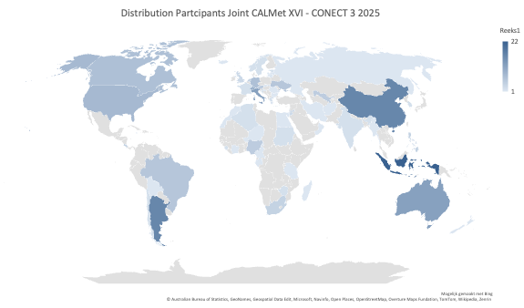
219 registered participants
from 62 countries
Notes:
during this conference we will have 219 paticipants from all over the world joining us from 62 countries...
look at this picture to see where they all come from
163 participants will join this conference online in one the the time zones and 56 will be present in Florence

Slide 4
Joint CALMet XVI - CONECT 3 Conference
CALMet XVI
An inspiring forum for sharing experiences, expectations, and bold new ideas that advance (technology-driven) meteorology and hydrology education.
CONECT-3
Shaping the future of global collaboration in meteorological education and training — together.
Notes:
#klik#
The first 3 days will be an inspiring forum for sharing experiences, expectations, and bold new ideas that advance (technology-driven) meteorology and hydrology education.
#klik#
During the last two days also knowledge, best practices and innovative strategies will be shared,
But then with more focus on how we can strengthen the coordination and sustainable capacity-development efforts in collaboration within our community.

Slide 5
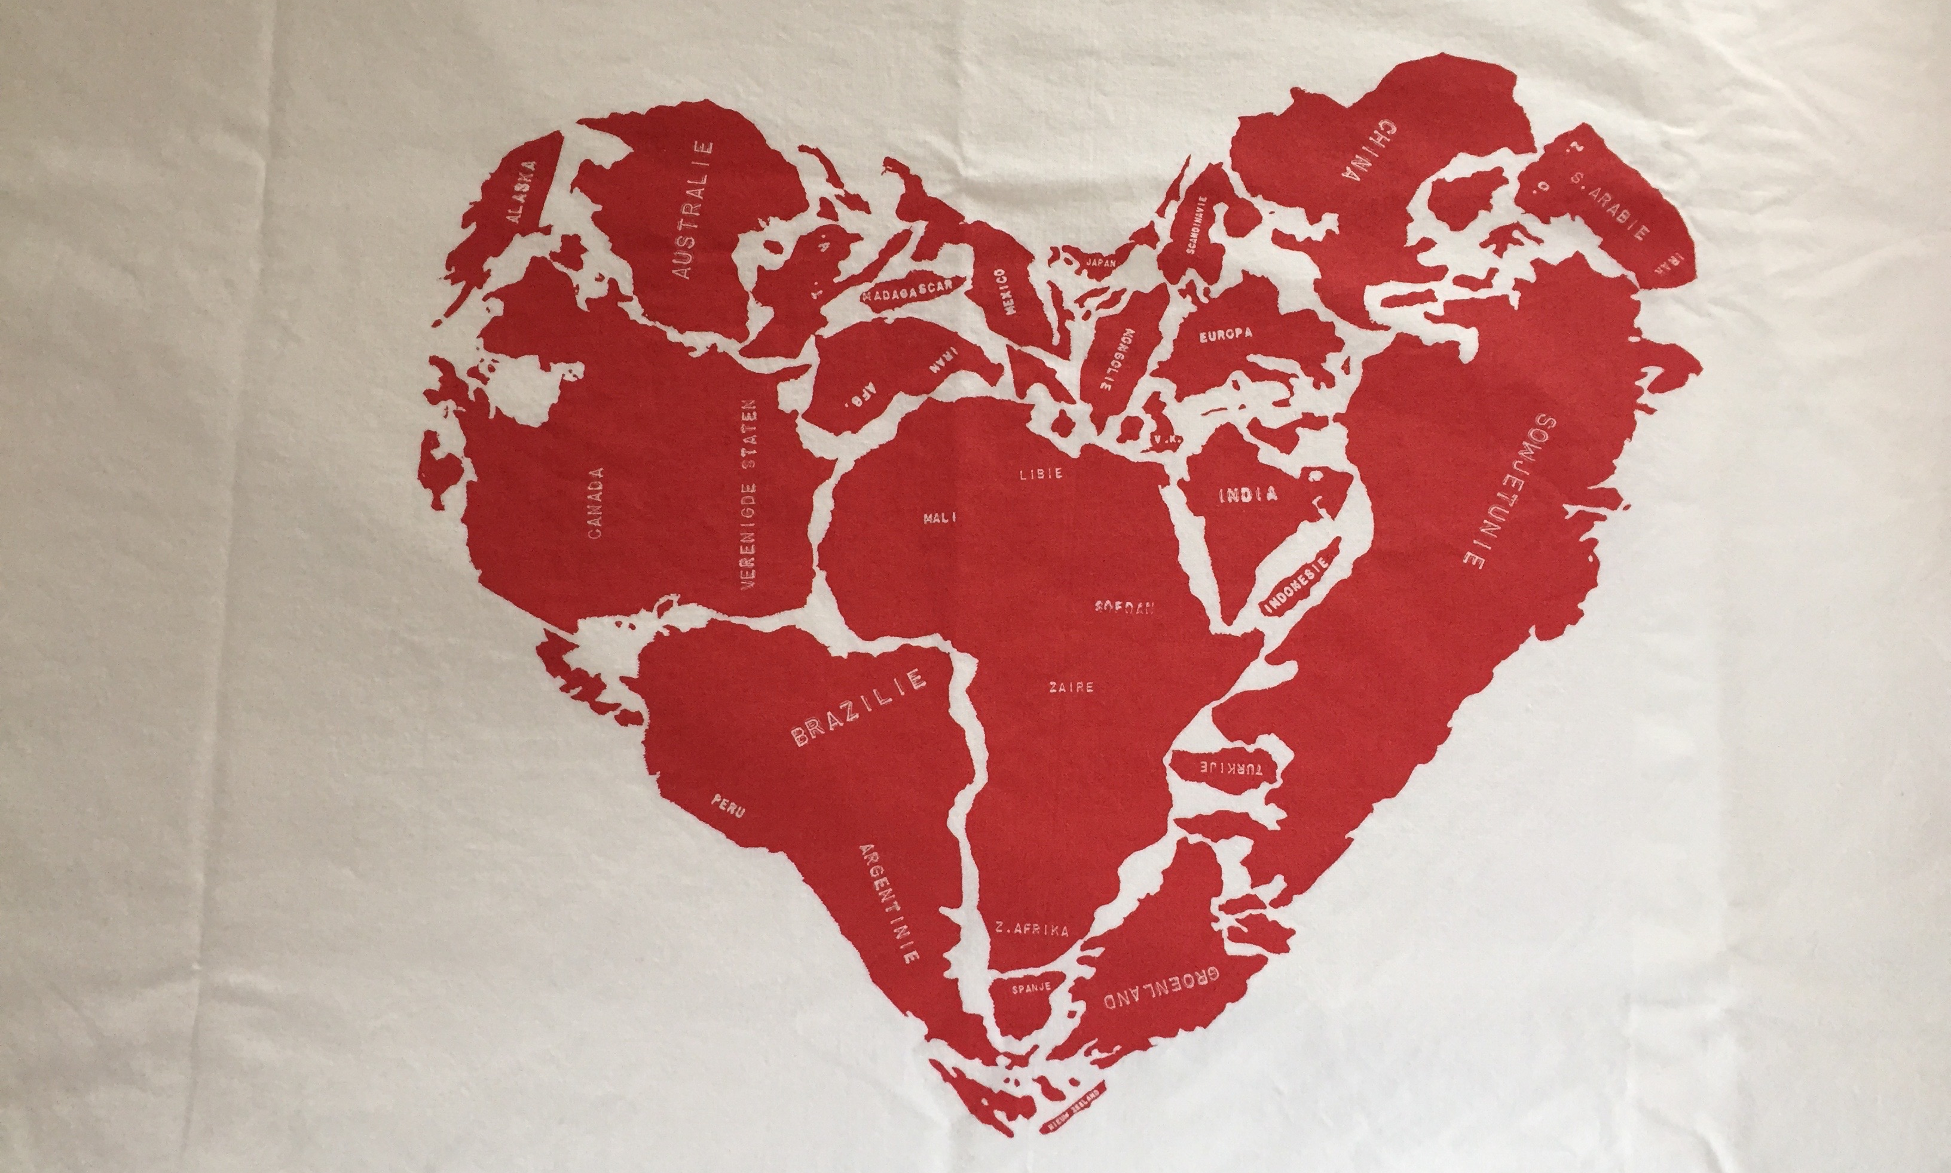
Joint CALMet XVI - CONECT 3 Conference
Notes:
For me the print of this pillow case is very applicable for this conference and the work we jointly do for it simply because for me this community is very much about love, friendship and a playground were we jointly experiment and get the best out of our global collaboration in the meteorological and hydrological training.
I am really hoping that you will enjoy this Conference and find it useful.
Please let us know during the week how it works out for you.

Slide 6
Joint CALMet XVI - CONECT 3 Conference
Enjoy!
Notes:
This leaves me to wish you all a great conference!
Enjoy!

