Slide 1
FIJI – Example presentation
OSCAR/Surface course for RA-V
Jakarta 18-20 September 2018

Slide 2
Introduction to the country and the NMHS
Physical context of the country
The Republic of the Fiji Islands is a sovereign island country in the central southwest Pacific Ocean; Two major islands: Viti Levu and Vanua Levu
Fiji’s Exclusive Economic Zone (EEZ) contains approximately 332 islands of which, about only a third are inhabited
Larger mountainous islands, which are largely of volcanic origin, numerous small volcanic islands, low lying atolls and exposed limestone reefs
The high islands have distinct wet and dry zones due to prevailing wind patterns and topography.
Coastal ecosystems include mangroves, algae, sea grass beds in shallow reef and lagoon areas, and various reef types such as barrier, fringing platform and atoll or patch reefs.
Brief introduction to the NMHS
Mandate
http://www.met.gov.fj/about_us.php
Infrastructures
- AWS, Radar, Lightning Detector, Data Collection Platforms, Wind Profiler, CTBTO, HF, Upper Air,Chatty Beetle
Total of 145 staff

Slide 3
National requirements for observations
II. Most relevant observed variables:
Temperature (Max)
Temperature (Min)
Temperature (Avg)
Relative Humidity
Wind Direction
Wind Speed
Wind Gust
Pressure, Grass Temp
Earth Temperature (10cm, 20c, 30cm, 100cm)
Solar Radiation
Rainfall
Soil Moisture
Leaf Wetness
National priority application areas
Water and Sanitation
Housing Development
Food and Nutrition Security
Education
Health and Medical Services
Modernising Land Transport
Inter-Island Network
Domestic Air Services
International Connectivity (Airports and Sea Ports)
Micro, Small and Medium Enterprises Development
Manufacturing and Commerce
Sustainable Cities and Towns
Expanding the Rural Economy
Fisheries
Forestry
Mining
Tourism
Enhancing International Trade and Foreign Relations
Information and Communication Technology

Slide 4
Inventory of current national observing capabilities
Networks description with metadata
Map and list of meteorological/climatological operational stations (identifying the technology used):
Surface observing stations - 33 x AWS/12 Manual
Precipitation stations - 10 x TB3
Upper-air/radiosonde stations - 1 (Nadi Airport)
Weather Radars - 3 (Nadi, Nausori and Labasa)
Lightning detection networks 4 (2xNadi, Suva and Labasa)
Map and list of other surface operational stations:
Hydrological stations - WL/RF-19|WL-18|TB3-7
Sea stations - Tide Gauges x 3
Atmospheric composition and other stations - 1 CTBTO

Slide 5
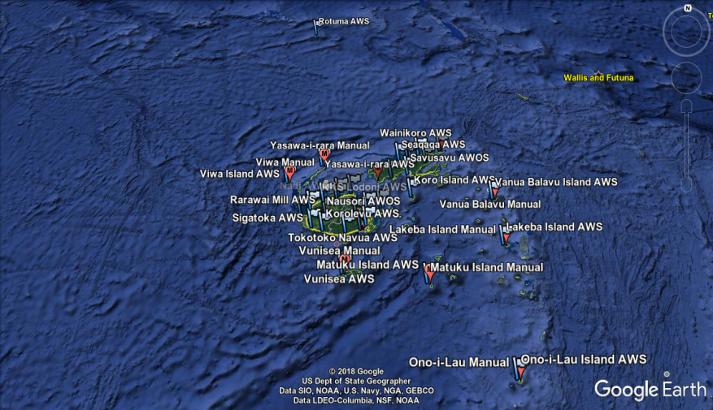
AWS/Manual Stations

Slide 6
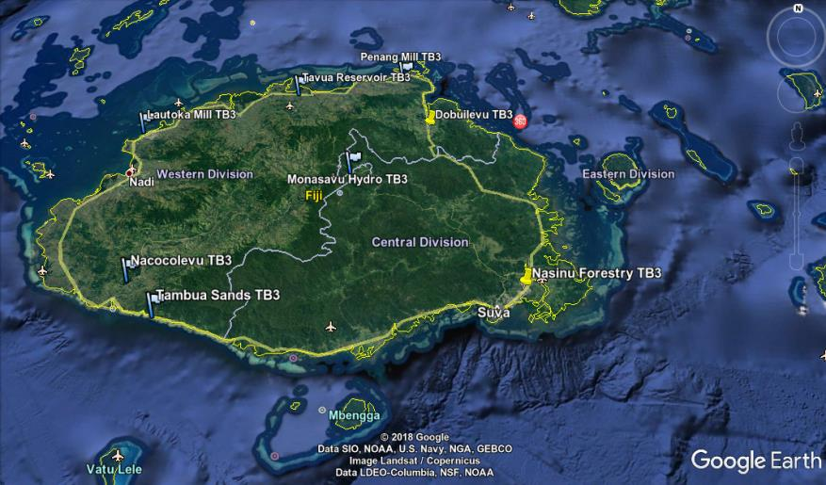
TB3 Rainfall

Slide 7
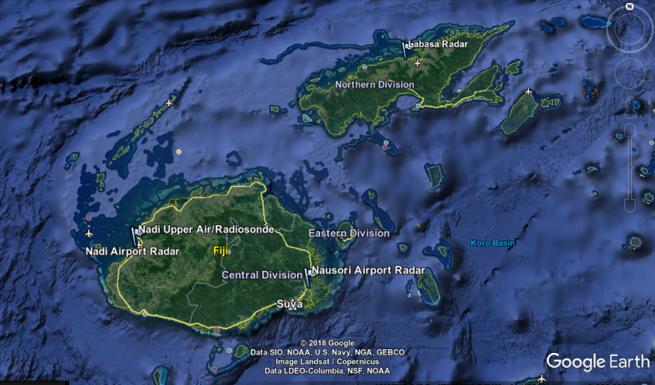
RADAR|UPPER-AIR

Slide 8
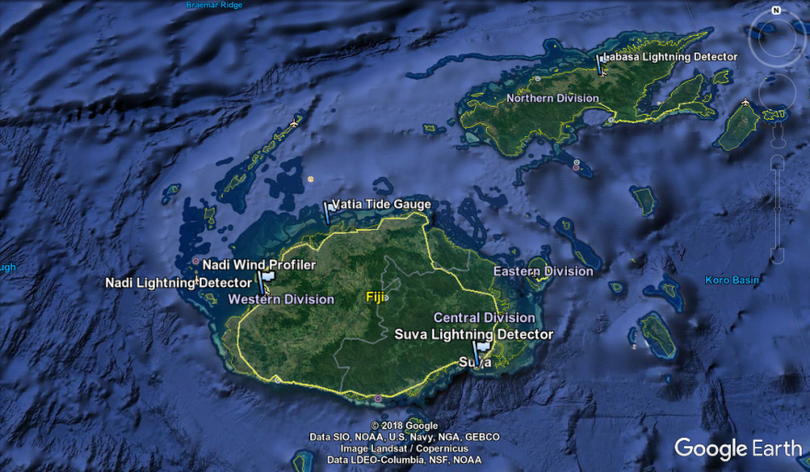
LIGHTNING DETECTORs

Slide 9
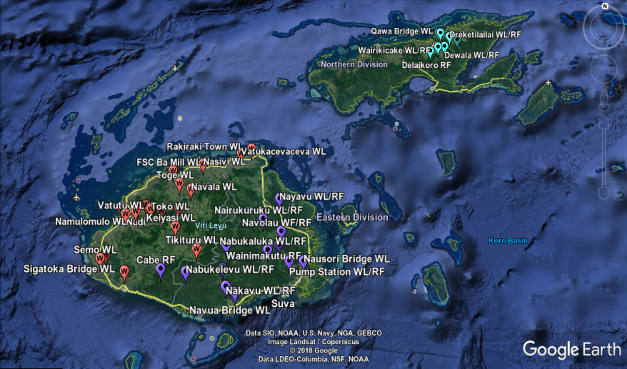
HYDROLOGY STATIONS

Slide 10
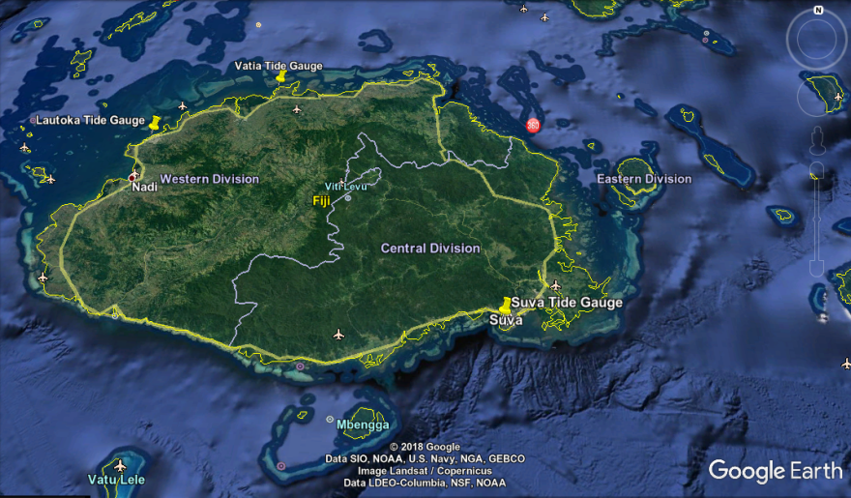
TIDE GAUGES

Slide 11
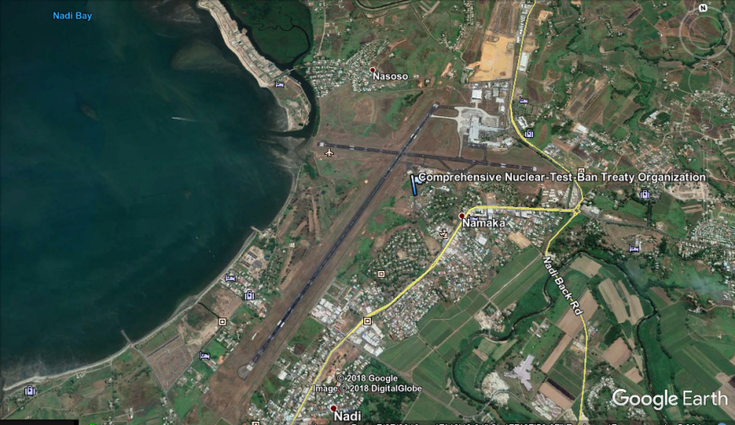
ATMOSPHERIC STATION

Slide 12
Thank you
Leonard.Bale@met.gov.fj
Leonard.Bale@govnet.gov.fj

