Slide 1
Meeting the Diverse Education and
Training Needs of Developing Countries
Prof. WANG Suchun
Dean& Executive Deputy Director
College of International Students, NUIST
World Meteorological Organization Regional Training Center Nanjing

Slide 2
ONTENTS
C
1
Data Analysis
2
Diverse Needs
3
Practice
4
Suggestions

Slide 3
1. Data Analysis
Degree Students
Non-degree Students
Total
International Students

Slide 4
1. Data Analysis
23%
Short-term Trainees
(328)
Technique & Management Training
Undergraduates
(420)
Postgraduates
(191)
International Students in 2016

Slide 5
1. Data Analysis
WMO International Training Programs | Time | Number of Countries/Regions | Countries/Regions
Training Seminar of RTC Instructors | May 5-18, 2001 | 19 | Russia , Philippines , Thailand, Mongolia, Fiji, Nepal
Seminar on Africa-Asian Monsoon Meteorology | Oct. 24-30, 2004 | 8 | Thailand , Indonesia , Kenya, Vietnam, Tanzania, Bangladesh
Seminar on East Asian Summer Monsoon Prediction | May 10-13. 2005 | 15 | Thailand, Malaysia, South Korea , North Korea, China Hong Kong
Training Course on Meteorological Applications of Environmental Satellite Data | Oct. 16-7, 2006 | 18 | Laos , Mongolia, Myanmar, Thailand, Pakistan, Kazakhstan,
International Workshop on Assessment of Socio-Economic Benefits of Meteorological and Hydrological Services | Sept. 21-28, 2009 | 20 | Lesotho , Ethiopia, Uzbekistan, Malaysia , Mauritius

Slide 6
1. Data Analysis
WMO International Training Programs | Time | Number of Countries/Regions | Countries/Regions
International Training Course on Typhoon Committee Roving Seminar | Nov. 16-19, 2009 | 14 | Vietnam, South Korea, Singapore, Philippines , North Korea
International Workshop on Climate Data Requirements and Applications | Mar. 4-8, 2013 | 78 | Australia , Japan , Britain , Netherlands , Russia
WMO Meeting of the CBS-OPAG/PWS Expert Team on Communication, Outreach and Public Education Aspects of Public Weather Services Delivery | Oct. 28-Nov. 1, 2013 | 10 | Netherlands , Kenya, Australia, Canada, Croatia, Greece
Equipment Maintenance and Calibration Training | Nov. 2-7, 2015 | 27 | Pakistan, Thailand, Myanmar, Nepal, Sri Lanka, Maldives,
International Training Course on Tropical Cyclones | Dec. 7-11, 2015 | 29 | Thailand , Vietnam , Philippines, Laos, Malaysia, North Korea
WMO Workshop on Climate Service Information System | Mar. 20-25, 2017 | 29 | USA , Netherlands , France, Britain , Spain, Ecuador, Barbados

Slide 7
1. Data Analysis
Other International Training Programs (Part) | Time | Number of Countries/Regions | Countries/Regions
2015 Master Program of Meteorology | Sept. 2015-July 2017 | 8 | Ethiopia, Papua New Guinea, Pakistan, Zimbabwe, Kenya, Mozambique, Uganda, Ghana
2016 Master Program of Meteorology | Sept. 2016-July 2018 | 10 | Algeria,Ethiopia,Ghana, Zimbabwe ,Kenya, Mozambique, South Sudan, Sudan, Tanzania, Uganda
2017 Master Program of Meteorology | Sept. 2017-July 2019 | 11 | Algeria, Ethiopia, Benin, Gambia, Laos, Namibia, South Sudan, Sudan, Nigeria, Senegal, Zambia
2016 Seminar on Climate Change and Climate Information Service for Developing Countries | Apr. 6-26, 2016 | 9 | Mongolia , Kenya , Malawi, Sudan, Ghana, Uganda
2016 Training Course on the Use and Maintenance of Meteorological Instruments for Developing Countries | June 3-30, 2016 | 8 | Kenya , Mongolia, Sudan, Ethiopia, Myanmar, Zambia, Egypt

Slide 8
1. Data Analysis
Other International Training Programs (Part) | Time | Number of Countries/Regions | Countries/Regions
2016 Seminar on Emergent Rescue of Earthquake Disasters for Developing Countries | Sept. 2-22. 2016 | 13 | Mongolia, Afghanistan, Ghana, Iran, Egypt, Zimbabwe
2016International Training Course on Agrometeorology | Sept. 12-23, 2016 | 4 | Uganda , Morocco , Congo , Togo
2016 Training Course on Technology Transfer for Developing Countries in Response to Climate Change | Oct. 11-27, 2016 | 11 | Ethiopia , Dominica , Ghana, Philippines, Suriname, Panama
2016 International Training Course on Radar Meteorology | Nov. 4-25, 2016 | 14 | Indonesia, Botswana, Palestine, Saudi Arabia, Romania, Maldives, Armenia,
2016International Training Course on Typhoon Committee Roving Seminar | Nov. 21- Dec. 2, 2016 | 7 | Yemen, Saudi Arabia, Maldives, Mozambique, Hong Kong, China, Papua New Guinea
2017 Seminar on Management for Meteorological Officials from Developing Countries | May 3-23, 2017 | 7 | Mongolia, Panama, Lebanon, South Sudan, Sudan, Jordan, Zambia

Slide 9
1. Data Analysis
Part of Bilateral Training Programs | Time | Country/ Region | Number of Students
Training Course on Aeronautical Meteorology Observers for Mozambique | Sept. 2012 | Mozambique | 25
Seminar on Pakistan Meteorological and Earthquake Forecast, Mitigation and Relief | Oct.13-Nov. 2, 2014 | Pakistan | 20
Seminar on Disaster Prevention Experiences and Policy for Afghanistan | Oct.21 – Nov. 17, 2015 | Afghanistan | 29
Training Course on Surface Meteorological Observation, Macao, China | Apr. 11- June 14, 2016 | Macao, China | 12
2016 Seminar on Earthquake and Disaster Prevention and Mitigation for Armenia | May 26- June 9, 2016 | Armenia | 20
2016 Training Course on Meteorology for Uganda | Oct 13 - Nov. 1, 2016 | Uganda | 20
2017 Bahamas Meteorological Disaster Prevention and Disaster Recovery Management Workshop | Sept. 8-29, 2017 | Bahamas | 20

Slide 10
1. Data Analysis
(Student Proportion)
Countries | Number of Students
Indonesia | 157
Kazakhstan | 153
South Korea | 131
Ghana | 89
Mongolia | 75
Oceania (4 countries)
Africa (43 countries)
America (16 countries)
Europe (12 countries)
Asia (36 countries)
(Student Proportion)
(Student Proportion)
(Student Proportion)
Top 5 Countries
International Students from 111 Countries (2016)
(Student Proportion)
International Students from Five Continents (2016)
Top 3: Asia, Africa and America

Slide 11
2. Diverse Needs-Programmes
International Training
Bilateral Training
Degree Education
“Go-out”Training
National Foreign-aid Training Programs
￭ World Weather Research Program
￭ World Climate Research Program
￭ Public Weather Services
￭ Calibration and Maintenance of
Meteorological Instruments
Seminar on Typhoon Committee
WMO Scientific Research Program
WMO Education Training Seminar
WMO Seminars & Workshops
￭ WMO Education Training Conference
￭ COCOM Seminar
Self-organization
(overseas training courses)

Slide 12
2.Diverse Needs-Disciplines
Atmospheric Science
Meteorological
Economy
Management
Meteorological
Equipment
Marine Science
Applied Meteorology
Environmental Science
Information
Basic Discipline
Physics
Math

Slide 13
2.Diverse Needs-Funds
Chinese Government Scholarship
Jasmine Jiangsu Provincial Government Scholarship
NUIST-WMO Scholarship
1
2
3
4
5
MOFCOM Scholarship
(Sponsored by Ministry of Commerce of People’s Republic of China)
Nanjing Municipal Government Scholarship

Slide 14
3. Practice
International Responsibility
National
Mission
Industry
Leader
University
Development

Slide 15
3. Practice
Meteorological Service
Meteorological Observation and Forecast
Public Meteorological Services
Climate Information Services
Agrometeorological Services
Other Related Topics
Disaster Prevention & Mitigation
Disaster Prediction & Early Warning
Disaster Response
Emergency Rescue
Disaster Prevention Experience Policy
Other Related Topics
M
N
M
D
New Technology Transfer
Weather and Climate Models
Climate Change and Technology Transfer
Assessment and Utilization of Climatic Resources
Remote Sensing Technology
Satellite Navigation and Space Applications
Other Related Topics
Meteorological Management
Meteorological Administration
Climate Change and Climate Policy
Disaster Risk Management
Meteorological International Cooperation
Other Related Topics
Needs Highlights Abilities
Short-term Training Topics

Slide 16
3. Practice
Undergraduate English-taught Programs
Applied Meteorology
Electronic Information Engineering
International Economy and Trade
Software Engineering
Computer Science and Technology
Postgraduate English-taught Programs
Meteorology
Applied Meteorology
Business Management
Computer Science and Technology
Environmental Science and Engineering
Chinese-taught Degree Programs
Chinese-language Training Programs
Non-degree Training Programs
Programs of NUIST International Students

Slide 17
3. Practice
Undergraduate Program of Atmospheric Science
Undergraduate Program of Applied Meteorology
Core Courses
Introduction to Atmospheric Science | Synoptic Processes in China
Atmospheric Observation | Analysis of Typical Synoptic Processes
Atmospheric Physics | Meteorological Statistical Method
Fluid Dynamics | Numerical Weather Prediction
Principle of Method Synoptic Meteorology | Short Period Climate Predictions
Modern Climatology | Weather Consultation and Discussion
Essentials of Synoptic Analysis | Weather Radar Data Processing and Application
Dynamic Meteorology I | Weather Satellite Data Processing and Application
Core Courses
Introduction to Meteorological Application | Boundary Layer Meteorology
Atmospheric Observation | Agrometeorology
Atmospheric Physics | Methods of Micrometeorology
Fluid Dynamics | Climate Resources
Essentials of Synoptic Analysis | Dynamic Meteorology
Principle of Method Synoptic Meteorology | Analysis of Typical Synoptic Processes
Theory of Remote Sensing | Micrometeorology
Principle of Geographic Information System | Agrometeorology Information and Forecast

Slide 18
3. Practice
Master's Program of Applied Meteorology
Master's Program of Meteorology
Core Courses
Atmospheric Physics
Introduction to Atmospheric Science
Principle of Environmental Physics
Agrometeoroloy
Principle and Practice of Synoptic Meteorology
Modern Meteorological Statistics
Principle of Remote Sensing
Principle of Geographical Information System
Global Climate Change
Core Courses
Advanced Atmospheric Dynamics | Data Assimilation in Meteorology
Geopsical Fluid Dynamics | Practice of Short term Climate Prediction
Mesoscale Weather Dynamics | Current Weather Discussion
Introduction to Atmospheric Science | Frontier Lectures and Discussions
Principle and Practice of Synoptic Meteorology | Advanced Atmospheric Numerical Simulation
Modern Meteorogical Statistics | Global Climate System

Slide 19
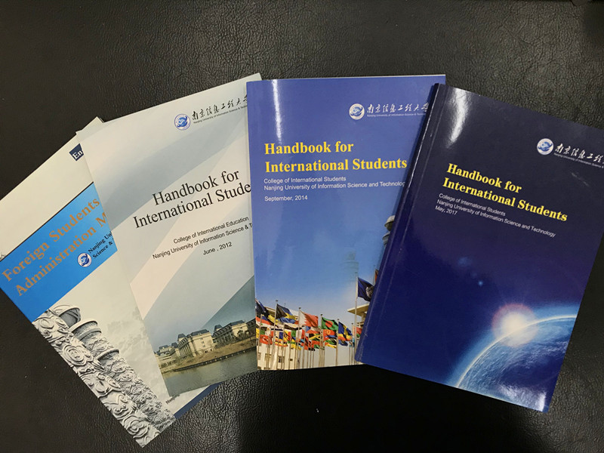
3. Practice
1. Degree
Provisional Measures on Bachelor’s Degree Conferment on International Students
Measures on Curriculum for International Undergraduates
Regulations on Curriculum and Qualifications for International Master Candidates
Regulations on Curriculum and Qualifications for International PhD Candidates
2. Management
Regulations on Enrollment and Requirements of International Students
Regulations on Examination Disciplines
Regulations on Penalties for Discipline Breach
Regulations on Residence and Visa
Dormitory and Accommodation Requirements
Insurance Policies for International Students
3. Scholarship Assessment
Measures on Annual Review of Government Scholarships
Measures on Assessing Scholarship of Excellent International Students
Measures on Assessing Specialized Awards of International Students
Measures on Assessing Award of Outstanding International Graduates

Slide 20
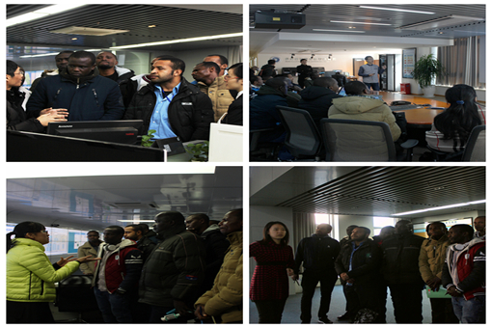
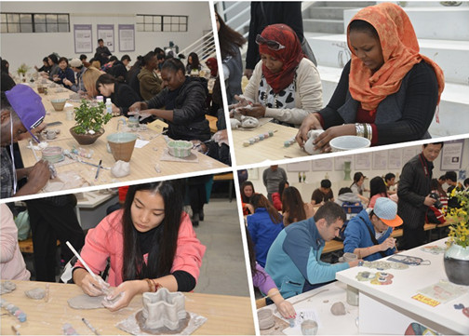
3. Practice

Slide 21
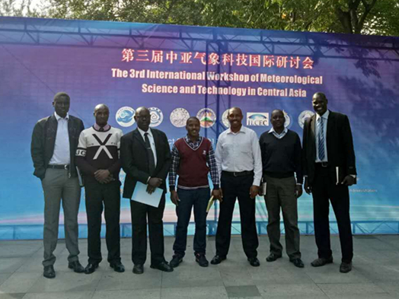
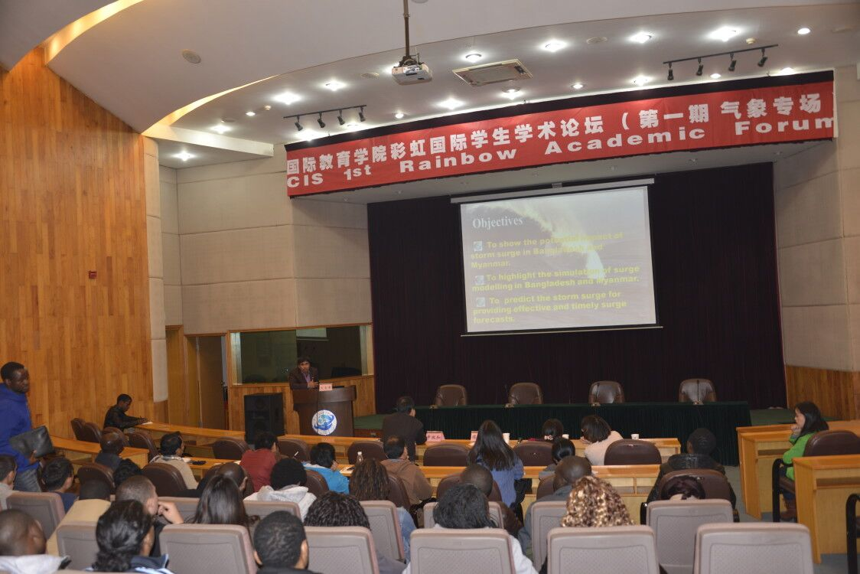
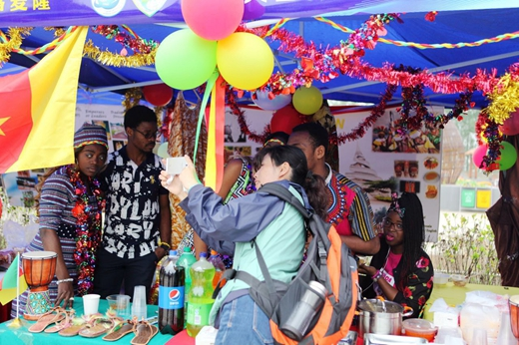
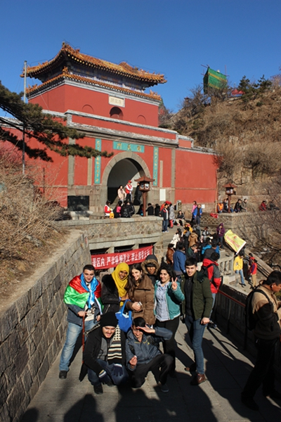
3. Practice

Slide 22
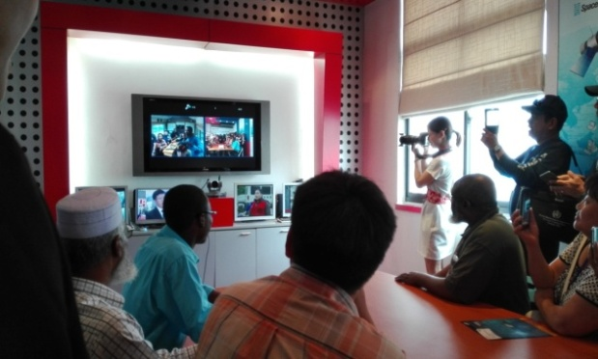
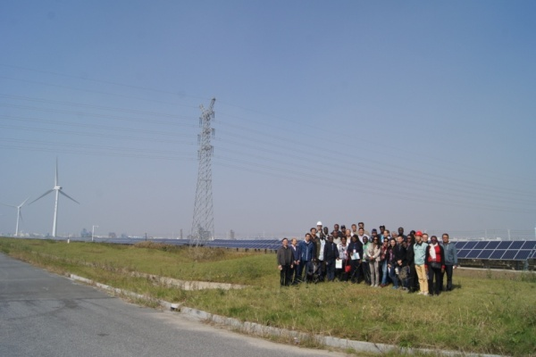
3.Practice
Study in Nanjing China-Spacenet Telecom Co. , Ltd
Visit Wind Power Generation

Slide 23
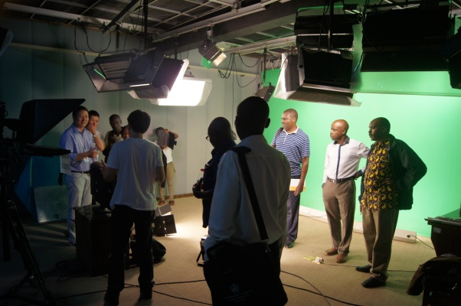
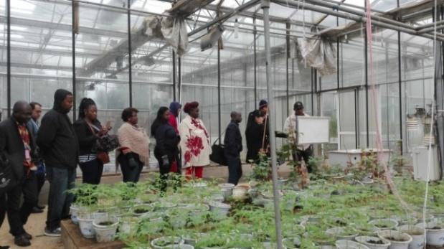
3.Practice
Study in NUIST Agricultural Meteorological Experimental Station
Practice in Weather Service Center of Wenzhou, Zhejiang Province

Slide 24
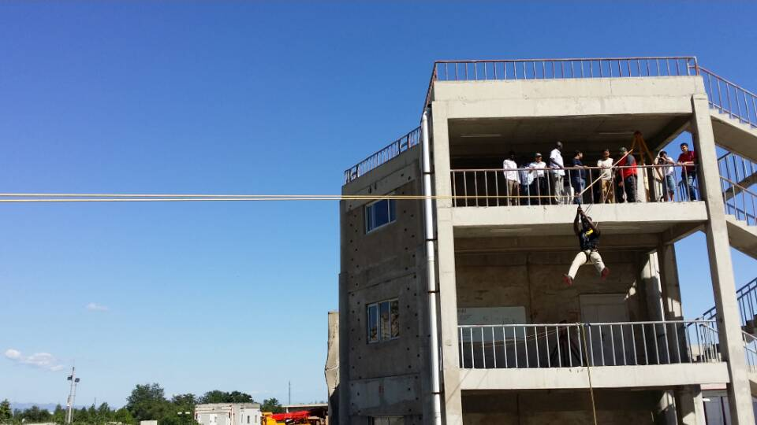
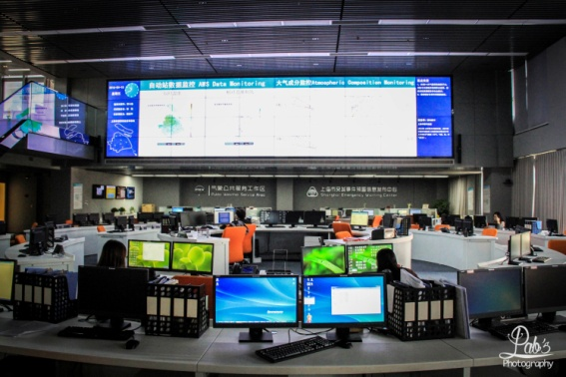
3.Practice
Visit National Earthquake Emergency Rescue Training Base
Visit Shanghai Meteorological Bureau

Slide 25
4. Suggestions
※WMO should encourage and instruct the education and training to meet the development of technology and society.
※WMO should be more diversified and inclusive to promote WMO RTC training programs.
※WMO SYMET could be organized every two years to enhance in-depth communication and achieve common understanding among member countries and RTCs.
※The practice of the education and training in some countrys could work as a case for WMO’s further work in leading the discipline development and conducting the training evaluation.
※The working language of WMO SYMET should be English without interpretation in other languages, or it is recommended to add Chinese if the simultaneous interpretation shall be retained.

Slide 26
Education for International Understanding
Living together –WMO Comunity Values of understanding, peace and coexistence
Cultural Diversity
Learn about various cultures and promote cultural integration
EIU
Competency of International corperation
An open mind, a inclusive attitude and an international perspective
If you want go fast, go alone If you want go far, go together

Slide 27
WMO is a big family,we are WMO members!
THANK YOU FOR ATTENTION!
www.nuist.edu.cn e-mail: suchun@nuist.edu.cn
No.219, Rd. Ningliu, Nanjing, Jiangsu 210044, China

