Slide 1
Collaboration among Multi-Agencies and a Consortium of Universities in the Philippines towards a Career Development in Meteorology
13th World Meteorological Organization (WMO) Symposium on Education and Training (SYMET-XIII)
CYNTHIA P. CELEBRE, Ph. D.
Chief
Research and Development and Training Division
PAGASA
cynthia_celebre@yahoo.com
Notes:
On the first day, we discussed various ways by which we can improve the competency of a meteorologist. Interpersonal skills were even included to b part of the competency.
The question is, if they already gained the competency, how do we retain them in the institution? The solution is difficult because it will involve money.

Slide 2
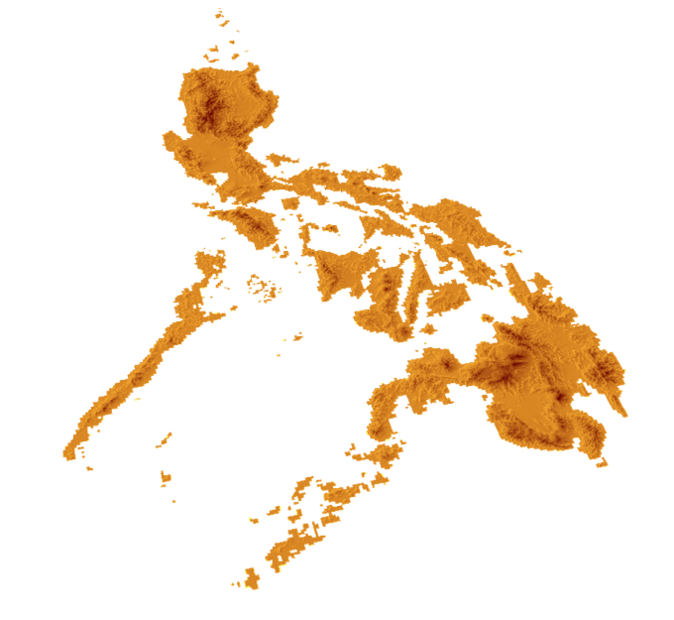
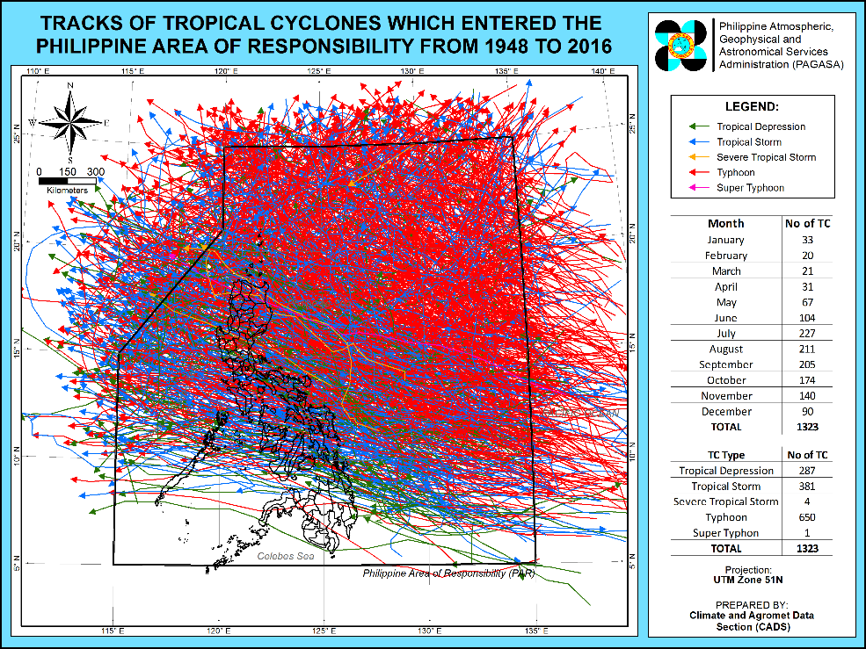
The Philippines
The Philippines ranked 3rd in the world as the most exposed and at risk to natural hazards after Vanuatu and Tonga (World Risk Report, 2016)
In the last 25 years, more than 80% of disasters experienced in the country were hydro-meteorologically related.
On the average, 20 Tropical Cyclones enter the Philippine Area of Responsibility each year.
Historical Tropical Cyclones from 1948 - 2016
Notes:
It is due to this reason that the weather forecasters of the country are being pirated by foreign countries.

Slide 3
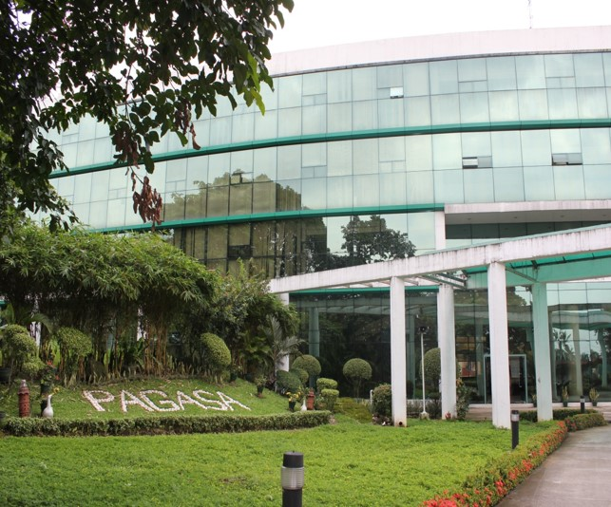
The Philippines
PAGASA: National Meteorological and Hydrological Services (NMHS) of the Philippines
WMO Regional Training Center (RTC) for RA V
Meteorologists Training Course and Meteorological Technicians Training Course
PHILIPPINE ATMOSPHERIC, GEOPHYSICAL & ASTRONOMICAL SERVICES ADMINISTRATION
The Philippines, through the PAGASA, is a Member of the World Meteorological Organization (WMO), a specialized body of the United Nations

Slide 4
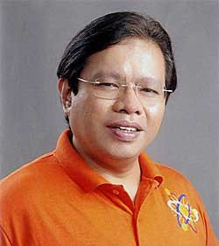
Project COMET
Project COMET (Consortium for Meteorology Education and Training) is a collaborative and innovative education approach that addresses the country’s need for meteorology experts.
In 2010, Cong. Palmones, former Representative of Alyansa ng mga Grupong Haligi ng Agham at Teknolohiya (AGHAM) Partylist, initiated the program pioneering the course offering of a B.S. degree in Meteorology, the first in Asia. – Champion
Collaborative undertaking among the following:
Consortium of Universities:
Cong. Angelo Palmones

Slide 5
Project COMET
The MAIN GOAL of the program is to PRODUCE, SUSTAIN and NURTURE specialized personnel in the field of METEOROLOGY in the Philippines.
The program addresses the need of the country on human resources in response to the emerging concern on weather and climate effects and solves the threat of losing experts to foreign countries (brain drain).

Slide 6
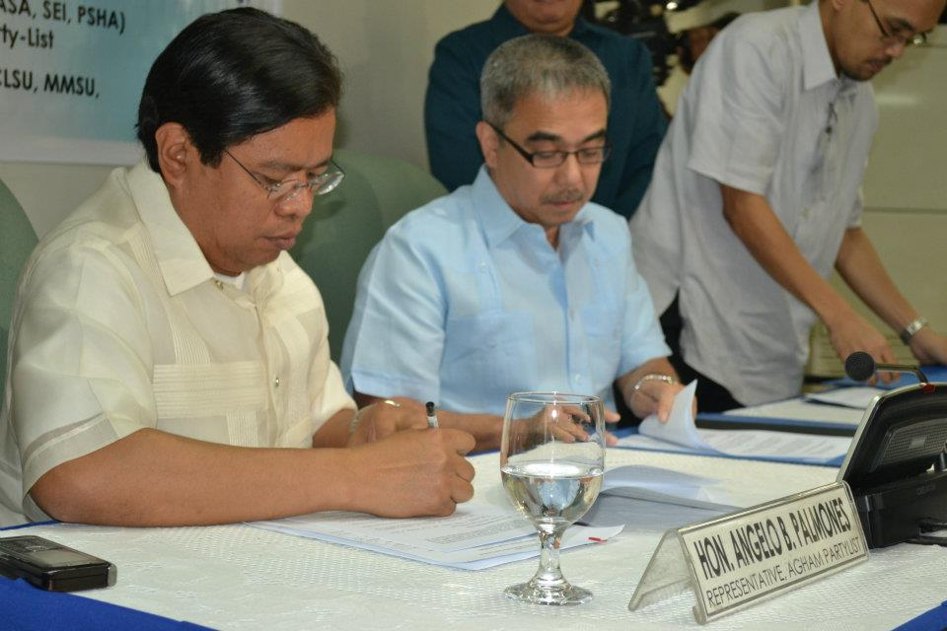
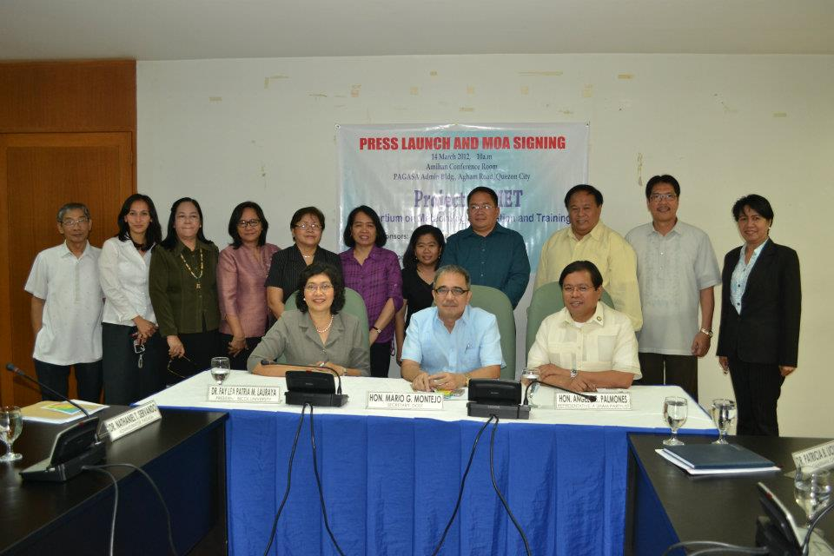
Signing of the Memorandum of Understanding
MOU was signed on 14 March 2011 by the then Secretary of the DOST for PAGASA and SEI (both agencies are under the umbrella of DOST), Congressman Palmones of AGHAM, and the CHED Commissioner who represents the consortium of universities

Slide 7
Signing of the Memorandum of Understanding
Objectives of the Project:
accelerate the development of human resource in meteorology that will ensure a steady supply of technically competent professionals needed in the country’s weather forecasting and other related activities.
establish a dynamic system of sharing expertise, knowledge, facilities and other resources through collaborations, and other innovative modes to strengthen partnerships among consortium member institutions.
develop a common curriculum for BS Meteorology and provide the scholars an enabling environment to ensure that they complete their degrees in accordance with the approved program of study.

Slide 8
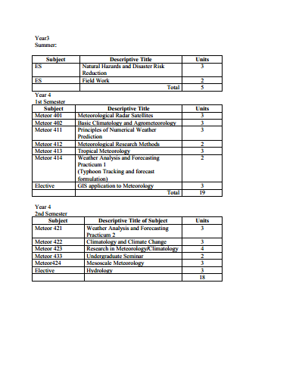
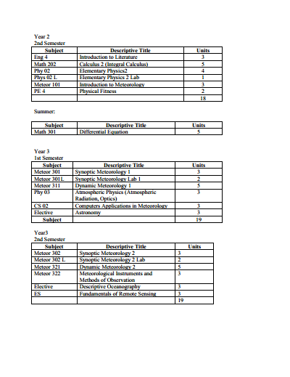
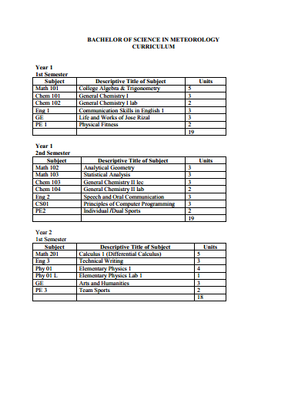
Role of the Philippine RTC
Served as Vice-Chair of the Technical Working Group (TWG) and as Coordinator.
In 2012, the RTC and the consortium of universities utilized the WMO BIP-M curriculum. The completed curriculum was submitted to CHED and was approved resulting to the accreditation of the course.
Provided the venue for the course and recommended lecturers including the use of its facilities
B.S. in Meteorology
Curriculum

Slide 9
Responsibilites of Members of the COMET
DOST-SEI: scholarship grant (Junior level Scholarship Program) with free tuition and other school fees, book, living and transportation allowances.
AGHAM Inc.: additional monthly allowances, payment of salaries of lecturers, computers and cost of supplies and materials.
Consortium Member Universities: assisted DOST-SEI and PAGASA in monitoring and evaluation of scholars; submitted semestral reports to DOST and AGHAM Inc.

Slide 10
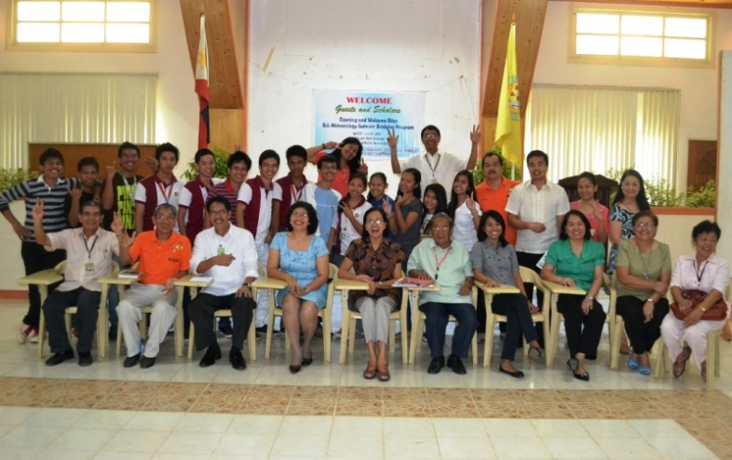
Implementation of the Course
The Course was offered to qualified incoming third year students who were enrolled in the Consortium Universities taking up mathematics, engineering and science courses.
The applicants went through rigorous screening process such as entrance examinations and interviews.
A six-week Summer Bridging Program started on
23 April 2012.
The Bridging Class was conducted prior to the
opening of the regular semester for School
Year (SY) 2012-2013 at the CLSU, Muñoz, Nueva
Ecija.
The subjects offered during this Summer Class are Differential Equations and Introduction to Meteorology.

Slide 11
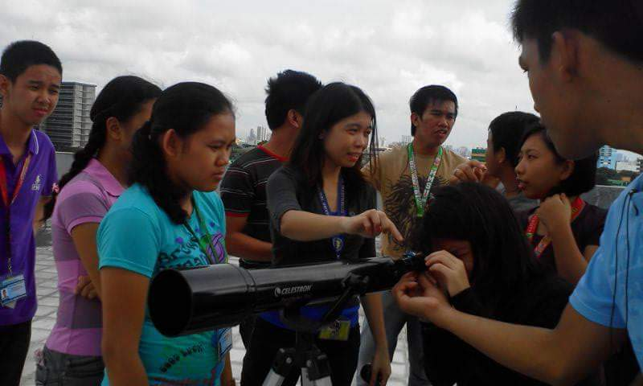
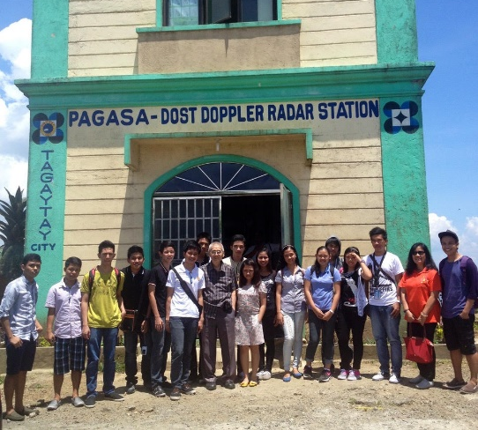
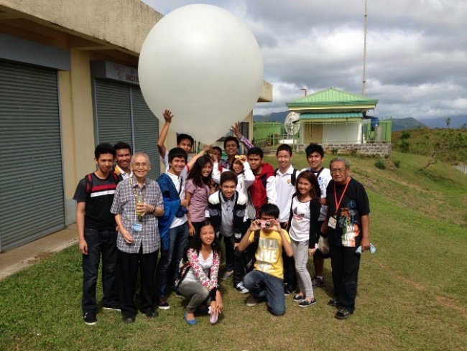
Implementation of the Course
For two years (2012-2014), the scholars underwent classes at PAGASA RTC Training Room in Diliman, Quezon City.
The professors were mainly composed of experts from the National Mapping and Resource Information Authority (NAMRIA), Rizal Technological University (RTU), University of the Philippines – Diliman and retired technical personnel of PAGASA.
They also had extensive field exposure in various weather stations such as nearby upper air and radar stations as well as in the Weather Forecasting Section of PAGASA.

Slide 12
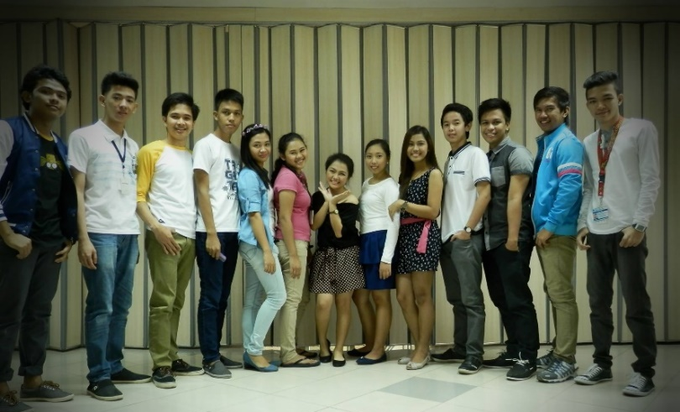
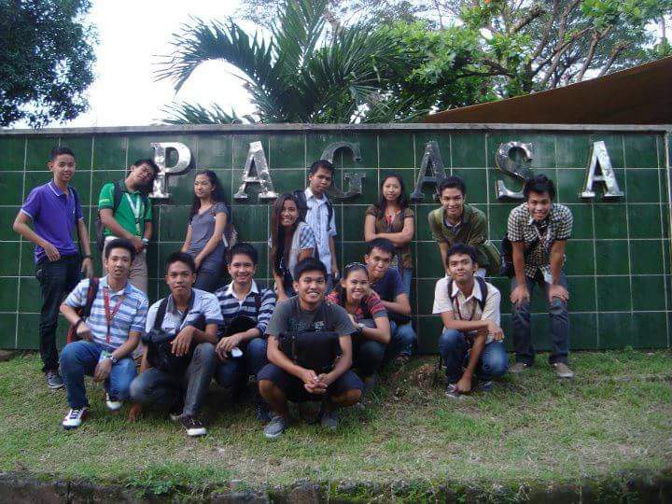
Implementation of the Course
A total of sixteen (16) graduated under the Project COMET’s program last SY 2013-2014.
Two (2) from Mariano Marcos State University (MMSU), seven (7) from the Central Luzon State University (CLSU), four (4) from the Bicol University (BU) and three (3) from the Visayas State University (VSU).
14 graduates are now employed, 10 of whom are working with PAGASA while 4 are serving as meteorologists in private companies and 2 are pursuing an M. Sc. Degree in Meteorology and Atmospheric Science at the University of the Philippines and Ateneo de Manila University respectively.

Slide 13
Recommendations
To the Education and Training Community, especially those from developing countries that are greatly affected by weather-related disasters and the changing climate and also experiencing brain drain issue, it is recommended to consider establishing the same course.
It will benefit not only your NMHS but also those public and private companies that are in need of weather experts.
The knowledge they gained in the field of research will also allow them to make innovative discoveries that may boost the economy.
It is important that you have Champion.

Slide 14
Recommendations
WMO Regional Training Centres, could play very important roles in the
development of a curriculum using the WMO BIP-M.
Elective subjects could be included in the curriculum depending upon the need of the NMHS and most of the companies who may employ the graduates.
Greater focus should be made during the implementation phase to ensure the success of the program.
Monitoring and evaluation schemes should be made ahead of time to minimize if not, eradicate failures.

Slide 15
Recommendations
International Development Partners can help in this endeavor by partnering with the concerned member or members and provide financial support, particularly in the provision of facilities that will be utilized in the various phases of the course.
They could offer immersion activities for the graduates that will provide them enriching experiences.
And to everyone, collaboration or partnership is the key word and the most important formula that was utilized in this undertaking.
The determination and synergy to save lives and boost the economy will ensure the success of the program.

Slide 16
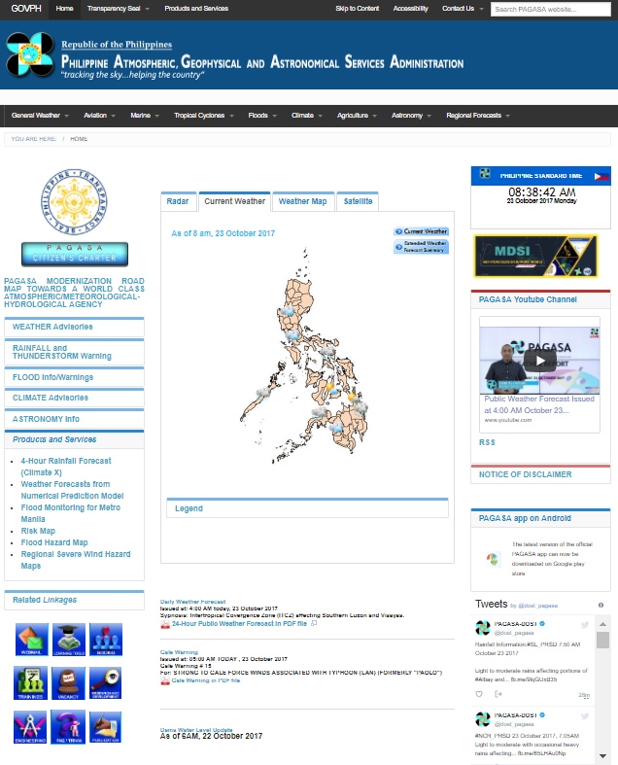
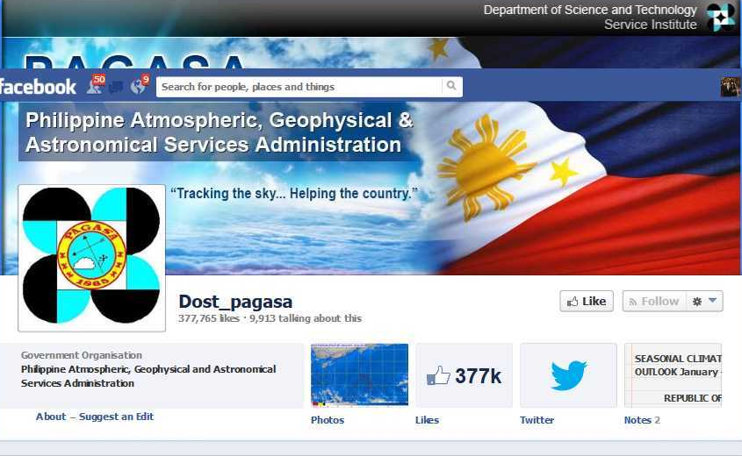
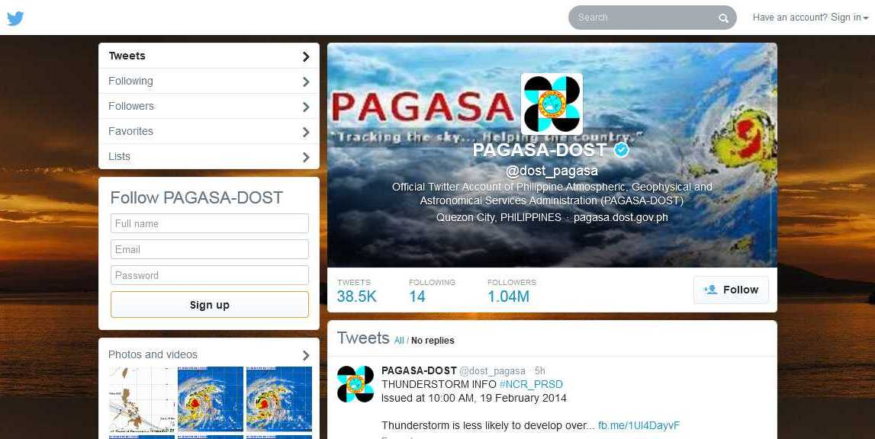
THANK YOU!
Website:
www.pagasa.dost.gov.ph
Facebook:
www.facebook.com/
pagasa.dost.gov.ph
Twitter:
@dost_pagasa

