Slide 1
Современное гидрометеорологическое образование в России и СНГ состояние и перспективы
MODERN HYDROMETEOROLOGICAL EDUCATION IN RUSSIA AND THE CIS COUNTRIES: STATE AND PROSPECTS
ADVANCED TRAINING INSTITUTE
OF ROSHYDROMET
Speaker:
Anna Timofeeva
Moscow, Russia
co-Rapporteur:
Julia Shushkova
St.Petersburg, Russia
SYMET-XIII, Bridgetown, Barbados, 30 October – 2 November 2017

Slide 2
Before the report, I would like to thank for the information:
Levon Vardanyan,
Director of the Hydrometeorological Service of Armenia
Maria Germenchuk,
Belhydromet
Peter Burdock,
Belarusian state University
B. Muminov,
Chairman of the Committee for Hydrometeorology under Cabinet of Ministers of Turkmenistan
Founded in 1988
In 1995 he received the status of WMO RTCs
For all the time raised the qualification for more than 12 thousand participants
Of them - more than a thousand – are foreign citizens
SYMET-XIII, Bridgetown, Barbados, 30 October – 2 November 2017

Slide 3
Hydrometeorological education in CIS countries
Founded in 1988
In 1995 he received the status of WMO RTCs
For all the time raised the qualification for more than 12 thousand participants
Of them - more than a thousand – are foreign citizens
Universities of Russia
Universities of CIS countries
Technical colleadges
SYMET-XIII, Bridgetown, Barbados, 30 October – 2 November 2017

Slide 4
Regional Training Center (RTC) of the World Meteorological Organization (WMO) in the Russian Federation
Founded in 1988
In 1995 he received the status of WMO RTCs
For all the time raised the qualification for more than 12 thousand participants
Of them - more than a thousand – are foreign citizens
Advanced Training Institute
Russian State
Hydrometeorological University
Moscow hydrometeorological
technical school
SYMET-XIII, Bridgetown, Barbados, 30 October – 2 November 2017

Slide 5
Russian State Hydrometeorological University
1930 – foundation
1944 – relocation to St.Petersburg
1995 – status of the RTC WMO
1998 – the University status
2015 – merger with State Polar Academy
Founded in 1988
In 1995 he received the status of WMO RTCs
For all the time raised the qualification for more than 12 thousand participants
Of them - more than a thousand – are foreign citizens
RSHU FACULTIES:
Meteorological
Hydrological
Oceanological
Ecology and environmental physics
SYMET-XIII, Bridgetown, Barbados, 30 October – 2 November 2017

Slide 6
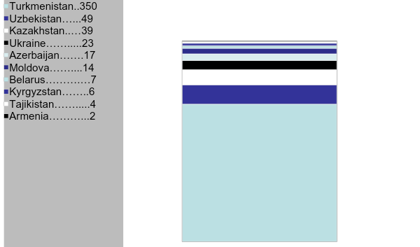
CIS countires students
Founded in 1988
In 1995 he received the status of WMO RTCs
For all the time raised the qualification for more than 12 thousand participants
Of them - more than a thousand – are foreign citizens
SYMET-XIII, Bridgetown, Barbados, 30 October – 2 November 2017

Slide 7
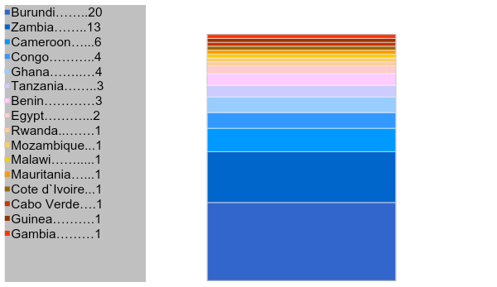
Students of Africa
Founded in 1988
In 1995 he received the status of WMO RTCs
For all the time raised the qualification for more than 12 thousand participants
Of them - more than a thousand – are foreign citizens
SYMET-XIII, Bridgetown, Barbados, 30 October – 2 November 2017

Slide 8
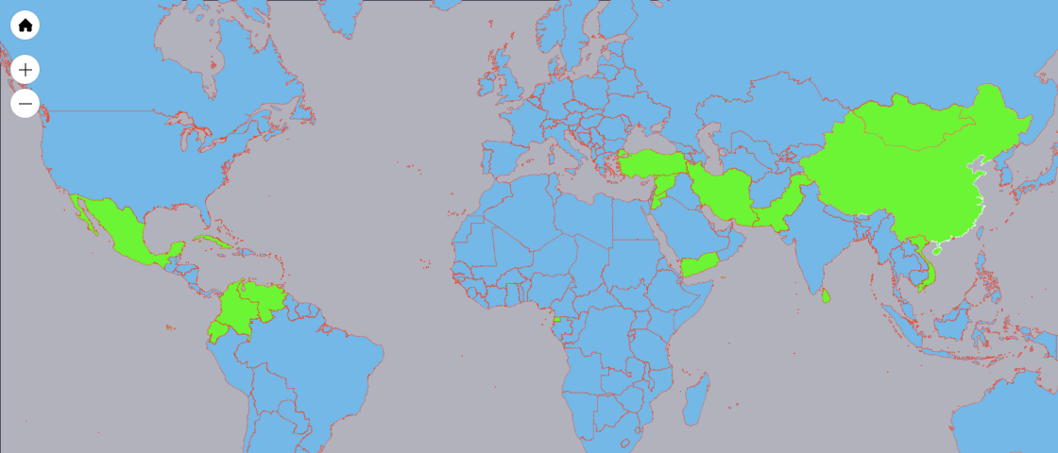
Other countries
Mongolia 4
China 4
Founded in 1988
In 1995 he received the status of WMO RTCs
For all the time raised the qualification for more than 12 thousand participants
Of them - more than a thousand – are foreign citizens
Turkey 1
Iran 3
Syria 3
Mexico 1
Cuba 1
Jordan 2
Venezuela 1
Pakistan 1
Yemen 5
Vietnam 6
Colombia 1
Sri Lanka 3
Ecuador 1
Equatorial Guinea 7
SYMET-XIII, Bridgetown, Barbados, 30 October – 2 November 2017

Slide 9
About us …
ATI of Roshydromet was founded in 1988
In 1995 ATI received the status of WMO RTC
More than 1,6 thousand foreign specialists have been trained so far
About 20 thousand national specialists have been trained at ATI
SYMET-XIII, Bridgetown, Barbados, 30 October – 2 November 2017

Slide 10
Educational and laboratory facilities of ATI
St.-Petersburg
- Voeikov Main Geophysical Observatory
- State Hydrological Institute
- The Arctic and Antarctic Research Institute
Moscow
Founded in 1988
In 1995 he received the status of WMO RTCs
For all the time raised the qualification for more than 12 thousand participants
Of them - more than a thousand – are foreign citizens
-- Hydrometeorological Research Centre of the Russian Federation
-- State Research Center "Planeta“
-- Central Aerological Observatory
- Institute of Applied Geophysics
- Institute of Global Climate and Ecology of Roshydromet and RAS
-- State Oceanography Institute
Obninsk
-- Russian Institute of Hydrometeorological Information (World Data Center)
-- Russian Research Institute of Agricultural Meteorology
-- Research and Production Association “Typhoon”
Rostov-on-Don
-- Hydrochemical Institute
Nalchik
-- High-Mountain Geophysical Institute
SYMET-XIII, Bridgetown, Barbados, 30 October – 2 November 2017

Slide 11
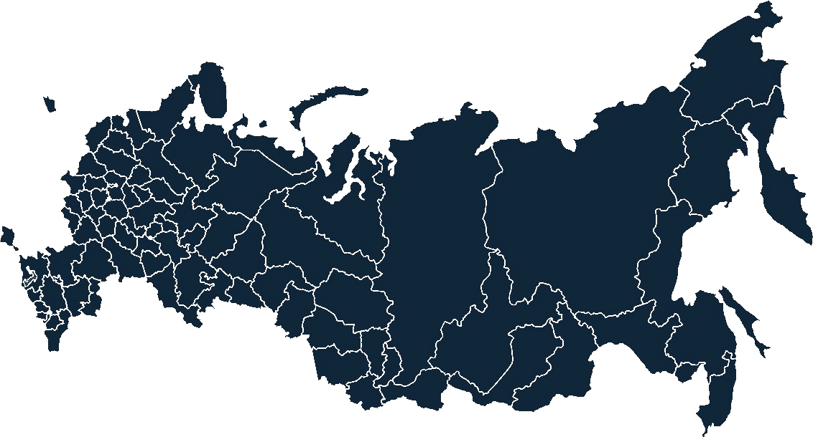
Regional Training Centers of Roshydromet
RTC
Rostov-on-Don
RTC
St.-Petersburg
RTC
Novosibirsk
RTC
Irkutsk
RTC
Vladivostok
Founded in 1988
In 1995 he received the status of WMO RTCs
For all the time raised the qualification for more than 12 thousand participants
Of them - more than a thousand – are foreign citizens
ATI
Moscow
SYMET-XIII, Bridgetown, Barbados, 30 October – 2 November 2017

Slide 12
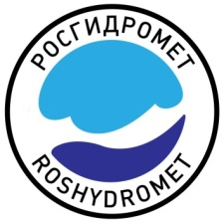
WMO Qualification Standard
By decision of the Sixteenth World Meteorological Congress in 2011 there were established requirements for the qualification of meteorological personnel (including-aerial).
From December 1, 2016, the qualification requirements became the standard practice of WMO.
Roshydromet got the task to introduce a WMO qualification standard for aeronautical meteorologists and forecasters in the Russian Federation.
Founded in 1988
In 1995 he received the status of WMO RTCs
For all the time raised the qualification for more than 12 thousand participants
Of them - more than a thousand – are foreign citizens
SYMET-XIII, Bridgetown, Barbados, 30 October – 2 November 2017

Slide 13
In 2016, ATI developed online professional development programs for AMF and AMT in line with the WMO Technical Regulations No. 49 and Competency Requirements No. 1083
Founded in 1988
In 1995 he received the status of WMO RTCs
For all the time raised the qualification for more than 12 thousand participants
Of them - more than a thousand – are foreign citizens
SYMET-XIII, Bridgetown, Barbados, 30 October – 2 November 2017
Notes:
В 2016 году ИПК разработал дистанционные программы повышения квалификации и переподготовки авиационных метеорологов - прогнозистов и техников в соответствии с требованиями Технического Регламента ВМО №49 и документа ВМО-1083.

Slide 14
85 NHMS specialists from CIS countries were trained
in 2016 along these new programmes of study
14
Kyrgyz Republic
Founded in 1988
In 1995 he received the status of WMO RTCs
For all the time raised the qualification for more than 12 thousand participants
Of them - more than a thousand – are foreign citizens
22
Georgia
22
Belarus
27
Kazakhstan
SYMET-XIII, Bridgetown, Barbados, 30 October – 2 November 2017
Notes:
В том числе:
Белоруссия – 22 человека (переподготовка 7 синоптиков и 15 техников)
Казахстан – 27 человек (переподготовка 19 синоптиков и 8 техников)
Грузия – 22 человека (переподготовка 13 синоптиков, повышение квалификации 9 синоптиков )
Киргизия – 14 человек (переподготовка синоптики)

Slide 15
In 2016, ATI was contracted by WMO to translate and adapt for
Russian-speaking audience the WMO Train-the-Trainer course.
In Autumn 2016 the online course was offered to trainers and
training managers from CIS countries, reaching the total number
of CIS NHMS specialists trained by ATI in 2016 as high as 118.
Founded in 1988
In 1995 he received the status of WMO RTCs
For all the time raised the qualification for more than 12 thousand participants
Of them - more than a thousand – are foreign citizens
1
Georgia
3
4
Turkmenistan
5
Ukraine
20
Uzbekistan
Kyrgyz Republic
SYMET-XIII, Bridgetown, Barbados, 30 October – 2 November 2017
Notes:
33 человека – в том числе ,
Узбекистан- 5,
Кыргызстан -20,
Грузия – 1,
Туркмения -3,
Украина – 4

Slide 16
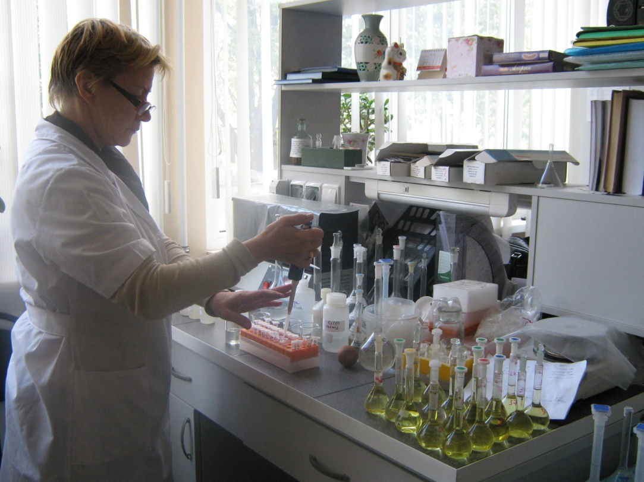
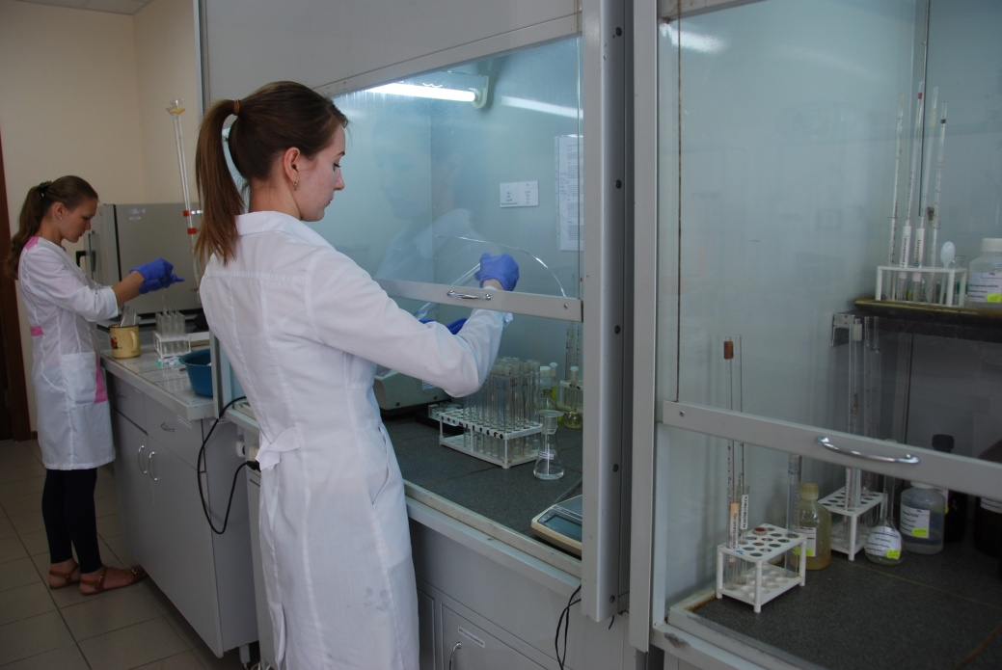
In line with national legislation of Russia, environmental monitoring courses were developed for atmosphere, surface water and soil monitoring
Founded in 1988
In 1995 he received the status of WMO RTCs
For all the time raised the qualification for more than 12 thousand participants
Of them - more than a thousand – are foreign citizens
More than 200 specialists have been retrained in 2016 by completing these courses
SYMET-XIII, Bridgetown, Barbados, 30 October – 2 November 2017
Notes:
В соответствии с российским законодательством разработаны курсы мониторинга природных сред: атмосферы, поверхностных вод суши, почвы

Slide 17
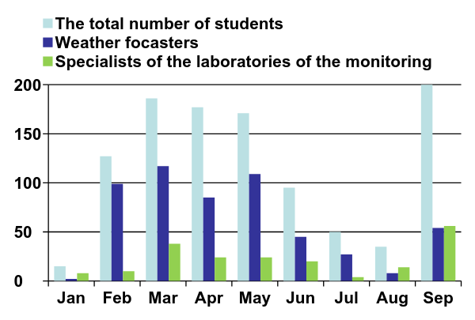
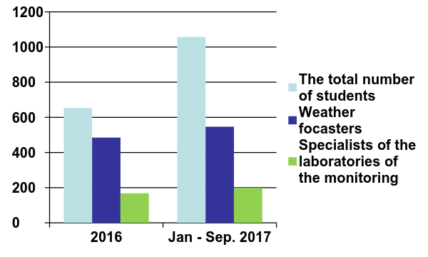
In an average month remote training for about 50 people.
Founded in 1988
In 1995 he received the status of WMO RTCs
For all the time raised the qualification for more than 12 thousand participants
Of them - more than a thousand – are foreign citizens
A comparison of the number of graduates in 2016 and the period from January to September 2017
SYMET-XIII, Bridgetown, Barbados, 30 October – 2 November 2017
Notes:
В соответствии с российским законодательством разработаны курсы мониторинга природных сред: атмосферы, поверхностных вод суши, почвы

Slide 18
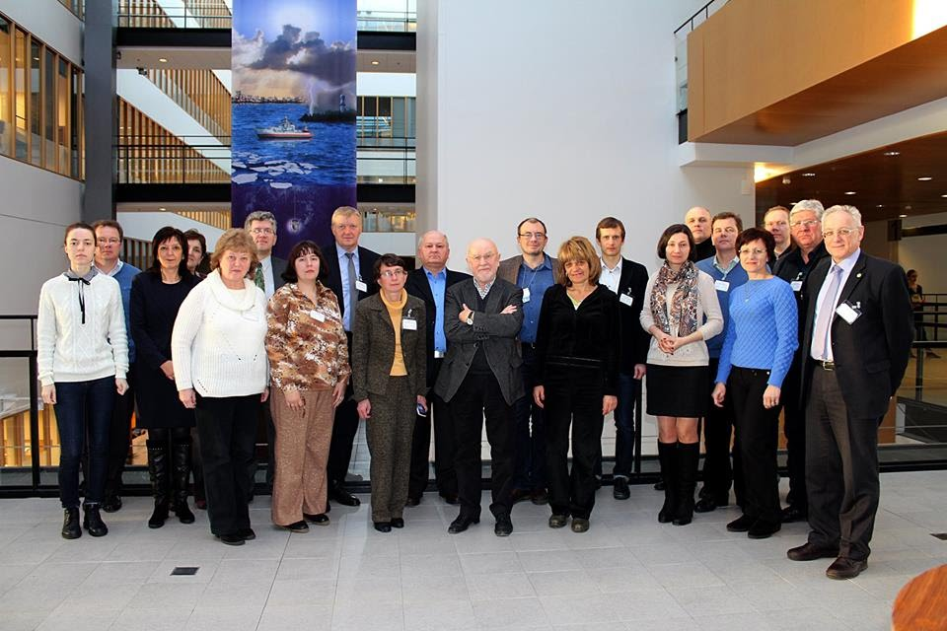
In 2016, the new international project has started, “Adaptive Learning Environment For Competence In Economic And Societal Impacts Of Local Weather, Air Quality And Climate (ECOIMPACT)”, where ATI is one of 8 consortium members.
Founded in 1988
In 1995 he received the status of WMO RTCs
For all the time raised the qualification for more than 12 thousand participants
Of them - more than a thousand – are foreign citizens
The ECOIMPACT project develops a personal learning environment (PLE) featuring custom-tailored learning materials, “smart” IoT-based weather observation instruments, and learning management software – all integrated into a single system. Such approach allows for learning in contact with a studied physical environment and develops competences required for today’s modern life.
SYMET-XIII, Bridgetown, Barbados, 30 October – 2 November 2017
Notes:
В 2016 году стартовал международный проект «Адаптивная учебная среда для развития компетенций в отношении влияния местной погоды, качества воздуха и климата на экономику и социальную жизнь (ECOIMPACT)». ИПК является одним из членов консорциума образовательных учреждений из Финляндии, России, Украины, Словакии и Болгарии. Цель проекта - разработать и применить на практике современные методы и методики в сфере гидрометеорологического образования для повышения эффективности обучения и коммерциализации интегрированной адаптивной учебной среды.

Slide 19
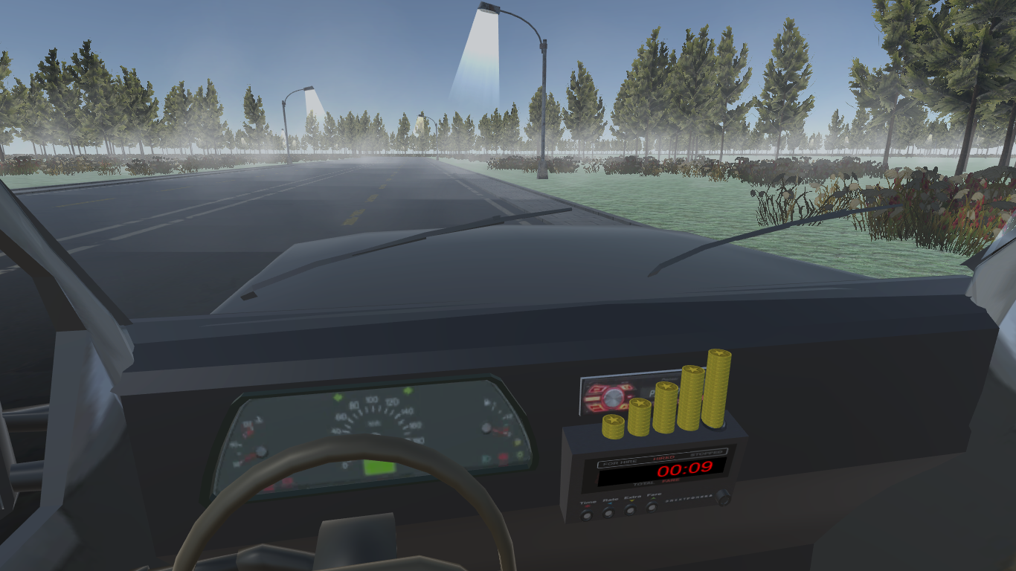
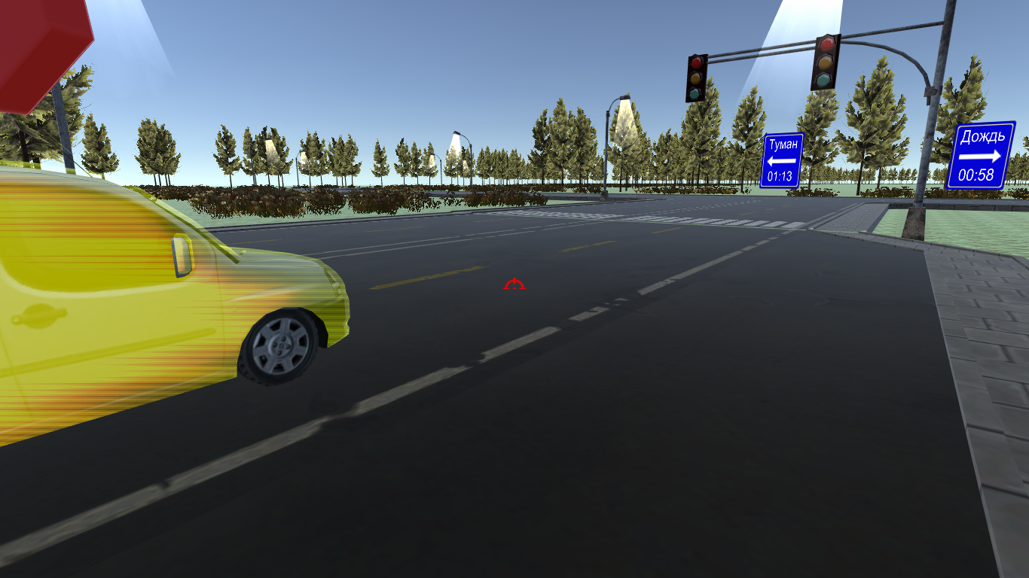
The project ECOIMPACT.
Training course on "Automobile transport"
Founded in 1988
In 1995 he received the status of WMO RTCs
For all the time raised the qualification for more than 12 thousand participants
Of them - more than a thousand – are foreign citizens
SYMET-XIII, Bridgetown, Barbados, 30 October – 2 November 2017
Notes:
В мае 2016 года ИПК организовал семинар для аспирантов НИУ Росгидромета «Мировой опыт прогнозирования погоды и перспективы развития» из 10 лекций (6 по динамической метеорологии и 4 по статистической метеорологии), который провел эксперт-метеоролог ВМО, профессор Андерс Перссон. Тексты и видеозаписи лекций выложены на сайте ИПК и доступны всем желающим.

Slide 20
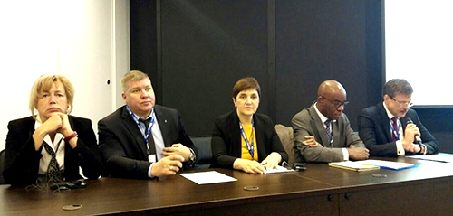
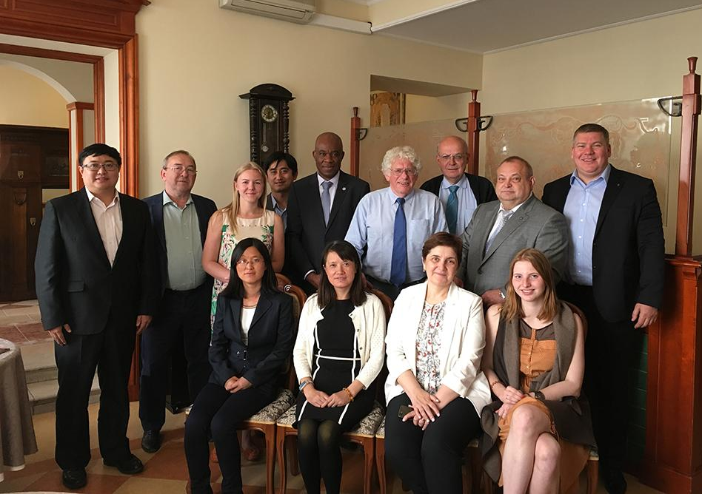
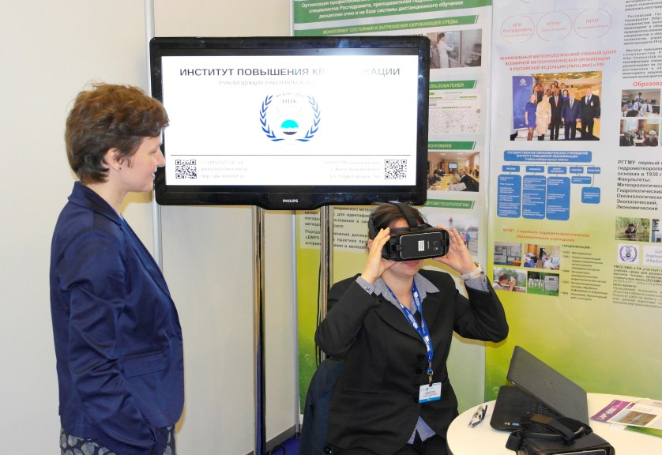
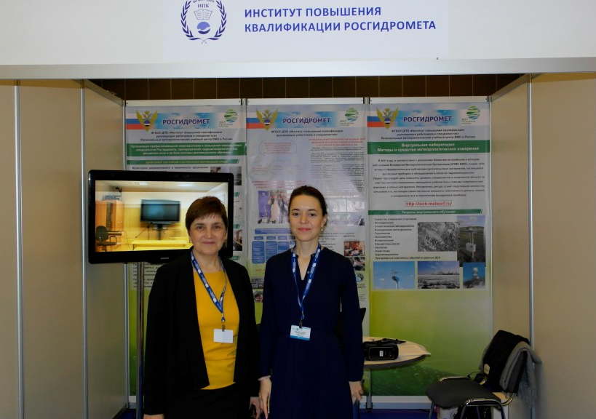
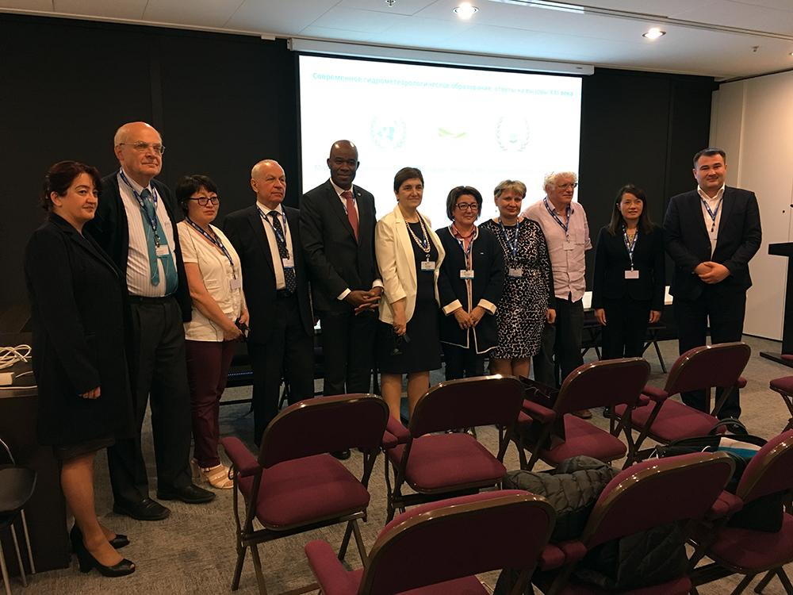
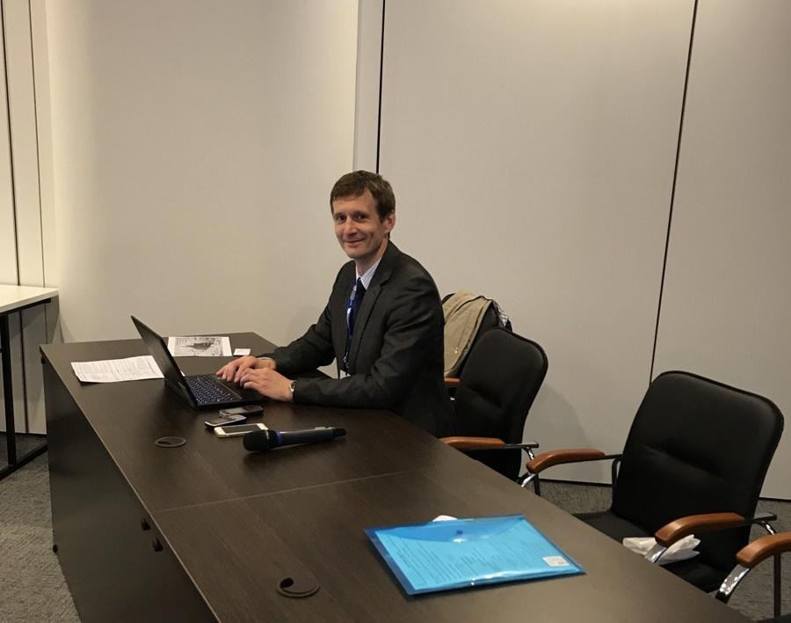
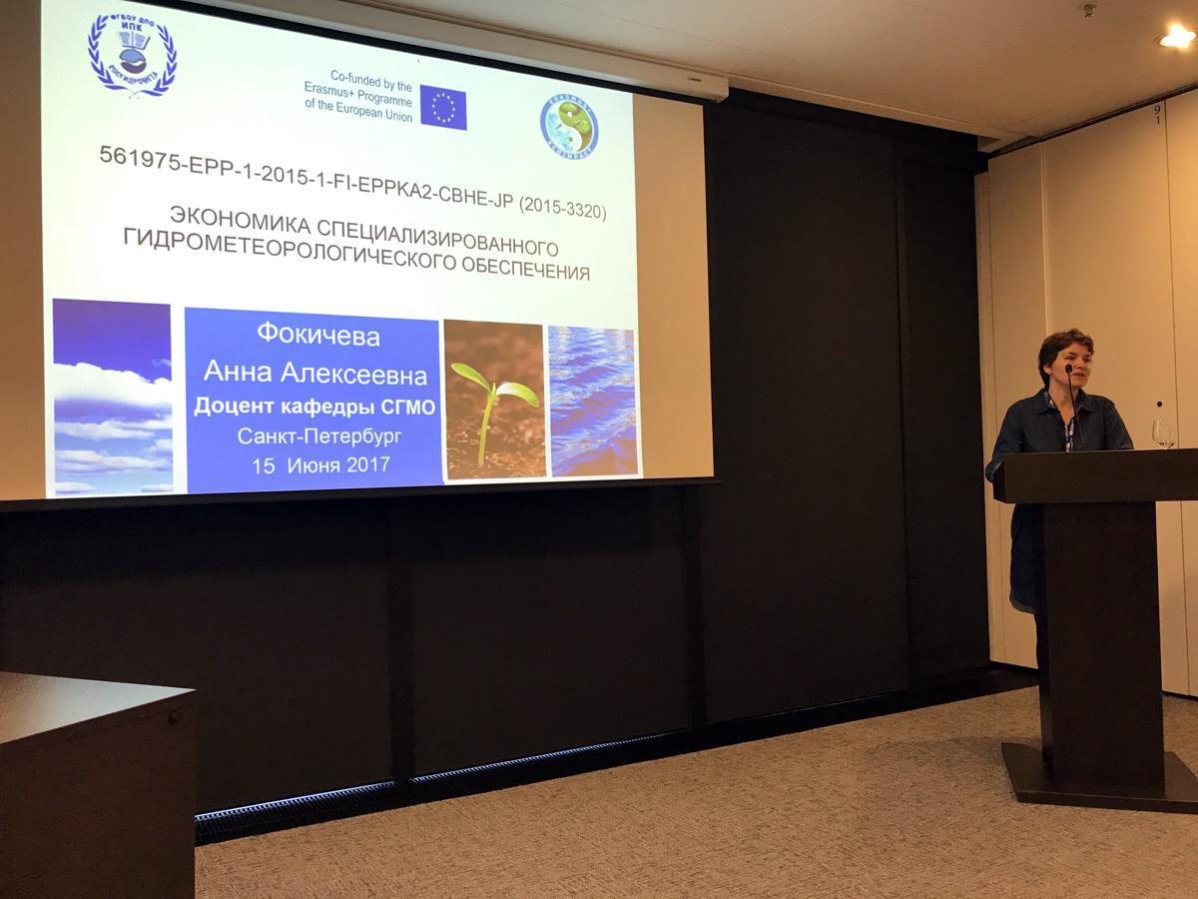
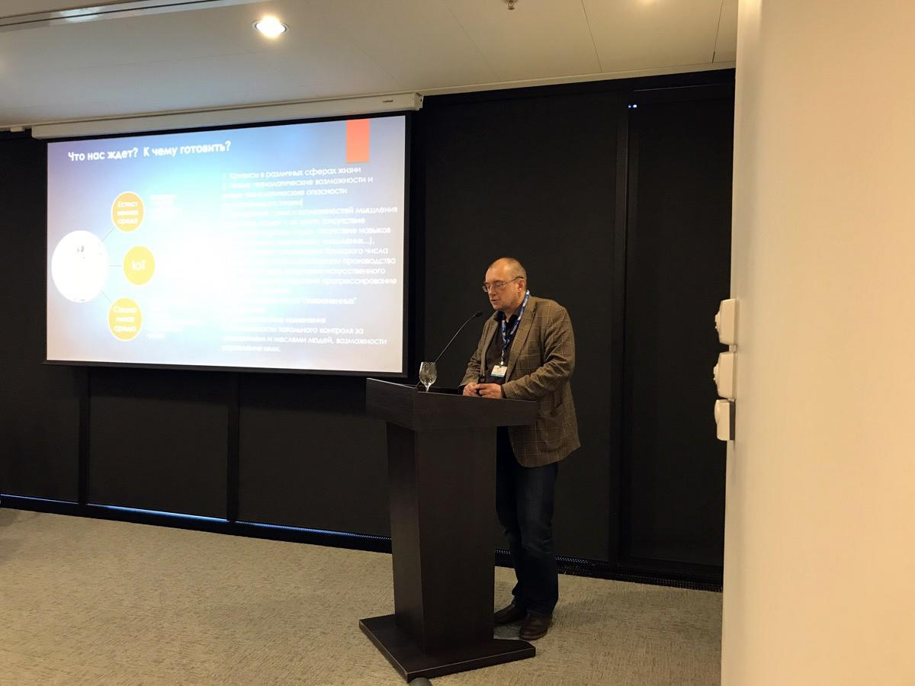
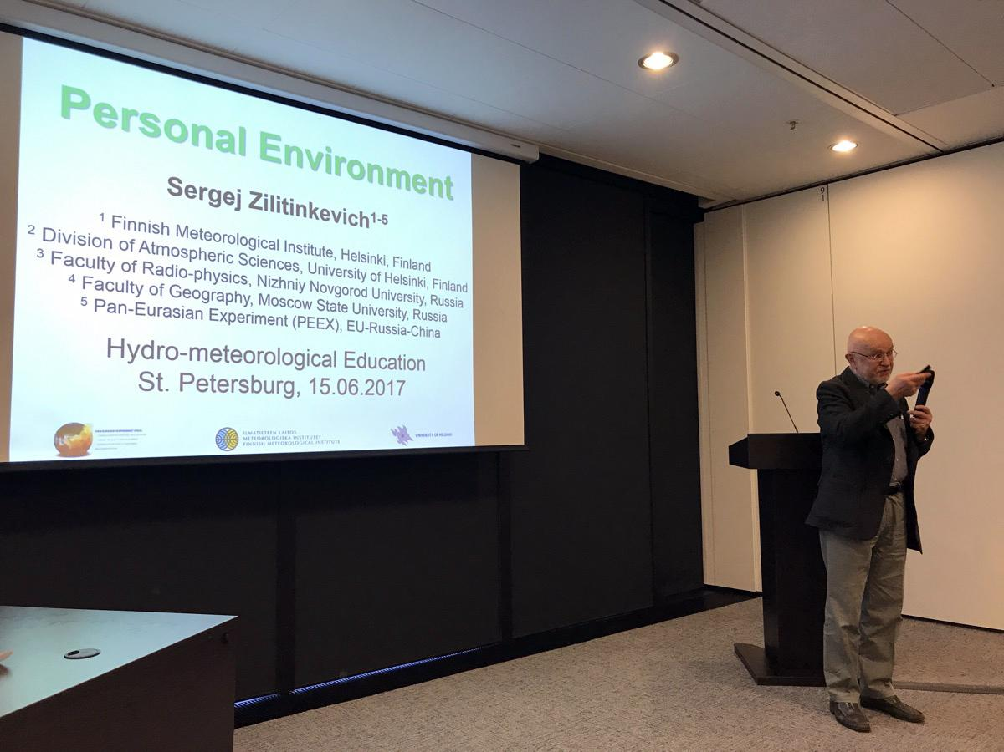
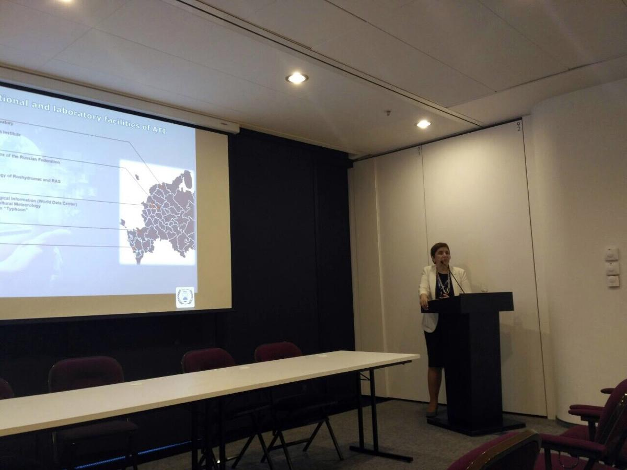
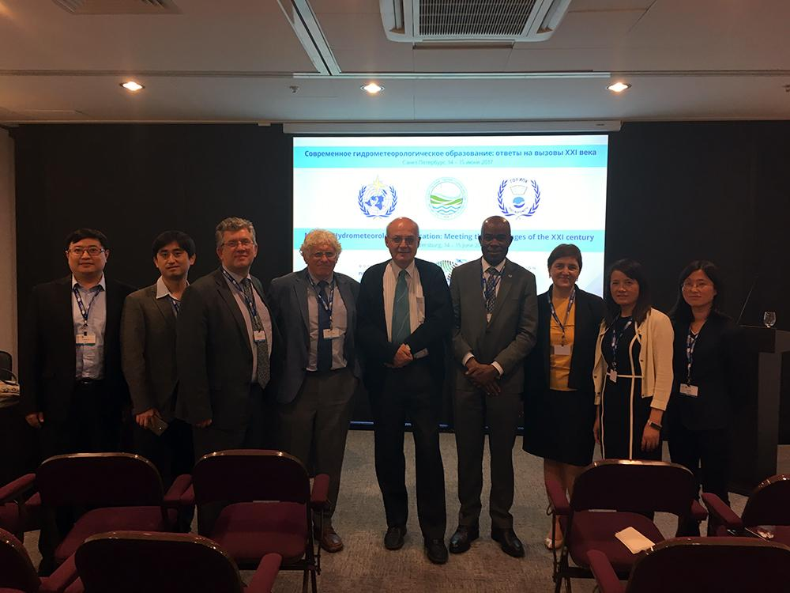
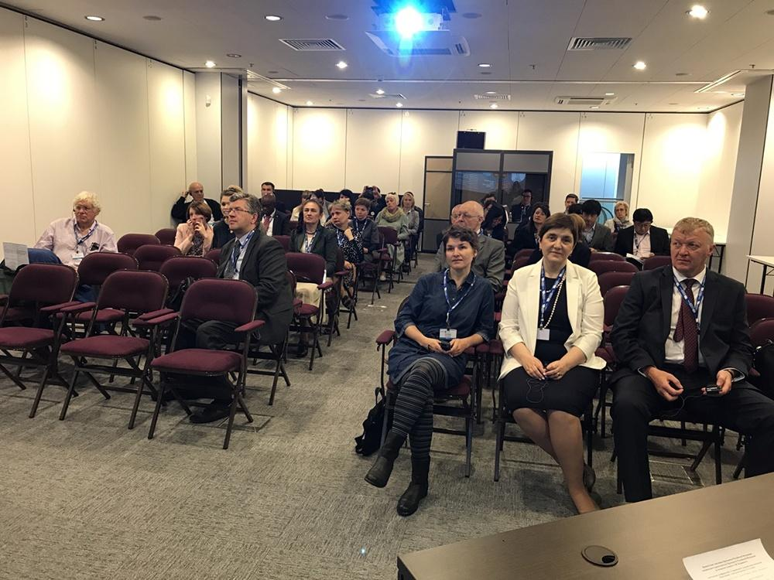
International Conference
"Modern Hydrometeorological Education:
Answers to Challenges of the 21st Century”
Founded in 1988
In 1995 he received the status of WMO RTCs
For all the time raised the qualification for more than 12 thousand participants
Of them - more than a thousand – are foreign citizens
St.Petersburg
14-15 June 2017
SYMET-XIII, Bridgetown, Barbados, 30 October – 2 November 2017
Notes:
В мае 2016 года ИПК организовал семинар для аспирантов НИУ Росгидромета «Мировой опыт прогнозирования погоды и перспективы развития» из 10 лекций (6 по динамической метеорологии и 4 по статистической метеорологии), который провел эксперт-метеоролог ВМО, профессор Андерс Перссон. Тексты и видеозаписи лекций выложены на сайте ИПК и доступны всем желающим.

Slide 21
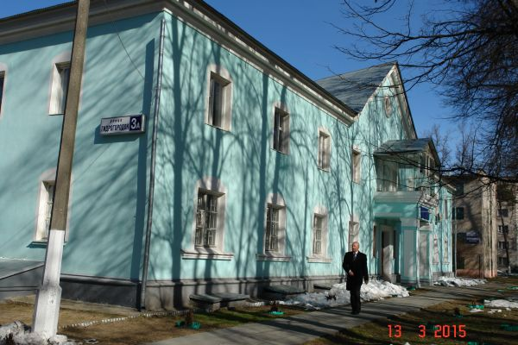
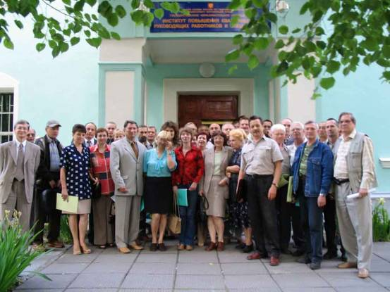
Thank you for your attention!
ipkmeteorector@gmail.com
Founded in 1988
In 1995 he received the status of WMO RTCs
For all the time raised the qualification for more than 12 thousand participants
Of them - more than a thousand – are foreign citizens
SYMET-XIII, Bridgetown, Barbados, 30 October – 2 November 2017

