Slide 1
A
practical example of the implementation of a new training process

Slide 2
Train the Trainer, Sibiu, 2010
Notes:
2
Sometimes you get information from which you think:
You are absolutely right but how the hell am I going to implement that in my organisation ……
Fresh into to the field of education and training I was confronted with this
Context of learning scheme of Ian Bell during the WMO train the trainer in Sibiu

Slide 3
Develop the program from the top down
Are the goals met?
Goals
Support
Evaluate all aspects of the training
Job Tasks
Competencies
Training Needs
Notes:
The message was: Develop the training program for your institute from the top down and evaluate all aspects of training against the goals of your organisation. That will be the only way that your training program will last.
Creating training needs from competencies is not the most difficult things. WMO has done a wonderful job with writing competencies for for instance aeronautical forecasters during the past few years….. and to be honest those helped me at awful lot during the past couple of years.
The main problem was THE BIT in the red circle ….. How to connect your education and training programme to the goals of a organisation. This organisation can be your own organisation or an organisation you train people for.

Slide 4
Goals
Support
Job Tasks
Competencies
Notes:
4
I won’t go into great detail on how our we have organised our training process within KNMI
but I wanted to show you how we made this desirable connection (Red Circle).
Blue Circle: the goals of the organisation you can find in the company strategy.
Based on this KNMI strategy each department has written its’ own strategy.
Orange Circle: I was very happy when KNMI introduced the Human Resource Cycle strategy.
Because there you have the connection how your organisation supports the goals through trained
staff, and a couple of other things ;-)
In this Human Resource Cycle our managers have to create a strategic staff planning and will have
a paper staff inspection in the management team meeting to see whether there are employees
that possibly fit better at an position within KNMI seen in the light of changes that are on the way.
Green Circle: In the strategic staff planning managers look to the situation of their department
as it is and to the situation as it should be in light of the changes that should be made to reach
the company strategy.
This is basically a GAP analyses and will result in a plan how to move forward.
And when this is done right you will find the changes your organisation and staff needs to go
through to achieve the ultimate goals and you know what groups/individuals need education
and training and where they need to go.

Slide 5
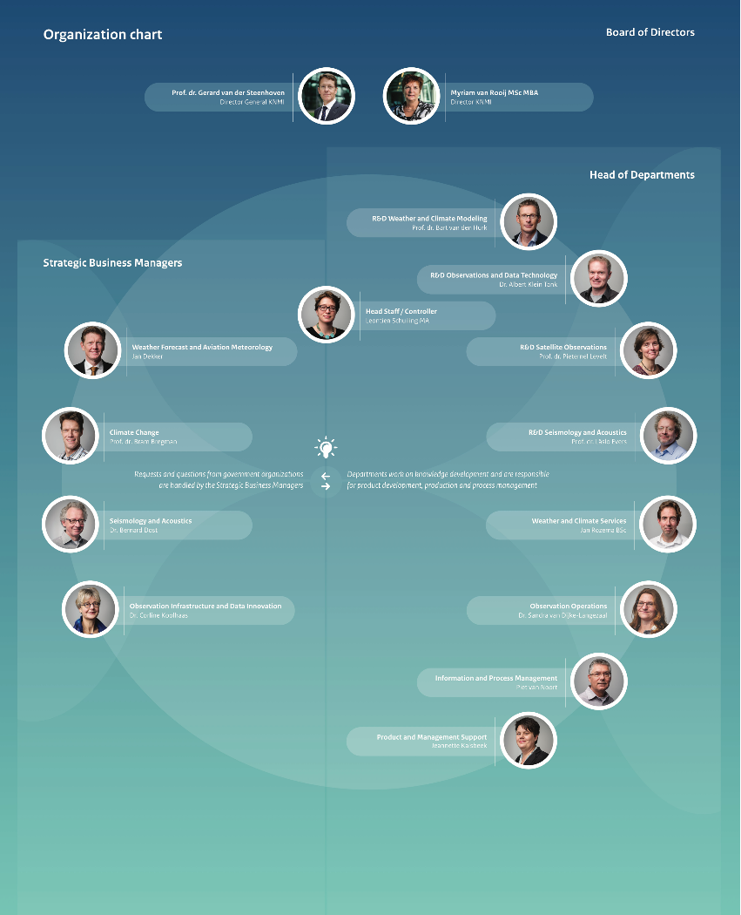
Observations Operational
Install, maintain and validate the meteorological and seismological instruments and support and run related projects
People are very specialised in their area
70% of staff will retire within next 5 years
E&T needs:
new staff needs to be trained
Single point of failure needs to be taken out.
Notes:
5
From this strategic staff planning we found that the manager of the department of
Observations Operational needed help. The staff of this department take care for
the installation, maintaince and validation of the meteorological and seismological
instruments and supports and run related projects
The problem was:
that there were a lot of people very specialised on one little specialism within
this department. So there is a large risk for single point of failure
AND
2) 70% of the staff from the department Observations Operational will retire
within the next 5 years. And the means A HUGE LOSS OF VERY VALUABLE KNOWLEDGE
The department manager needed help with:
Creating plans for the training of new staff up to stands
The excising staff needs to be trained in a wider area.

Slide 6
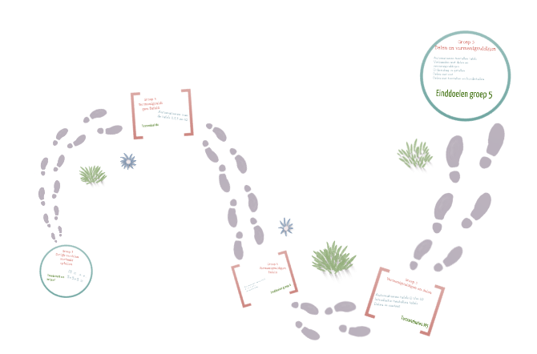
Learning pathway
Professional
Start
Notes:
6
We decided to solve that with a learning pathway. A learning pathway in nothing
more and nothing less than the description of the route a new staff member goes
from entering the institute to become a professional in that area.
These people can be right from school or from another job profession. This can look like:
An initial training
An on the job training
Experience
More training
Experience
Etc.
The great thing of this method is that you can use it for new staff members and
also for experienced staff members who need to switch jobs or learn new competencies
How did I create my learning pathways for this department observations operational??

Slide 7
Observations Operational
Goals
WMO technical regulations WIGOS
Draft WMO competencies:
Observing programme network management
observations
Instrumentation
Calibration
Consulting colleagues
INTERVIEWS staff members
Support
Job Tasks
Competencies
Training Needs
Notes:
7
We go back to the piramid from Ian
If the job tasks are completed the goals of the organisation should be met
To find out the job tasks:
I read the the named documents,
asked colleagues within Europe, US and Canada whether they could help me with
information regarded competencies needed for these jobs and possibly training material
3) And very important I interviewed both very experienced staff members and
staff members at the start of their career to find out what their day to day job tasks were.
Next to these people were asked to tell from each other what they would desperately
miss if the other suddenly dropped dead for what ever reason.
The staff members were really challenged to think out of the box. So not only content
but also in social competencies of this that keep the team up and running where named.
Last but not least I asked the staff members at the start of their carrier how they
have experienced the E&T route so far: what could be done more efficient and what
was desperately missed
Doing this all of this, adapt the relevant competency framework to your needs and
writing a report with an overview you will find that your competencies and training needs
dropping out by itself….really nice to experience that!

Slide 8
Learning pathway
Professional
Define steps of the learning pathway
Identity learning solutions
Develop:
Training plans
Training activities
Assessment methods
Run E&T activities
Start
Notes:
8
Then you can go back to your learning pathway and
define the steps to do to become a professional,
identify the needed learning solutions
Develop trainings plans, activities and assessment methods for the needed training
And run the training programme

Slide 9
Are the goals met?
Goals
Support
Evaluate all aspects of the training
Job Tasks
Competencies
Training Needs
Notes:
9
When all of this done and the training is completed we will evaluate all aspects of the training
against the company strategy to see whether we have met all the goals of this department.
As training centre, both internal as external, it could be very useful to ask
the manager of the participants after say half a year whether the training
has been useful and have solved his or her problem.

Slide 10
Other things to think about
What about the Continuous Professional Development for the staff of a department like this? How do you keep them up to date?
What are the consequences when this training AND Continuous Professional Development is not properly organised?
Is there a need for an official certification to show that also this part of your company chain is properly secured?
Notes:
10
When you are busy developing such an huge training solution it might be a
good time to also think about the following points:

Slide 11
Suggestions to the WIGOS project
Notes:
In contact with my colleagues worldwide I found out that I am not the only one struggling
with this question and that is why I have some suggestions to the WIGOS project.
The way the aeronautical competencies were put across was very nice…

Slide 12
Members needs
Knowledge about strategies
Knowledge of the needed competencies
Example learning pathways
Training guidance
Examples how to do assessments of individuals
Strategies to keep the people updated
Evaluation of Met Services?
Basic Meteorological Understanding?
Notes:
12
So it would be valuable
1+2) If the knowledge about the strategies and needed competencies
is easier to reach for E&T specialists
3+4) That there are some example learning pathways and a training guidance created…
just a question I came across related to the competencies:
what is “Basic Meteorological Understanding” for people who
install, maintain and validate the meteorological and seismological instruments
and support and run related projects?? I m sure that every one has their own ideas
about it…..but if you are going to write it down, please make sure that it is
very much related to the knowledge they need to know to preform their job well
7) It is handy to have some example assessments to see whether the work is done right
8) It is handy to have a strategy to keep people updated
9) And the last one might be a real bomb. But how do you know whether your personal is up to
international standards??
To be very honest among us, it helped me an awful lot to get education and training back in the
KNMI agenda when the Aeronautical Meteorological Personnel Competency Standards became
mandatory and I suspect I am not the only one. The fact that these mandatory competencies
came along made it possible for me to think of E&T for all KNMI personal in a later stage rather
than being de dependant on the urge felt by the managers and financials of the institute.

Slide 14
HR strategy v.s. KNMI training and education
Notes:
14
This is what the full training process of KNMI looks like!

