Slide 1
WMO Global Campus: Open Educational Practice in Action
Patrick Parrish
Chief, Training Activities Divisions
Education and Training Office
Development and Regional Activities Department

Slide 2
WMO Global Campus Fundamentals
Builds upon the existing WMO ETR Programme (RTC network, national centres, other national and international training partners, universities, regional partnerships, and allied communities)
Activities should increase learning opportunities for Members, through (a) increased visibility, (b) sharing resources, (c) facilitating innovations, (d) promoting compliance, (e) enhancing quality.
WMO Global Campus is an ETRP initiative, not a new programme or a proposal to move all training online.
Collaboration, Cooperation, Sharing

Slide 3
Global Campus Endorsements
SYMET-13: “…the feasibility activities in the WMO Global Campus demonstration show positive progress. SYMET-13 recommends the WMO Global Campus concept is further developed by the WMO Education and Training community for operational implementation during the 2020 to 2023 Financial period.”
EC Panel on ETR-28th Session: “… decides to endorse the WMO Global Campus initiative for developing a coordinated and collaborative network of institutions that work together to meet the growing education and training needs of WMO Members…”
Executive Council-70, Dec. 48. : “…decides to endorse the WMO Global Campus initiative …, building upon the existing network of WMO Regional Training Centres (RTCs) and other WMO training partners.
WMO Congress-18, Res. 72: “…Decides to endorse the WMO Global Campus for developing a coordinated and collaborative network of institutions the work together to meet the growing education and training needs of WMO Members… Urges Members to take an active role in the WMO Global Campus by forming regional and global collaborations…”
Notes:
Rich

Slide 5
WMOLearn Portal
http://learn.wmo.int

Slide 6
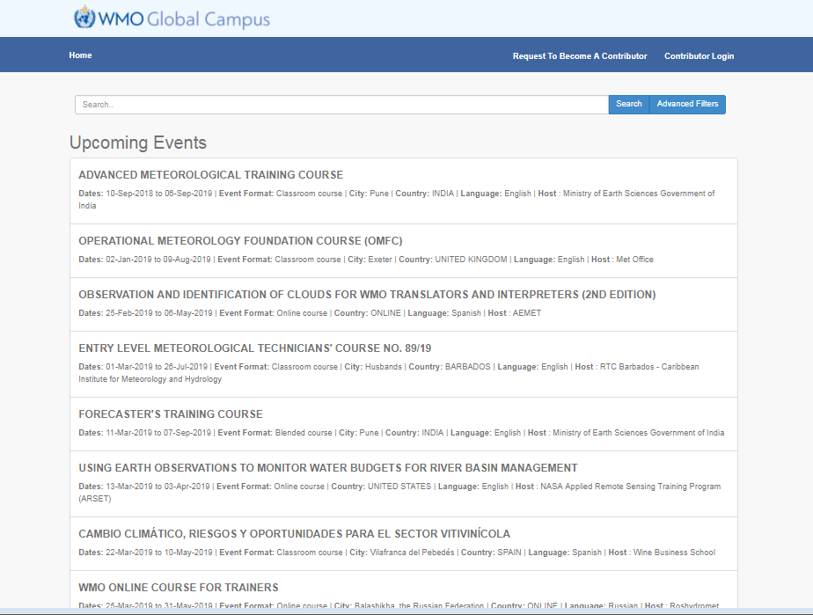
WMO Global Campus Events Calendar
http://learningevents.wmo.int
Notes:
Features
Current and upcoming events around the world submitted by registered providers
Text search and filters by event metadata
Event notification (in development)
Can include multiple databases (EUMETSAT/Vlab) and future partners

Slide 7
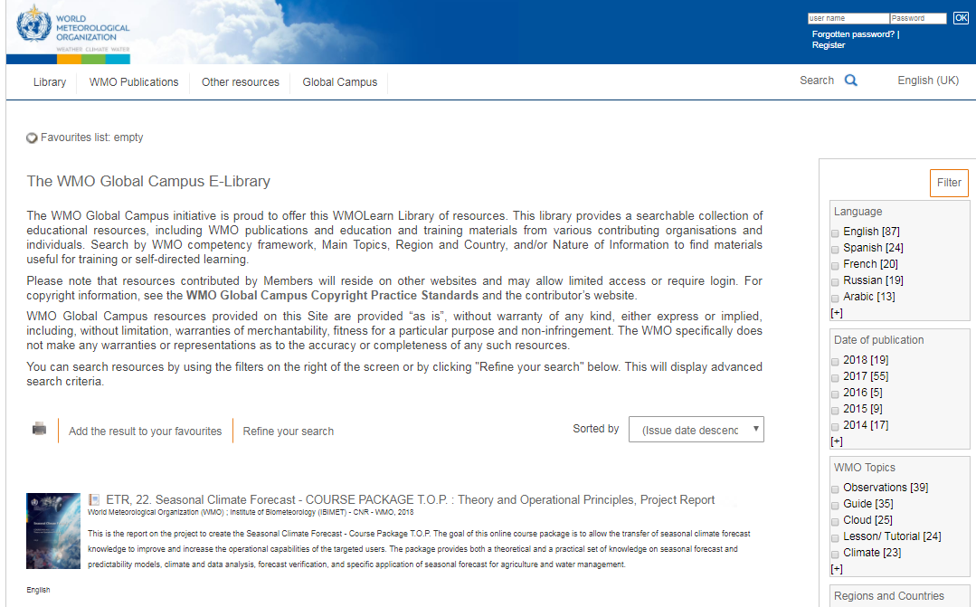
WMO Global Campus E-Library
http://library.wmo.int
Notes:
Features
Resources from WMO Secretariat, WMO Technical Commissions and all WMO Members who wish to share resources
External provider submission forms (in development)
Search by WMO Competency Framework
Filter by language, topic, publisher, document type, etc.
Metadata harvesting capability
Personalized experience through saving, sharing, and ratings

Slide 8
Why should WMO promote OERs?
To drive innovation
To improve quality of content
To reduce costs
To allow for customization
To promote accessibility
Social justice—to increase opportunity
Notes:
Build institutional reputation with stakeholders, funding sources and globally
Attract new staff and students
Share expertise within the institution
Encourage high-quality teaching and learning
Support modular course development
Support feelings of altruism—sharing knowledge is what we are here for
Encourage review of curriculum, pedagogy and assessment

Slide 9
Global Campus Activities
Translations Resource Center
Assistance in developing partnerships
Promoting innovative learning approaches (including new WMO publication)
Database of experts and institutional capabilities
Standard competency achievement certificates
Building a global E&T community of practice
WMO Global Campus Calendar (learningevents.wmo.int)
Global Campus E-Library (https://library.wmo.int/)
WMOLearn Portal (learn.wmo.int)

Slide 10
Regional and university contributions to WMO Global Campus
Regional coordination and leadership expected from the WMO Regional Training Centres and other institutions and programmes that address regional training needs
Coordination meeting of RA-I (Africa) RTCs and allied training partners
WMO RTCs hosted by IberoAmerican met for coordination and planning in November, 2018. Ongoing collaborative projects. Publicized in MeteoWorld
Planning underway for a meeting of a WMO Global Campus consortium of universities
Links between WMO Global Campus and Eumetcal-2 embedded in programme goals

Slide 11
Benefits of university collaboration and contributions
Universities see the WMO Global Campus as one mechanism for expanding their offerings beyond traditional on-site degrees
Can make online courses and short-courses more viable through greater visibility
Global Campus can help them to reach a wider variety of students, and understand the market for more advanced topics
Global Campus can expand brand awareness of universities.
See many benefits in institutional collaborations in course and resource development (both University-University and University-NHMS)

Slide 12
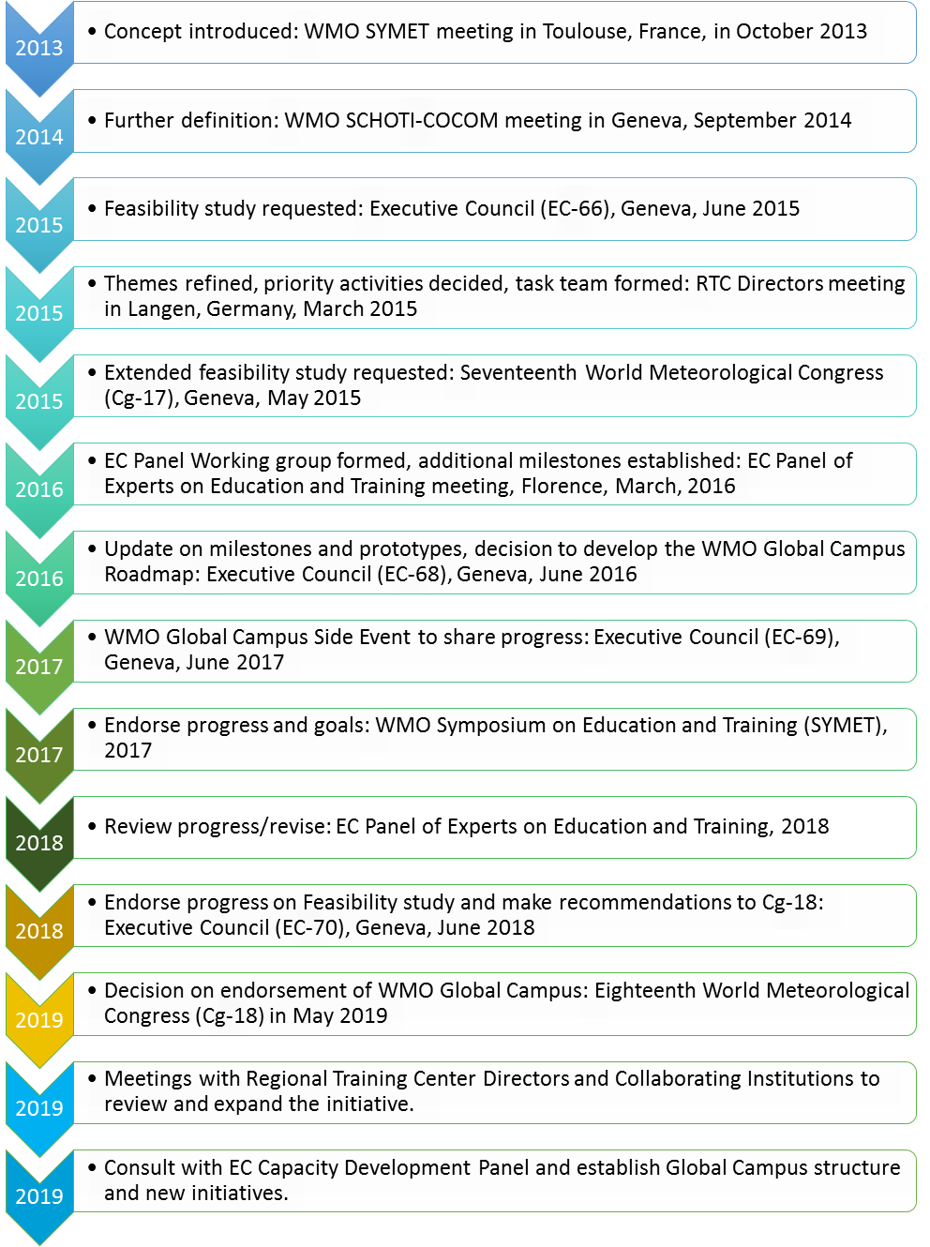
Timeline: Where we are now

Slide 13
Global Campus Challenges
Estimating, justifying and identifying budget and human resources to support defined activities.
Complexity of activities requires many partners and shared leadership
Strong outreach required to inform stakeholder communities of benefits and encourage participation
Monitoring and reporting framework to evaluate use, usefulness, and efficiency
Success requires participation by ALL Members

Slide 14
WMO Global Campus Advisory and Oversight Structure
WMO Education and Training Office
EC Capacity Development Panel
Technical Commissions and other WMO Bodies
WMO Global Campus Integrated Collaboration Group
WMO Community Platform
WMO Global Campus University Component
(Expert Teams, Regional Groups)
Joint University & NMHS Initiatives (Expert Teams, Regional Groups)
WMO Global Campus NMHS Component
(Expert Teams, Regional Groups)
Global, Regional, Multi- and Bi-lateral initiatives

Slide 15
Thank you
Merci

