Slide 1
How to find information in OSCAR/Surface?

Slide 2
Learning topics
Where can you find information?
How can you find information?
How you can export results?
The station report
Which information is available?

Slide 3
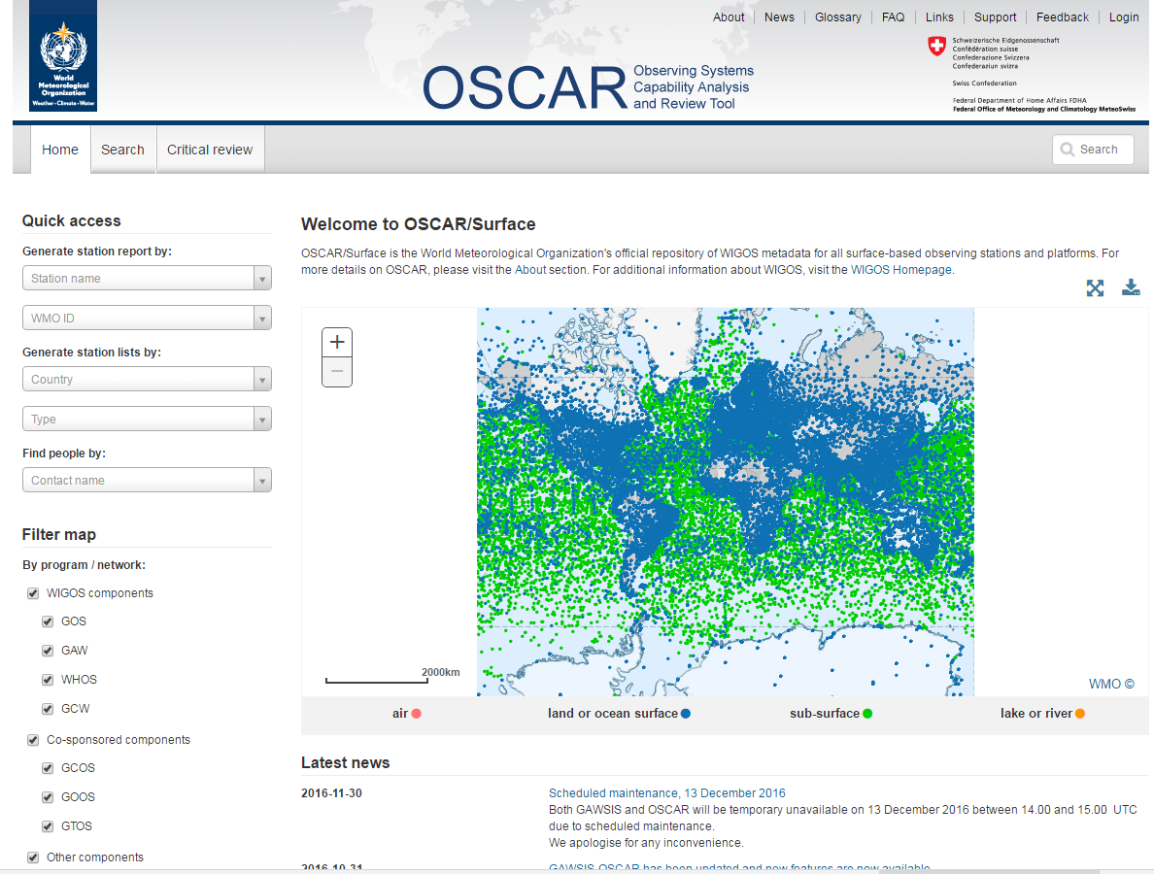
Where to find information?
Quick station access
Access detailed search
Quick-search
Map filter

Slide 4
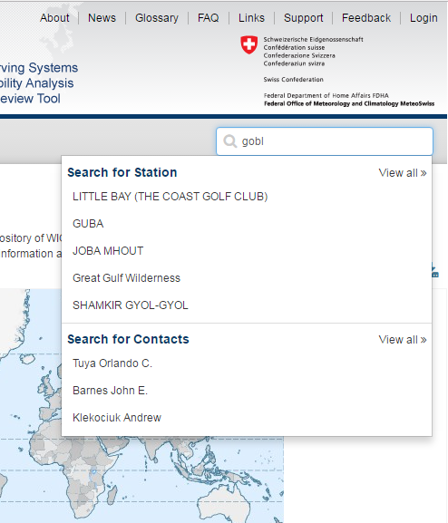
Quick search
Quickly and directly access stations and contacts by name
Results show as you type
Try finding yourself and then a station in your country using the quick-search!

Slide 5
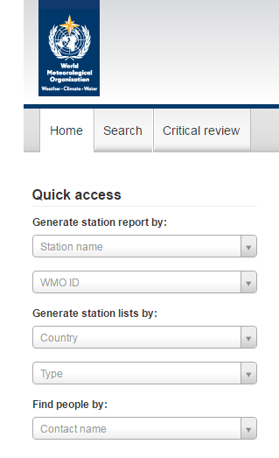
Quick station access
Directly access station by name or WMO ID
Directly access contact by name
Generate list of stations by countr or Type
Use the Quick access to list all stations in your country!

Slide 6
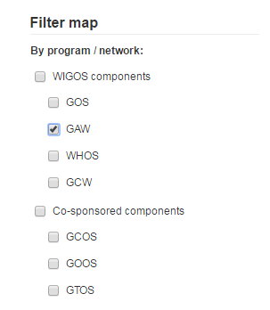
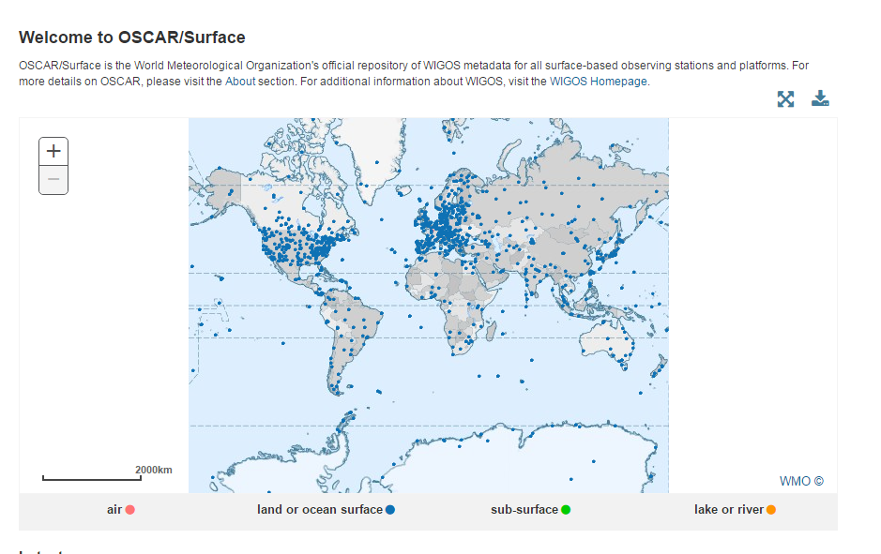
Map filter
Only show selected programs/networks on the map
Tree structure allows to select all child elements
Try to display only GAW stations on the map!

Slide 7
Search for stations
In the search form you can search stations by name or by advanced criteria

Slide 8
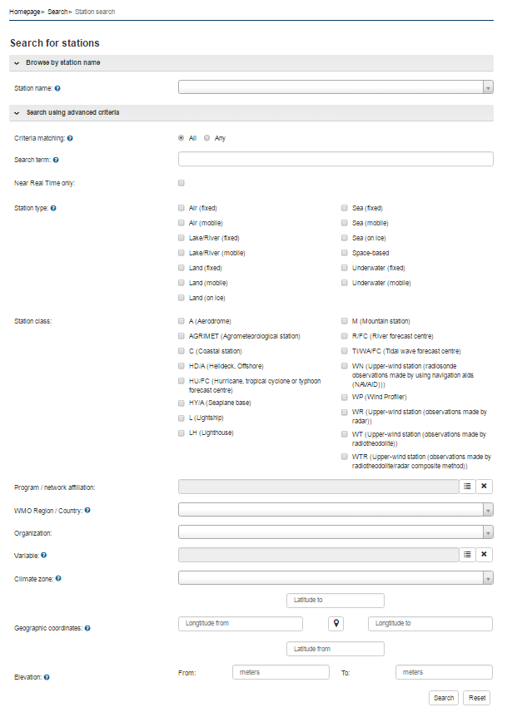
Searching stations using advanced criteria
There are multiple categories of criteria
Location
Affiliation
Measured variables
Country

Slide 9
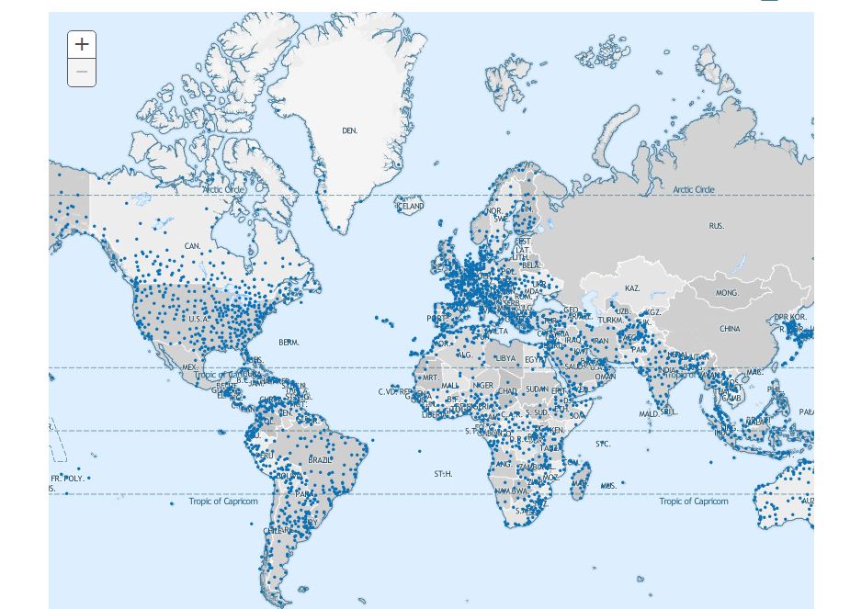
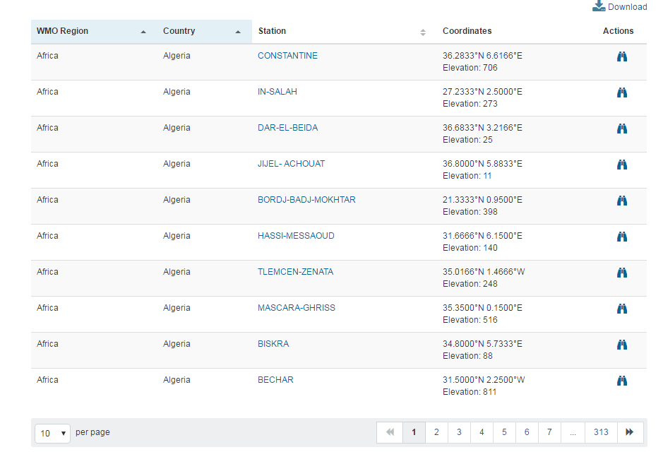
The search result
The result of the search is shown on the map and in tabular form
It is possible to download the result as list or image
Clicking on the name opens the station details
The station can also be located on the map by clicking on the binoculars to the right

Slide 10
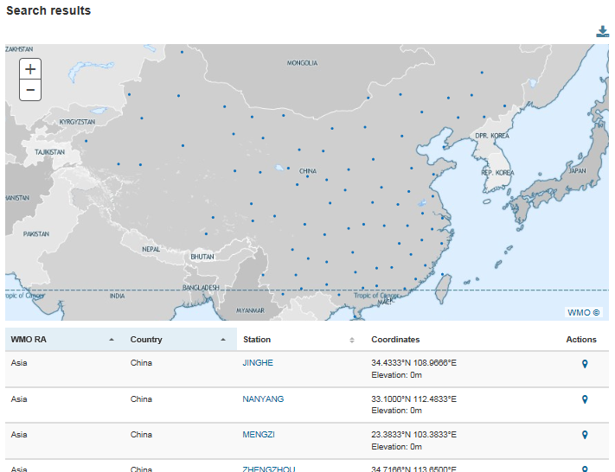
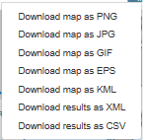
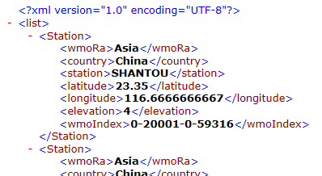
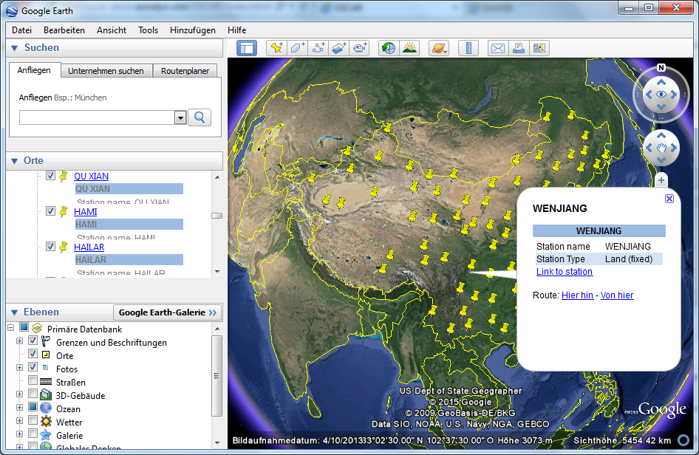
OSCAR search results
Download for further analysis
Integration with GoogleEarth

Slide 11
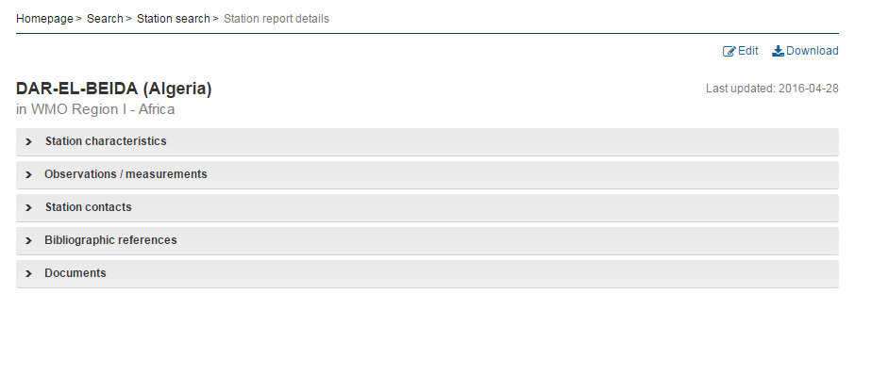
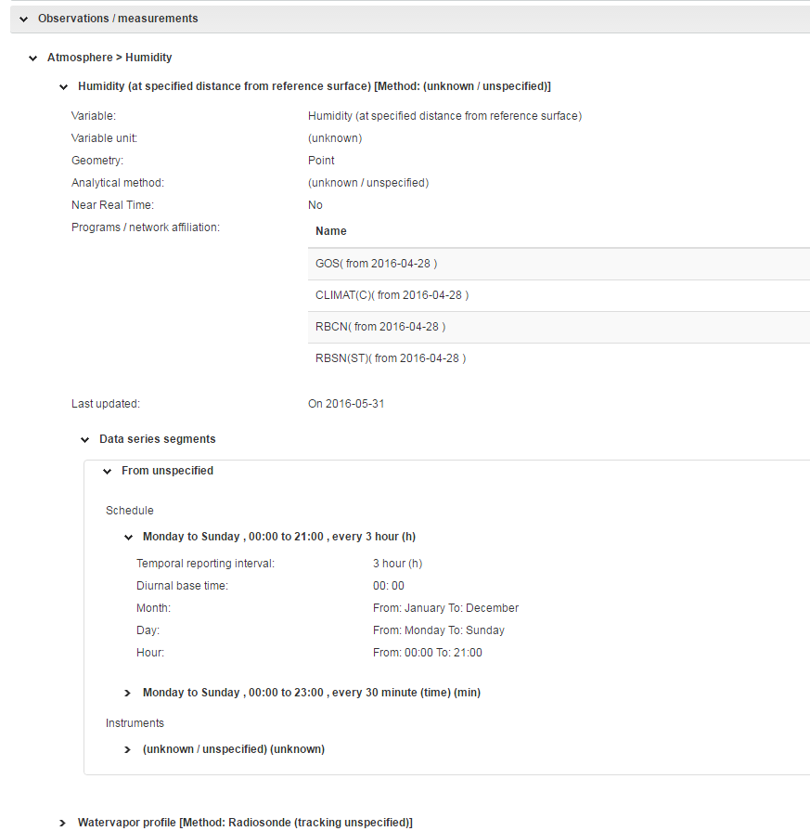
The station report
The station report contains all relevant information about the staton
It is categorized into five main categories
Each of the categories can be expanded
The observations / measurements category has further expandable sub-menues

Slide 12
Which information is available in OSCAR/Surface?
# stations
1’053
13’026
11’387
762
GAWSIS
Metadata for the Global Atmosphere Watch
WMO Pub 9 Vol A
Catalogue of synoptic and upper-air stations of GOS
JCOMMOPS
Marine element of GOS / GOOS
WMO Radar DB
WMO Weather Radars
Other components, such as Aircraft Based Observations, to be added soon
Sometimes there are multiple stations with the same name in OSCAR (e.g Tamanrasset). The reason is that a station with this name existed in two or more of the data-sources (e.g Vol A and GAWSIS), or was listed twice in Vol A as surface and upper-air stations

Slide 13
Learning topics
Where can you find information?
How can you find information?
How you can export results?
The station report
Which information is available?

Slide 14
Thank you
Merci

