Slide 1
How to create a new station in OSCAR/Surface?

Slide 2
Learning topics
How to create a new station?
When to create a new station and when to update an existing one
Access control

Slide 3
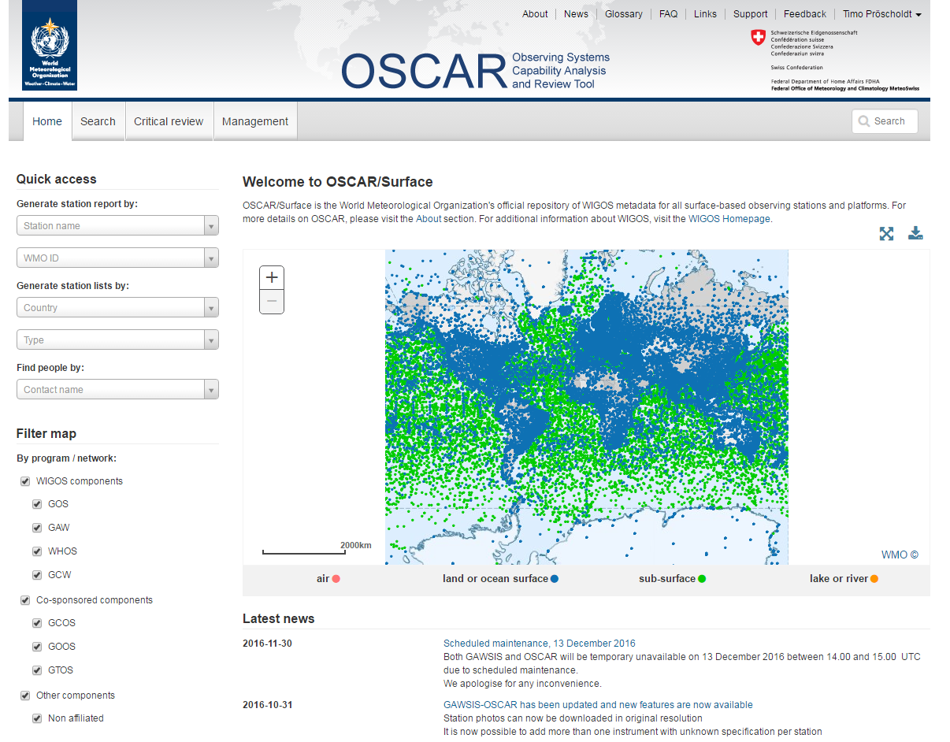
How to create a new station?
Management console
Login

Slide 4
Create a new station (from scratch)
To create a completely new station, use the «Register new station» form in the management menu

Slide 5
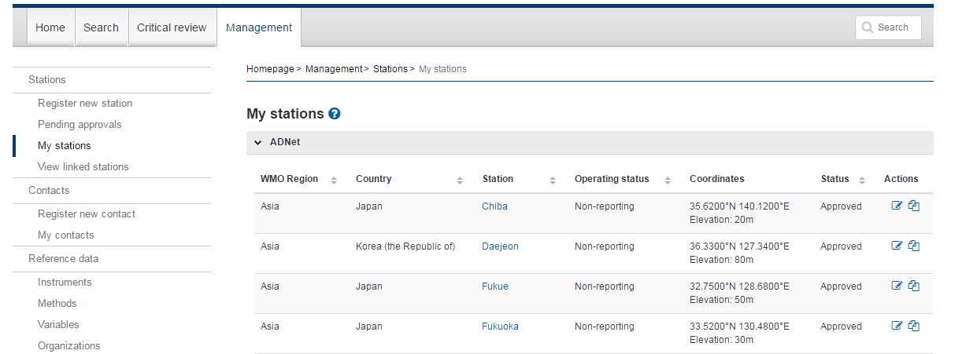
Create a new station (with a template)
To use an existing station as template, go to «my station» in the management menu, and click on «copy».

Slide 6
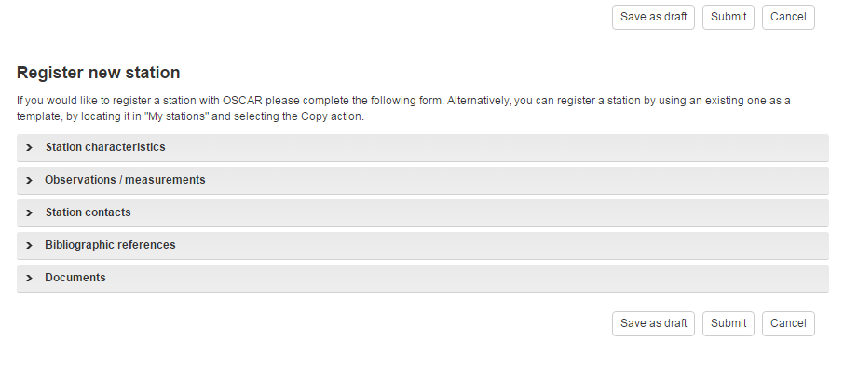
Station registration form
The form consists of several expandable sections, grouping the fields thematically
Some fields are mandatory (*)
An unpublished station can be saved as «draft»
Previsouly saved draft stations can be found in «my stations»

Slide 7
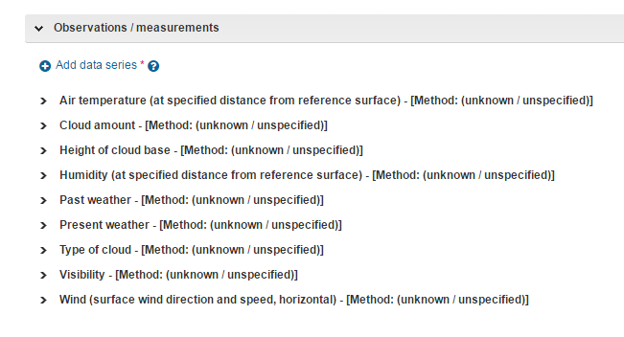
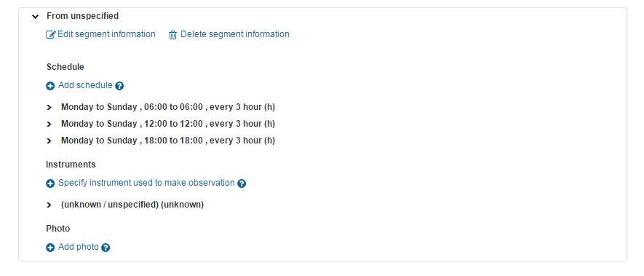
Station registration form, cont.
The section «observations» is central
All present and past observations taken at the station are documented here, together with supporting attributes (e.g schedule, unit)

Slide 8
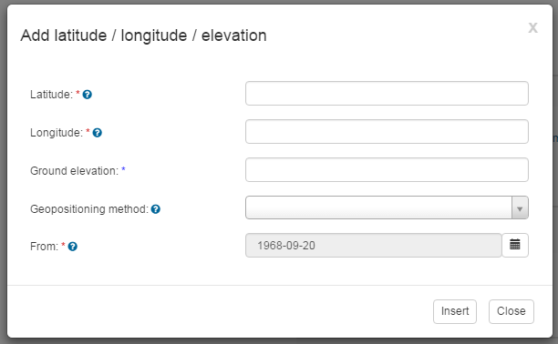
The station and it’s history
The purpose of OSCAR/Surface is to store historic information, as well as current one
Many fields are «historized» (an associated date field «from» allows to indicate the period when the station had this property)
Thus: Stations, observations and other attributes are usually never deleted, only updated

Slide 9
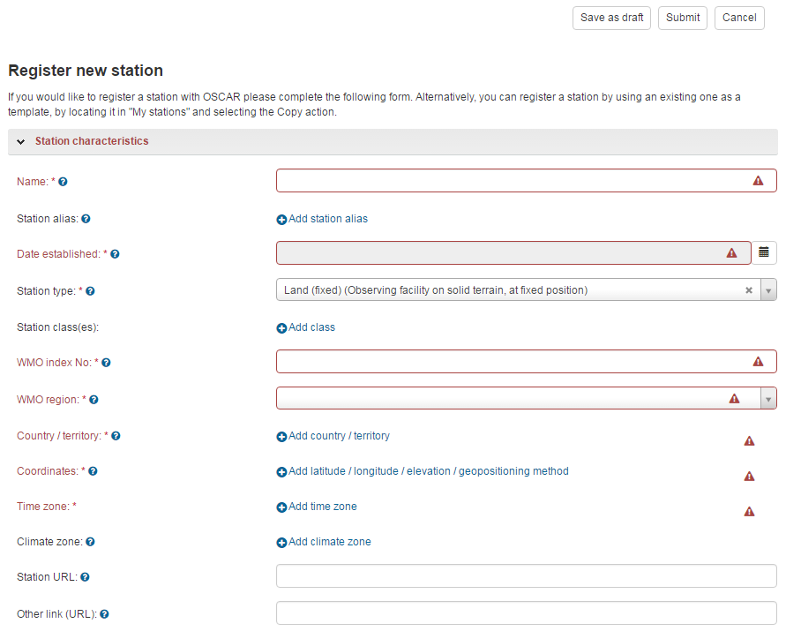
Publishing a station
Press «Submit» to publish the station
In case mandatory fields are not supplied, the section and fields will be indicated in red
No idea what the field is for? Use the blue «help» sign next to the field for help

Slide 10
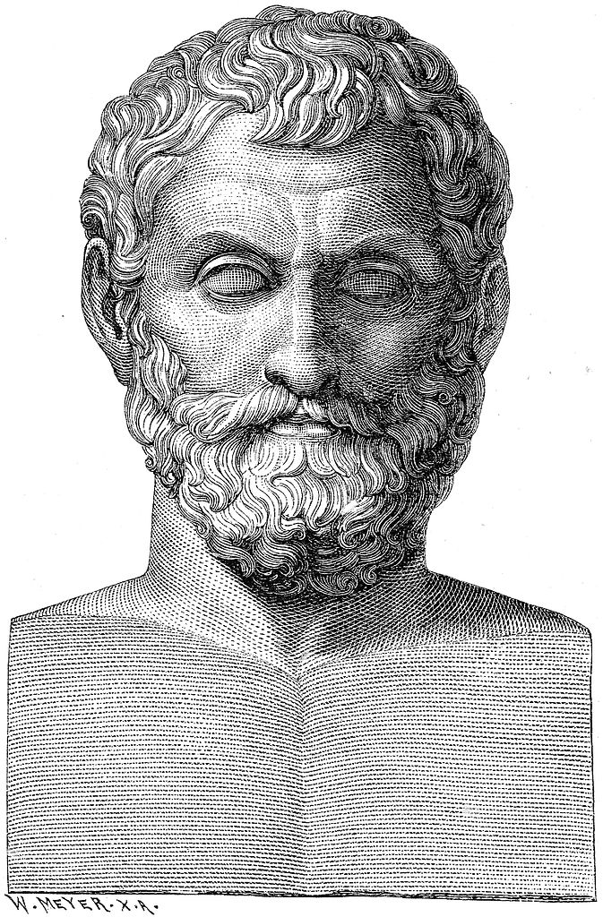
New station or updating an existing?
OSCAR/Surface is «observation centric»
This means several (unrelated) observations taken in the same area can be part of the same station
Local conditions, such as administrative or access control, can justify creating a new station
Decison best made locally
Creating a new station or not depends on the point of view

Slide 11
Thank you
Merci

