Slide 1
Towards teaching meteorology with due regard to its changing content, priorities, methods and applications
Sergej Zilitinkevich
Division of Atmospheric Sciences, University of Helsinki
Finnish Meteorological Institute, Helsinki, Finland
with contributions from I. Bashmakova, S. Tyuryakov
and teams of educational projects: Marie-Curie Chair, COMBAT-METEO, QUALIMET, and ECOIMACT
WMO SYMET-3, Barbados, 30.10-2.11.2017

Slide 2
TIMELINE
QUALIMET
2010-2013
Qualification for job competency
Life-long learning (LLL)
Certification
ECOIMPACT
2015-2018
Personal environment → personal education
MARIE CURIE CHAIR
2004-2007
Boundary layer physics
COMBAT-METEO
2007-2010
Competency-based (labor market) vs
Traditional (academic knowledge)
EDUCATION
RESEARCH
ERC AdG
2009-2013
Atmospheric boundary
layers (ABL)
RU MegaGrant
2011-2015
Air-sea/land
interaction
ERC PoC
2014-2015
Local weather monitoring and forecasting
RU Science F.
2015-2017
ABL over heterogeneous terrain
Academy of Finland
2014-2017
Air-sea interaction in the
Baltic and Arctic Seas

Slide 3
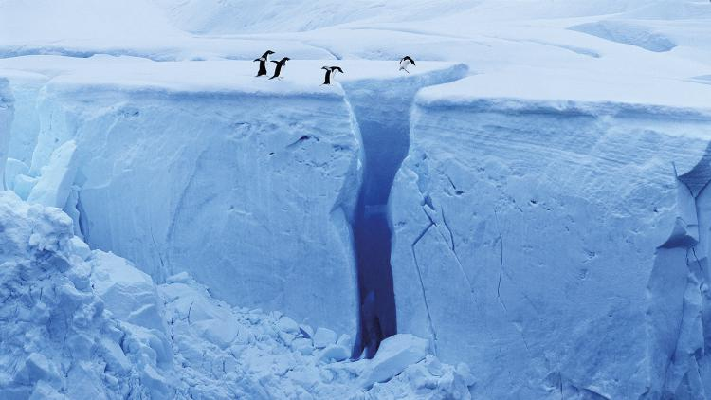
Combat-meteo Tempus III, 2007-2010, 500kE
 | U. Helsinki, FI
 | U. Tartu, EE
 | RSHU, U. Moscow, Acad. Association of Hydromet. Universities, RU
 | Odessa Environmental U., UA
Development of competency-based two-level curricula in meteorology
RU 2003
UA 2005
Gap between
Educational
content
technologies
infrastructure
Staff capacity
Successful career
Demands of the economy
Notes:
AAU – 11 members - St. Petersburg State University, Kazan State University, Perm' State University, Tom' State University, Irkutsk State University, Far-east State University (Vladivostok), Saratov State University, Mozhaisky Military-Space Academy (SPb), Frunze Higher Navy School (SPb), Voronezh Higher Aviation Engineering School, Makarov State Maritime Academy (SPb)

Slide 4
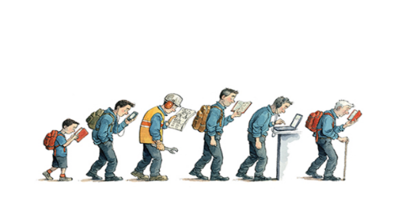
QUALIMET Tempus IV, 2010-2013, 1mE
 | U. Helsinki, FI
 | U. Tartu, EE
 | U. Copenhagen, DK
 | ENEA, IT
 | RSHU, Acad. Association of Hydromet. Univ., Roshydromet Advanced Training Institute, U. Moscow, U. Tver, RU
 | Odessa Environmental U., U. Simferopol, UA
Development of qualifications framework in meteorology
Motivation: Higher education falls behind progress in
science and not necessarily guarantee professional skills
Outdated system of professional-qualification requirements
Diploma by academic community = to permit to profession
without testing / approval by professional community
From traditional learning to qualifications for job-competency → Life-long learning (LLL)
Notes:
In labor market in meteorology in Russia the old system of qualification requirements developed for the fading away one-cycle educational system is dominant. During the past decade, meteorology, as an applied physical science, has undertaken important advancements resulting from an improved understanding of the coupled land-ocean-atmosphere system and the ongoing revolution in information technology. Meteorological education and training also considerably changes in the methods, tools and attitudes, in particular: 1) redirecting the initial professional instruction from teaching objectives to learning outcomes and focusing the subsequent qualification more to proven job-competency rather than to formal training attestations or certificates; 2) the ever-increasing importance of career-long continuing education and training to maintain and enhance competency in a world of rapid scientific advancements, technological changes, and socioeconomic challenges; and 3) the promise of distance learning technology to timely deliver education and training even in remote places; also the rapidly expanding opportunities for self-training.

Slide 5
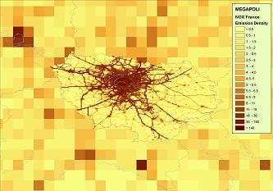
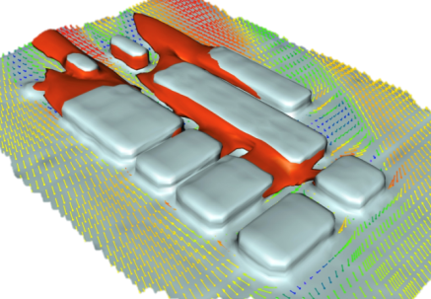
ECOIMPACT Erasmus+, 2015-2018, 1mE
http://e-impact.net
 | U. Helsinki, FI
 | Agricultural U. Plovdiv, BG
 | U. of Central Europe, SK
 | Roshydromet Advanced Training Institute, RSHU, U. Nizhny Novgorod, RU
 | U. Kyiv, Odessa Environmental U., Agricultural U. Kherson, UA
Personal learning environment for competence in economic and societal impacts of local weather, air quality and climate
Growing urbanization and complexity of connected infrastructures
Poorly comprehended urban environments
Increased vulnerability to local environmental impacts: concept of personal environment
Modern problems: clip and copy-paste thinking, memorizing facts rather than principles
H.A.C. Denier van der Gon, MEGAPOLI, 2009-2011
R. Nuterman et al., MEGAPOLI, 2009-2011
Notes:
With increasing complexity and heterogeneity of urban infrastructure, the modern life and economy progressively depend on local weather, air/water/soil quality, and microclimate (Grimmond et al., 2014). These comprise “personal environments”, controlled by physical and chemical processes in the lower atmospheric planetary boundary layer, directly interacting with the Earth’s surface and affected by industrial emissions and anthropogenic warming (Zilitinkevich et al., 2015).
The term «clip thinking» appeared in the 90-ies of the last century. It was just like the symbol of human’s ability to perceive the world in the form of short bright events, without going into details.
CopyPasteThinking is the act of using a predefined or commonly accepted thought process without analyzing it prior to use. The original thought process can originate from an individual, or from a group.

Slide 6
Lesson from COMBAT-METEO / Marie Curie
Educators, students and employers
think differently about
subject of expectations from and demands to
meteorological education
Meteorology, along with computational and observational technologies develop faster than university courses and syllabi
Employers value capability to combat difficulties more than good knowledge of meteorology
Notes:
New syllabi: risk management, ecological economy of the environment, aviation meteorology, statistical processing of hydrometeorological information (RSHU and AAU), boundary layer physics (UHEL). Significantly transformed syllabi were developed on climate theory, dynamic meteorology, satellite meteorology (AAU).

Slide 7
Lesson from QUALIMET / ERC-AdG
Air pollution and climate change increase natural hazards Urbanisation makes society more vulnerable to hazards
Air pollution cause 2.5 million deaths per year in China
Society and professionals need better knowledge of
heterogeneous environments towards CLIENT-ADDRESSED SERVICES
Air pollution in the neighbouring streets: EU project MEGAPOLI 2008-2011 (coordinator
(Alexander Baklanov)
Notes:
New syllabi: risk management, ecological economy of the environment, aviation meteorology, statistical processing of hydrometeorological information (RSHU and AAU), boundary layer physics (UHEL). Significantly transformed syllabi were developed on climate theory, dynamic meteorology, satellite meteorology (AAU).

Slide 8
Further lesson
The concept of PERSONAL ENVIRONMENT: local weather, air, water, soil quality and microclimate at work or home, indoors or out controlled by physical and chemical processes in atmospheric Planetary Boundary Layer = PBL (Z et al. WMO Bulletin 2015)
ERC PoC: new research for client-aimed services
Erasmus+ ECOIMPACT: teaching and promoting personal-environment services among academia, and potential service-providers and users
Notes:
New syllabi: risk management, ecological economy of the environment, aviation meteorology, statistical processing of hydrometeorological information (RSHU and AAU), boundary layer physics (UHEL). Significantly transformed syllabi were developed on climate theory, dynamic meteorology, satellite meteorology (AAU).

Slide 9
ECOIMPACT Erasmus+, 2015-2018, 1mE
Approach
Personalized learning
in connection with environment
via IoT
Problem-centered vs.
discipline-centered
Target groups
University students
(hydrometerology and economics)
Hydrometeorology professionals
Managers at weather-sensitive firms and public bodies
Custom-tailored learning materials
Learning management software
IoT weather instruments
Expert guidance

Slide 10
Connected infrastructures
in Smart Santander, North Spain,
make it ready to personal-environment services

Slide 11
THANK YOU!
ECOIMPACT
http://e-impact.net
PERSONAL ENVIRONMENT
Zilitinkevich, S., Kulmala, M., Esau, I. and A. Baklanov (2015)
Megacities – Refining Models to Client
WMO Bulletin 64 (1), 20-22.
The presentation was prepared within ECOIMPACT project (Grant 561975-EPP-1-2015-1-FI-EPPKA2-CBHE-JP), which has been funded with support from the European Commission. This presentation reflects the views only of the author, and the Commission cannot be held responsible for any use which may be made of the information contained therein.
Notes:
Needs analysis to evaluate awareness of meteorological products and/or their applications available, satisfaction of the service/feedback and expectations towards the proposed learning environment

