Slide 1
Regional WIGOS Centre Tokyo
Submitted by
MATSUDA Kohei
Japan Meteorological Agency
OSCAR/Surface Training Course for RA II –East-Asia Subregion
13-15 November 2019, Tokyo, Japan

Slide 2
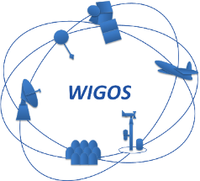
Outline
Mandatory Functions
Optional Functions
Future operation and activities

Slide 3
I. Mandatory functions
Regional WIGOS Centre Tokyo

Slide 4
RWC Tokyo’s Mandatory Functions
JMA is developing RWC mandatory functions now!
Regional WIGOS metadata management (to work with data providers to facilitate collection, updating and provision of quality control for WIGOS metadata in OSCAR/Surface)
Sharing of expertise and experience to support for Members in registering/correcting the OSCAR/Surface database
Regional WIGOS performance monitoring and incident management (WIGOS Data Quality Monitoring System; WDQMS) and follow-up with data providers on availability/quality issues
Bearing of evaluation and incident management functions and providing of incident information via WDQMS with close communication

Slide 5
1. Regional WIGOS metadata management

Slide 6
Outline of regional WIGOS metadata management
Provision of support for the introduction of OSCAR/Surface by individual Members via workshops and other related activities
Review of the WIGOS metadata registration status in OSCAR/Surface for individual Members
Encourage Members to update metadata in OSCAR/Surface by notifying each NFPs of the unregistered stations or issues regarding to registered data
OSCAR/Surface
Each Member
RWC Tokyo
Register
Review
Notify & Support

Slide 7
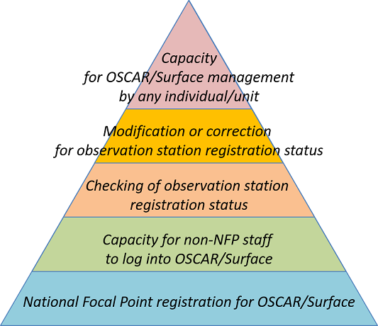
Plans for OSCAR/Surface in RA II
Training courses on OSCAR/Surface Training courses in RA II - West Asia and East Asia in 2019 !
Confirming and updating more than 150 stations in Japan
←This year’s Goal
←This year’s Goal

Slide 8
2. Regional WIGOS performance monitoring and incident management (WDQMS)

Slide 9
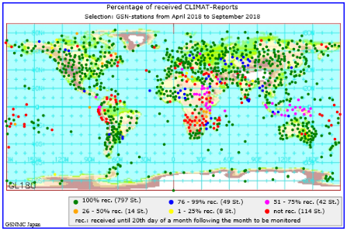
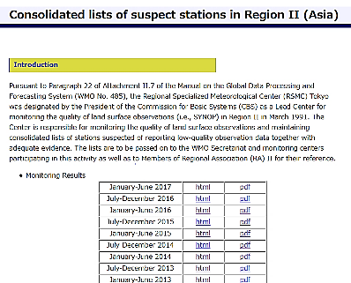
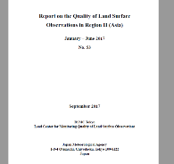
NWP-based monitoring
JMA Numerical Weather Prediction (NWP) enables monitoring land/sea surface and upper-air observations in the World
GSN Monitoring Center for climate data
CBS Lead Centre monitoring for land surface observations
https://www.dwd.de/EN/ourservices/gsnmc/gsnmc.html
http://qc.kishou.go.jp/

Slide 10
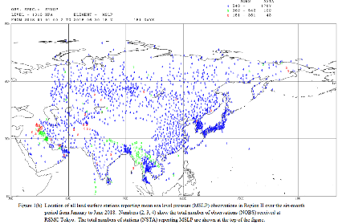
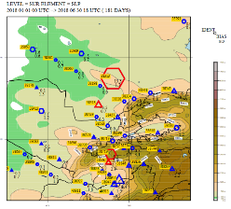
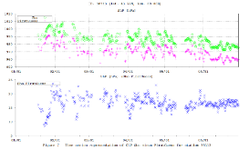
CBS Lead Centre monitoring for land surface observations
JMA has been providing 6-Monthly monitoring report on land surface observations in Region II since 1991.
This activity is based on the designation of the RSMC Tokyo as a Lead Centre for monitoring the quality of land surface observations (i.e., SYNOP) in Region II by the President of the CBS in March 1991.

Slide 11
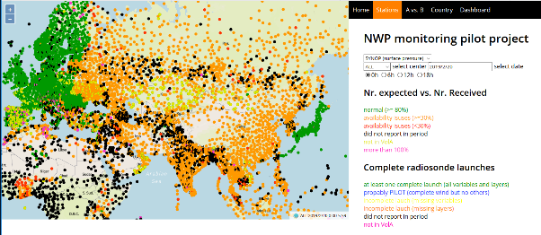
NWP Quality Monitoring Pilot Project on WDQMS
JMA has been participating in the NWP Quality Monitoring Pilot Project on WDQMS since 2016, providing monitoring output in near real time with ECMWF, NCEP and DWD to WMO Secretariat.
The Project collects (shows) availability and quality information on surface observations in the world.
This activity is regarded as a start of the WIGOS monitoring function.
Surface pressure observation availability map developed by WIGOS Project Office

Slide 12
WIGOS Data Quality Monitoring System (WDQMS)
Quality Monitoring: To monitor availability, immediacy and quality of observation data (by WIGOS Monitoring Centres including JMA)
Evaluation: To evaluate the monitor results and specify problematic stations
Quality Monitoring
WIGOS Monitoring Centres
Evaluation
RWC Tokyo
Incident Management
Follow-up
Existing WMO Regional Centres
Collaboration

Slide 13
WIGOS Data Quality Monitoring System (WDQMS)
Incident Management: To notify the problem to Members and keep track of recovering progress
Follow-up: To assist Members in solving problems in collaboration with relevant existing WMO Regional Centres, e.g. RIC Tsukuba, GISC Tokyo, Tokyo Climate Center (TCC)
Quality Monitoring
WIGOS Monitoring Centres
Evaluation
RWC Tokyo
Incident Management
Follow-up
Existing WMO Regional Centres
Collaboration

Slide 14
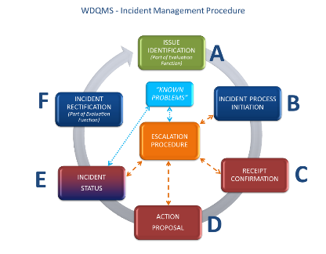
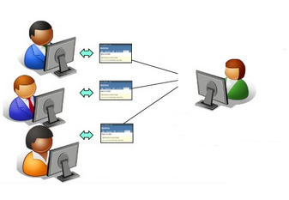
JMA’s plan for Incident Management procedure
JMA is preparing a web-based issue tracking tool (Redmine) for Incident Management procedure during the pilot phase of RWC.
JMA’s responsible person will communicate with the contact point of Member country by email to support to function the issue tracking tool well.

Slide 15
Issue tracking system concept
Tracking system
Timeline
WMO RA-II
Monitoring
A
RWC Tokyo
Data report
Station Z
Entry Ticket #01
B
Station Z
No report
C
《!》Station Z
No reports for X days
Update
Ticket #01
A
Performance of extra inspection at Station Z
Detection of communication line abnormality
Update
Ticket #01
A
Communication line restoration
Update
Ticket #01
Checking of report from Station Z
RWC Tokyo
Update
Ticket #01
Closure
RWC Tokyo

Slide 16
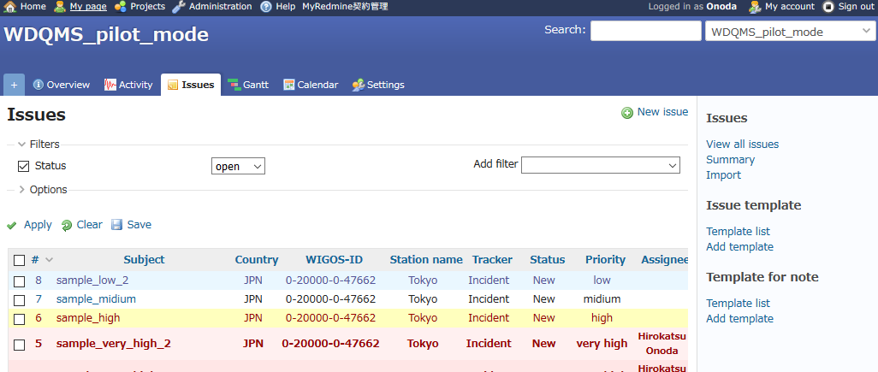
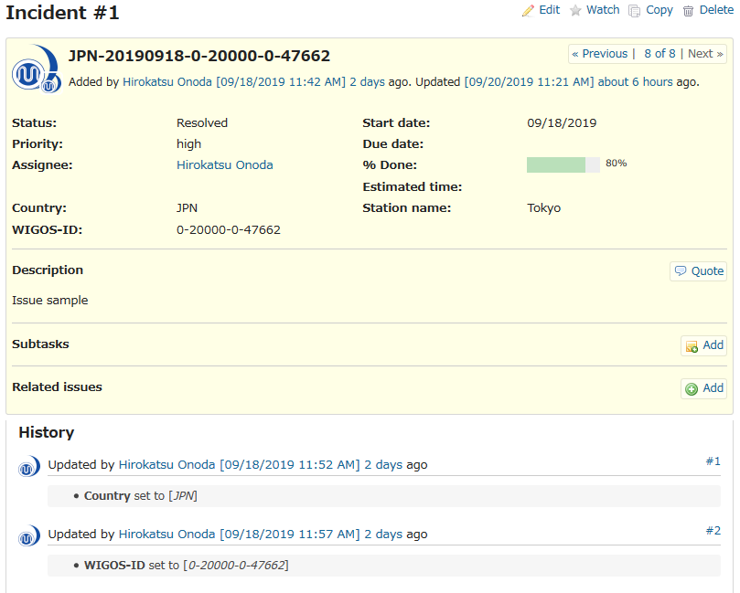

Slide 17
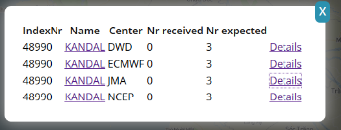
JMA’s high prioritized area in WDQMS
Technical Guidelines defines the three key areas in Monitoring function: Data availability, Timeliness and Accuracy.
JMA considers that it is suitable to take data availability as a first step of WDQMS activity rather than two other areas during the pilot phase of RWC.
Identification of silent stations via monitoring
Issuance of "Incident" ticket status and initiation of communication with relevant contact points
Establishment of reasons for station silence and provision of information on contact points for related improvement
Recording of activities in the issue tracking system

Slide 18
II. OPTIONAL functions
Regional WIGOS Centre Tokyo

Slide 19
RWC Tokyo’s Optional Functions
JMA will continue the regional activities as “RWC Tokyo’s Optional Functions” in collaboration with existing WMO Centres.
Assistance with the coordination of regional/sub-regional and national WIGOS projects
Coordinating the RA II WIGOS Implementation Projects as the Project Leaders/Coordinators, and advising national WIGOS projects in each Member.
Assistance with regional and national observing network management
Providing advices on management of regional and national observing networks in collaboration with existing WMO Centres (RIC, RCC, RRC, WCC and QA/SAC).
Support for regional capacity development activities
Supporting regional capacity development activities through technical cooperation in collaboration with existing WMO Centres (RSMC for Nowcasting, RIC and RCC).

Slide 20
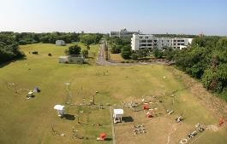
Regional Instrument Centre (RIC) Tsukuba
Conducts regional capacity development activities to ensure accuracy of meteorological observation in RA II.
Runs the “RIC Tsukuba Package” as a comprehensive support approach encompassing the following activities.
Calibration of national standard instruments
Transfer of calibration technology
Preparation of instruments for national standards where necessary
RIC-RWC collaboration brings efficient and effective services, especially for quality management.
RIC Tsukuba Package
Survey
Provision
Training
Follow-up
Preliminary survey of calibration capacity
Provision of standard instruments and/or inspection equipment
Training sessions
Follow-up activities
https://www.jma.go.jp/jma/jma-eng/jma-center/ric/RIC_HP.html

Slide 21
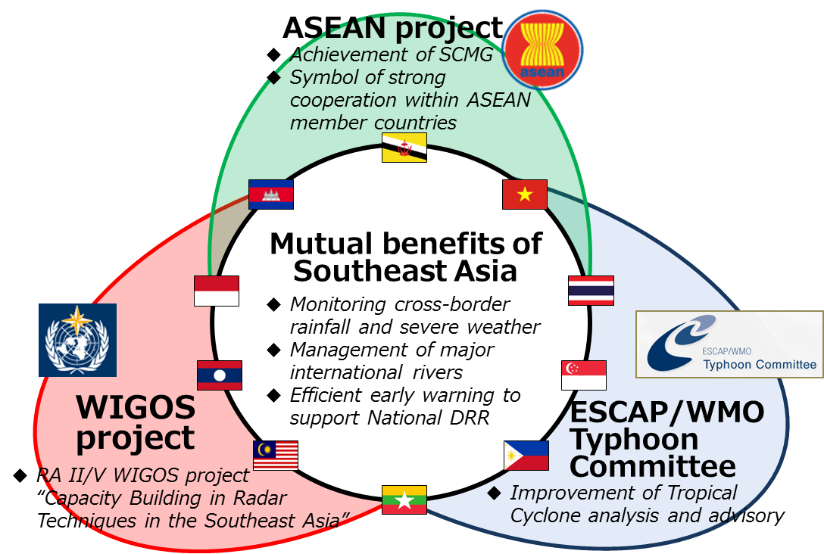
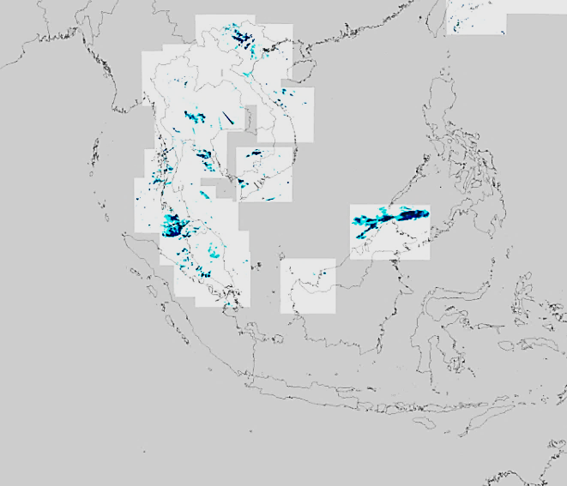
RA II WIGOS Implementation Project No. III Capacity Building in Radar Techniques in the Southeast Asia
Capacity Building in Radar Techniques in Southeast Asia
ASEAN Radar Workshops (2014 and 2018)
WMO RA II & V WIGOS regional radar project
Technical cooperation on development of regional radar network in Southeast Asia under the ESCAP/WMO Typhoon Committee
Southeast Asian Radar Network

Slide 22
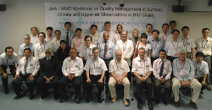
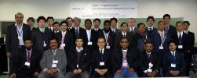
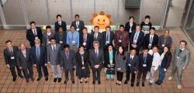
RA II WIGOS Implementation Project No. IV Enhance the Availability and Quality Management Support for NMHSs in Surface, Climate and Upper-air Observations and Project
Survey
Workshop
Report
Actions
Round 1
Gap-analysis between user requirements and current status in NMHSs in RA II
(27-30 July 2010, Tokyo, Japan)
Round 2
Improvement of understanding of and skills in traceability of measurements in NMHSs in RA II
(19-22 February 2013, Tsukuba, Japan)
Round 3
Capacity building on Quality Management techniques in rainfall observation in NMHSs in RA II
(19-23 March 2018, Tokyo, Japan)

Slide 23
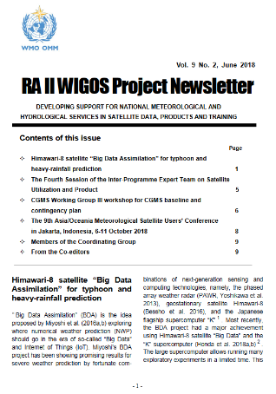
RA II WIGOS Implementation Project No. VI Develop Support for NMHSs in Satellite Data, Products and Training
Support for the preparation of satellite data users in relation to the new generation of geostationary meteorological satellites
Establishment of close coordination between the RA II WIGOS Project and the RA-V Task Team on Satellite Utilization
Establishment of the new webpage of the RA II WIGOS Project (hosted by JMA)
Convening the series of Asia/Oceania Meteorological Satellite Users’ Conference (AOMSUC)
Conducting the trainings and questionnaires on the utilization of new generation of geostationary meteorological satellites through the AOMSUCs
Quarterly newsletters for RA II Members
https://www.jma.go.jp/jma/jma-eng/satellite/ra2wigosproject/ra2wigosproject-intro_en_jma.html

Slide 24
III. Future operation and activities
Regional WIGOS Centre Tokyo

Slide 25
RWC Tokyo’s Milestones
June 2018: | Designated as a RWC in pilot mode
2019: | Prepare and begin pilot RWC activities
March 2019: | RA II WIGOS Workshop in Tokyo
Second half of 2019 - 2020: | Begin regional WIGOS metadata management and the WDQMS in pilot mode
2020 -: | Begin operational RWC activities

Slide 26
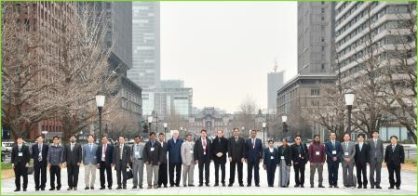
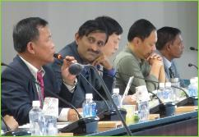
The RA II WIGOS Workshop - Regional WIGOS Centres (RWCs) and its services for Members (Tokyo, Japan, 6 - 9 March 2019)
The event was attended by 21 experts from 17 NMHSs in RA II and RA V and from the WMO Secretariat.
Workshop attendees shared understanding of key WIGOS matters (including RWCs and its Member services as well as the concept of WIGOS focus on integration, quality management and application of data from observations made from surface to satellite level), and discussed RWC functions.
https://www.jma.go.jp/jma/jma-eng/jma-center/rwc/event/RWCws_2019/

Slide 27
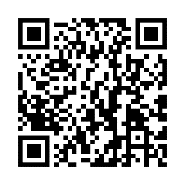
For more information, please visit our website:
https://www.jma.go.jp/jma/jma-eng/jma-center/rwc/
Contact:
rwc-tokyo@met.kishou.go.jp

Slide 28
Thank you
kohei.matsuda@met.kishou.go.jp
Japan Meteorological Agency

