Slide 1
Advanced editing: tips and tricks
Luisa Ickes, WIGOS Project Office

Slide 2
Tip 1: Ctrl C + Ctrl V in OSCAR
You want to add a new station in OSCAR similar to an existing station:
copy the station!

Slide 3
Tip 2: Step by step
You started to register a station but some information are still missing- you don’t want to loose the information:
Save as a draft
Find your draft again:
Managment -> My stations

Slide 4
Tip 3: Dates
Which elements in OSCAR have dates and why?
Date established
Coordinates
Deployments
…
What you have to take into account:
Correct the «station established date» does not correct the date in the deployments
Many date/timestamps:
→ From-To
→ Since-Till

Slide 5
OSCAR/Surface is history aware
Information about past history:
Instrument moved from one station to another
Instrument re-located at station
Maintenance schedules changed
Station, instrument log books, events
…
Add and correct, don’t delete!

Slide 6
Tip 4: Speak to your neighbour
Creating a new station close to an existing one: warning from OSCAR
If it makes sense: use existing OSCAR station and complement it
An observing facility can host many different instruments and serve several programs / networks
Several organizations can share the same observing facility
More stations only mean more work!

Slide 7
Consolidate co-located stations or link
It is possible to combine two stations:
Decide which station should remain
Copy all information from one to the other
Use «Support» to request complete deletion of one station
It is possible to link two stations:
Contact «Support» for more information

Slide 8
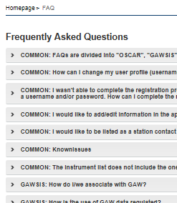
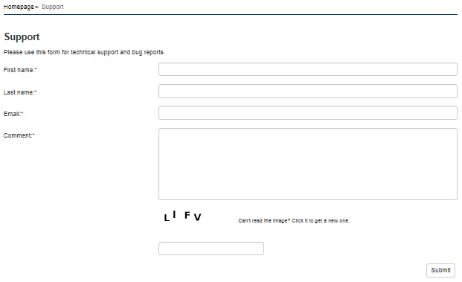
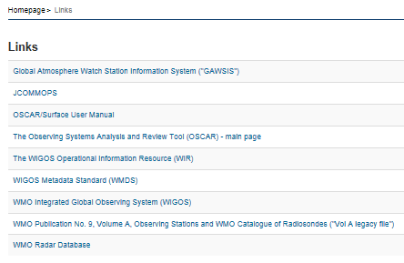
Tip 5: Where to get help

Slide 9
Support and further help
OSCAR/Surface helpdek
1st and 2nd level support
Operated by MeteoSwiss
OSCAR/Surface Learning Resources Portal on WMO Moodle site
Presentations
Videos
Discussion forums
OSCAR/Surface blog
OSCAR/Surface User Manual
WMO OSCAR team (oscar@wmo.int)

Slide 10
Thank you
Merci

