Slide 1
Introduction to the WIGOS Identifiers
(WIGOS IDs)
Luís Nunes
WIGOS Project Office

Slide 2
Outline
Framework/References
The structure of the WIGOS IDs
Practical application
Example
Final remarks

Slide 3
Outline
Framework/References
The structure of the WIGOS IDs
Practical application
Example
Final remarks

Slide 4
The WIGOS IDs and the WIGOS Metadata
The WIGOS IDs - one of the elements of the WIGOS Metadata Standard (observational metadata)
Element 3-06, "Station/platform unique identifier"
It also belongs to the WIS metadata (discovery metadata)
That is the main common element linking WIGOS and WIS metadata

Slide 5
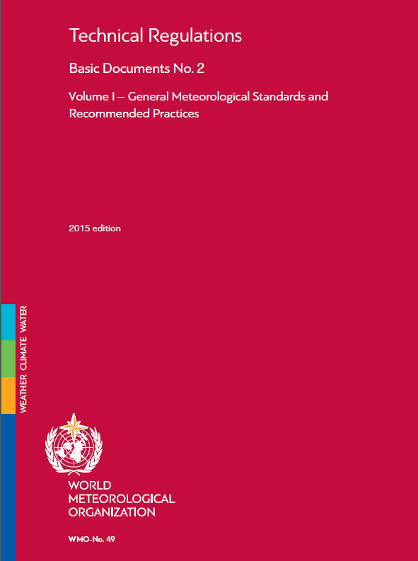
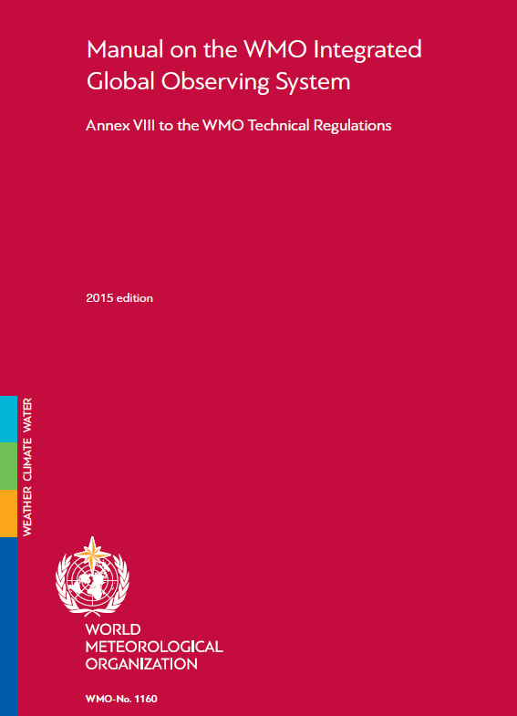
WIGOS Regulatory Material
Members shall implement and operate their observing networks and systems in accordance with:
WMO Technical Regulations and Manual on WIGOS
(WMO-No. 49) (WMO No.1160)

Slide 6
From the Manual on WIGOS (Annex to the Tech Regulations WMO-No. 49, Vol. I, Part I)
2.4.1.2 “Members shall issue WIGOS station identifiers for observing stations and platforms within their geographic area of responsibility that contribute to a WMO or co-sponsored programme and shall ensure that no WIGOS station identifier is issued to more than one station”
2.4.1.3 “Before issuing a station identifier, Members should ensure that the operator of a station or platform has committed to providing and maintaining WIGOS metadata for that station or platform”
Note: “Members may issue WIGOS station identifiers for observing stations and platforms within their geographic area of responsibility that do not contribute to a WMO or co-sponsored programme, provided that the operator has committed to providing and maintaining WIGOS metadata”
2.4.1.4 “Members shall make available to WMO the updated metadata each time a new station identifier is issued”
Notes: In circumstances when a WIGOS identifier is required for a station or platform to support a WMO or co-sponsored programme and a Member is not able, or no Member is in a position to issue one (for example, in Antarctica), the Secretary-General may issue a WIGOS station identifier for that station or platform, provided that its operator has committed to: (a) Providing WIGOS metadata; (b) Conforming to Tech.Reg.

Slide 7
Outline
Framework/References
The structure of the WIGOS IDs
Practical application
Example
Final remarks

Slide 8
The structure of the WIGOS ID (1)
COMPONENT | ROLE | INITIAL RANGE
WIGOS Identifier Series | Allows future expansion | 0
Issuer of identifier | Allow delegation of issuing identifiers by different organizations | 0…65534
Issue number | Sub-delegation, or absorb historic IDs | 0…65534
Local Identifier | Allocated to station | 16 characters
COMPONENT
WIGOS Identifier Series
Issuer of identifier
Issue number
Local Identifier
0 = WIGOS Station Id
200000 = WWW fixed land
276 = Germany
e.g. drifting buoy identifiers,
regional offices
10637 (FRANKFURT/MAIN)
EDDF (Frankfurt Airport)

Slide 9
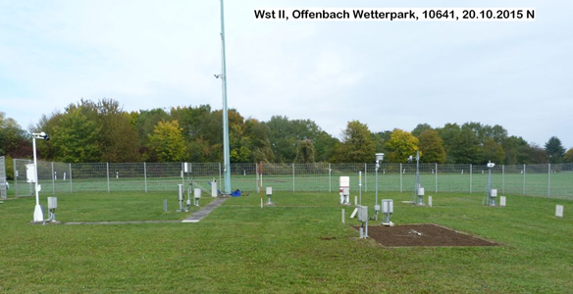
The structure of the WIGOS ID (2)
WIGOS Identifier Series (number) | Issuer of Identifier (number) | Issue Number (number) | Local Identifier (characters)
Example of station Offenbach/Wetterpark
0 | 20000 | 0 | 10641

Slide 10
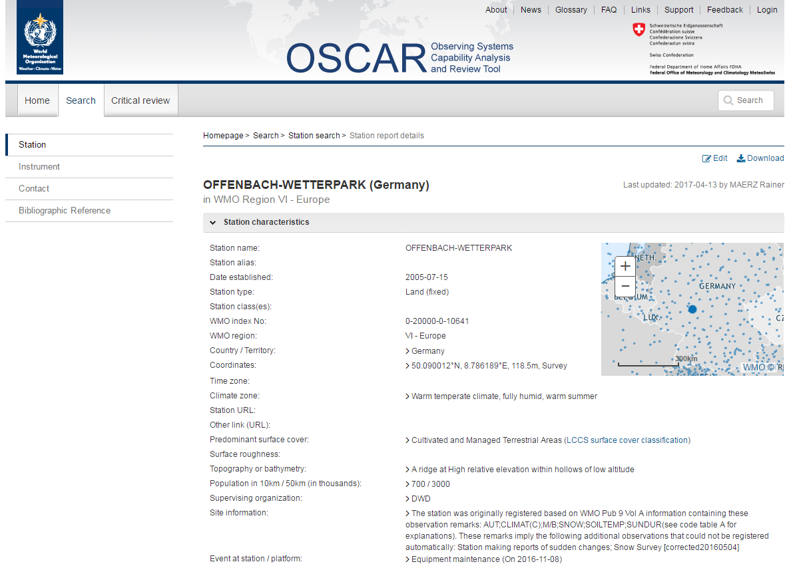
Fundamentals of WIGOS ID
WIGOS Identifiers do not have meaning in themselves
Users must not interpret any patterns they see in WIGOS IDs
Users should use OSCAR/surface to look up the metadata for the station associated with the WIGOS station identifier.

Slide 11
Outline
Framework/References
The structure of the WIGOS IDs
Practical application
Example
Final remarks

Slide 12
Assigning WIGOS IDs to Observing Stations
Each observing station must have at least one WIGOS ID associated with it
Observing stations that had been allocated with station identifiers by a WMO Programme before the introduction of WIGOS identifiers (1.Jul.2016):
may continue to use those identifiers, and are not required to have additional identifiers created
for these observing facilities, the WIGOS station identifier can be deduced from the pre-existing identifier using the table "Issuer of Identifier"
if a station take on new responsibilities (e.g. an aviation station starting to report synop reports), the WIGOS identifier can also be used in that new context, (in this example the synoptic report could use the WIGOS ID derived from the ICAO aerodrome indicator)
It is possible for a station to be associated with more than one WIGOS identifier, but it is desirable to associate as few identifiers as possible.
if a station is already associated with a WIGOS identifier, or is associated with an identifier issued by a WMO or partner programme, an additional WIGOS station identifier should not be issued

Slide 13
Flow chart/Decision tree
Only WIGOS Identifier Series 0 has been defined. This series is used to identify observing stations
Check the table “Issuer of Identifier”: The station has (is using) an identifier issued by a WMO Programme?
Check the table "Observing Programmes with international system for assigning station identifiers" to find the value
(may) Continue to use the "old" identifier as the value of "Local Identifier"
Check the table "Observing Programmes with international system for assigning station identifiers" to find the value in the range 20000-39999
YES
The Value correspondes to the territory: range 1-11999; Check table “Issuer of Identifier”
NO (new station)
The territory defines its own procedures for issuing the "Issue Number" and the "Local Identifier" values
Territory has an ISO 3166-1 numeric code
Territory has not an ISO 3166-1 numeric code
The territory may choose to use "Issue Number" to allow them to delegate the allocation of "Local Identifier" values to the bodies responsible for managing individual observing networks
Check table ISO 3166-1 to find the 3 digits value
WMO Secretariat allocates the value for the territory: range 10000-11999

Slide 14
Table “Issuer of Identifier”
Range of Issuer of Identifier | Category of issuer | Method of allocating | Procedures for issuing Issue Number and Local Identifier
0 | Reserved for internal use by OSCAR | OSCAR allocates the value. | Determined by OSCAR.
1-9999 | Member State or territory for which there is an ISO 3166-1 numeric country code | ISO 3166-1 three digit numeric country code (by convention leading zeroes are not shown in WIGOS Identifiers). See ISO web site and click on "Officially assigned codes" (on the left of the screen) | Issuer identifies its own procedures. Further guidance is available in the section "Guidance on recommended practices for the allocation of 'issue number' and 'local identifier' for Member states and territories that have an 'issuer of identifier' allocated to them".
10000-11999 | Member State or territory for which there is no ISO 3166-1 numeric country code | WMO Secretariat allocates an available number on request. | Issuer identifies its own procedures. Further guidance is available in the section "Guidance on recommended practices for the allocation of 'issue number' and 'local identifier' for Member states and territories that have an 'issuer of identifier' allocated to them".
12000-19999 | Reserved for future use | To be determined. | To be determined.
 | Identifiers in the ranges 20000-21999 and 22000-39999 are intended only to be used to allocate WIGOS identifiers for observing facilities that had one or more pre-existing identifiers.
20000-21999 | WMO Secretariat for identifiers associated with WMO Programmes | Details are provided in the section "Allocation of 'issuer of identifier' for station identifiers associated with WMO Programmes". | Details are provided in the section "Allocation of 'issuer of identifier' for station identifiers associated with WMO Programmes".
22000-39999 | WMO Secretariat for identifiers associated with programmes of Partner organizations | Details are provided in the section "Allocation of 'issuer of identifier' for station identifiers associated with WMO co-sponsored programmes". | Details are provided in the section "Allocation of 'issuer of identifier' for station identifiers associated with WMO co-sponsored programmes".
40000-65534 | Reserved for future use | To be determined. | To be determined.
65535 | Missing value (reserved value in Table Driven Code Forms)

Slide 15
“Observing Programmes with an Int. System for Assigning Station ID”
Issuer of Identifier | Category of station identifier | Method of allocating Issue Number | Method of allocating Local Identifier
20000 | World Weather Watch land station with sub-index number (SI) = 0 | 0: station defined in WMO-No. 9 Volume A on 1 July 2016. Any other positive number: to distinguish between different observing facilities that used the station identifier in the past. | Use the block number (II) and the station number (iii) as a single five digit number IIiii (with leading zeroes). Example: station 60351 would be represented by 0-20000-0-60351
20001 | World Weather Watch land station with sub-index number (SI) = 1 | 0: station defined in WMO-No. 9 Volume A on 1 July 2016. Any other positive number: to distinguish between different observing facilities that used the station identifier in the past. | Use the block number (II) and the station number (iii) as a single five digit number IIiii (with leading zeroes). Example: upper air station 57816 would be represented by 0-20001-0-57816
20002 | World Weather Watch Marine Platform (moored or drifting buoy, platform, etc.) | 0 - platform for which the identifier was in use on 1 July 2016. Any other positive number - to distinguish between different platforms that used the same identifier at different times. | Use the region/platform number combination A₁b_{w}n_{b}n_{b}n_{b} Examples: the data buoy 59091 would be represented by 0-20002-0-59091. The World Weather Watch list of data buoys lists two buoys with identifier 13001. The buoy most recently used at the time WIGOS station identifiers were introduced is allocated 0-20002-0-13001 and the second is issued identifier 0-20002-1-13001 (note - the Issue Number is different from that for the first buoy).
20003 | Ship identifier based on ITU call sign. | 0 - ship allocated the identifier more recently on 1 July 2016. Any other positive number - to distinguish between different ships that used the same ship identifier at different times. | Ship call sign. Example: the (now obsolete) weather ship C7R would be represented by 0-20003-0-C7R.
20004 | Ship Identifier - issued nationally | 0 - ship allocated most recently on 1 July 2016. Any other positive number: to distinguish between different ships that used the same ship identifier at different times. | Ship identifier. Example: the fictitious shop XY123AB would be represented by 0-20004-0-XY123AB
20005 | AMDAR aircraft identifier | 0 - aircraft most recently issued the identifier on 1 July 2016. Any other number: to distinguish between different aircraft that used the same aircraft identifier at different times. | Aircraft identifier. Example: aircraft EU0246 would be represented by 0-20005-0-EU0246.
20006 | ICAO airfield identifiers | 0 - airfield most recently allocated the identifier on 1 July 2016. Any other positive number: to distinguish between airfields that used the same airfield identifier at different times. | ICAO airfield identifier. Example: Geneva airport (LSSG) would be represented by 0-20006-0-LSGG.
20007 | Ship IMO number (hull number) | 0 - ship to which the IMO number was most recently allocated on 1 July 2016. Any other positive number: to distinguish between ships that used the same IMO identifier at different times. | Ship identifier. Example: ship 9631369 would be represented by 0-20007-0-9631369.
20008 | Global Atmosphere Watch Identifier | 0 - station to which the GAW identifier was most recently allocated on 1 July 2016. | Three character GAW identifier. Example: Jungfraujoch JFJ would be represented by 0-20008-0-JFJ.
20009 | WMO Satellite Programme | 0 | Three digit satellite identifier with leading zeroes (recorded in Common Code Table C-7 of WMO-No. 306, Manual on Codes Volume I.1) Example: METEOSAT 10 (with identifier 057) would be represented by 0-20009-0-057.
20010 | WMO Weather Radar | 0 | Unique key used to cross-reference information about a single radar within the WMO radar database (note: this key was not previously published) Example: Station with record number 121 would be represented by 0-20010-0-121.
20011-21999 | Reserved for future use. | To be determined. | To be determined.

Slide 16
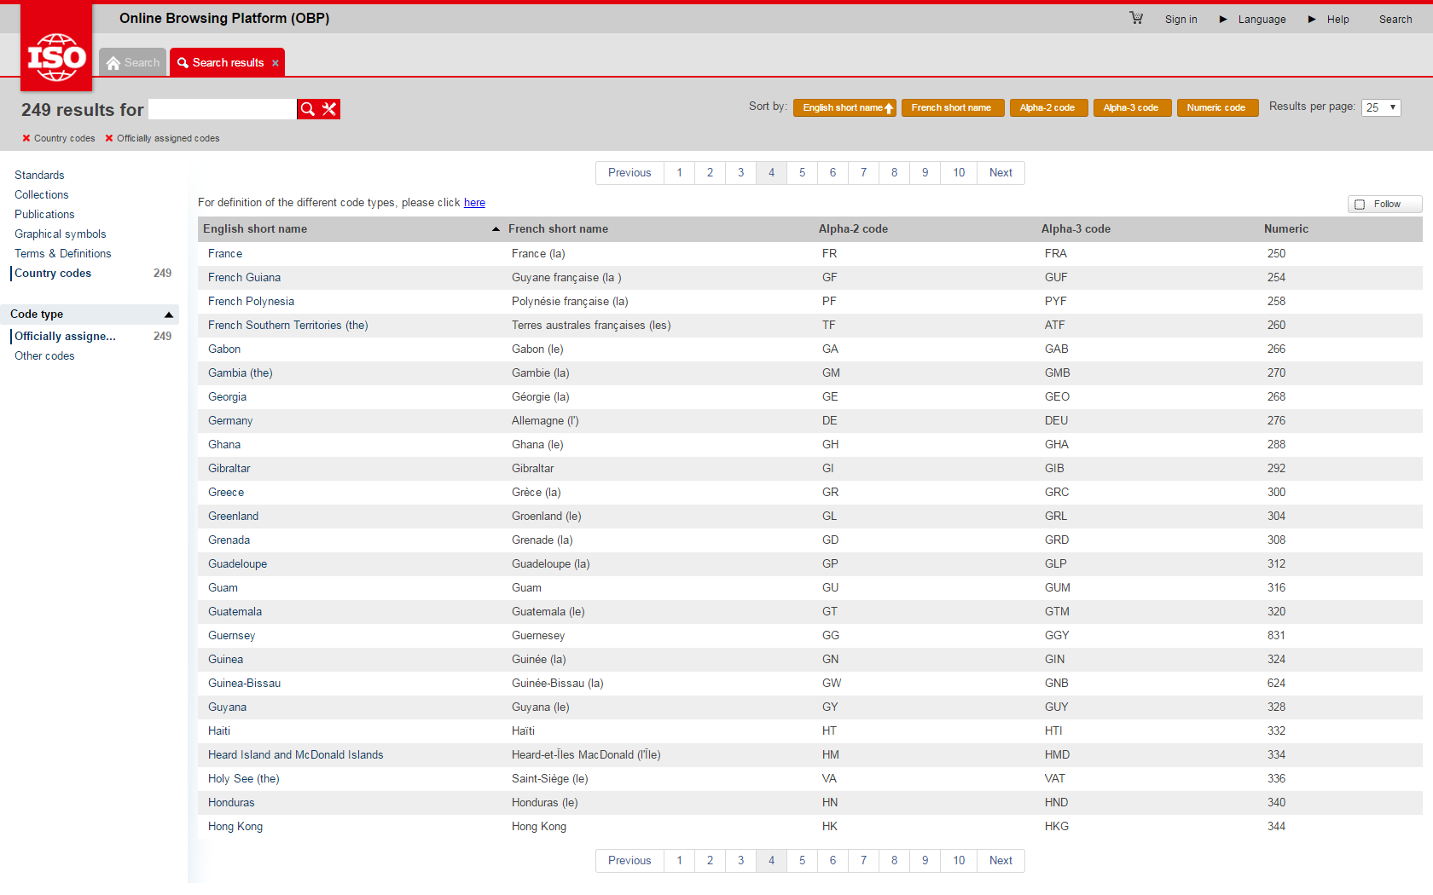
Table “ISO 3166-1 numeric code” (https://www.iso.org/obp/ui/#search)

Slide 17
Table “Partner IDs”
Issuer of Identifier | Category | Issue Number | Local Identifier
22000-39999 | Identifiers for marine systems administered through JCOMMOPS. Note: JCOMMOPS coordinates some marine observing systems to avoid technical incompatibilities. | Determined by JCOMMOPS | Determined by JCOMMOPS.
22001-39999 | Reserved for future use. | To be determined. | To be determined.

Slide 18
Outline
Framework/References
The structure of the WIGOS IDs
Practical application
Example
Final remarks

Slide 19
Example of allocation of “issue number” and “local identifier” for a Member that has an “ISO code”
A Member country/territory has observing systems managed by many different organizations, including
- the National Meteorological Service (NMS),
- the National Hydrological Service (NHS),
- the National Transport Department (TD)
Each of these organizations is independent, and each has its existing conventions for labelling observing facilities, where the NMS uses:
- WMO World Weather Watch station identifiers for its synoptic network,
- its own numbering system for other weather observing facilities,
- another numbering system for its climate observing facilities
In this situation, the Member (as issuer of identifiers) might choose to use the following convention for assigning WIGOS station identifiers.
In all cases, the Local Identifier must not be re-issued (with the same Issue Number) if an observing facility is closed.

Slide 20
(Cont.) Example of allocation of “issue number” and “local identifier” for a Member that has an “ISO code”
Issue Number | Interpretation of Issue Number | Local Identifier
1 | NMS synoptic observing facility | WMO World Weather Watch station identifier (as characters with leading zero if necessary to make it 5 digits long). Initially, to ensure that plotting software can display the local identifier, the Member chooses to limit the length of Local Identifiers to 5 digits, and to assign new WIGOS stations identifiers that lie outside the block of identifiers allocated to the Member by the World Weather Watch.
2 | NMS other weather observing facility | Existing national station identifier (as characters with leading zero if necessary). The local identifier for a new observing facility is created using the existing procedures for national station identifiers.
3 | NMS climate observing facility | Existing climate station identifier (as characters, without leading zeroes because that was the convention for writing down climate observing facility identifiers in the past). New observing facilities are allocated identifiers using the existing practices.
100-200 | Used by NHS for allocating identifiers for their observing facilities. The NHS allocates one number for each of their regions. The NHS is organized according to river basins, and it uses its range of Issue Numbers to sub-delegate allocation of Local Identifiers to each river basin authority. | The NHS uses their existing river basin observing facility numbering system.
1000-10000 | Used by the TD for allocating their observing facility identifiers. Their management procedures number the observing facilities by their distance in metres from the end of the road that is closest to the national capital. Each Issue Number corresponds to one road. | Distance of observing facility from the end of the road that is closest to the national capital.

Slide 21
Outline
Framework/References
The structure of the WIGOS IDs
Practical application
Example
Final remarks

Slide 22
Final Remarks
The WIGOS Identifiers have been developed and approved by World Meteorological Congress (May 2015) to be used from the 1st July 2016
As part of the WMO Technical Regulations No.49, Vol.I Part 1
It is described in the Manual on WIGOS (WMO- No.1160)
Some guidance is available in the Initial Guide to WIGOS
- these slides were based on these documents
The operational use of the WIGOS Identifiers in the reports for international exchange of data has been postponed to 2019(20)

Slide 23
Thank you
lfnunes@wmo.int
www.wmo.int/wigos

