Slide 1
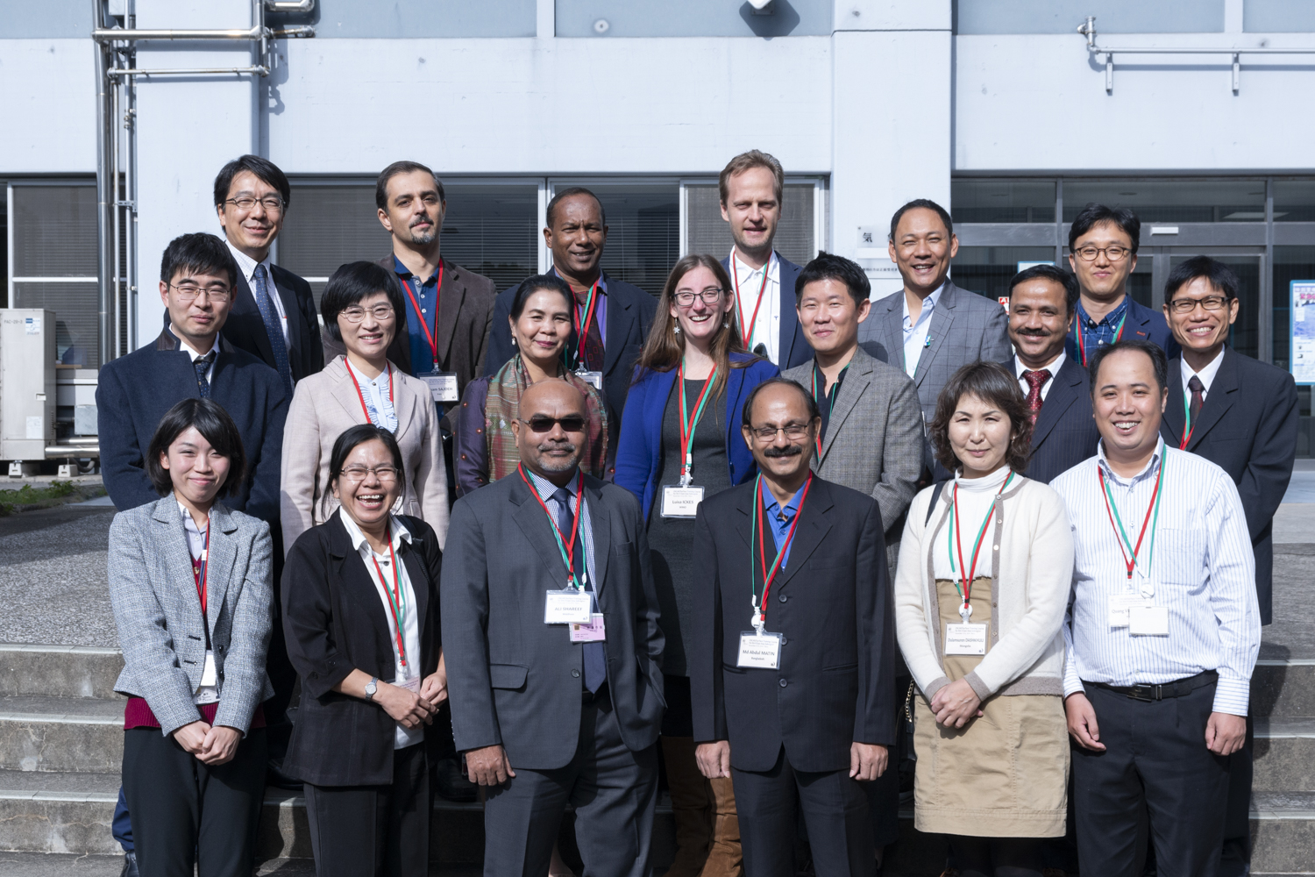
Way forward, closure & working together
Timo Pröscholdt, WMO

Slide 2
Regional implementation plan
Status of WIGOS implementation: https://www.wmo.int/pages/prog/www/wigos/wigos-readiness.html
WIGOS Data Quality Monitoring System (WDQMS) http://wdqms.wmo.int/wdqms

Slide 3
Next steps
Preparatory webinar 06 November 2019 (online)
OSCAR/Surface training 13-15 November 2019 (Ukraine)
Follow-up webinar 2019 (online)
Implementation plan review 2019 (online)
Closure and evaluation Q1 2020 (online)

Slide 4
Where to get further information?
OSCAR/Surface Resources Portal, please enroll
https://etrp.wmo.int/course/view.php?id=146
OSCAR/Surface User Manual, watch out for the new edition (English version out already)
OSCAR/Surface Helpdesk. “Support & Feedback form” in OSCAR/Surface

Slide 5
Course evaluation
Link to survey is in the course platform:
https://www.surveymonkey.com/r/VJWNYTS

Slide 6
Closing ceremony

Slide 7
Thank you
Merci
شكرا
You & your organization!
Financial support. Swiss Federal Office of Foreign Affairs, MeteoSwiss, WMO, Met Norway
Project Team at MeteoSwiss. (current) J Klausen, L Cappelletti, B Calpini, M Musa, M Brändli, L Koppa, C Walder, E Grüter, S Sandmeier, M Schäfer, A Rubli, Tom Hager, Attila Loos; (past) J Mannes, S Spreitzer, M Leutenegger, C Sigg, M Abbt, W Brunelli, J Mettler
Project Team at WMO (current). F Belda, LP Riishojgaard, T Pröscholdt
Project Team at European Dynamics (current). T Galousis, M Ulmann, L Christou, N Pappa, S Sklavos, …
ICG-WIGOS. S Barrell, B Calpini, …
TT-WMD. (current) K Monnik, J Klausen, J Swaykos, T Boston, U Looser, E Büyükbas, Zhao Licheng, T Oakley, S Foreman, D Lockett, L Nunes
IPET-MDRD. D Lowe, J Tandy, …
JCOMMOPS, GAW WDCs, ET-WDC, …

