Slide 1
WIGOS Metadata Standard
… Supporting adequate use of observations
Luisa Ickes, WIGOS Project Office
Jörg Klausen, MeteoSwiss
ICG-WIGOS TT-WMD
Notes:
Abkürzungen irgendwo an die Tafel/Flipchart schreiben!

Slide 2
Learning Objectives
Understand the importance of observational metadata
Understand the concepts of the WIGOS metadata vs the WIS metadata
Know where to find information
Notes:
2: Bilder?

Slide 3
What are metadata?

Slide 4
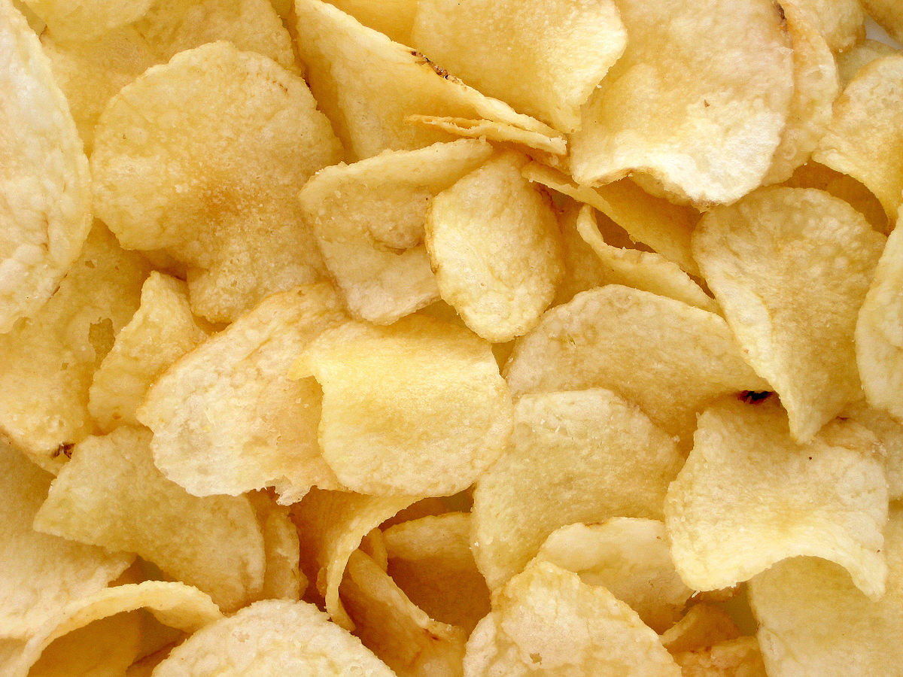
What are metadata?
Notes:
1: fertig!!!

Slide 5
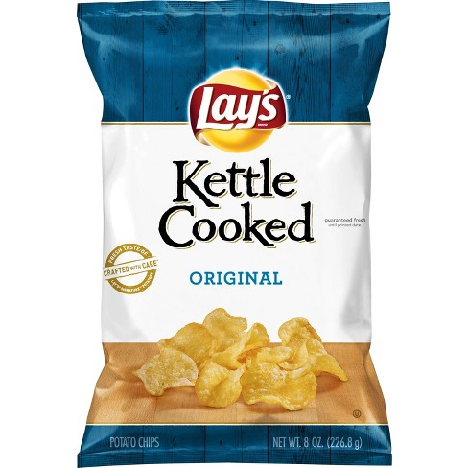
What are metadata?
Notes:
1: fertig!!!

Slide 6
What are metadata?
Metadata = documentation describing data
15.04.2019
280.2
285.5
287.7
Notes:
Mannheimer Stunden: 7, 14, 21

Slide 7
What are metadata?
Metadata = documentation describing data
15.04.2019
280.2
285.5
287.7
Temperature?
Kelvin?
Daily cycle?
Europe?
…
Notes:
Mannheimer Stunden: 7, 14, 21

Slide 8
What are metadata?
Metadata = documentation describing data
Metadata = context of observations
Observed variable
Location
Environment
Intended use
…

Slide 9
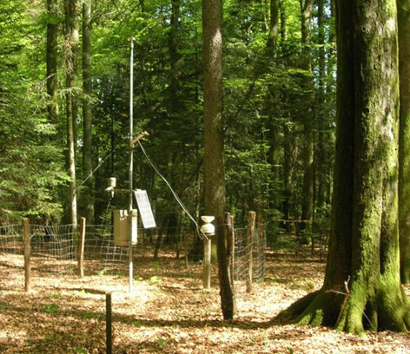
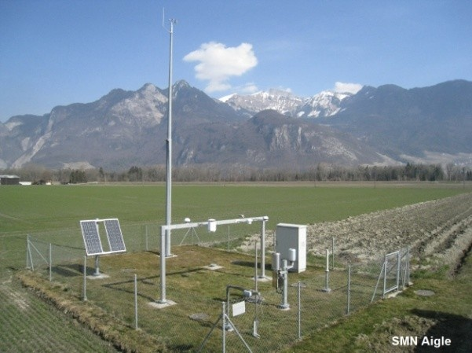
Why are metadata important?
T=17°C
T=17°C
T=17°C
T=17°C
Needed to make adequate use of observations
But: not always easily available to users (not exchanged globally)

Slide 10
Metadata for climate applications
“The details and history of local conditions, instruments, operating procedures, data processing algorithms and other factors pertinent to interpreting data (i.e. metadata) should be documented and treated with the same care as the data themselves.”
GCOS Climate Monitoring Principle #3
Notes:
2: Sprechblase climate activist oder so

Slide 11
WIS vs WIGOS Metadata
WMO Information System (WIS) Metadata
Describe products
Support discovery, access & retrieval
Formalized using ISO19115 metadata standard
WMO Integrated Observing System (WIGOS) Metadata
Describe observations & stations
Enable adequate use of observations
Support rational evolution of observing systems (RRR)
→ Formalized using ISO19156 (includes ISO19115) metadata standard
WIS
WIGOS
Notes:
2: Animieren (formalized?), Pfeile an die Plakate!, TIMO: was heisst products (WIS)?

Slide 12
WIGOS Metadata Standard (WMDS)
The framework of metadata
Notes:
1: Schöner machen

Slide 13
WIGOS Metadata Standard (WMDS): Objectives
Enable adequate use of meteorological and climatological observations for various application areas serving society.
Create a common «language» for Members to document existing observing capabilities.
Enable Members to evolve their observing systems rationally, with a view to the needs of the global systems.
Replace «Pub 9 Vol A»
Notes:
1: Beispiel für jedes objectives überlegen!, Bilder einfügen!

Slide 14
WIGOS Metadata Standard (WMDS):
Approach
Develop a comprehensive metadata standard to enable and improve the documentation of observations and exchange of information.
Agree on vocabulary (= code lists) to harmonize documentation.
Establish a web-based platform for the management, archival and exchange of such information world-wide.
Notes:
1: Bilder einfügen?

Slide 15
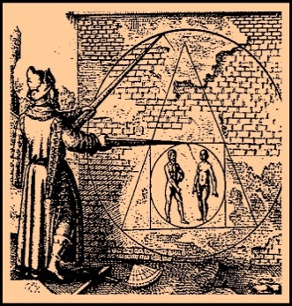
Technical requirements of WMDS
Cover all types of observations
Cover all disciplines / application areas
Forward-looking but also respecting legacy
Acceptable to and applicable by all Members
Keep it simple
, not too many items
… or, how to square the circle

Slide 16
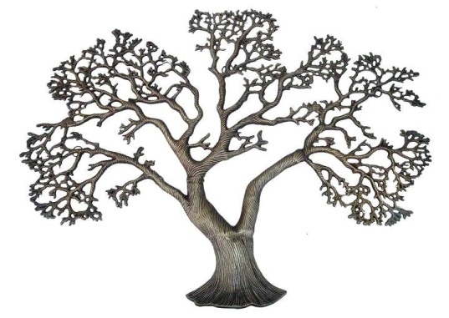
Considerations of WIGOS Metadata
WIGOS
Generation
Various levels of granularity
Transmission
Various intervals for (incremental) update
Access and use
By humans (researchers, managers, the public)
By machines (services)
WIS
Rather invariant
intermediate
Very dynamic
Notes:
1: verstehen und überarbeiten!

Slide 17
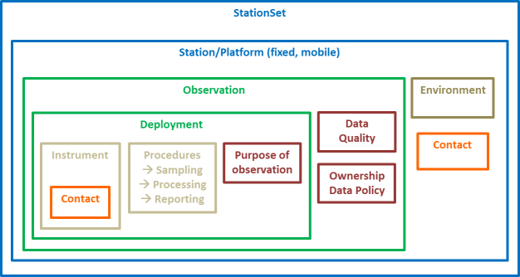
WMDS categories
1. Observed variable
2. Purpose of observation
3. Station/ platform
4. Environment
5. Instruments & methods of observation
6. Sampling
7. Data processing and reporting
8. Data Quality
9. Ownership and Data Policy
10. Contact

Slide 18
WMDS categories – some examples
Observed variable
Variable, unit, geometry
Purpose of observation
Programme/network affiliation, application area
Station/platform
Name, WSI, station type, country, coordinates, date established
Environment
Surface cover, climate zone, topography

Slide 19
WMDS categories – some examples
Instruments and methods of observation
Observing method, Coordinates, Instrument type
Sampling
Schedule
Data processing and reporting
Reporting interval, International exchange flag

Slide 20
WMDS categories – some examples
Data Quality
Traceability, Uncertainty
Ownership and data policy
Supervising organization
Contact
Station conctacts

Slide 21
Hierarchy of WMDS categories
StationSet
Station/Platform (fixed, mobile)
Observation
Environment
Deployment
Data Quality
Contact
Instrument
Procedures
→ Sampling
→ Processing
→ Reporting
Purpose of observation
Ownership
Data Policy
Contact

Slide 22
Conclusions
Exchanging WIGOS metadata of internationally exchanged data is important and mandatory (WMO Tech Reg)
The WMDS is the framework for documentation of metadata
The WMDS has been implemented in OSCAR/Surface for YOU! Use it!

Slide 23
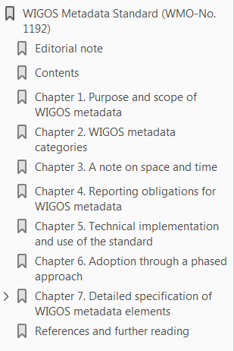
Reference
https://wis.wmo.int/WIGOS-MD
WMDS Code Tables:
http://test.wmocodes.info/wmdr/ (soon at: http://codes.wmo.int/)

Slide 24
Summary
Metadata are crucial for adequate use of observations, especially for climate applications.
Understand the importance of observational metadata
Understand the concepts of the WIS vs WIGOS metadata
Know where and how to find information
WIS
WIGOS
WMDS and its code tables: describe the most important aspects of observations harmonized.

Slide 25
Thank you
Merci
شكرا
You & your organization!
Financial support. Swiss Federal Office of Foreign Affairs, MeteoSwiss, WMO
Project Team at MeteoSwiss. (current) J Klausen, L Cappelletti, B Calpini, M Musa, M Brändli, L Koppa, C Walder, E Grüter, S Sandmeier, M Schäfer, Attila Loos
Project Team at WMO (current). F Belda, LP Riishojgaard, T Pröscholdt, L Nunes
Project Team at European Dynamics (current). T Galousis, M Ulmann, L Christou, N Pappa, S Sklavos, …
ICG-WIGOS. S Barrell, B Calpini, …
TT-WMD. (current) K Monnik, J Klausen, J Swaykos, T Boston, E Büyükbas, T Oakley, D Lockett, L Nunes, E Fucile
IPET-MDRD. (past) D Lowe, J Tandy, …
JCOMMOPS, GAW WDCs, ET-WDC, …

Slide 26
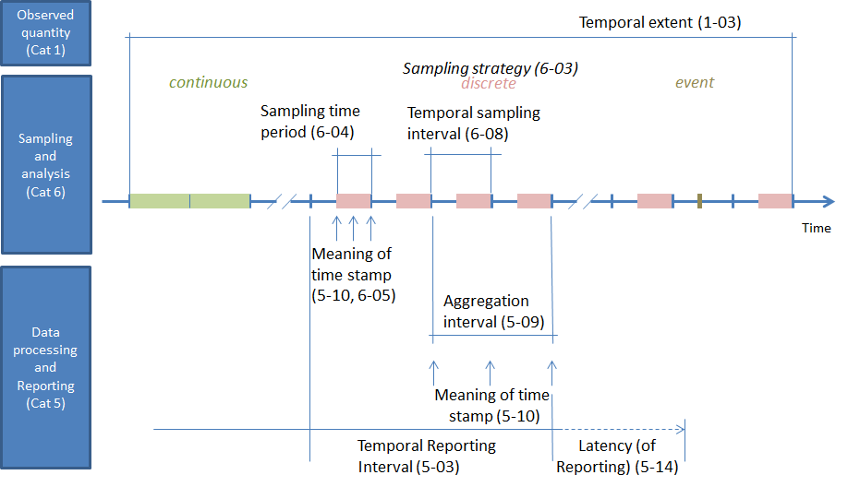
Concepts of Time in WMDS
Notes:
1: verstehen!!!, braucht man codelist nummern hier?, Timo fragen

Slide 27
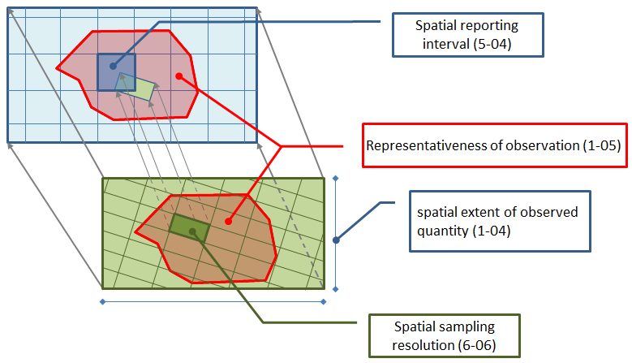
Concepts of space in WMDS
Notes:
1: verstehen!!!, Timo fragen

Slide 28
What Members will need to do:
Comply with the WMO Technical Regulations; WMO-No. 49, Volume I, Part I – WIGOS and the Manual on WIGOS:
Keep records of WIGOS metadata
For those observations that are exchanged internationally:
Exchange also the associated WIGOS metadata
Review the information in OSCAR/Surface
Keep entries in OSCAR/Surface up to date
The more accurate and up-to-date the information in OSCAR/Surface is, the more useful it will be!

