Slide 1
Course on
Meteorological Warnings
Shefayim, November 5-17, 2017
Air quality warnings – the Intermittent Control System (ICS)
Avner Furshpan
Director of climatology
Israel Meteorological Service
avnerf@ims.gov.il

Slide 2
outline
Motivation: Keeping the air clean
The power plants and their geographical domain.
Behavior of the plumes under different atmospheric stabilities – when/where is it dangerous?
The Intermittent Control System (ICS) – what’s behind?
The warnings schedule
Other ways…

Slide 3
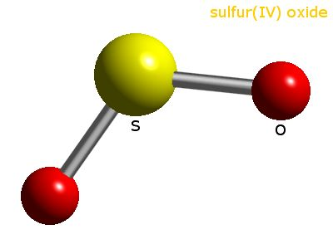
Motivation
Sulfur Dioxide
Short-term exposures to SO₂ can harm the human respiratory system and make breathing difficult.
SO₂ emissions that lead to high concentrations of SO₂ in the air generally also lead to the formation of other sulfur oxides (SO_{x}). SO_{x} can react with other compounds in the atmosphere to form small particles. These particles contribute to particulate matter (PM) pollution: particles may penetrate deeply into sensitive parts of the lungs and cause additional health problems. (from EPA website)

Slide 4
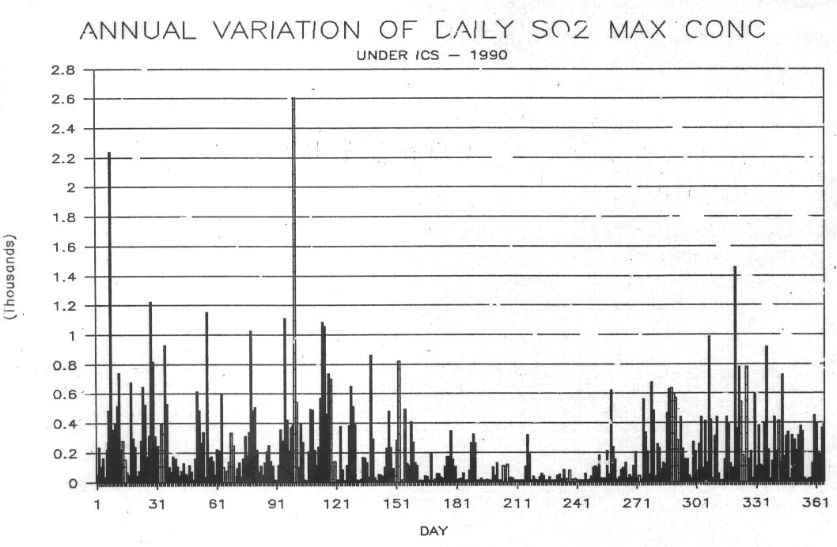
Motivation in Israel
Back in the 80’s and the 90’s:
High concentrations of SO₂

Slide 5
2008 : Clean Air Act
Air Quality Values.
The Environment Standard defines the concentration of pollutant permitted in the open air without reference to a specific pollutant factor. The purpose of the standard is to determine the maximum value of a pollutant concentration that will, to the extent possible, prevent public health effects
3 new thresholds:
Target values
Limit values (Air quality standards)
Alert thresholds

Slide 6
2008 : Clean Air Act

Slide 7
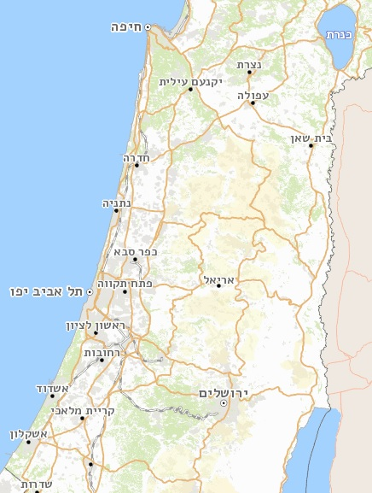
The sources of emissions (Power Plants)
Ashqelon – 250 m – Coal.
Hadera – 250 -300 m – Coal.
Haifa – 80 m, Mazut (recently – Natural Gas)
Sulfur Oxide
Haifa
Hadera
Ashqelon

Slide 8
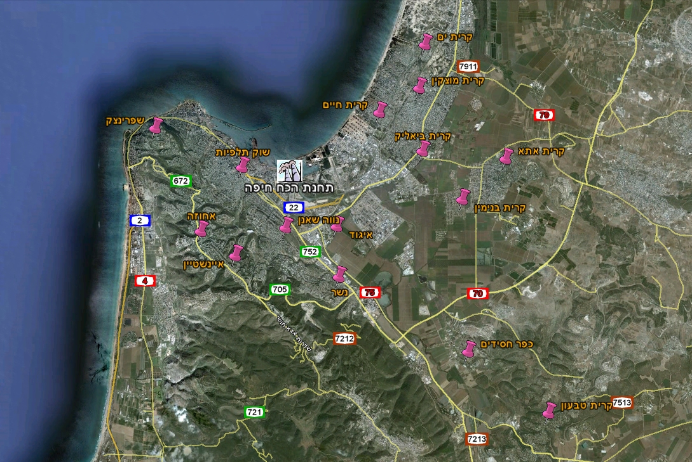
Haifa area
Power plant

Slide 9
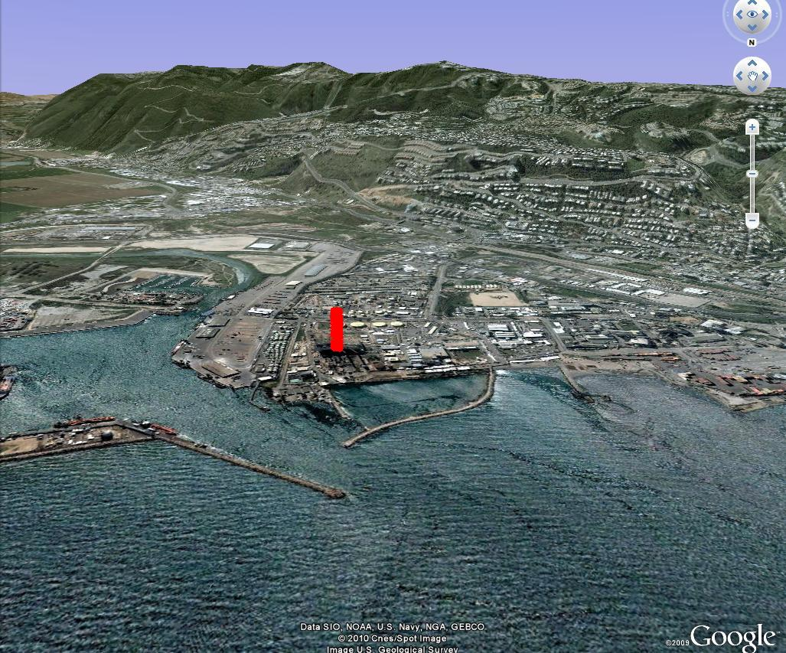
Haifa area

Slide 10
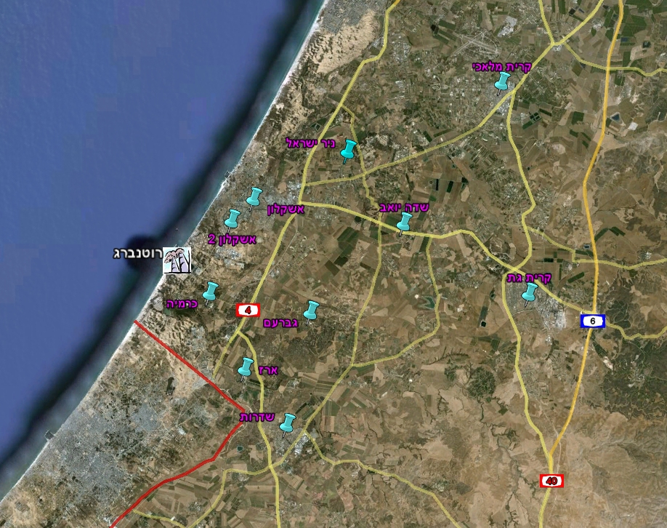
Ashqelon area
Power plant

Slide 11
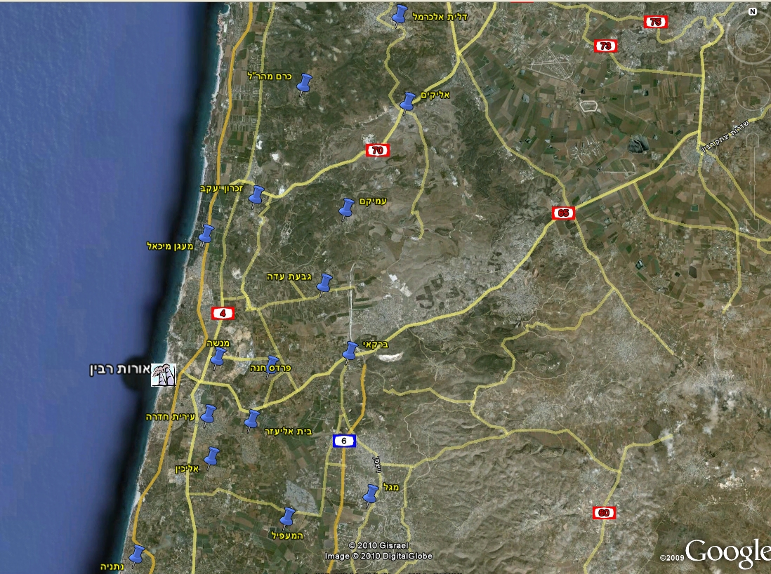
Hadera area
Power plant

Slide 12
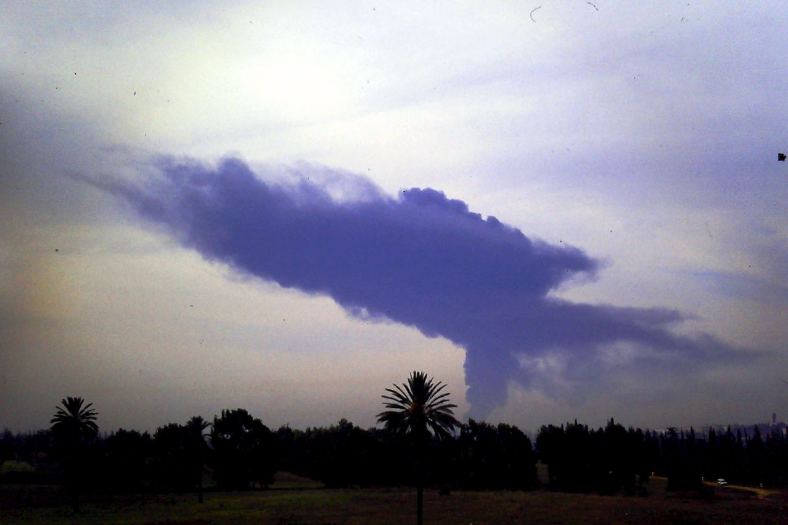
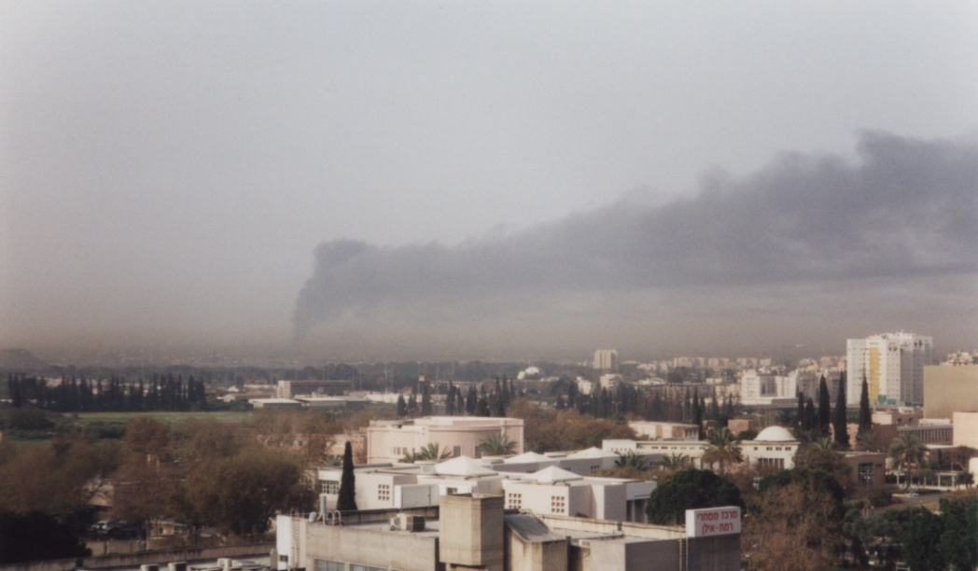
Behavior of the pollution plume as a result of the meteorological conditions

Slide 13
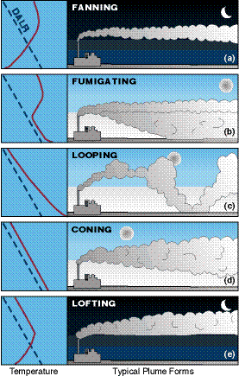
Behavior of the pollution plume as a result of the meteorological conditions

Slide 14
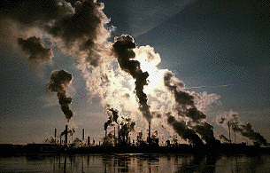
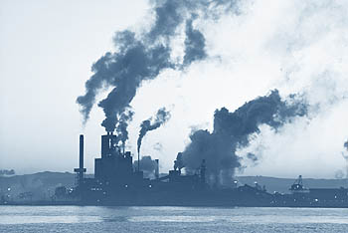
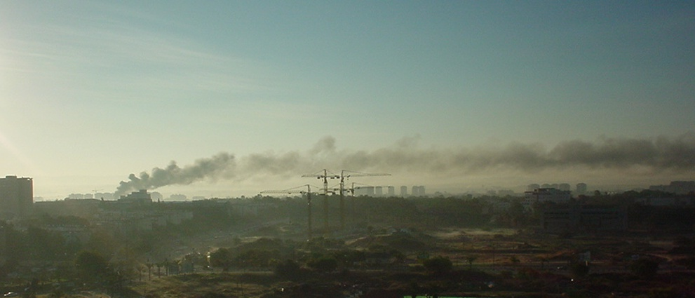
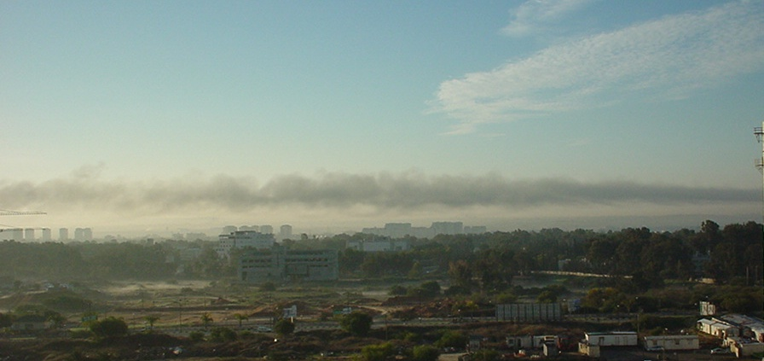
Unstable atmosphere
Stable atmosphere

Slide 15
What is dangerous in each region?
Hadera and Ashqelon: 250-300 m chimneys
Haifa: 80 m chimneys

Slide 16
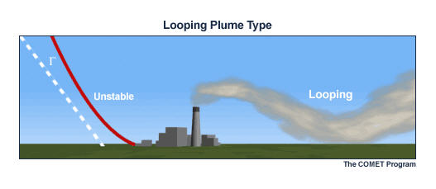
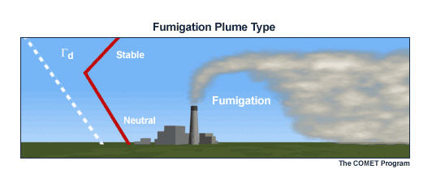
Undesired situations in Hadera and Ashqelon
wind directions from the south west to north are dangerous.
These situations can develop during the day (noon)

Slide 17
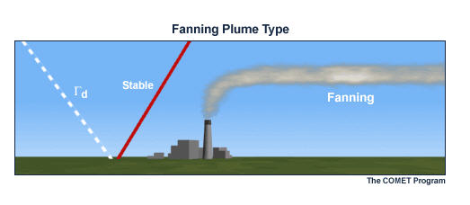
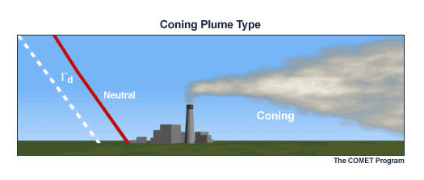
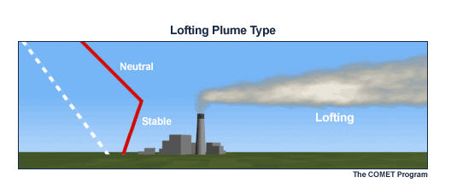
Undesired situations in Haifa
The most dangerous situations might develop at night

Slide 18
Intermittent Control System (ICS)
The purpose of the ICS:
To warn, in time, the relevant authorities, about weather conditions that are dangerous in terms of air pollution.
Who is given the alert?
The environmental units at the regional associations.
What is the target of the ICS?
The power plants of the Electric Company and the Oil Refineries (high chimneys)

Slide 20
The ICS model
Was developed in the 90’s
Based on a statistical relationship between different atmospheric situations to high pollution concentrations (not too high – to enable sufficient population of cases).
Originally developed for Haifa, Ashdod and Hadera. Later adopted (with the help of models) for Ashqelon.

Slide 21
Different atmospheric situations
Synoptic situation
Depth of the mixed-layer/ground inversion
Temperatures and heights at different levels (including differences from the previous day)
Wind speed and direction; wind shear etc.

Slide 22
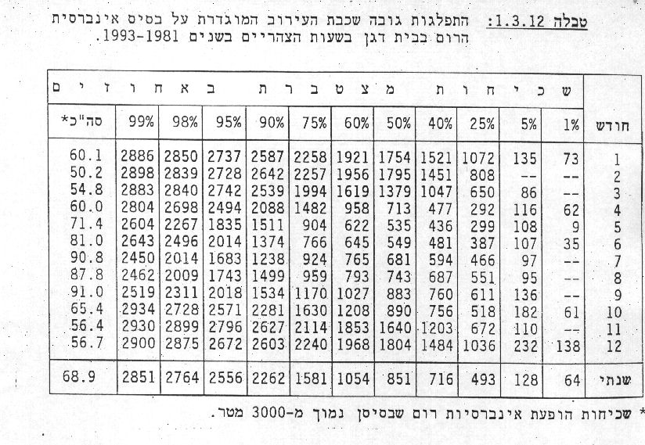
Hadera and Ashqelon – it’s important to predict the height of the mixing layer in day time
Distribution of the mixing layer (subsidence inversion) height (meters) in Bet Dagan at noon, 1981-1993
Accumulated distribution
Total*
month
annual
*Frequency of subsidence inversions with base lower than 3000 meters

Slide 23
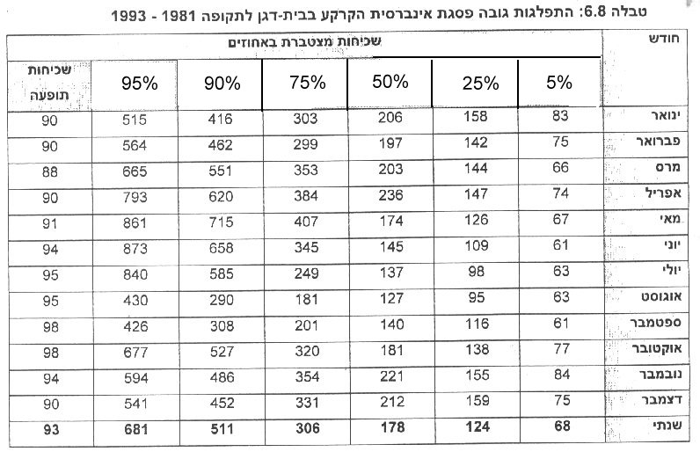
In Haifa it’s important to predict the depth of the ground inversion at night
Distribution of the ground inversion depth (meters) in Bet Dagan 1981-1993
Accumulated distribution
month
Jan
Feb
Mar
Apr
May
Jun
Jul
Aug
Sep
Oct
Nov
Dec
annual

Slide 24
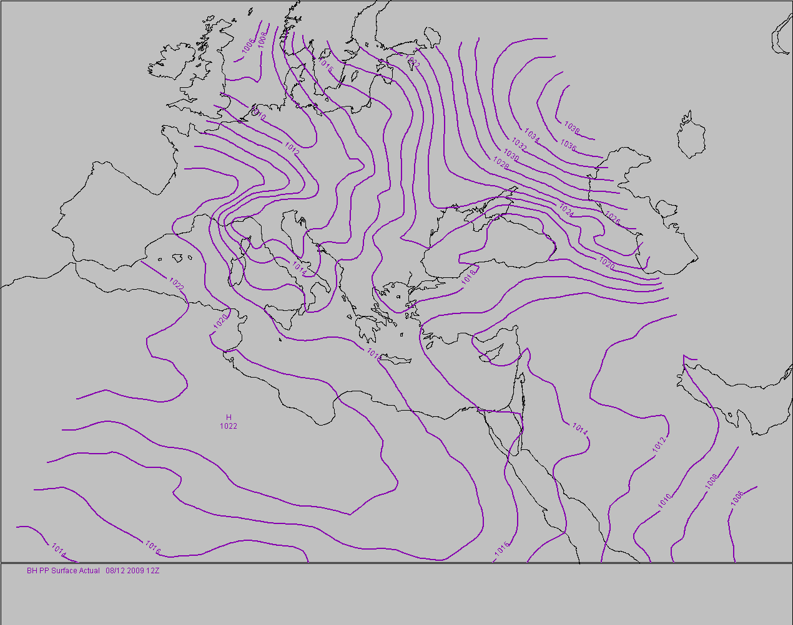
3) Moderate westerly wind
In 850 mb in the eastern Mediterranean westerly winds but not included in situation 2. 1.6 mb ≤ P_{C-N} ≤ 3.9 mb with 210°≤ D₈₅₀ ≤ 340°, 9 ≤ V₈₅₀ ≤ 15 kn. Usually unstable weather but not necessarily with rainfall.

Slide 25
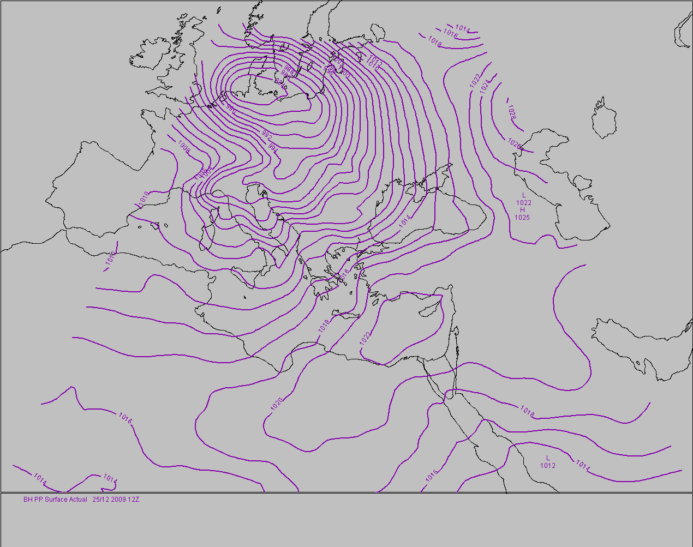
6) Local High pressure system

Slide 26
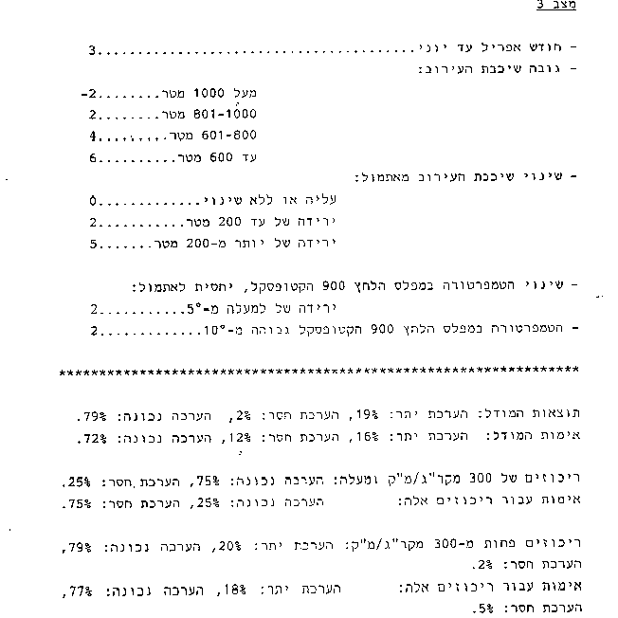
3) Moderate westerly wind
Months April to June
Above 1000m
Depth of the mixed-layer
Change of mixed layer depth from yesterday
Increase or no change
decrease of up to 200m
decrease of more than 200m
Change in temp. 900hPa compared to yesterday
More than 5 deg
Temp. in 900 hPa higher than 10 deg.
True
Underesti.
Overesti.
Model results
Model verification

Slide 27
Warnings on time
Hadera/Ashqelon – since coal: the day before
Haifa (while Mazut) – at least 3 hours before

Slide 28
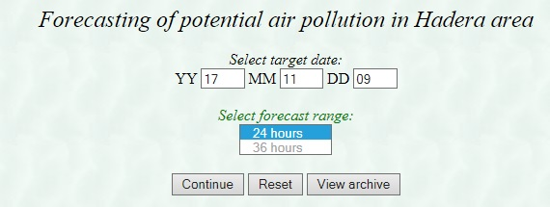
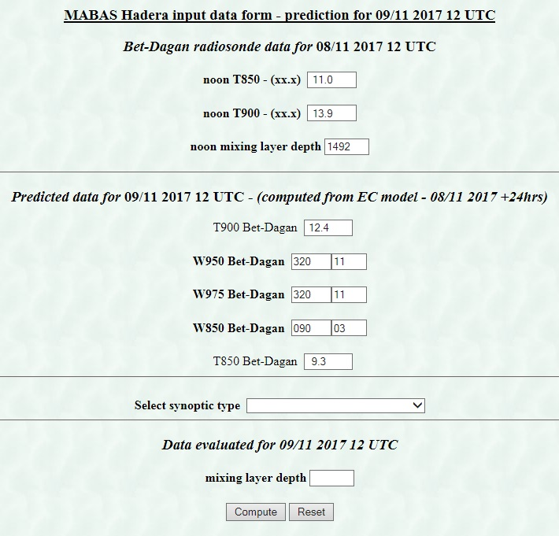
Hands on……

Slide 29
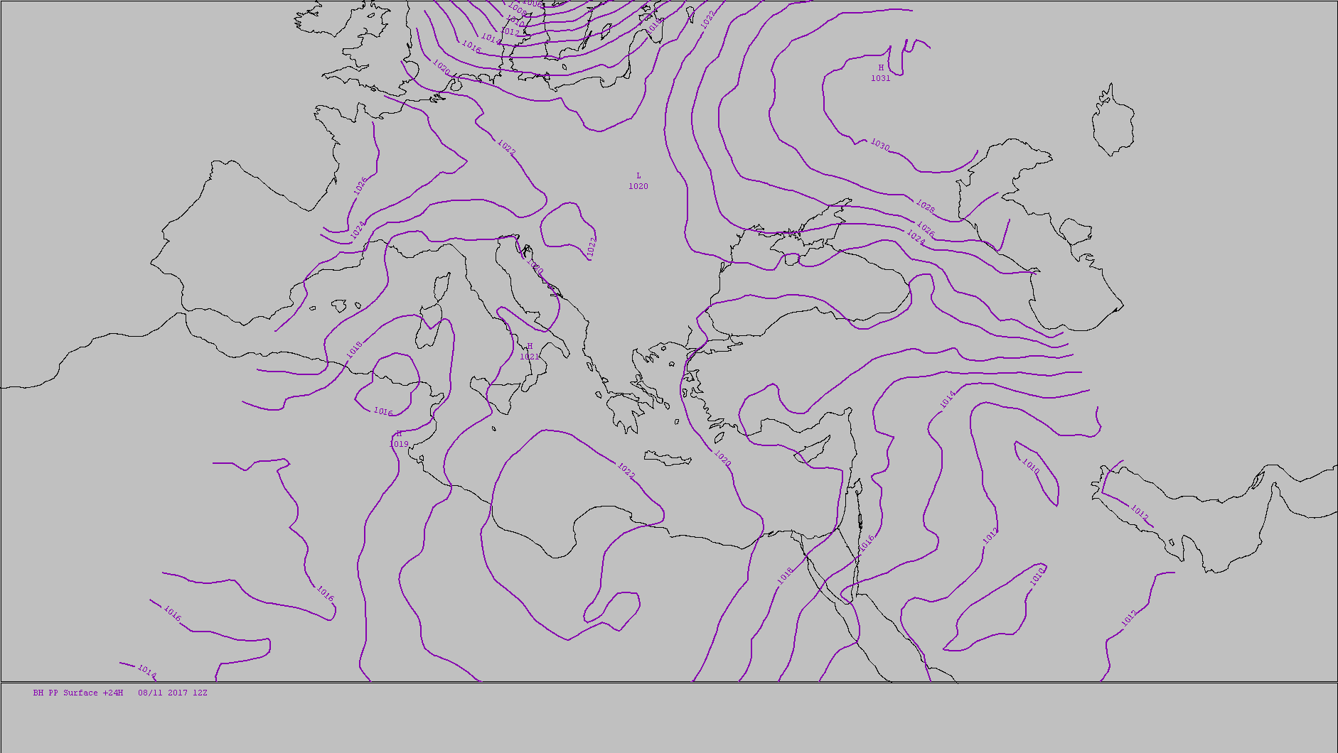
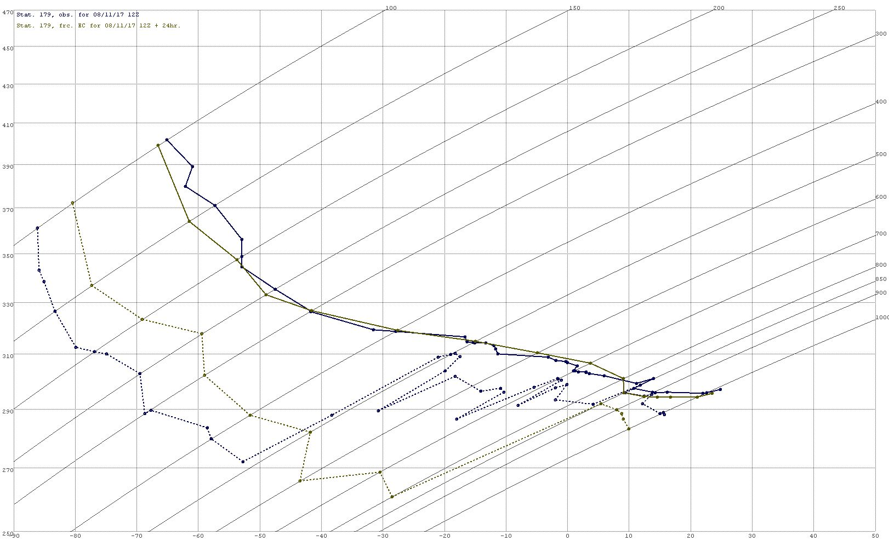
Hands on……

Slide 30
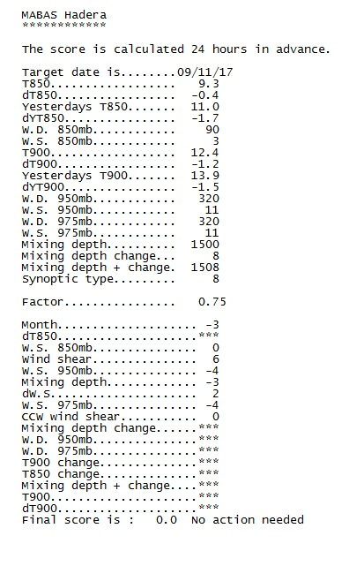
results

Slide 31
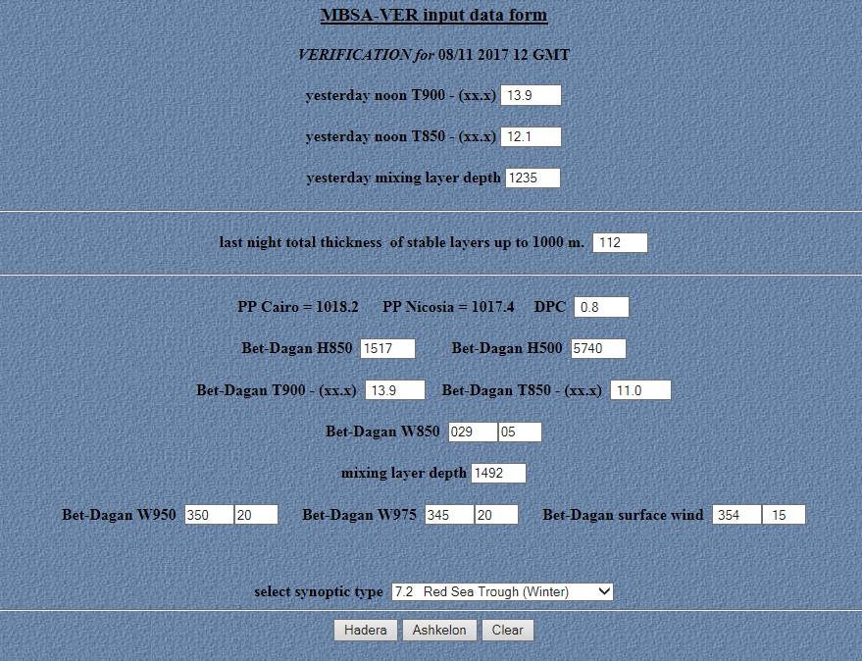
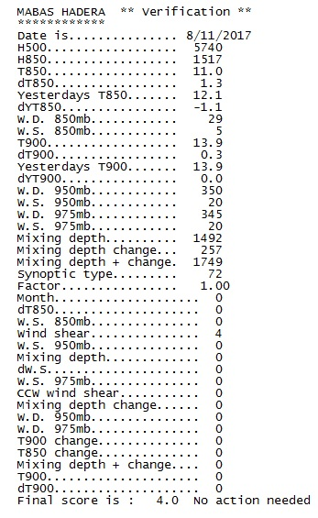
Verification (of yesterday...)

Slide 32
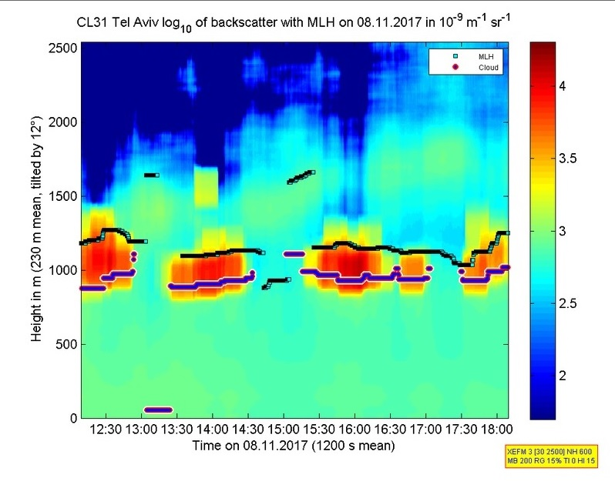
Remote sensing
A way to follow the development of the mixed layer depth

Slide 33
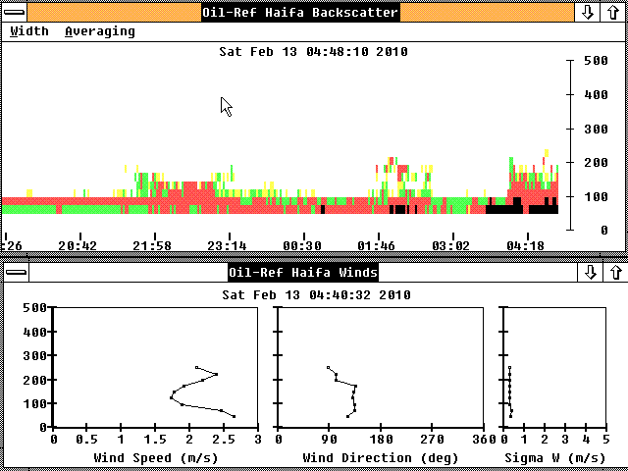
Remote sensing Haifa (2010)
Development of ground inversion
Wind profile
Was very helpful

Slide 34
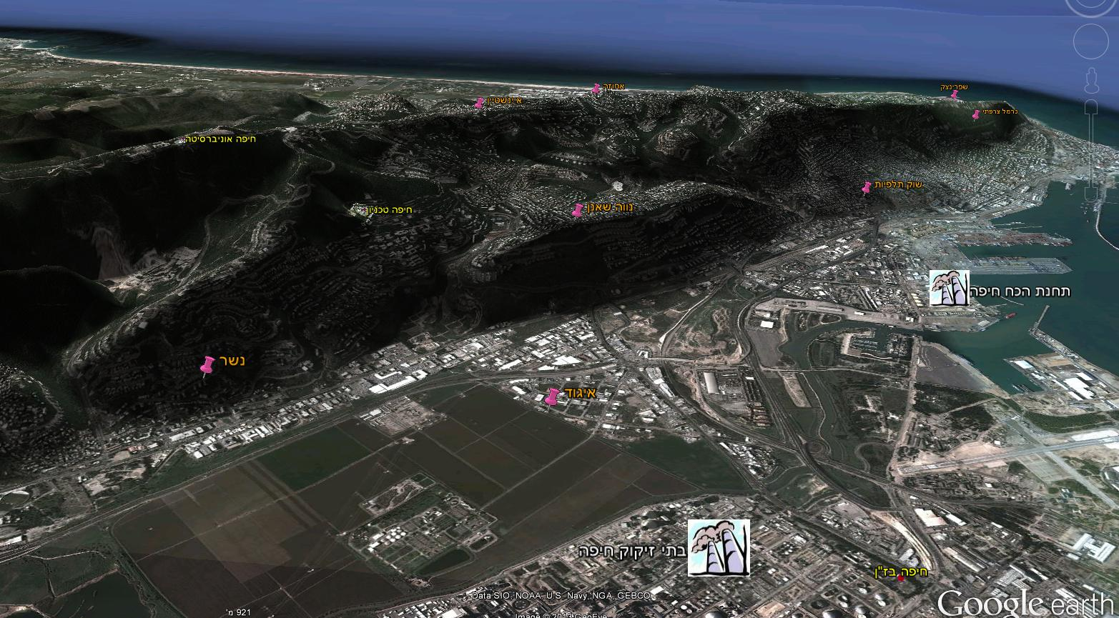
An example in Haifa
Haifa, clear night, weak winds
22/11/1999 02:00
◦ 24
IEC Power station
Oil Refineries
◦ 17

Slide 35
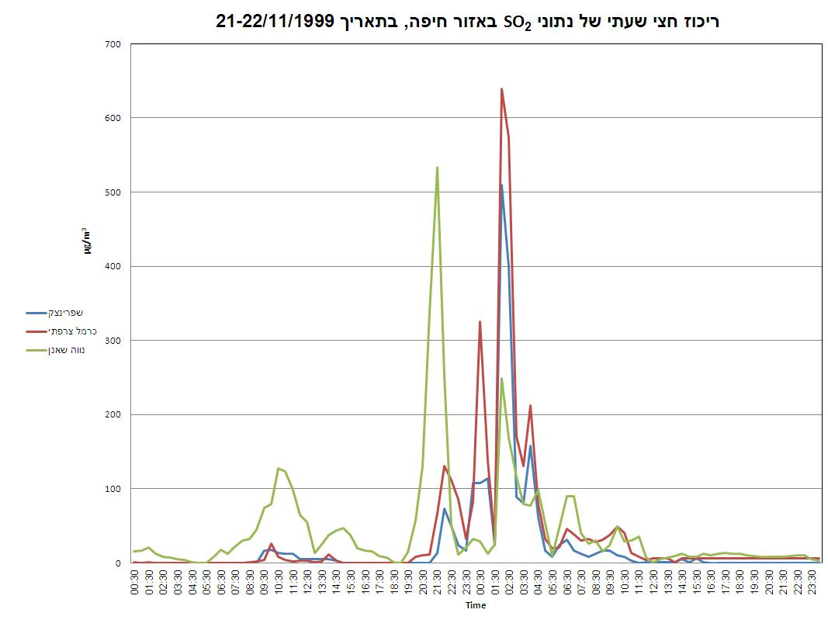
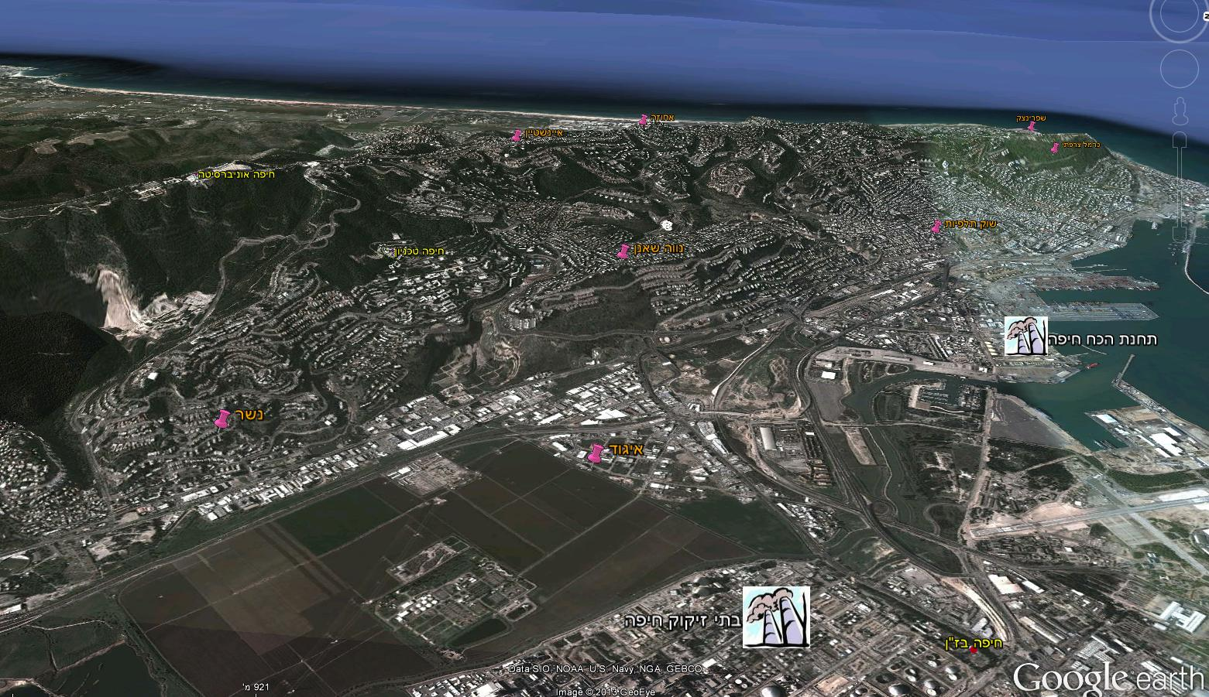
What influence more?
The fuel or the weather?
Haifa
High concentrations even when working with the lowest sulfur content

Slide 36
validation
SO₂ weighted
SO₂ emission
 | טבלה 3: ( המשך )סיכום פעילות מב"ס באיזור חדרה ספטמבר 2009
 | SO₂ |  | תחנת | כושר ייצור | פליטת | ריכוז | תחזית 24 שעות |  | ציון | אימות
תאריך | מירבי | שעה | ניטור | בפועל | SO₂ | משוקלל | מצב סינופטי | ניקוד | למודל | מצב סינופטי | ניקוד
1 | 238 | 14:30 | גן שמואל | 2577 | 7 | 425 | 93 | 6 | C | 92 | 0
2 | 283 | 12:45 | גן שמואל | 2583 | 7 | 505 | 92 | 9 | U | 92 | 9
3 | 199 | 12:05 | גן שמואל | 2516 | 7 | 355 | 92 | 9 | C | 92 | 1
4 | 256 | 11:55 | גן שמואל | 2544 | 7 | 457 | 92 | 7 | C | 92 | 7
5 | 144 | 12:40 | פרדס חנה | 2486 | 7 | 257 | 92 | 2 | C | 92 | 4
6 | 139 | 14:40 | פרדס חנה | 2582 | 7 | 248 | 92 | 2 | C | 92 | 2
7 | 84 | 11:45 | עמיקם | 2605 | 7 | 150 | 92 | 2 | C | 92 | 4
8 | 115 | 12:40 | גבעת עדה | 2580 | 7 | 205 | 92 | 9 | C | 92 | 4
9 | 356 | 12:50 | גן שמואל | 2568 | 7 | 636 | 92 | 2 | U | 93 | 2
10 | 251 | 12:30 | גן שמואל | 2507 | 7 | 448 | 92 | 4 | C | 93 | 1
11 | 251 | 12:00 | גן שמואל | 2514 | 8 | 392 | 6 | 5 | C | 6 | 3
12 | 209 | 14:45 | עמיקם | 2219 | 7 | 373 | 4 | 0 | C | 4 | 0
13 | 196 | 13:50 | פרדס חנה | 2547 | 8 | 306 | 3 | 4 | C | 3 | 4
14 | 167 | 12:55 | מגל | 2586 | 8 | 261 | 3 | 5 | C | 3 | 5
15 | 311 | 13:00 | גן שמואל | 2579 | 8 | 486 | 92 | 6 | C | 93 | 7
16 | 157 | 14:45 | גבעת עדה | 2566 | 8 | 245 | 92 | 4 | C | 91 | 0
17 | 212 | 15:35 | גן שמואל | 2582 | 8 | 331 | 92 | 4 | C | 92 | 1
18 | 154 | 13:25 | גבעת עדה | 2580 | 7 | 275 | 92 | 2 | C | 3 | 9
19 | 113 | 09:15 | פרדס חנה | 1750 | 5 | 283 | 3 | 6 | C | 3 | 5
20 | 24 | 13:35 | גבעת עדה | 1775 | 5 | 60 | 2 | 0 | C | 3 | 2
21 | 120 | 12:35 | גבעת עדה | 2532 | 8 | 188 | 3 | 2 | C | 3 | 2
22 | 165 | 15:20 | המעפיל | 2599 | 8 | 258 | 8 | 9 | C | 8 | 17
23 | 76 | 13:05 | אליכין | 2513 | 7 | 136 | 8 | 0 | C | 71 | 4
24 | 202 | 13:05 | אליכין | 2606 | 8 | 316 | 71 | 9 | C | 71 | 9
25 | 113 | 12:15 | אליכין | 2596 | 7 | 202 | 71 | 8 | C | 71 | 11
26 | 123 | 12:55 | המעפיל | 2485 | 7 | 220 | 71 | 6 | C | 6 | 14
27 | 225 | 14:30 | פרדס חנה | 2500 | 7 | 402 | 3 | 2 | C | 3 | 6
28 | 133 | 16:25 | ברקאי | 2351 | 6 | 277 | 3 | 6 | C | 71 | 7
29 | 317 | 13:30 | אליכין | 2603 | 7 | 566 | 71 | 6 | U | 6 | 3
30 | 170 | 15:20 | המעפיל | 2611 | 7 | 304 | 71 | 6 | C | 71 | 4
Model mark
תחזית
SO₂ max
score
day

Slide 37
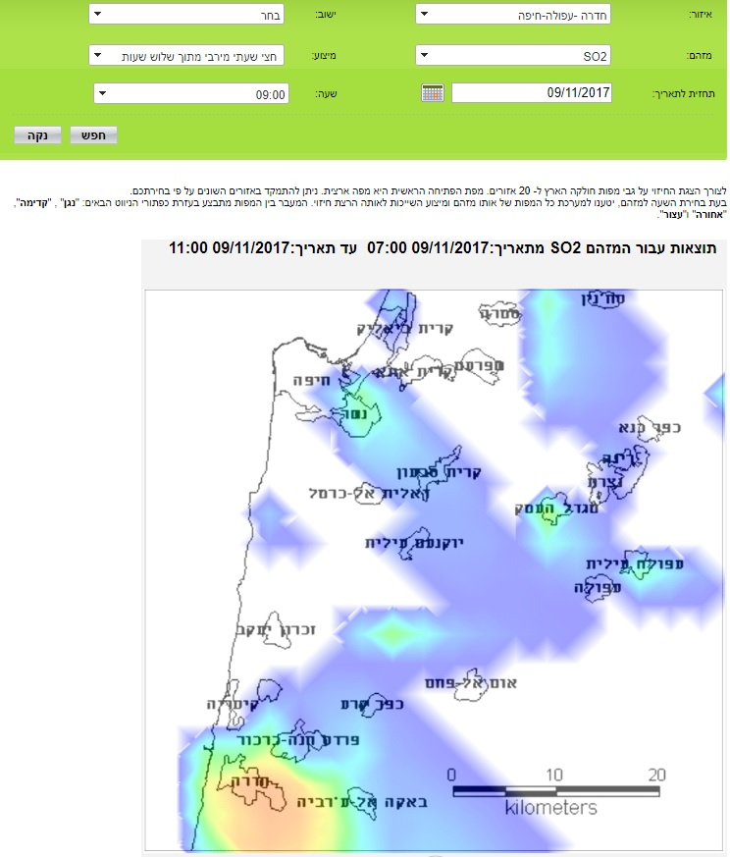
Other ways

Slide 38
Summary
Response of the IMS to the need of the environmental agencies to develop a warning system for air pollution.
“The operation of the ICS led to a significant improvement in air quality in the Haifa area, and a further decrease in SO₂ emissions was achieved by a gradual reduction in the sulfur content of the fuel oil used in the factories” (old website of the Haifa regional association)

Slide 39
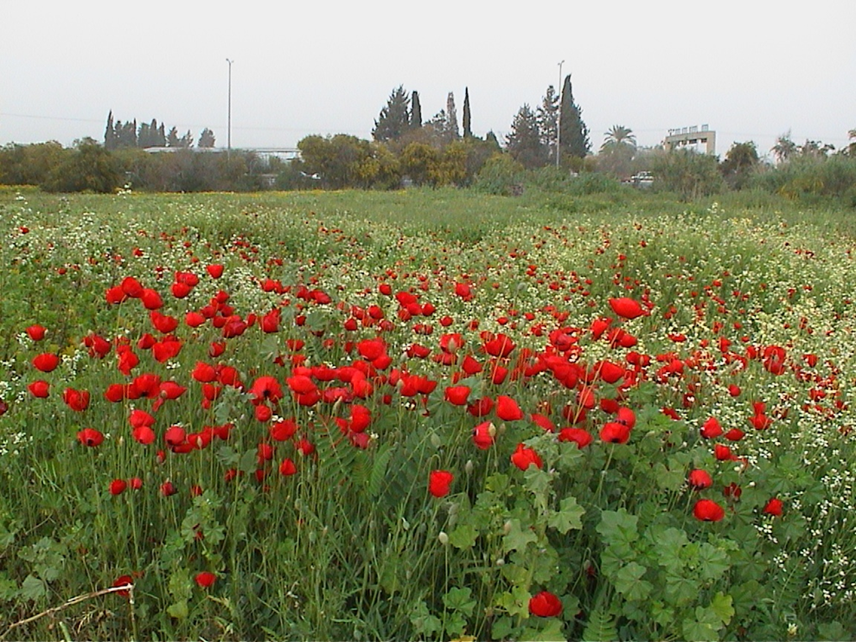
Thank you

