Slide 1
Overview of the Thirteenth WMO Symposium on Education and Training (SYMET-XIII),
Barbados, 30 October – 1 November 2017
Dr Yinka Rotimi Adebayo
Director, Education and Training Office

Slide 2
Education and Training Symposia of WMO
Year | Venue | Theme
1970 | Italy | Higher Education and Training
1975 | Venezuela | Meteorological Aspects of Environmental Problems
1979 | Spain | Meteorological Aspects of Energy Problems
1982 | Costa Rica | Climatic Change and Variability
1987 | UK | Optimal Use of Meteorological Information and Products
1991 | Canada | Methods of Meteorological Educational and Training Including the Use of New Relevant Technologies

Slide 3
Education and Training Symposia of WMO
Year | Venue | Theme
1995 | France | Curriculum Needs beyond 2000
1999 | Islamic Republic of Iran | Continuing Education and Training in Meteorology and Operational Hydrology
2003 | Spain | New Perspectives of Education and Training in Meteorology and Operational Hydrology
2006 | China | Education and Training in Meteorology and Operational Hydrology
2010 | Indonesia | New Approaches to the Education and Training for Meteorological and Hydrological Forecasters
2013 | France | Training with a Purpose

Slide 4
Rationalization for Efficiency
Symposium on Education and Training
5 days
Symposium on Education and Training
Meeting of Directors of Regional Training Centres
3 days
Transformed to
+
4 days
Meeting of Directors of Regional Training Centres
1 day
5 days

Slide 5
Benefit of Rationalization
Both SYMET and RTC Directors’ meeting together bring substance and management
Immediate following activities
Opportunity for RTC Director to meet with wider community

Slide 6
Committees in Support of Planning and Delivery
Secretariat Coordinating Committee (SCC)
International Advisory Committee (IAC)
Local Organizing Committee (LOC)

Slide 7
Goals of SYMET-XIII
General Goal:
To stimulate and facilitate the development of a vibrant and robust education and training capacity within the worldwide meteorological and hydrological community and recommend possible new avenues for development.
Key Objectives:
Enhancing service-specific education and training needs;
Increasing education and training capacity;
Focusing on partnership and resource mobilization.
Achieving Objectives:
The Objectives will be achieved by engaging the heads of meteorological/hydrological training institutions and other stakeholders in discussions that address key education and training topics

Slide 8
Symposium Themes
The main theme: “Education and Training for Human Resource Development in
Meteorological and Hydrological Services”
Theme I: Service-specific Education and Training Needs
Preparation by Patrick Parrish
Contributors: Dr. Jim Poole, Heleen ter Pelkwijk, others, WMO Secretariat
Theme II: Increasing Education and Training Capacity
Preparation by COMET, Dr. Rich Jeffries
Contributors: Patrick Parrish, Jennifer Milton
Theme III: Partnership and Resource Mobilization
Preparation Yinka Adebayo
Contributors: Michael Williams, Jean-Paul Gaudechoux, Paul Egerton, William Nyakwada, and Sally Wolkowski, Mark Higgins, Jennifer Milton

Slide 9
Symposium Programmatic Activities
Prepared thematic papers to cover a full range of issues
Reviews thematic papers
Draw out preliminary recommendations
Review in WMO Secretariat
Review by targeted experts
Review and discuss virtually prior to events
Discussions during Symposium to take into account presentations
Base outcome of Symposium on what emerged from the consolidated output.
Further review and editing of this output
Publication of SYMET outcome

Slide 10
SYMET-XIII Recommendations
Recommendations for training institutions
Recommendations for the WMO Secretariat and ETR Office
Recommendations for Executive Council
Recommendations for Regional Associations
Recommendations for the Technical Commissions
Recommendations for PRs and NMHSs
Recommendations for development partners and international organizations
Recommendations for the private sector

Slide 11
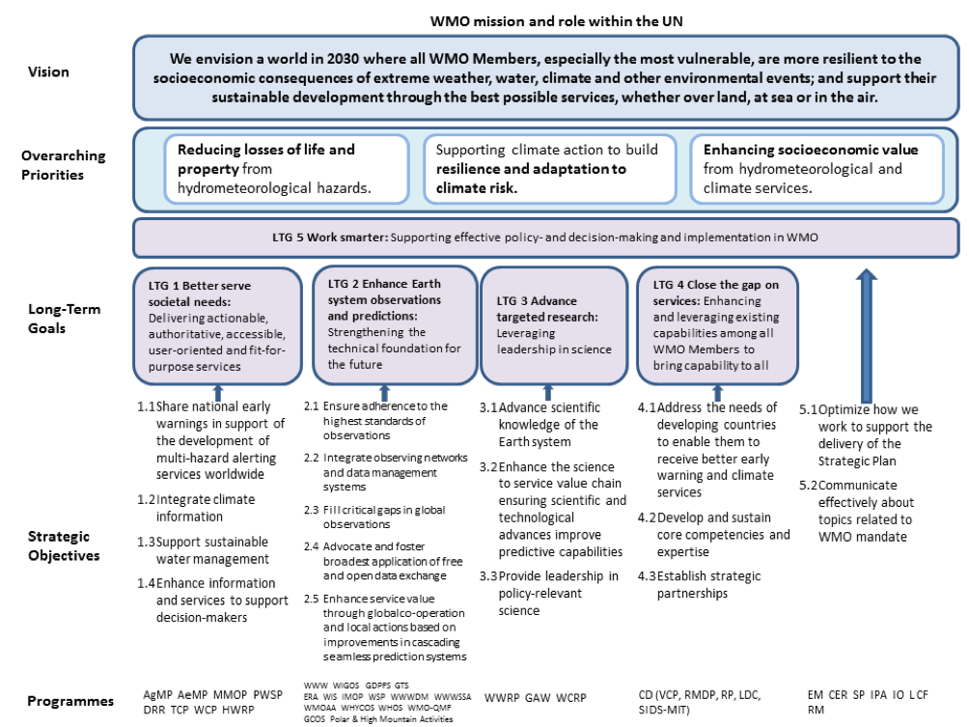
DRAFT: WMO Strategic Plan Summary: 2020-2023

Slide 12
Towards a Structured Outputs (Discussion Documents to be modified based on SYMET-XIII deliberations)
I: Synthesis of Issues entitled “Contemporary and future issues on promotion and delivery of education and training in meteorology and hydrology”
Section I: Service-specific education and training needs
Section II: Increasing Education and Training Capacity for the WMO Members
Section III: Partnership and Resource Mobilization
II: Conclusions and Recommendations on, and Implementation and Future Actions entitled “An International Agenda for Education and Training”
Section I: Conclusions
Section II: Recommendations
Section III: Implementation and Future Actions
III: Symposium Statement
Short public statement on the outcome

Slide 13
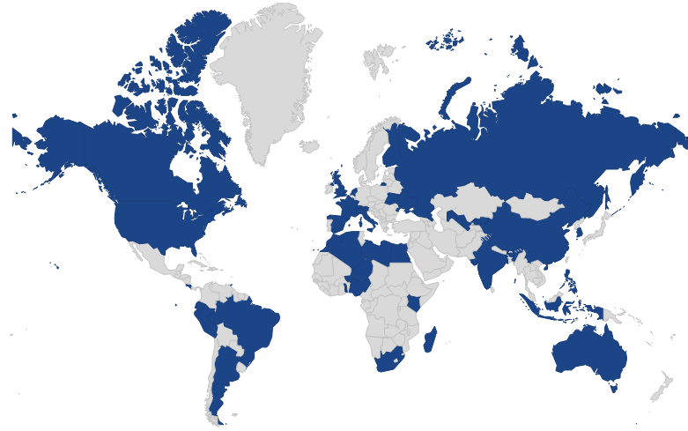
86 Participants from 37 Countries

Slide 15
Thank you
Merci

