Slide 1
How to manage Information in OSCAR/Surface
Jörg Klausen, MeteoSwiss
Lucia Cappelletti, MeteoSwiss

Slide 2
Outline
Introduction
Stations, unite!
She can, I can’t
Historical information
To the rescue!

Slide 3
introduction

Slide 4
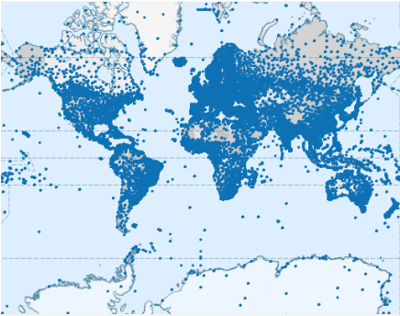
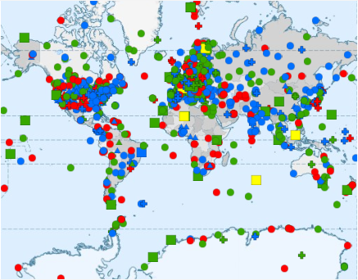
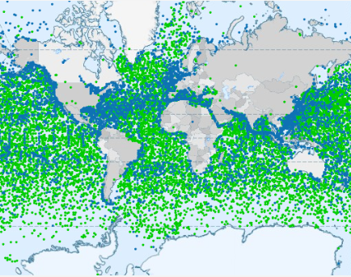
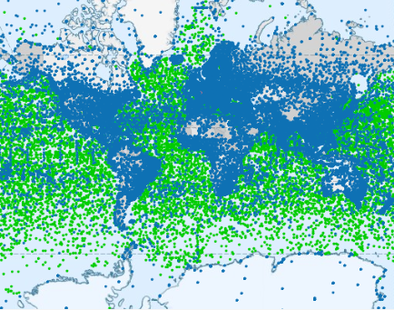
OSCAR/Surface initial data integration
Vol A + WRD
(«GOS»)
GAWSIS
(«GAW»)
JCOMMOPS
(«GOOS»)
OSCAR/Surface
Integrate first, then consolidate
Potential duplicates between Vol A, WRD, and GAW
Members only know what is a duplicate

Slide 5
Stations, Unite!

Slide 6
Speak to thy neighbour
Use existing OSCAR entries if possible
Don’t generate new stations unless there is a good reason!
Several organizations can share the same observing facility
An observing facility can host many different instruments and serve several programs / networks
Station metadata should enable adequate use of observations
Various different observations can increase the value of each, so documenting them in one place is good practice
More stations only mean more work!

Slide 7
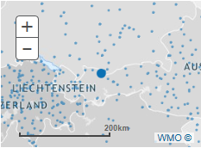
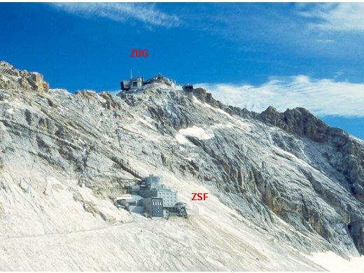
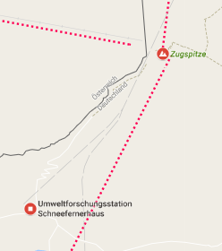
Example
A: ZUGSPITZE (0-20000-0-10961)
47.4222222222°N, 10.9866666667°E, 2964m
B: Zugspitze-Schneefernerhaus (0-20008-0-ZSF)
47.4165°N, 10.97964°E, 2671m
C: Zugspitze-Gipfel (0-20008-0-ZUG)
47.421075°N, 10.985896°E, 2962m
A and C are the same station and could be consolidated
Horizontal distance of ca. 650 m between A/C and B might not warrant 2 different station entries … but due to the alpine setting, the difference in elevation clearly leads to quite different exposure.

Slide 8
Consolidate co-located stations
This is the preferred approach!
If station A should be combined with station B, first decide which station should remain. Then copy all information from one to the other, and use «Support» to request complete deletion of one station.

Slide 9
Linking stations
OSCAR administrators can link stations that somehow belong together. If co-located stations cannot be combined into one for specific reasons, then this may be a solution.
Contact «Support» for more information.

Slide 10
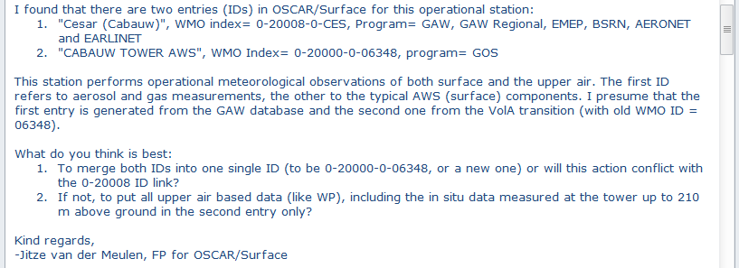
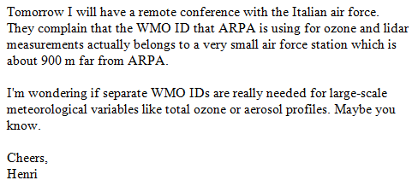
More examples

Slide 11
She can, I can’t

Slide 12
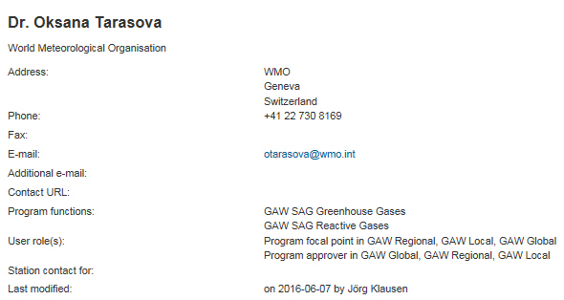
User roles in OSCAR/Surface: overview
Anonymous user
Registered user
User roles (imply user rights):
Administrator
National Focal Point (for a program*)
Program Focal Point
Station contact
Instrument expert
Program approver
User functions (no rights):
GAW World Data Centre
JCOMMOPS Chairperson
…..
*available from release 1.2.1

Slide 13
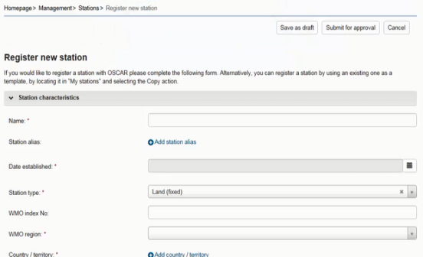
Security and user management: Assignment of roles and rights
Authentification by identity provider (Swiss Government)
Authorization within application based on «trust-relationships» and various «user roles»
Register
Edit all stations in country
Also: register new contact
Admin
NFP
Edit assigned stations
Also: register new contact
Station contact

Slide 14
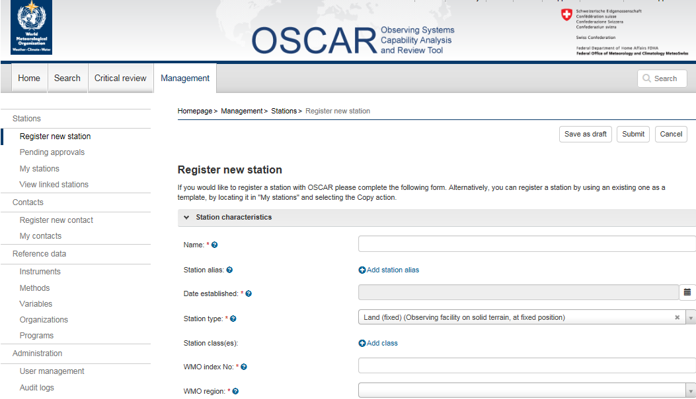
User roles in OSCAR/Surface: Rights
Management tab includes a role-tailored vertical menu
Reflects the user role and rights model
Role/rights | Manage Stations | Approve stations** | Manage Contacts | Manage Code tables
Administrator | All | All | All | All
National Focal Point | Add and edit: In own country of responsibility | - | Add: in own country Edit: contacts for stations in his/her country | Organisations
Program Focal Point | Add: no restrictions Edit: stations in his/her program | For own program | Add: In own country Edit: contacts for stations in his/her program | Organisations
Station contact | Add: in own country Edit: Assigned stations | - | Add: In own country Edit: contacts for assigned stations | Organisations
Program approver | - | For own program | Add: in own country Edit: own | Organisations
Instrument expert | - | - | Add: - Edit: own | Instruments, organisations
**only stations affilated with certain programs (i.e. GAW) need approval

Slide 15
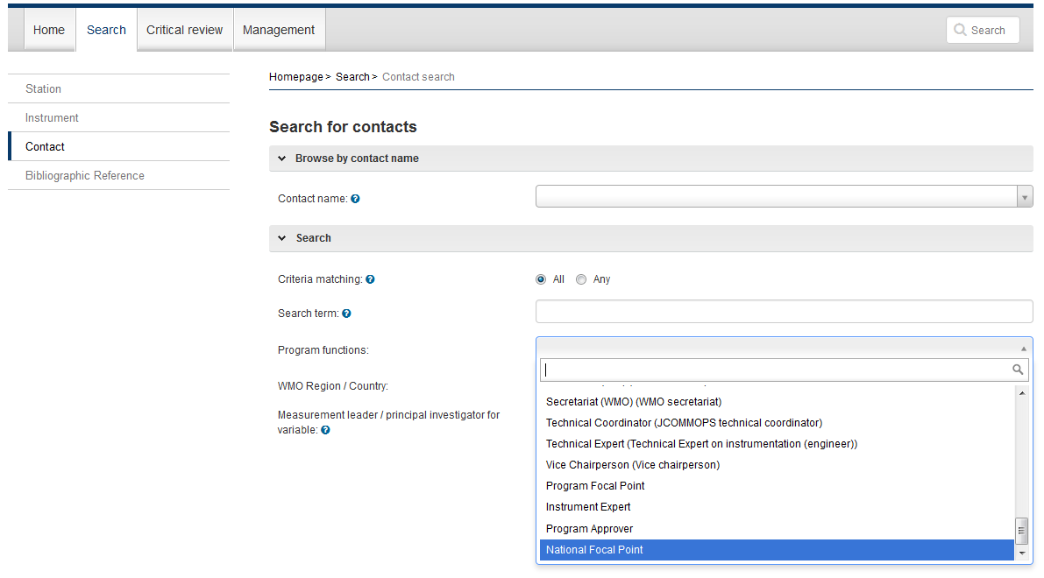
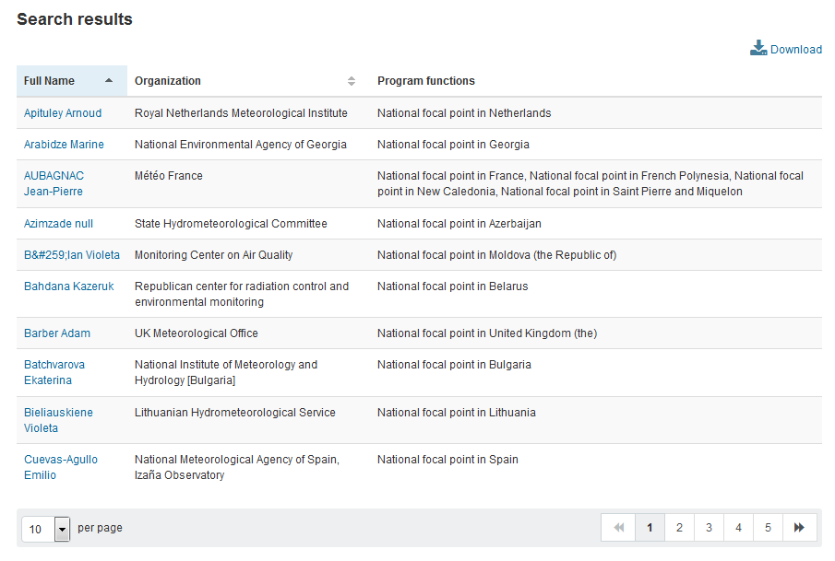
Find users by roles in OSCAR/Surface*
Search for contact(s) by functions
Search for contact(s) by role
Download search results (csv, xml)
*available from release 1.2.1

Slide 16
Historical information

Slide 17
OSCAR/Surface is history aware
Information about past history enables adequate use of observations
Same observer at different stations
Instrument moved from one station to another
Instrument re-located at station
Maintenance schedules changed
Station, instrument log books, events
…

Slide 18
Add and correct, don’t delete
Changes are added as new information
Erroneous information should be corrected
Old information is not («cannot be») deleted
OSCAR/Surface asks for and maintains very many date/timestamps
→ From-To
→ Since-Till

Slide 19
To the rescue!

Slide 20
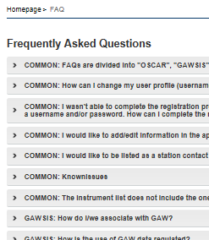
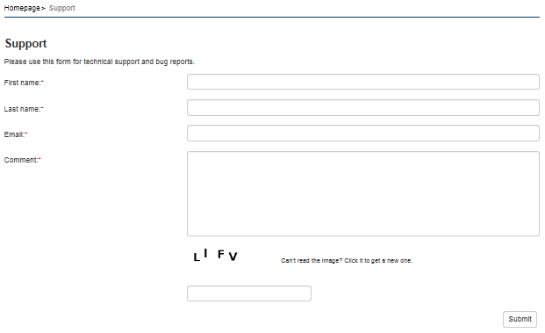
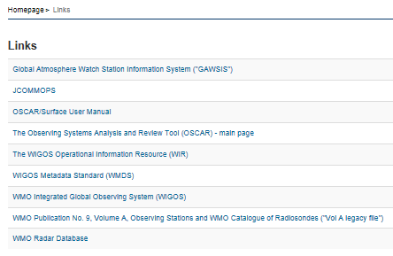
Where to get help

Slide 21
Thank you
Merci
شكرا
You & your organization!
Financial support. Swiss Federal Office of Foreign Affairs, MeteoSwiss, WMO, Met Norway
Project Team at MeteoSwiss. (current) J Klausen, L Cappelletti, B Calpini, M Musa, M Brändli, L Koppa, C Walder, E Grüter, S Sandmeier, M Schäfer, A Rubli, Tom Hager, Attila Loos; (past) J Mannes, S Spreitzer, M Leutenegger, C Sigg, M Abbt, W Brunelli, J Mettler
Project Team at WMO (current). F Belda, LP Riishojgaard, T Pröscholdt
Project Team at European Dynamics (current). T Galousis, M Ulmann, L Christou, N Pappa, S Sklavos, …
ICG-WIGOS. S Barrell, B Calpini, …
TT-WMD. (current) K Monnik, J Klausen, J Swaykos, T Boston, U Looser, E Büyükbas, Zhao Licheng, T Oakley, S Foreman, D Lockett, L Nunes
IPET-MDRD. D Lowe, J Tandy, …
JCOMMOPS, GAW WDCs, ET-WDC, …

