Slide 1
Reunión de Directores de CRF Noviembre 2018 Roles and Responsibilities of RTCs and their stakeholders WMO Global Campus Other opportunities and models for collaboration

Slide 2
WMO Support for the RTC network
Providing guidance and support to the RTC network, External Assessments
Establishing best practices for regional needs assessment
Training the trainers in RTCs and national services
Helping to increase opportunities through promotion of distance learning and expanded learning approaches
Establishing partnerships to support all of the above
Clarifying roles and responsibilities of RTCs
Notes:
RTCs have been in existence for 50 years.
In the last two years, they have served an average of 1000 students per year, with the majority served by a handful of centers.
Large numbers of students is not the most important criteria—meeting key priorities of members is also a highly valued one.

Slide 3
Role of the Director of an RTC Component
Monitor and plan the RTC’s activities based on understanding of regional needs
For vocational training, use WMO-1114 or ISO 29990 to guide processes
Develop requirements for RTC staff and infrastructure, keeping pace with evolving technological and educational developments
Submit annual reports to WMO
Promote the RTC to WMO Members, including through WMOLearn
Work with other RTCs to coordinate activities and share resources and experiences
Seek funding and resource opportunities

Slide 4
Role of Permanent Representatives in Supporting RTCs
Ensure ongoing communication the RTC and the regional association
Engage in resource mobilization for the RTC through national and international funding mechanisms
Review and approve annual reports on the RTC activities to be submitted to WMO
Collaborate with other PRs hosting RTCs, particularly within the region
Advocate for the RTC to comply with national and WMO standards and guidelines, and keep pace with evolving technological and education developments
Inform WMO if the Director of the RTC changes

Slide 5
Role of Regional Associations in Supporting RTCs
Prioritize education and training needs of the region, and communicate them to the RTCs
Be aware of activities and plans of each RTC via annual reports
Provide feedback to the RTCs and WMO on the performance of RTCs
Contribute to external reviews of RTCs
Recommend reconfirmation or removal of RTCs at each RA Session, based on performance
Promote the RTCs with members of the RA
Resource mobilization for the RTCs through national and international funding mechanisms

Slide 6
WMO Global Campus

Slide 7
WMO Global Campus Principles
Builds upon the existing WMO ETR Programme (RTC network, national centres, and other national and international training partners)
Activities should increase learning opportunities for Members, through (a) increased visibility, (b) sharing resources, (c) facilitating innovations, (d) promoting compliance, (e) enhancing quality.
WMO Global Campus is an ETRP initiative, not a new programme or a proposal to move all training online.
Collaboration, Cooperation, Sharing

Slide 8
Global Campus Endorsements
WMO Symposium on Education and Training-13: “…the feasibility activities in the WMO Global Campus demonstration show positive progress. SYMET-13 recommends the WMO Global Campus concept is further developed by the WMO Education and Training community for operational implementation during the 2020 to 2023 Financial period.”
WMO EC Panel on ETR: “… decides to endorse the WMO Global Campus initiative for developing a coordinated and collaborative network of institutions that work together to meet the growing education and training needs of WMO Members…”
Executive Council -70: “…decides to endorse the WMO Global Campus initiative …, building upon the existing network of WMO Regional Training Centres (RTCs) and other WMO training partners.
Notes:
Rich

Slide 9
WMOLearn Portal
Access to
Events calendar
Learning resources library
Regional resources
Social media
Collaborative projects
Global Campus Roadmap
http://learn.wmo.int

Slide 10
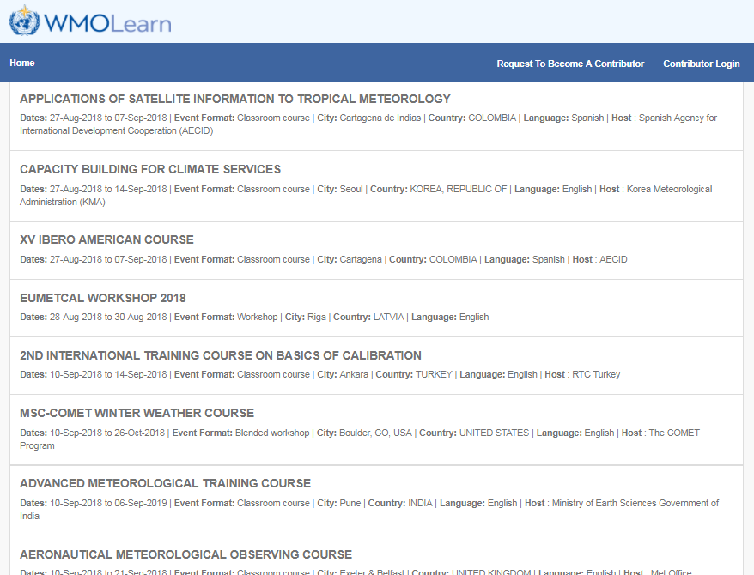
WMOLearn Events Calendar
http://learningevents.wmo.int
Notes:
Features: Current and upcoming events around the world submitted by registered providers; Text search and filters by event metadata
Event notification (in development); Synchronized databases (EUMETSAT/Vlab) and future partners; Collaborative projects

Slide 11
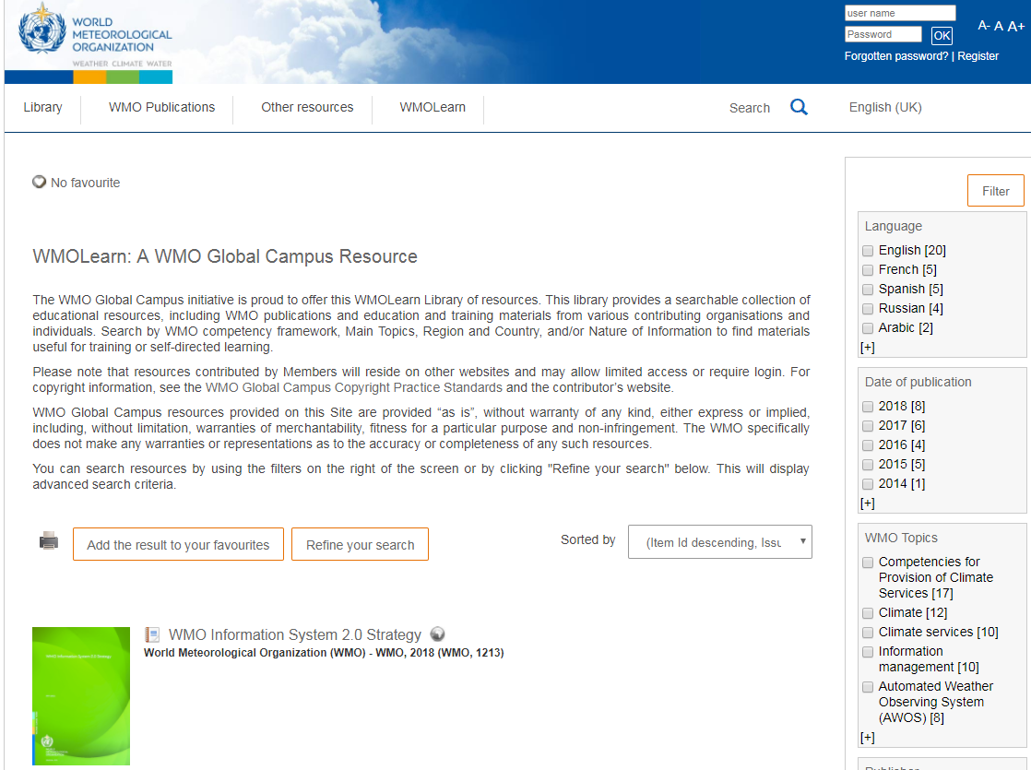
WMOLearn Resources Library
http://library.wmo.int
Notes:
Features
Resources from WMO Secretariat, WMO Technical Commissions and all WMO Members who wish to share resources
External provider submission forms (in development)
Search by WMO Competency Framework
Filter by language, topic, publisher, document type, etc.
Metadata harvesting capability

Slide 12
Why should WMO promote OERs?
To drive innovation
To improve quality of content
To reduce costs
To allow for customization
To promote accessibility
Social justice—to increase opportunity

Slide 13
Why All institutions should want to use OERs
Build institutional reputation with stakeholders, funding sources and globally
Attract new staff and students
Share expertise within the institution
Encourage high-quality teaching and learning
Support modular course development
Support feelings of altruism—sharing knowledge is what we are here for
Encourage review of curriculum, pedagogy and assessment

Slide 14
Additional Global Campus activities
Translations Resource Center
Guidance on developing partnerships
Promoting innovative learning approaches (including new WMO publication)
Database of experts and institutional capabilities (a Global Campus topography)
Competency achievement certificates
Building a global E&T community of practice

Slide 15
Other opportunities and models for collaboration
WMO Vlab (e.g. CM4SH, Weather Briefings)
CALMet, CALMet Online
WMO Courses for Trainers (2021 en español)
Others?
Models
Eumetcal
Others?

Slide 16
Thank you
Merci

Slide 17
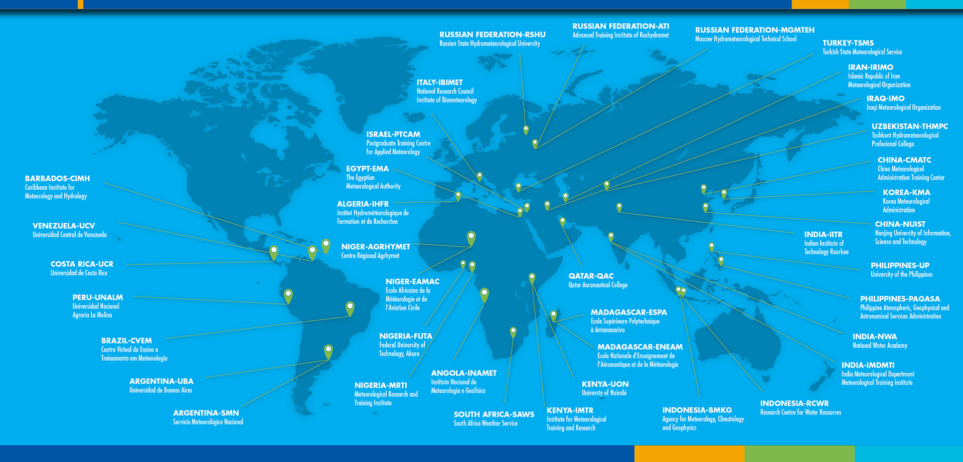
WMO Regional Training Centres

