Slide 1
National Meteorological Service (SMN) University of Buenos Aires (UBA) First steps towards Global Campus
Regional Training Center Argentina
Marinés Campos (RTC-SMN)
Moira Doyle (UBA)

Slide 2
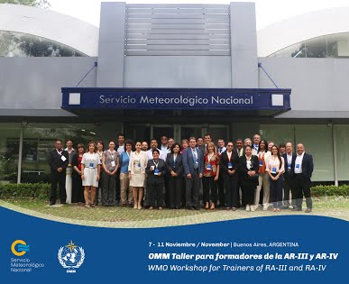
RTC National Meteorological Service (SMN) _ RAIII
WMO Guidelines
Training for Operational tasks,
focused on competencies to improve Service
Continuous training
Training new technologies, new approaches
How?
Online and blended training
(courses and workshops).
Keep updated and connected by
participation in international
projects, conferences, events

Slide 3
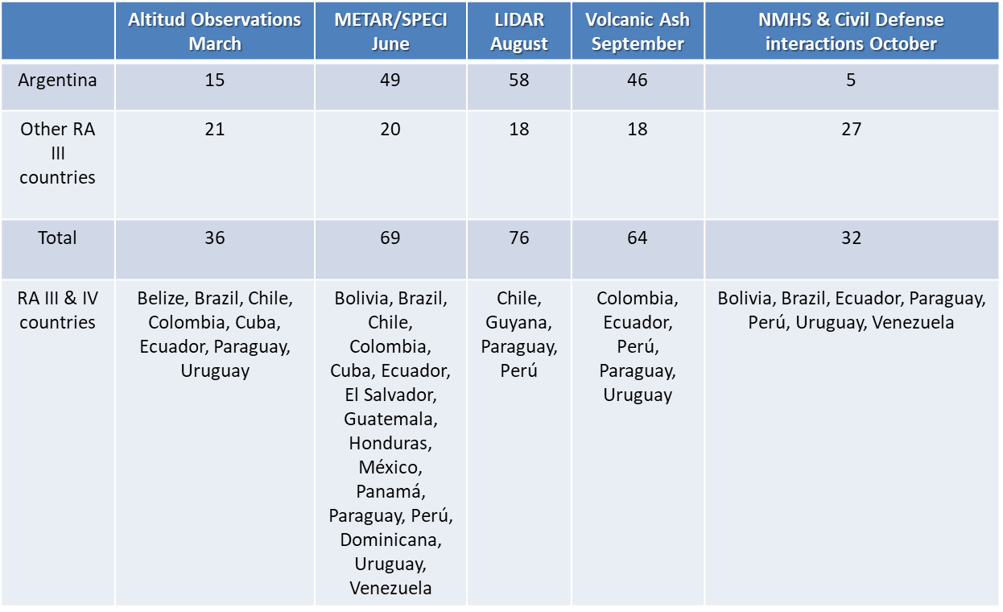
RTC SMN_ Short online courses for RAIII _2017
Hydrological Balance and AWS in Nov
RESOURCES : Workbook for forecasters and GOES 16 training

Slide 4
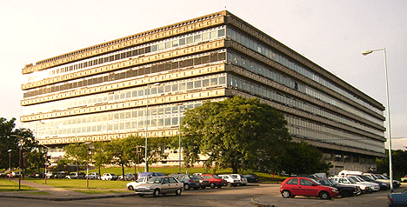
The University (UBA)
Worldwide recognized professors educating
high standard professionals and technicians
WMO BIP M and BIP MT and guidelines
Immediate access to the state of the art in
training and research.
Venturing in
Distance Learning.

Slide 5
Partners or Competitors?
Differences: goals, approach, criteria
As competitors:
Funds
Leadership
Repetition
Human resources
As partners:
Complementary
Opportunity
Synergy
Conflict still going on: sensitivities, vision of each other
Notes:
The gap in training between Theory and Practice, and thus between University and NWS are well known. This generates competition between institutions.

Slide 6
How do we develop a long lasting healthy relationship?
University SMN
theory practice
R & D Service
Professionals as Partners in training
COMPETENCIES
Notes:
Each one has a specific Role and must perform it with excellence and for the benefit of each other.
Communication between institutions is essential to learn about the needs of each other.
Competencies framework is a great help for both training institutions to work on together.
Univ must continue in esearch and improve services which have been neglected???????
Univ must not be isolated be isolated from operational world , it is not only dediated to research.
what new tech and changes are taking place at SMN, regional and global, WMO priorites , trends, guidelines

Slide 7
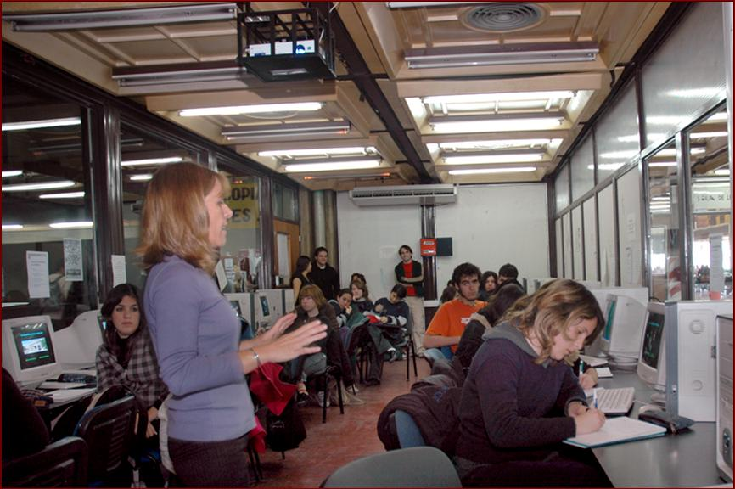
How do we develop a long lasting healthy relationship?
SMN-UBA together as PARTNERS
New developments (Research and Training)
Graduate Diploma (Lic.) and PhD Thesis co-direction
SMN professionals are instructors at University
Scholarships for University students
Final course hosted by SMN
University courses for operational
meteorologists (in progress)
Notes:
Research Example: Relampago, For training: development of new courses (Aviation Met, Antartic Met, Atmospheric Electricity)
New developments are generated in cooperation between University scientists and SMN research office. Efforts are being made to train personnel for the operational phase of these developments.
SMN finances scholarships for University students
SMN professionals train future professionals at University
University final training courses are hosted by SMN
SMN-University Co direction of Licenciatura and PhD thesis
University Courses for operational staff

Slide 8
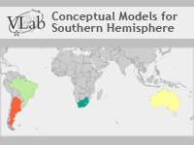
How do we develop a long lasting healthy relationship?
Together in projects
Application of CM in forecasting

Slide 9
How do we develop a long lasting healthy relationship?
Challenges
Funds
increase training offer
improve training resources design
Translations
Communication tools
Human Resources
Limited number of Experts with teaching background
Time limitations: Timing and lag time
Notes:
funds to increase training offer and improve design of training resources. Limited number of experts with background in education.
Training in new advances take off time from current work and research. At university experts are reluctant to engage in new courses….
Overworking –same funding
Overcoming obstacles
Economic disadvantage
Improvements needed in Team Work and organization
Involvement in training

Slide 10
How do we insert ourselves in the global training community?
Global Campus is the natural educational hub, a revolution in Meteorology training which strengthens bonds, sharing and collaboration. A change of mindset that will be beneficial to all
Sharing and Contributing
Providing Southern H.
cases
Participating in regional and international Projects
Participating in Collaborative Training
Translation Center
Notes:
7- Our involvement in region RAIII
Sharing SMN and University free on line courses
Providing Southern Hemisphere examples
Sharing training resources from projects (Workbook for forecasters)
8- Sharing with the all the community
Our experience
As we reduce the gap between our institutions we want to collaborate in developing projects to reduce gaps in training in other places.
Where and how??
Global Campus puts projects into action (ejecutar el proyecto)
One example Interest in participating other Projects (e.g. EUMETLearn: A Blended International Foundational Meteorological Course)

Slide 11
Working towards a flourishing Global Campus
Action Plan
UBA - SMN
SYMET XIII
SYMET XIV

