Slide 1
The WMO Integrated Global Observing System;
Status of pre-operational phase, plans for transition to operational phase;
OSCAR/Surface training course for RA-VI
1-3 October 2019 Kyiv/Ukraine
WMO Secretariat

Slide 2
What is WIGOS?
WMO foundational activity
addressing the observing needs of the weather, climate, water and environmental services of its Members
A framework for integrating all WMO observing systems and WMO contributions to co-sponsored observing systems
a common regulatory and management structure
WIGOS is not replacing or taking over existing observing systems
they will continue to be owned and operated by a diverse array of organizations and programmes, national as well as international.

Slide 3
What is WIGOS?
World Weather Watch
GAW
WIGOS
GCW
Hydro OS
GOS
GCOS
Partners
GDPFS
Co-sponsors
WMO Information System -WIS
GTS

Slide 4
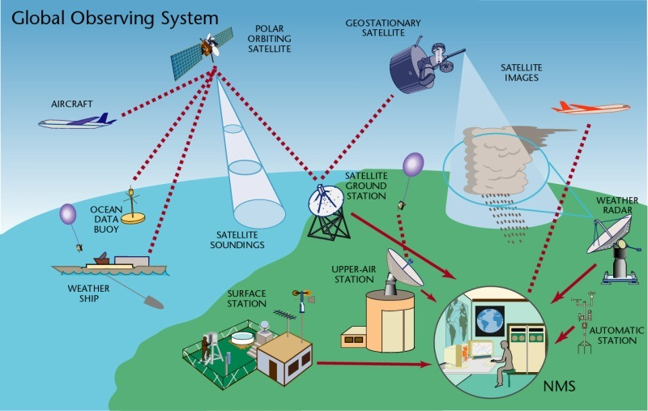
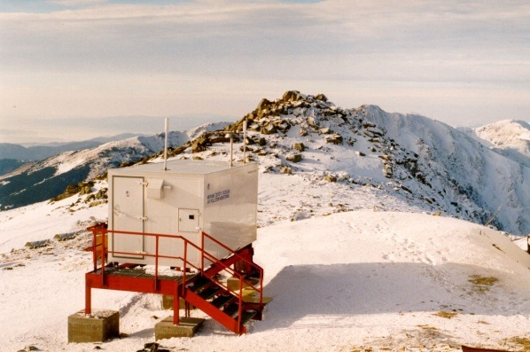
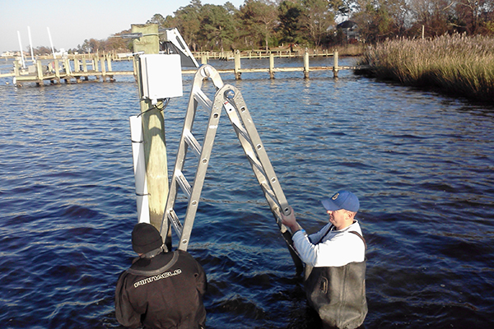
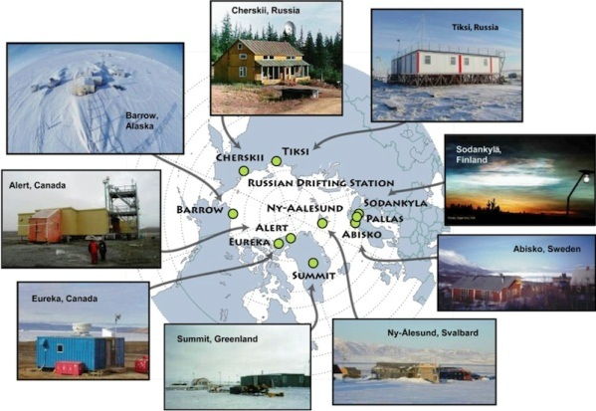
WIGOS Component Systems
Global Observing System (WWW/GOS)
Observing component of Global Atmospheric Watch (GAW)
WMO Hydrological Observations (including WHYCOS)
Observing component of Global Cryosphere Watch (GCW)

Slide 5
Why WIGOS? (1)
I. NMHS mandate typically broader now than when the World Weather Watch and the GOS were created, including e.g.
Climate monitoring, climate change, mitigation
Air quality, atmospheric composition from urban to planetary scales
Oceans
Cryosphere
Water resources
II. Technical and scientific advances:
Observing technology
Telecommunications
Numerical modeling and data assimilation
Increased user demand to access and use observations in decision making

Slide 6
Why WIGOS? (2)
III. Economic realities
Budgetary pressure on many NMHS, in spite of expanding mandates and increasing demand for services
Exploiting synergies through integration across:
disciplines (e.g. weather and climate)
organizational boundaries, e.g. between different national ministries/departments operating observing systems
technological boundaries, e.g. between surface- and space-based systems

Slide 7
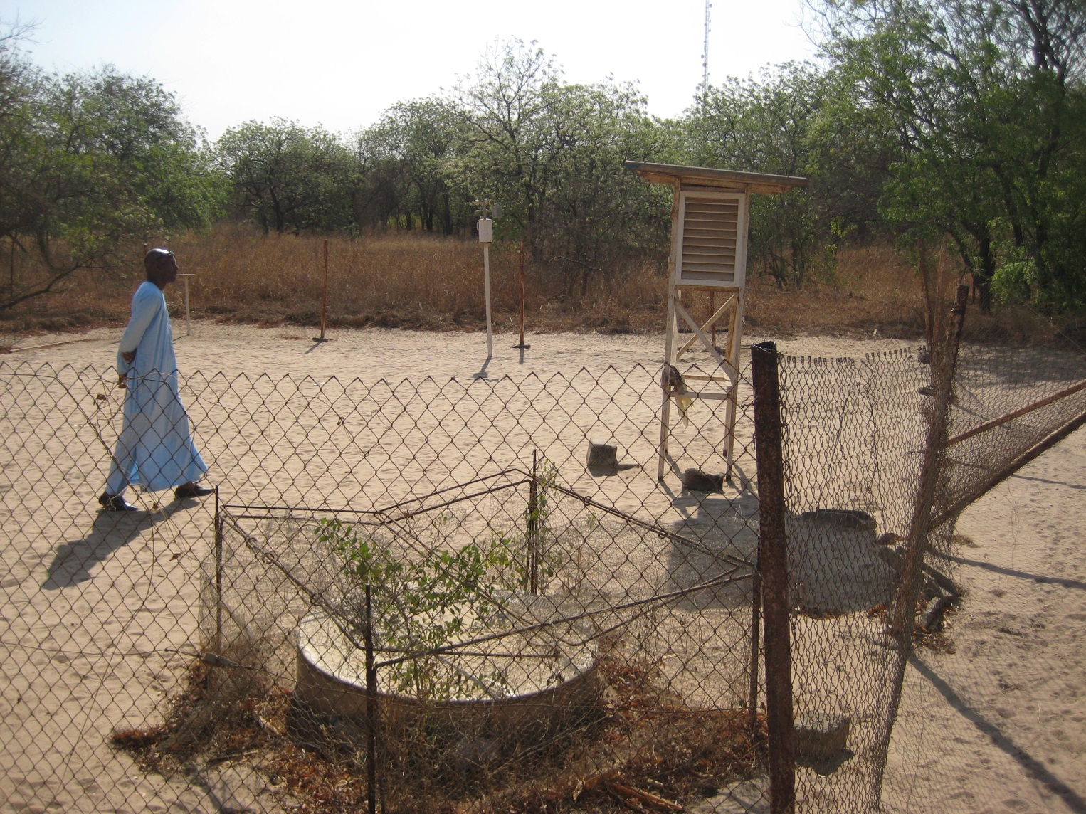
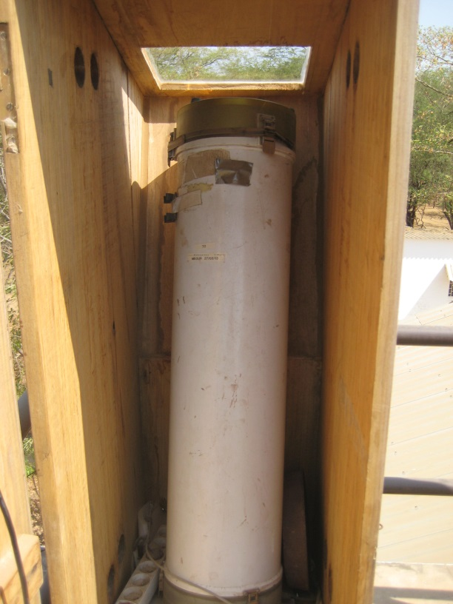
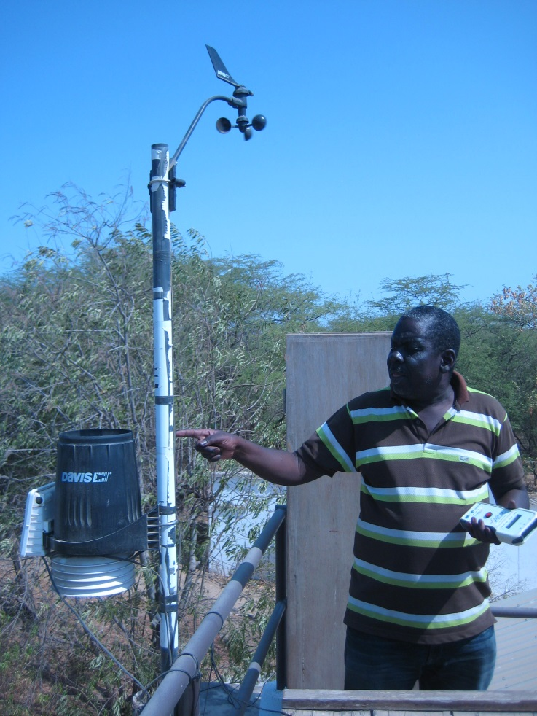
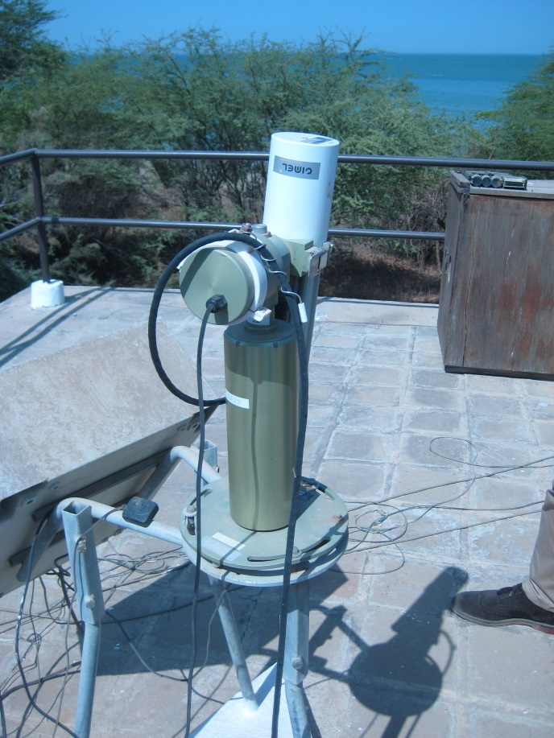
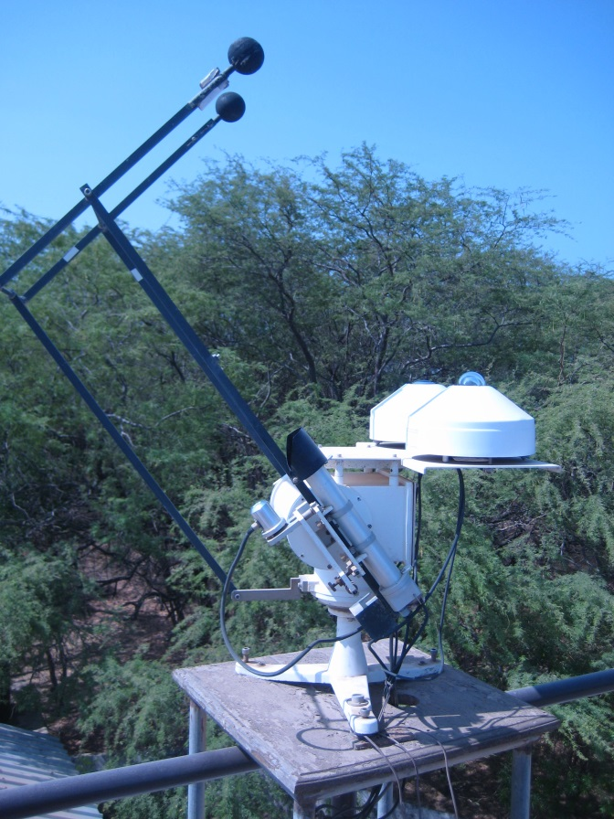
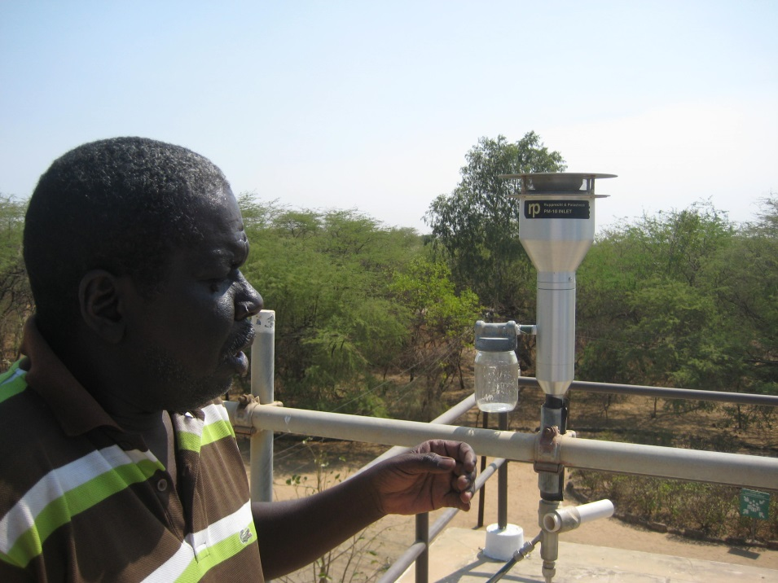
Why WIGOS? (example)

Slide 8
How to implement WIGOS?
Through:
Integration
Sharing data and metadata
Partnerships
Leadership
Planning
Interoperable systems
Cooperation
Culture of compliance

Slide 9
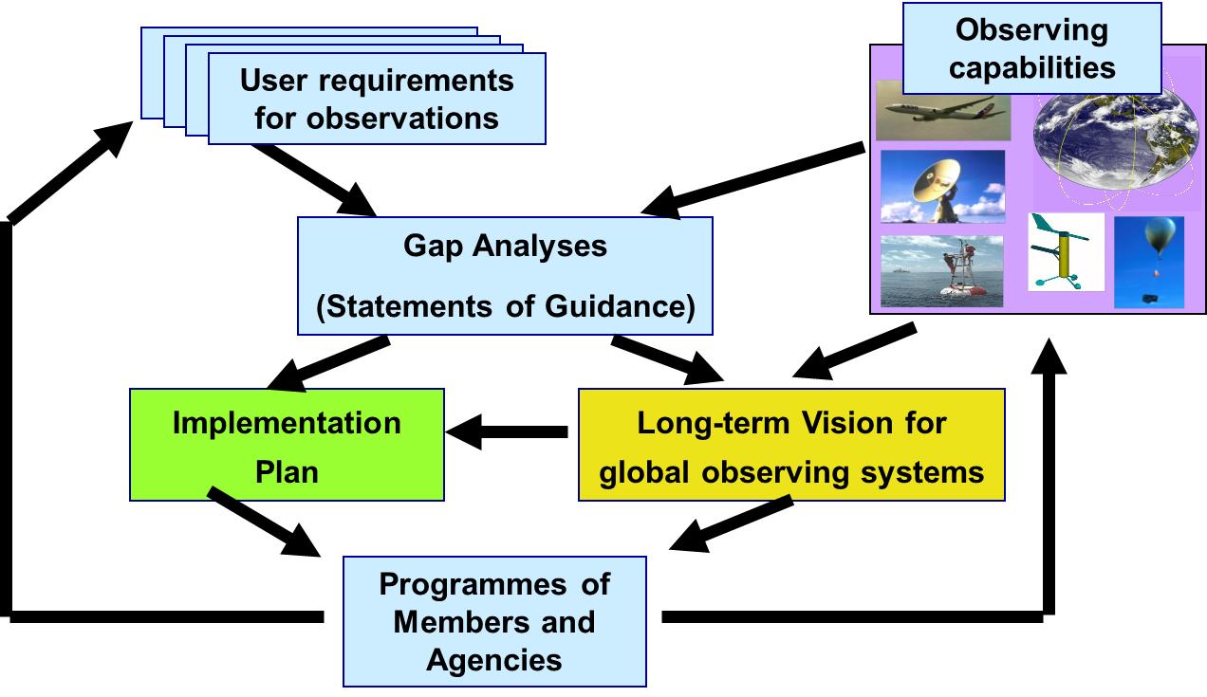
WMO Rolling Review of Requirements (RRR)
WMO Congress decided that:
RRR process shall be used to design networks, plan the evolution and assess the performance of all WMO and WMO co-sponsored observing systems
It allows to process collect, assess and record the user requirements for all WMO application areas
and match them against observational capabilities

Slide 10
WMO Rolling Review of Requirements (RRR)
OSCAR/Space
OSCAR/Surface
OSCAR/
Requirements

Slide 11
The WIGOS Pre-Operational Phase (2016-2019) decided by Cg-17 in 2015
Increased emphasis on regional and national activities
Five main priority areas:
WIGOS Regulatory Material, supplemented with necessary guidance material;(already covered under draft resolution Cg-18 6.1(1)/3);
WIGOS Information Resource, including the Observing Systems Capabilities analysis and Review tool (OSCAR), especially OSCAR/Surface;
WIGOS Data Quality Monitoring System (WDQMS);
Regional Structure; Regional WIGOS Centers;
National WIGOS Implementation, coordination and governance mechanisms; undertaken by Members, supported by items I-IV

Slide 12
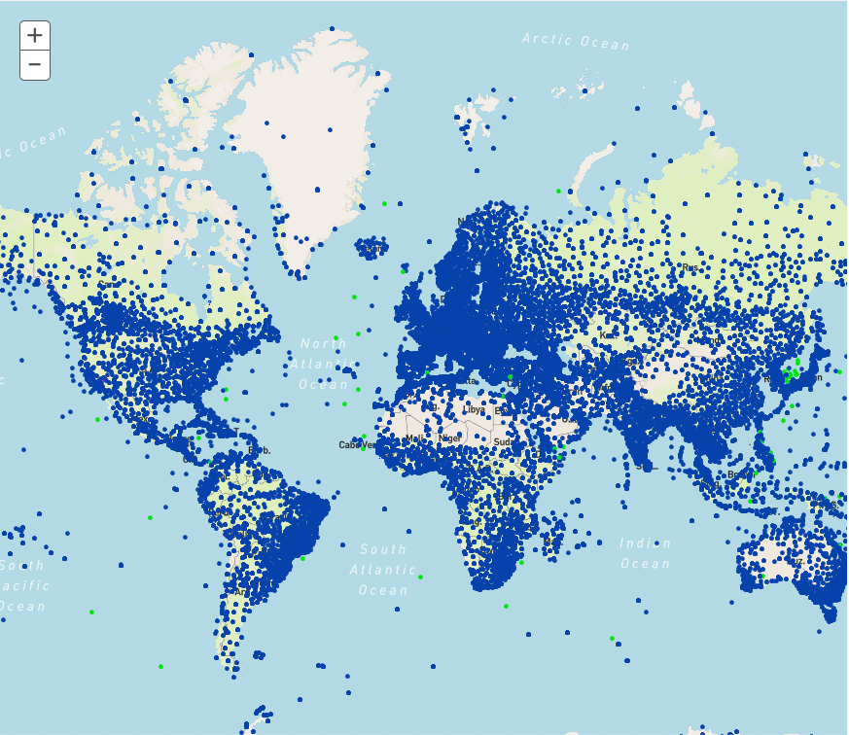
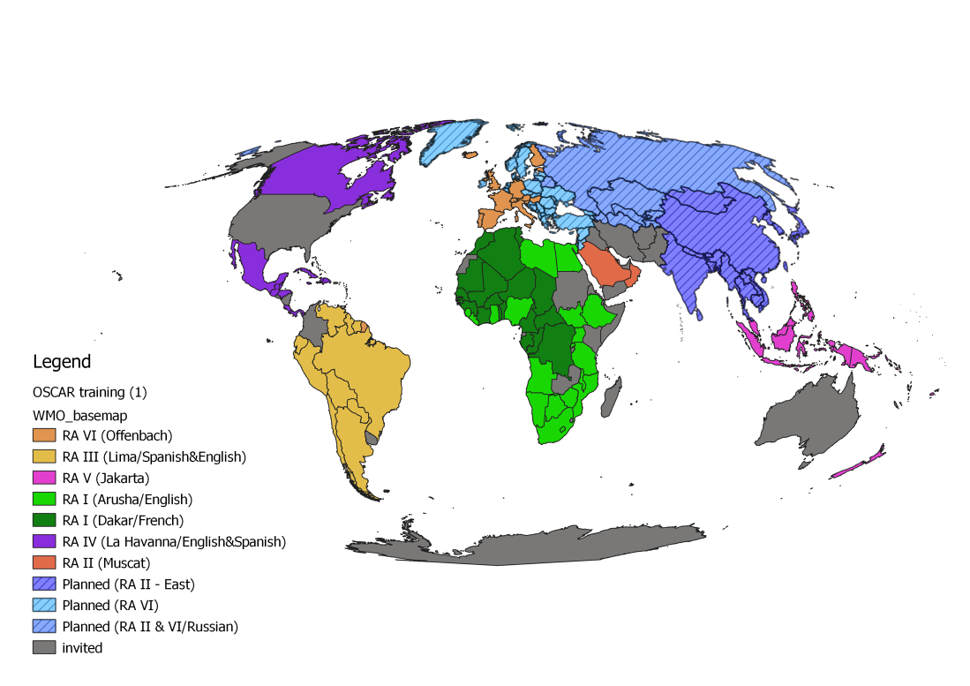
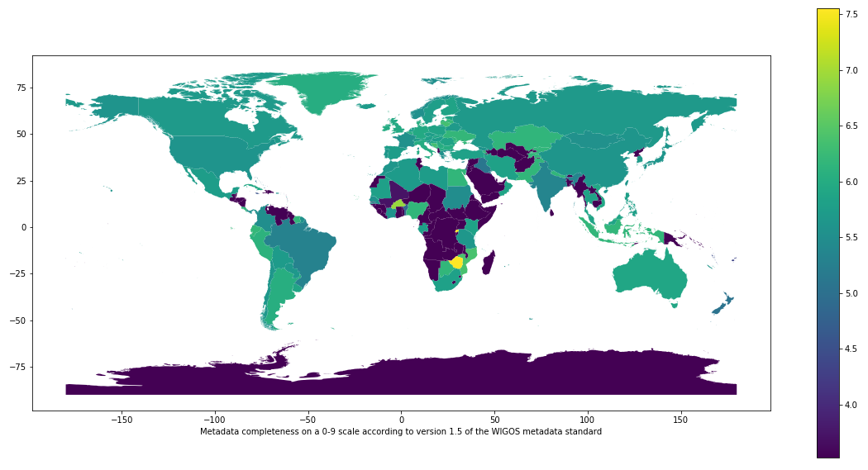
II. WIGOS Information Resource (Observing Systems Capabilities and Review, OSCAR)
Three operational databases supporting WIGOS:
OSCAR/Requirements, in which “technology free” requirements are provided for all WMO application areas;
OSCAR/Space, listing the capabilities of all satellite sensors;
OSCAR/Surface, list surface-based capabilities; developed by MeteoSwiss for WMO, operational since May 2016;
OSCAR homepage
WIGOS self portrait (OSCAR); stations operating on June 6 2019
OSCAR training delivered worldwide
OSCAR metadata completeness (lighter colors is better)

Slide 13
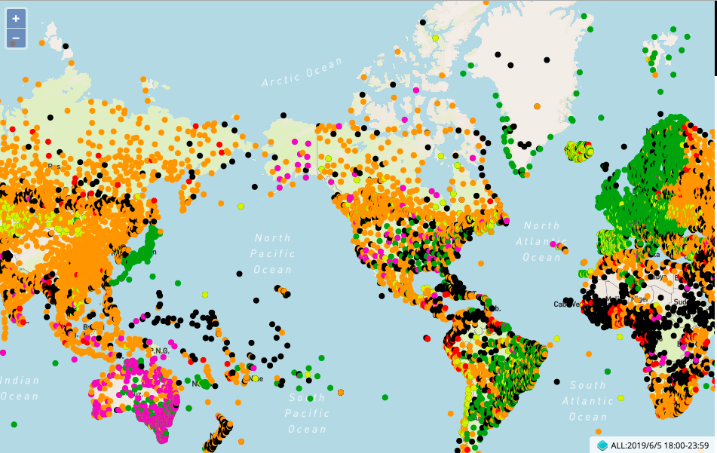
III. WIGOS Data Quality Monitoring System
Tool to measure how well WIGOS is functioning
Real-time monitoring of performance
data availability (implemented) and quality (in development),
searchable by region, country, station type, period, etc.
for all WIGOS components (GOS, GAW, WHOS, GCW, GCOS),
Incident management component for mitigation of issues
WDQMS data delivery; surface pressure observations exchanged internationally, June 5 2019, 18Z
Current status:
Pilot project on NWP-based monitoring: data from ECMWF, NCEP, DWD, JMA;
Data analysis and web display tool now being developed in pre-operational mode by ECMWF

Slide 14
IV. Regional WIGOS Centers (RWC)
What?
Critical support of national WIGOS Implementation especially for
OSCAR/Surface; input and updating of metadata, QC
WDQMS; monitoring and coordination of mitigation efforts
How?
To be decided by the WMO Regions – in alignment with existing cultural, linguistic and/or political groupings
The relatively slow pace of engagement of NMHSs in RWC development has been a risk factor for WIGOS!
Recent signs of progress have been encouraging
Region I: RWC pilot planned in East Africa (Kenya and Tanzania); South Africa has submitted proposal; interest from Morocco;
Region II : China and Japan have RA-II approved RWC pilots; national commitment from Saudi Arabia; interest from India and Russia;
Region III: Plans for Virtual RWC approved by RA-III-17 in November 2018;
Region IV: CMO has expressed interest; Canada, USA may help; to be discussed during Cg-18
Region V; Formal decision by RA-V-17 in October 2018 to request Australia and Singapore to submit RWC proposal; encouraging Fiji, Indonesia to join;
Region VI: successful RWC operating in pilot mode thanks to EUMETNET; tentative plan for RWCs also in Russia/Belarus and Croatia (specifically for marine observing systems). Interest also from Greece, Italy, Turkey.

Slide 15
V. National WIGOS Implementation
Almost all Members have had exposure to both the WIGOS concept and to the specifics of the WIGOS Technical Systems via dedicated WIGOS Workshops arranged by the WMO Secretariat in all Regions;
A majority of Members have had at least some level of activity in using the OSCAR/Surface database to manage their surface-based observing systems;
Assessment of national observing capabilities made for several Members;
A small number of countries have developed and approved their National WIGOS Implementation Plans;
The bulk of the national WIGOS implementation work is expected to take place once the Regional WIGOS Centres are fully functional and once National WIGOS Implementation Plans have been developed and approved.

Slide 16
Res. 6.1(1)/4: WIGOS is now mature enough to transition from project to operational status, as basic WMO infrastructure, with the following six priority areas:
National WIGOS implementation;
Implementation of the Global Basic Observing Network and the Regional Basic Observing Networks;
Operational deployment of the WIGOS Data Quality Monitoring System;
Operational deployment of Regional WIGOS Centres;
Further development of the Observing Systems Capability Analysis and Review (OSCAR) databases and integration with other system elements;
Fostering a culture of compliance with the WIGOS technical regulations.
Request Infrastructure Commission to develop a plan for these activities for the 2020-2023 period and submit to EC-72 for approval

Slide 17
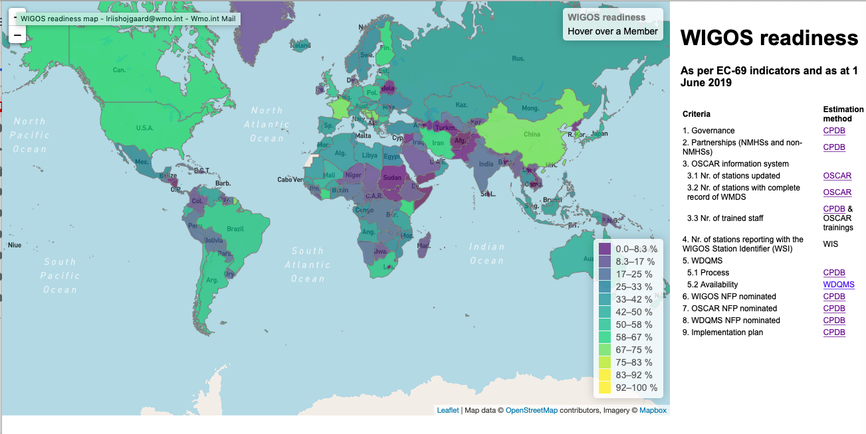
Fostering a culture of compliance Monitoring of WIGOS Implementation by country; 1st step

Slide 18
Thank you
www.wmo.int/wigos

